Slide 1
Chapter 3:
The Project Management Process Groups: A Case Study
Refrences:
Information Technology Project Management, Sixth Edition(ch#3)
Note: See the text itself for full citations.

Slide 2
Learning Objectives
Describe the five Project Management (PM) process groups, the typical level of activity for each, and the interactions among them.
Review a case study of an organization applying the project management process groups to manage an IT project; describe outputs of each process group; and understand the contribution that effective project initiating, planning, executing, monitoring and controlling, and closing make to project success
Information Technology Project Management, Sixth Edition

Slide 3
PM Process Groups
Project management can be viewed as a number of interlinked processes
A process is a series of actions directed toward a particular result
The project management process groups include:
  Initiating processes
  Planning processes
  Executing processes
  Monitoring and controlling processes
  Closing processes
Process groups can be applied to each phase of the project or to the entire project

Slide 4
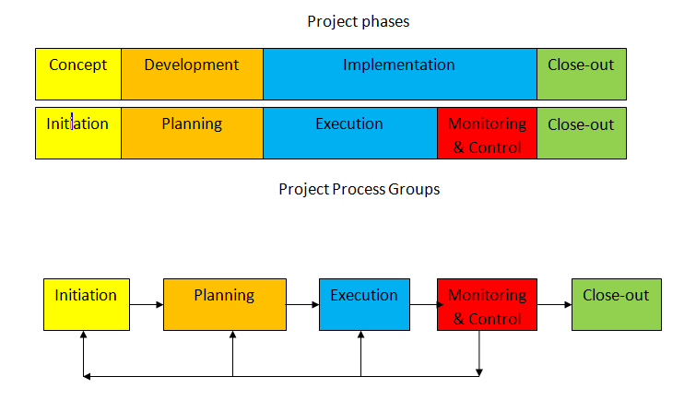
Process Groups and Project Phases

Slide 5
Initiating processes
Defining and authorizing the project
Prepare project charter
Register stakeholder
Determine if the project is worth continuing, should be redirected, or canceled
May take place at the beginning of each phase
Reexamine the business need for the project during every phase of the project life cycle

Slide 6
Planning processes
Scope management plan
  Define the work that needs to be done
Schedule management plan
  Schedule activities related to the work
Cost management plan
  Estimate cost for performing the work
Quality management plan
  Product meets written specifications and intended use
Procurement management plan
  Decide what resource to procure to accomplish the work
Revise plan during each phase for changes
  Ensure that the project addresses organization needs

Slide 7
Execution processes
Acquiring project team and resources to carry out various plans and various tasks
Conduct procurement
Manage stakeholder expectations
Produce product, services, or results of the project or phase
Perform quality assurance

Slide 8
Monitoring and controlling processes
Measure progress against all plans
Take corrective actions when there is deviation
Ensure that progress meet project objectives
Ensure that the project meets stakeholders’ needs and quality standards
Reporting performance to stakeholders
Stakeholder can identify any necessary changes to keep project on track

Slide 9
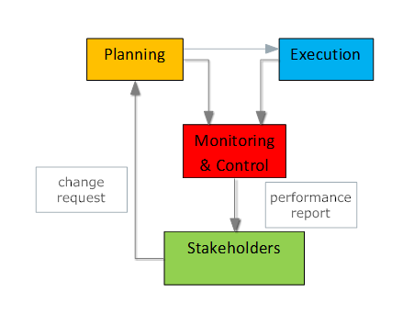
Planning, Execution & Contol

Slide 10
Closing processes
End the project efficiently
Archiving project files
Closing out contracts
Document lessons learned
Receiving formal acceptance of the delivered work from customers

Slide 11
Process Group | Output (outcomes)
initiation | Complete project charter, complete a business case (the need for the project)
planning | Complete project scope, schedule, cost, quality, procurement plans Work breakdown structure (WBS) Revise plans, Ensure the plans address organization needs
Execution | Take the actions necessary to complete the work described in planning (e.g. purchase HW and SW, develop and install SW), deliver the actual work of the project, perform quality assurance
Monitoring & controlling | Monitor deviations from the plans, take corrective actions to mach progress with the plans, measure progress toward project objectives, ensure that deliverable are being completed and objectives are being met in terms of scope, cost, time, and quality, complete performance report
Closing | Close contracts, Archive files, Gain acceptance for project results, Report lessons learned

Slide 12
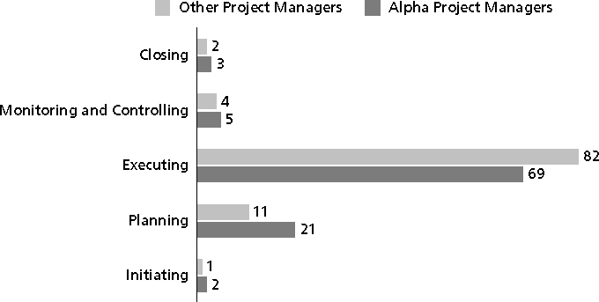
Percentage of Time Spent on Each Process Group

Slide 13
Chapter Summary
The five project management process groups are initiating, planning, executing, monitoring and controlling, and closing

