Slide 1
Chapter 2:
A Systems View and Systems Methodology
Information Technology Project Management, (chapter#2)
Methods of IT Project Management, (chapter#2)

Slide 2
Learning Objectives
Explain why stakeholder management and top management commitment are critical for a project’s success
Understand the concept of a project phase and the project life cycle and distinguish between project development and product development
Discuss the unique attributes and diverse nature of IT projects

Slide 3
The Importance of Top Management Commitment (support)
People in top management positions are key stakeholders in projects
A very important factor in helping project managers successfully lead projects is the level of commitment and support they receive from top management
Without top management commitment, many projects will fail
Some projects have a senior manager called a champion who acts as a key proponent for a project

Slide 4
How Top Management Can Help Project Managers
Providing adequate resources (HR, FR)
Approving unique project needs in a timely manner (SW, HW needs, financial support as the project run)
Getting cooperation from other parts of the organization (encourage functional manager to cooperate with project managers)
Mentoring and coaching on leadership issues (give advices for project managers in leadership and encourage them to take classes to develop their leadership skills and assign funds and time to do so)

Slide 5
Need for Organizational Standards
Standards and guidelines help project managers be more effective
Senior management can encourage:
  The use of standard forms, templates, and software for project management
  The development and the use of guidelines for writing project management plans or providing status information

Slide 6
Project Phases and the Project Life Cycle
A project life cycle is a collection of project phases that defines:
  What work will be performed in each phase
  What deliverables will be produced and when
  Who is involved in each phase
  How management will control and approve work produced in each phase
A deliverable is a product or service produced or provided as part of a project
Project can have different life cycles

Slide 7
More on Project Phases
In early phases of a project life cycle:
  Resource needs are usually the lowest
  The level of uncertainty (risk) is the highest
  Project stakeholders have the greatest opportunity to influence the project
In middle phases of a project life cycle:
  The certainty of completing a project improves
  More resources are needed
The final phase of a project life cycle focuses on:
  Ensuring that project requirements were met
  The sponsor approves completion of the project

Slide 8
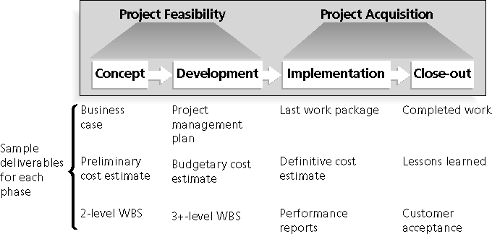
Phases of the Traditional Project Life Cycle

Slide 9
Project life Cycle
Concept and development phases focus on planning – project feasibility
Implementation and close-out phases focus on delivering the actual work – project acquisition
A project should successfully complete each phase before moving to next phase

Slide 10
Concept phase
Manager develops a business case, which describes the need for the project and its basic concepts
A primary rough cost estimate is developed
A work breakdown structure (WBS) is created
  WBS outlines project work by decomposing the work tasks into different levels

Slide 11
Concept phase – case study
Tom could have created a committee from faculty and staff to develop a business case that studies:
  the need for increasing the use of technology on campus
  its alternative ways
  its effects on students, faculty, and staff
Estimate initial cost of establishing laptop technology on campus
WBS divides the work into three levels
  A competitive analysis for, say, five campuses
  Survey for students and staff
  Rough assessment for the effect of the project on enrollment

Slide 12
Development phase
Project team creates a project management plan
More accurate cost estimate
More thorough WBS

Slide 13
Development phase – case study
Project team would have to put a project management plan
  Decide whether student should lease or purchase laptops
  What type of SW and HW
  How much to charge students
  How to handle training
More accurate cost estimate, if it is too high compared to the benefits, the project should be canceled in the development phase before wasting time and money in the next phases

Slide 14
Implementation phase
Lowest level in WBS (work package)
Deliver the required work
Definitive or very accurate cost estimate
Provide performance report to stakeholders

Slide 15
Implementation phase-case study
Obtain the required HW and SW, install network equipments, deliver the laptops to students, collecting fees, provide training to students, faculty and staff
The project team would have to report results (success/failure) to stakeholders

Slide 16
Close-out
All work is completed
  Close-out any activities related to laptops project
Report customer acceptance
  Survey for students, faculty, and staff
Team work would have to report experience and lesson learned (learned lesson report)
  Share lessons and experience with other college campus

Slide 17
Product Life Cycle/ SDLC
Products also have life cycles
  Classic System Development Life Cycle SDLC Models (SE: software engineering prescriptive models)
  New SDLC Models/Methodologies based on ideas of agility or agile programming styles
The Systems Development Life Cycle (SDLC) is an approach to building information technology systems consisting of a standard set of phases each producing a prescribed set of deliverables

Slide 18
Classic SDLC Models
Classic (traditional) SDLC Models/Methodologies (from 1950s)
  Waterfall (predictive)
  Incremental Model (50-50, predictive-adaptive)
  Evolutionary Prototyping Model (50-50, predictive-adaptive)
  Spiral Evolutionary (somewhat predictive)
  Iterative (adaptive)

Slide 19
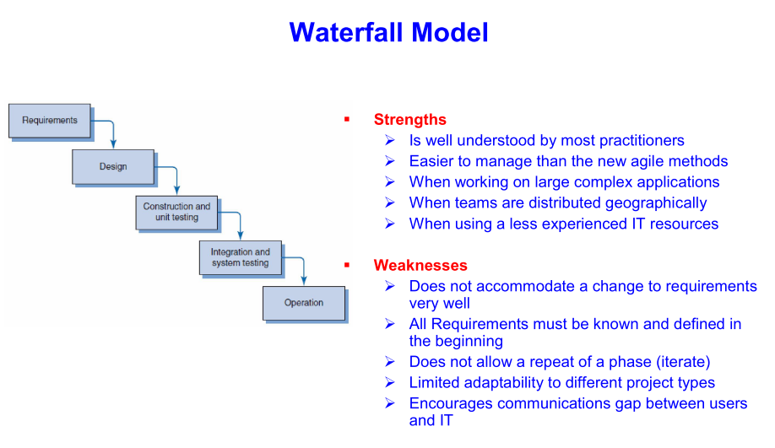
Waterfall model for SDLC

Slide 20
Evolutionary Prototyping Model
Focuses on gathering correct and consistent requirements and is the approach of building a system incrementally through a series of gradual refinements or prototypes
Strengths
  Visibility – customers see steady progress
  Useful when requirements are changing rapidly or no one fully understands the requirements
Weaknesses
  It is impossible to know at the beginning of the project how long it will take
  There is no way to know the number of iterations/phases that will be required
  Difficult to build an accurate cost estimate

Slide 21
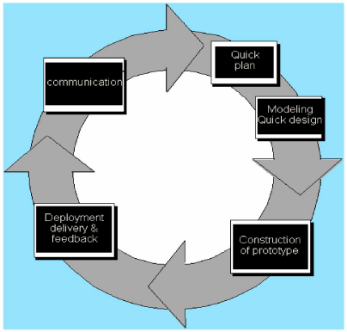
Evolutionary Prototyping Model

Slide 22
New SDLC Models for product development life cycle
Extreme programming (XP): Developers program in pairs and must write the tests for their own code. XP teams include developers, managers, and users.
Scrum: Iterative development in which repetitions are referred to as sprints, which normally last thirty days. Teams often meet each day for a short meeting, called a scrum, to decide what to accomplish that day. Works best for object-oriented technology projects and require strong leadership to coordinate the work.

Slide 23
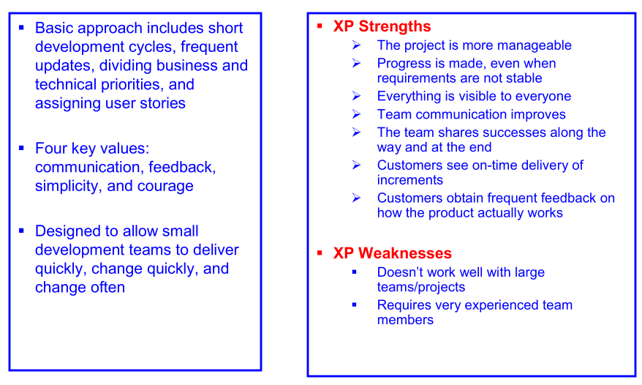
XP

Slide 24
Integration Project Management LC to Software Development Life Cycles
The project life cycle applies to all projects, regardless of the products being produced
Product life cycle models vary considerably based on the nature of the product
Most large software products are developed as a series of projects
Project management is conducted during all of the product life cycle phases
The overlap occurs from project management life cycle (PMCL) to software development product life cycle (SDLC) during Analysis and Design.
During project Execution the bulk of the product is built.

Slide 25
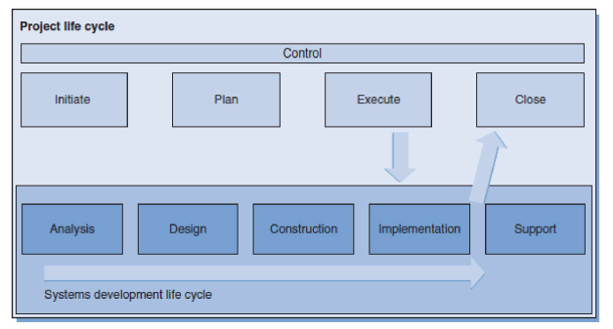
Integration Project Management LC to Software Development Life Cycles

Slide 26
The Importance of Project Phases and Management Reviews
A project should successfully pass through each of the project phases in order to continue on to the next
Management reviews, also called phase exits or kill points, should occur after each phase to evaluate the project’s progress, likely success, and continued compatibility with organizational goals
Project may be continued, redirected, or terminated

Slide 27
Management review-Case study
At the end of the concept phase, Tom and his project team could have
  Presented information to faculty, staff, and students that describe different opinions for increasing the use of technology on campus
  An analysis of what competing colleges were doing
  Results of a survey of local stakeholders’ opinion on the subject
This presentation is a management review
Suppose the study reported that 90% of student opposed the idea, then the college may decide not purse the project

Slide 28
Diversity in IT Projects
Project nature: IT projects can be very diverse in terms of size, complexity, products produced, application area, and resource requirements
Team Members Characteristics: IT project team members often have diverse backgrounds and skill sets
Technologies: IT projects use diverse technologies that change rapidly; even within one technology area, people must be highly specialized

Slide 29
Chapter Summary
Projects should successfully pass through each phase of the project life cycle
The product have different types of life cycles.
The importance of phase reviews.
Information technology projects are diverse in nature, team members characteristics, and technology used.

