Slide 1
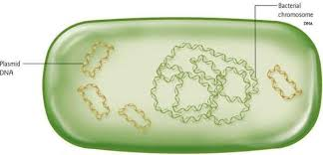
Plasmid purification lab

Slide 2
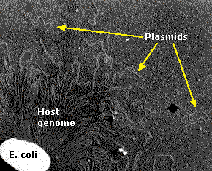
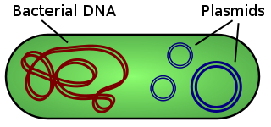
Plasmid
What is the plasmid ?
Plasmid are small, double strand , closed circular DNA molecules , that can be isolated from bacterial cells, they replicate independently of the bacterial chromosome
Notes:
A plasmid is an extra-chromosomal element

Slide 3
Features
1. Found in a wild variety of bacterial species.
2.Extra-chromosomal elements, which replicate independently of the bacterial chromosome.
3. Are not essential for the bacterium but may confer a selective advantage.
4.Using the enzymes and proteins encoded by their host for their replication and transcription.
5. Are inherited.
6. Used in many applications e.g. Drugs production.

Slide 4
Types of Bacterial Plasmids
There are three general classes for plasmids which can be advantageous for host cell:
A- Virulence plasmids encoding toxin genes.(turn the bacterium into a pathogen.
B- Drug-resistance plasmids that confer resistance to antibiotics.(containing antibiotic or drug resistant gene
C-Plasmids encode gene required for bacterial conjugation.

Slide 5
Some of plasmid applications
Plasmids serve as important tools in genetics and biochemistry labs, where they are commonly used to
1 multiply or express particular genes.
2 Gene therapy.
3 Molecular cloning.
Plasmids used in genetic engineering are called vectors.

Slide 6
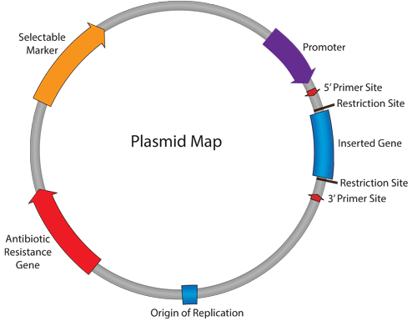
Vector Element

Slide 7
Vector Element
 | Vector Element
DNA sequence which allows initiation of replication within a plasmid by recruiting transcriptional machinery proteins | Origin of Replication (ORI)
Allows for selection of plasmid-containing bacteria. | Antibiotic Resistance Gene
Short segment of DNA which contains several restriction sites allowing for the easy insertion of DNA. In expression plasmids, the MCS is often downstream from a promoter. | Multiple Cloning Site (MCS)
Gene, promoter or other DNA fragment cloned into the MCS for further study. | Insert
Drives transcription of the target gene. Vital component for expression vectors: determines which cell types the gene is expressed in and amount of recombinant protein obtained. | Promoter Region
The antibiotic resistance gene allows for selection in bacteria. However, many plasmids also have selectable markers for use in other cell types. | Selectable Marker
A short single-stranded DNA sequence used as an initiation point for PCR amplification or sequencing. Primers can be exploited for sequence verification of plasmids | Primer Binding Site

Slide 8
Plasmid Copy Number
It is one of the most critical factors affecting the yield of plasmid from a given system.
It is determined primarily by the replicon.
Replicon is the region of DNA surrounding and including the origin of replication in the plasmid.
Usually low copy number yield is ~25 copies of the plasmid per bacterial cell.
High copy number plasmid yield is approximately 200–700 plasmid copies per cell.

Slide 9
Three general steps involved in plasmid purification
Many methods have been developed to purify
Plasmids from bacteria . This methods generally involve three steps :
1-Growth of the bacterial culture
2-Harvesting and lysis of bacteria
Using either detergents, alkali, organic solvents, or heat.
The choice among these methods depends on:
Plasmid size.
Bacterial strain.
The subsequent technique used to purify the plasmid DNA.
3-Purification of plasmid DNA

Slide 10
Growth of the bacterial culture
Depending upon nutritional status, bacteria exhibit different growth patterns which include:
Lag phase: in this phase bacteria adapt themselves to growth conditions and synthesis its own DNA,RNA and proteins.
Log phase: it is exponential phase, bacterial cells divide and the production of new cells is proportion to increased time.
Stationary phase: the growth rate slows as nutrients become limited, waste products accumulate and the rate of cell division equals the rate of death.
Death phase: due to continuous accumulation of toxic metabolites and the lack of nutrients, death occurs of the bacteria.

Slide 11
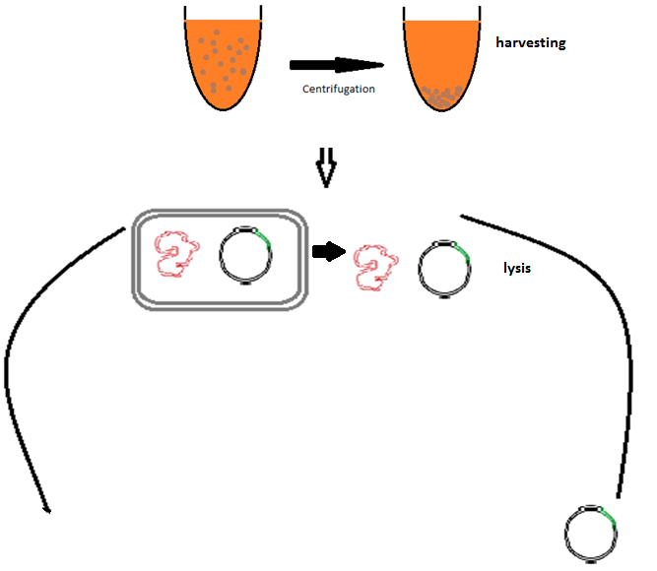
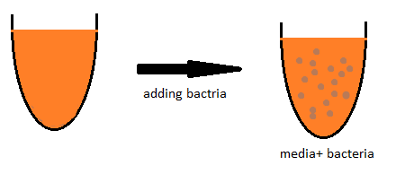
Three general steps involved in plasmid purification:
2. Harvesting and lysis of the bacteria.
1. Growth of the bacterial culture
3. Purification of plasmid DNA.

Slide 12
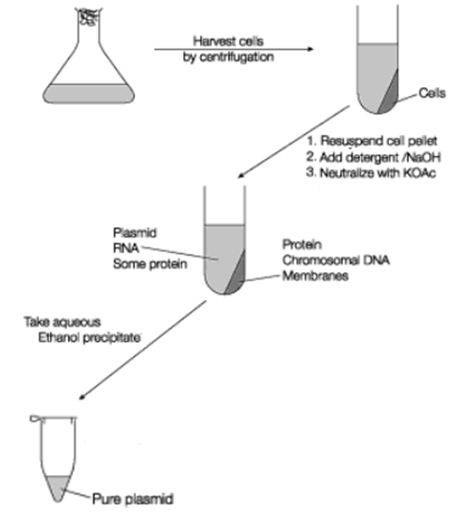
Outline of the Plasmid Isolation
BIOS Instant Notes in Molecular Biology by Phil Turner,2005

Slide 13
Practical part

Slide 14
Plasmid isolation and purification
Principle of the experiment “Alkaline lysis method “:
using SDS in the alkaline solution:
-The SDS: will lyse the bacterial cell membrane and denature the proteins too.
-The alkaline pH :denature the genomic DNA and denature the proteins too.
-The degraded cell wall, denatured chromosomal DNA and bacterial proteins form large aggregated complex which will precipitated during the plasmid isolation and removed by centrifugation.
-Native plasmid DNA can be collected from the supernatant.

Slide 15
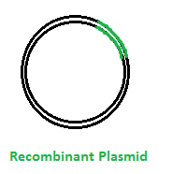
Using same R.E used
For cutting gene A
Using R.E
Animal DNA
“gene A”
“gene A”
DNA cloning using plasmid
1
Ligation
[using ligase enzymes]
2
Bacterial cell
Introducing
3
cloning
Chromosomal
DNA
Culture plate
[media containing appropriate antibiotic ]
Amplified Recombinant plasmid
Transformed bacteria

