Slide 1
PBL , case 2 . Ecchymosis , patechiae , purpura
Abdulrahman M. Barri
Pbl
Ecchymosis
434104003@student.ksu.edu.sa

Slide 2
black – blue Skin discoloration most obvius in the palatal area of the mouth.
a petechiae, an ecchymoses, or a purpura. have various etiologies. All three of them may present on the same person
Mind Map

Slide 3
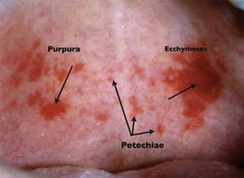
Distinguishing characteristics
Petechiae are small, usually rounded red or purple spots that are approximately 1-2 mm in size.
Pupura are larger than the petechiae, but less than 1 cm in size. The shape depends upon the location of the tissue, and the amount/disbursement of the pooled blood.
Ecchymoses is described as hemorrhagic spots that measure over 1 cm in size. Both purpura and ecchymoses may be irregular in shape depending upon the amount of pooled blood.

Slide 4
Vessel wall
platelet
Hereditary
Aquired
causes
Allergy
radiation
Coagulative state
infection
drug
( ()steriods)
nutrition
age

Slide 5
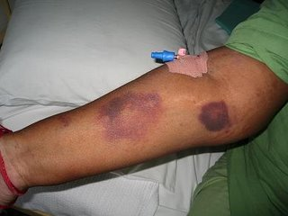
Dermatologic manifestations of Cushing’s syndrome include ecchymoses that is caused by deficient collagen synthesis, resulting in thin and fragile skin.
Patients often report easy bruising, which is caused by weakness of vessel walls and the surrounding connective tissue
Bruising in cushing ?!

Slide 6
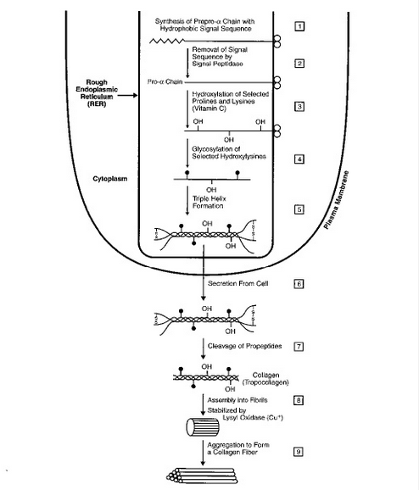
Bruising in cushing ?!
Molecular level

Slide 7
THANK YOU !
Notes:
s

