Slide 1
Physical Assessment for neonate

Slide 2
Nursing Health History

Slide 3
1) Bio-graphic Demographic
Name, age, health care provider
Parents name age /siblings age
Ethnicity / cultural practices
Religion / religious practices
Parent occupation

Slide 4
2) Chief complain
To establish the major specific reason for the child’s and parant’s seeking professional health attention

Slide 5
4. Past History
3. History of present illness
To obtain all detials related to chief complaint
Seven attributes
Allergies
Childhood illness
Trauma / hospitalizations
Birth history, pregnancy and delivery
Did baby go home with mom / special care nursery
Genetics: anything in the family

Slide 6
6. Review of systems
5.Family history
Any underlying illness / genetic condition.
Ask questions about each system
Measuring data: growth chart, head circumference, BMI
Nutrition: breast fed, formula, eating habits
Growth and development: How does parent think child is doing?

Slide 7
Vital Signs

Slide 8
What are vital signs?
Vital signs include heart rate, respiration (breathing rate), blood pressure, and temperature.

Slide 9
Infant and Toddler Vital Sign Measurement
Count respirations FIRST (before disturbing the child)
Count apical HR SECOND
Measure BP (if applicable) THIRD
Measure temperature LAST

Slide 10
Temperature
Body temperature is the difference between heat produced by internal processes and heat lost through the external environment.

Slide 11
Temperature
There are several ways to take child’s temperature. The American Academy of Pediatrics no longer recommends mercury thermometers because these glass thermometers may break and, as their mercury vaporizes, it can be inhaled, resulting in toxic levels. Digital electronic thermometers are better choices.

Slide 12
Types of thermometer
Digital electronic: oral and axillary
Infrared: tympanic
another acceptable choice. it accuracy depends on the ability of the beam emitted by the device to reach the eardrum.
Chemical (e.g. Tempa-dot)
Mercury or glass thermometer

Slide 13
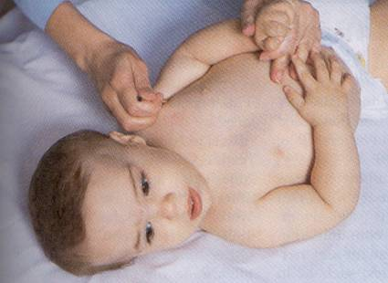
Temperature
Position for taking
axillary temperature.

Slide 14
Ear (Tympanic) Temperature
Can also be affected by:
Impacted ear wax & ear infections
Should NOT be used if child had ear surgery

Slide 15
Temperature
Oral temperature for children over 5 to 6 years.
Rectal temperatures are contraindicated if the child has had anal surgery, diarrhea, or rectal irritation.
Normal temp : 36.5-37.5

Slide 16
Position for Rectal tempreture
To take the temperature in your child’s bottom (rectally), then put a small amount of lubricant, such as petroleum jelly, on the small end of it. Place child on something firm, either faceup or facedown (if he’s facedown, put one hand on his back; if he’s faceup, bend your child’s leg to his chest,

Slide 17
Heart rate
The pulse is a wave of dilation - the wave of blood, created by the heart pumping that travels along the arteries
Where to find pulse:
At points where the artery is between fingertips and a bony area
Called pulse points
Felt with two or three fingers but never the thumb

Slide 18
Heart rate
Pulse sites:
Temporal, Carotid, Radial, Ulnar, Brachial, Apical, Femoral, Popliteal, Dorsal Pedis, Posterior tibial.
Notes: -
Carotid most common in emergencies.
Radial most common for routine examination.
Apical pulse provides a more accurate assessment of heart function, particularly when tachycardia present

Slide 19
Heart rate
Apical pulse for infants and toddlers under 2 years
Count for 1 full minute
Will be increased with: crying, anxiety, fever, and pain

Slide 20
Pulse rates
Neonate: 100 – 180
1-year: 100 – 160
3 years: 80- 110
14 years 60 - 100

Slide 21
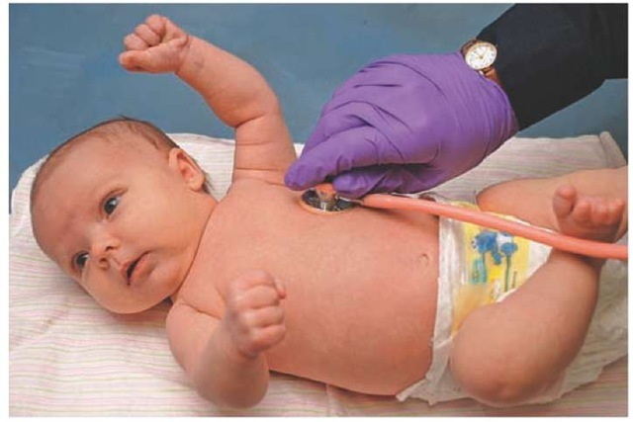
Apical Pulse

Slide 22
Pulse - Brachial
Used for infants and small children
Place fingertips of first 2 or middle 3 fingers over the brachial pulse area
Inside of the elbow
Lightly press your fingertips on the pulse area

Slide 23
Respiration
The exchange of gases between a living organism and its environment.
The mechanical act of breathing in air (inspiration) and expelling air (expiration) from the body.
Normal Respirations:
Effortless
Regular
Smooth

Slide 24
Respiratory
Count for one full minute
May want to do before you wake the infant up
Rate will be elevated with crying / fever
Newborn: 30 – 60
Toddler: 25- 40
School-age: 18 - 30
Adolescent: 16- 20

Slide 25
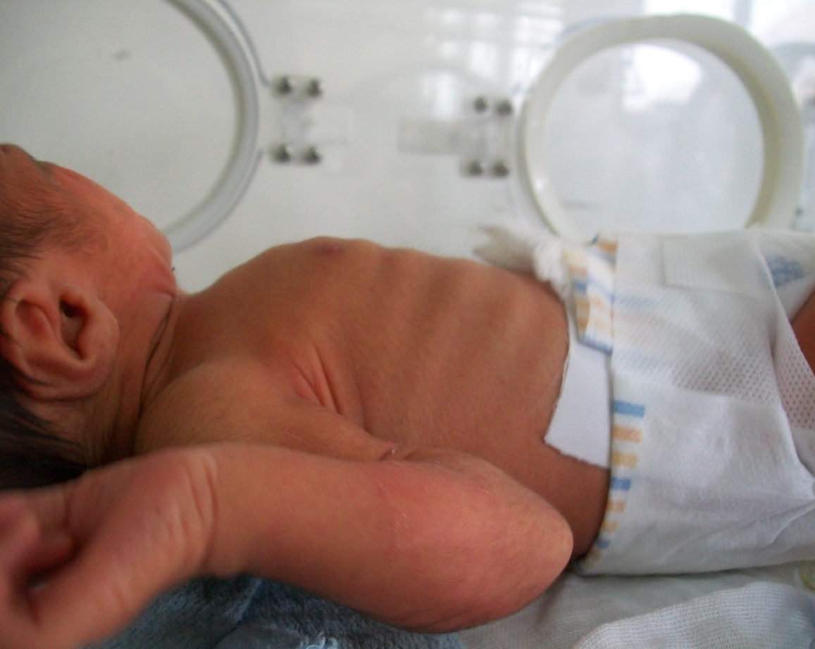

Slide 26
Blood Pressure
The width of the rubber bladder should cover two thirds of the circumference of the arm, and the length should encircle 100% of the arm without overlap.
Crying can cause inaccurate blood pressure reading.
Consider normal for age.

Slide 27
Blood Pressure
Systolic blood pressure is the highest pressure reached in the arteries as the heart pumps blood out for circulation through the body.
Diastolic blood pressure is the much lower pressure that occurs in the arteries when the heart relaxes to take blood in between beats.

Slide 28
Blood Pressure
Approximate Age Range | Systolic Range | Diastolic Range
1-12 months | 75-100 | 50-70
1-4 years | 80-110 | 50-80
3-5 years | 80-110 | 50-80
6-13 years | 85-120 | 55-80

Slide 29
Oxygen Saturation
Oxygen Saturation provide important information about cardio-pulmonary dysfunction and is considered by many to be a fifth vital sign.

Slide 30
1. General appearance
General appearance and behavior of new born.
Flexion position
Head flexed, chin resting on the upper chest, arm flexed with hand clenched and the feet dorsiflexed.
Check vital sign

Slide 31
a. Skin
Skin reddish in color, smooth and puffy at birth
At 24 - 36 hours of age, skin flaky, dry and pink in color
Edema around eyes, feet, and genitals
Turgor good with quick recoil < 2 sec
Mongolian spots: are large patches of bluish colored skin with wavy border often seen in sacral area.
Bruises, cyanosis

Slide 32
a- Skin
Check for color variations—such as increased or decreased
pigmentation, pallor, mottling, bruises, erythema,cyanosis, or jaundice
Some variations in skin color are common and normal, such as freckles found in the white population and Mongolian spots found on dark-skinned

Slide 33
a- Skin
When a skin color abnormality is suspected, inspect the buccal mucosa and tongue to confirm the color change.
Generalized cyanosis is associated with respiratory and cardiac disorders.
Jaundice is associated with liver disorders.

Slide 34
a- Skin
Cord clamp tight and cord drying
Jaundice, note in seclera
Colour of the skin depends on the familial and racial back ground.
Texture is soft, smooth skin
Rashes, petechia, scar, lesions (describe location,size and characteristics)

Slide 35
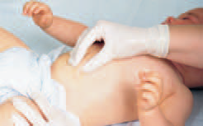

Slide 36
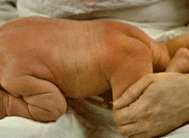
Skin cont…

Slide 37
Skin cont…
Vernix caseosa - The white, cheesy substance covering the newborn's body. Often present only in the skin folds.
Lanugo - Fine downy body hair usually distributed over shoulders, sacral area, and back of newborns. Usually disappears before birth or shortly after birth.

Slide 38
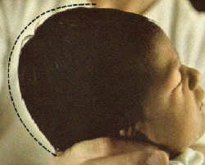
b. Head
Contour of the head.
Six bones:
Frontal bone
Occipital bone
Two parietal
Two temporal bone
Between the junction of these bone are bands of connective tissue called Sutures.
At the junction of the are wider spaces unossified membranous tissue called Fontanels

Slide 39
Head
Expected findings:
Anterior fontanel diamond shaped 2-3 to 3-5 cm
Posterior fontanel triangular 0.5 - 1 cm
Fontanels soft, firm and flat
Sutures are fibrous connetions between the bone.
Bulging indicates increase intracranial pressure
Sunken indicates dehydration

Slide 40
Cont … head
Check fontanels:
Anterior: 12 to 18 months
Posterior: closes by 2-3 months
head control usually establish by 6 month

Slide 41
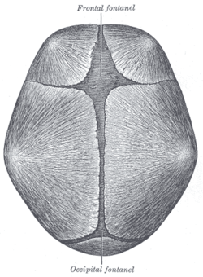

Slide 42
b. Hair
Inspect the scalp hair for color, distribution, and cleanliness.
The hair shafts should be evenly colored, shiny, and either curly or straight.Variation in hair color not caused
Normally, hair is distributed evenly over the scalp

Slide 43
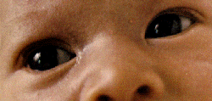
C. Eyes
Slate gray or blue eye color
No tears
Fixation at times - with ability to follow objects to midline
Corneal reflex
Distinct eyebrows
Cornea bright and shiny
Pupils equal,reactive to light, round and clear
Hypertelorism: widely spaced eye.

Slide 44
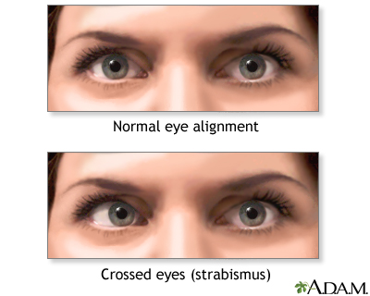
Eyes
Sclera should be white and clear.
Yallowish sclera indicate jaundice
strabismus may present
Sunken or bulging
Strabismus:
Alignment of eye important due to
correlation with brain development
May need to corrected surgically

Slide 45
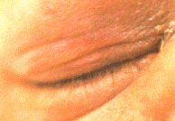
Common variations
Edematous Eyelids
May focus for a few seconds
Uncoordinated movements

Slide 46
Signs of potential distress or deviations from expected findings:
Discharges
Opaque lenses
Absence of Red Reflex
Reflexes absent
"Doll's Eyes" Reflex (beyond 10 days of age): When the head is moved slowly to the right or left, the eyes do not follow nor adjust immediately to the position of the head.

Slide 47
Ears
Ears Expected findings:
Loud noise elicits Startle Reflex
Flexible pinna with cartilage present
Pinna top on horizontal line with outer canthus of eye, if pinna is lower outer canthus may indicate congenital anomalies

Slide 48
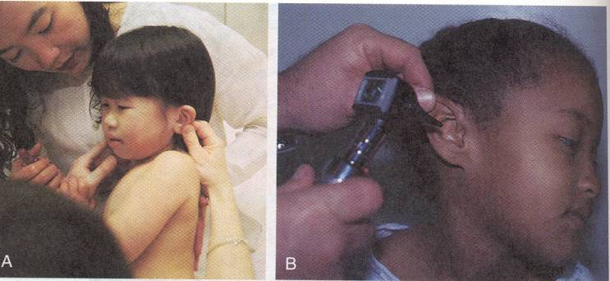
Ear Exam
.
pulled down and back to straighten ear canal in children under 3 years

Slide 49
Nose
Expected findings:
Nostrils patent bilaterally
Obligate nose breathers
No nasal discharge
Common variations:
Sneezes to clear nostrils
Thin white nasal mucus discharge

Slide 50
Mouth and Throat
Expected findings:
Uvula midline
Minimal or absent salivation
Tongue moves freely and does not protrude
Well developed fat pads bilateral cheeks
Sucking reflex
Rooting reflex
Gag reflex

Slide 51
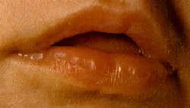
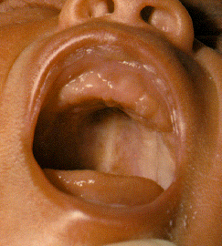
Mouth and Throat
Mucosa moist. Shortly after birth may visualize sucking calluses on central portions of lips.
Palate high arched:
Cleft lip or cleft palate
Common variations:
Epstein's pearls on ridges of gums

Slide 52
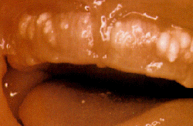
Common variations:
Epstein's pearls on ridges of gums, small, white.
Lingual frenulum: tight.
Frenuloplasty
Uvula can be inspected when open mouth.

Slide 53
Neck
Expected findings:
Short and thick
Turns easily side to side
Clavicles intact
Tonic neck reflex present
Some head control

Slide 54
Neck
Range of motion.
Shape.
Abnormal mass.
Palpate clavicle for fracture
Palpable crepitus, movement with palpation of clavicle
Torticollis-stiff neck: difficulty in holding head straight.

Slide 55
Chest
Expected findings:
Protruded xiphoid process.
Shape is circular: Equal anteroposterior and lateral diameter.
Ribs are very flexible and slight intercostal retraction
Bilateral synchronous chest movement

Slide 56
Chest
Breast:
Size, shape and nipple formation.
Location symmetry.
With’s milk.

Slide 57
Breast
Signs of potential distress or deviations from expected findings:
Asymmetrical chest movements
Sternum depressed
Marked retractions
Absent breast tissue
Flattened chest
Nipples widely spaced
Bowel sounds auscultated

Slide 58
Lungs
The normal respiration are irregular and abdominal.
The rate is between 30- 60b/m.
Irregulataries occur during crying, sleeping and feeding.
Bronchial equal bilaterally
Crackles soon after birth may indicate presence of fluid.
Wheezing or stridor.

Slide 59
Wheeze or Stridor
Wheezes occur when air flows rapidly through bronchi that are narrowed nearly to the point of closure.
Wheezes is lower airway
Asthma = expiratory wheezes
A stridor is upper airway
Inflammation of upper airway or FB

Slide 60
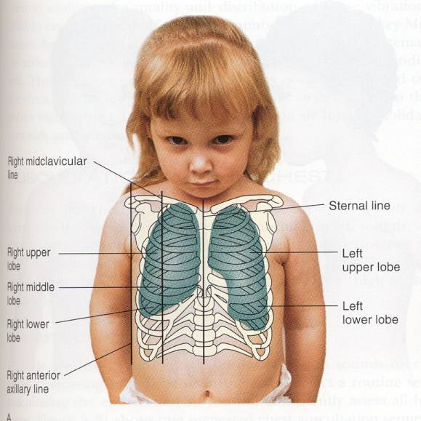
Child Chest

Slide 61
Chest assessment
Retractions
Subcostal
Intercostal
Sub-sternal
Supra-clavicular
Red flags: grunting / nasal flaring

Slide 62
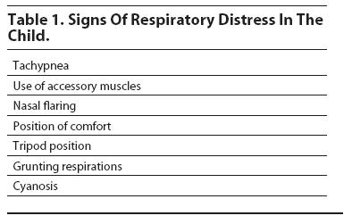

Slide 63
Heart
Heart rate: 100 – 180b/m after birth.
The Point of Maximums Impulses (PMI).
4th to 5th intercostals space.
Give us the location of the heart ( congenital diaphragmatic hernia or hemothorax.
Dextrocardia: heart in the right side.
Murmur: represents the incomplete functional closure of fetal shunt.

Slide 64
Abdomen
Shape is cylindrical and with few visible vein.
Bowl sound are heard within 15 – 20 m after birth.
Umbilical cord presence two arteries and one vein.
After clamping, it begins to dry and dull yellowish.
If umbilical cord appear unusually in diameter may indicate hematoma or small omphalocele.

Slide 65
Abdomen
Liver palpable 2 - 3 cm below right costal margin
Bilaterally equal femoral pulses
Voiding within 24 hours of birth
Meconium within 24 - 48 hours of birth

Slide 66
Male Genitalia
Expected findings:
Urinary meatus at tip of glans penis
Palpable testes in scrotum
Large, edematous, pendulous scrotum, with rugae
Stream adequate on voiding
Common variations:
Prepuce covering urinary meatus
Erections
Increased pigmentation
Edema and ecchymosis after breech delivery

Slide 67
Male Genitalia
Smegma: a white cheesy substance is commonly around the glans penis.
Epithelial pearls: small, white firm lesion may be seen at the tip of prepuce

Slide 68
Signs of potential distress or deviations from expected findings:
Non palpable testes
Hypospadius
Epispadius
Scrotum smooth
Ambiguous genitalia
inguinal hernia.

Slide 69
Female Genitalia
Expected findings:
Edematous labia and clitoris
Labia majora are larger and surrounding labia minora
Vernix between labia
Common variations:
Hymenal tag
Pseudomenstruation
Increased pigmentation
Ecchymosis and edema after breech birth.

Slide 70
Signs of potential distress or deviations from expected findings:
Labia fused
Fecal discharge from vaginal opening
Ambiguous genitalia
Widely separated labia

Slide 71
Back and Rectum
Expected findings:
Intact spine without masses or openings
Patent anal opening
"Wink reflex" present
Signs of potential distress or deviations from expected findings:
Limitation of movement
Spina bifida
Imperforate anus
Anal fissures
Pilonidal cyst

Slide 72
Extremities
Expected findings:
Maintains posture of flexion
Equal and bilateral movement and tone
Full range of motion all joints
Ten fingers and ten toes
Grasp reflex present
Legs appear bowed

Slide 73
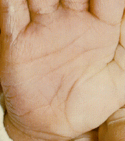
Feet appear flat
Palmar creases present
Sole creases present

Slide 74
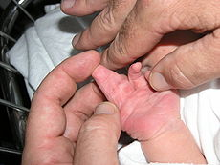
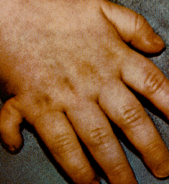
Signs of potential distress or deviations from expected findings:
Unequal tone
Asymmetrical movement of extremities
Syndactyly
Unequal leg length
Asymmetrical skin creases posterior thigh
Dislocation of hip
Persistent cyanosis of nail beds
Polydactyly

Slide 75
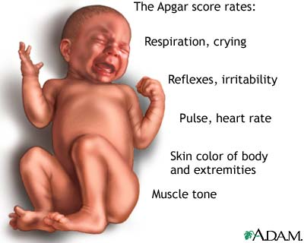
APGAR TEST

Slide 76
What is it?
A test developed in 1952 by Dr. Virginia Apgar
A baby’s first test
Quick assessment of the newborn’s overall well-being
Given one-minute after birth and five minutes after birth
Rates 5 vital areas

Slide 77
Why is it done?
To assess the baby’s vital signs quickly
The score is helpful for later evaluations

Slide 78
The 5 Signs: 1. The baby’s color
Color:
a. Pale or blue = 0
b. Normal color body, but blue extremities (arms and/or legs) = 1
c. Normal color = 2 – completely pink

Slide 79
2. The baby’s respiratory effort
Respiration:
a. Not breathing = 0
b. Weak cry, irregular breathing = 1
c. Strong cry = 2
2 points for a strong cry
1 point for a slow or weak cry
0 points for no cry at all

Slide 80
3. The baby’s heart rate
Heart Rate:
a. Absent heartbeat = 0
b. Slow heartbeat (less than 100 beats/minute) = 1
c. Adequate heartbeat (more than 100 beats/minute) = 2
2 = good strong heartbeat
1 = slow but steady heartbeat
0 = little or no heartbeat

Slide 81
4. The baby’s muscle tone
Muscle Tone:
a. Limp, flaccid = 0
b. Some flexing or bending = 1
c. Active motion = 2
2 points for vigorous motion
1 point for small flexing
0 points for no movement

Slide 82
5. The baby’s reflexes
Response to Stimulation
a. No response = 0
b. Grimace (facial expression) = 1
c. Vigorous cry or withdrawal = 2
2 points if the baby cries
1 point if the baby grimaces (facial expression)
0 points for no movement or sound

Slide 83
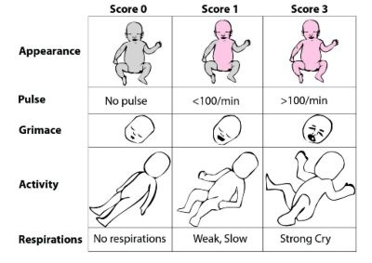

Slide 84
APGAR Score Interpretation
Score | Intervention
8 – 10 ( Eight to ten ) | No intervention is required
4 – 7 ( Four to seven ) | Gently stimulate Rub newborn’s back Administer O2 to the newborn.
0 – 3 ( Zero to three ) | Infant requires resuscitation

Slide 85
Example
A newborn assessed using APGAR scoring system, found with heart rate = 120 bpm, slow and weak cry, well flexed, the newborn found crying and sneezing as a response , and pale ….. how much in APGAR? And what will be your intervention ?.

Slide 86
Answer
The sign | Newborn’s findings | The score
Heart rate | 120 bpm | 2
Respiratory effort | Slow, weak cry | 1
Muscle tone | Well flexed | 2
Reflex irritability | Sneeze , cry | 2
Skin color | Pale | 0
Total |  | 7 ???!!!

Slide 87
Growth Measurements
Lab 3

Slide 88
Introduction
Measurement of physical growth in children is a key element in evaluation of the health status of children.
Physical growth parameters include height, weight, and head circumference.
Over all evaluation of growth requires judgment in interpretation of growth percentiles.

Slide 89
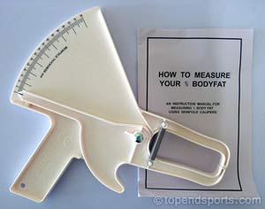
Physical growth parameter
Weight
Height / length
Skin fold
Head circumferences
Chest circumferences

Slide 90
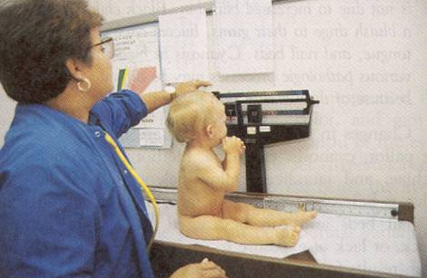
Weight
Note close proximity of nurses hands for safety

Slide 91
Weight
Needs to be recorded on a growth chart
Newborn may lose up to 10% of birth weight in 3-4 days.
Too much or too little weight gain needs to be further investigated.
Double birth weigh by 5-6 months
Triple birth weight by 1 year
Nutritional counseling
The normal birth weight is 2700- 4000g .

Slide 92
Weight-for-age percentiles, boys 0 to 24 months, WHO growth standards

Slide 93
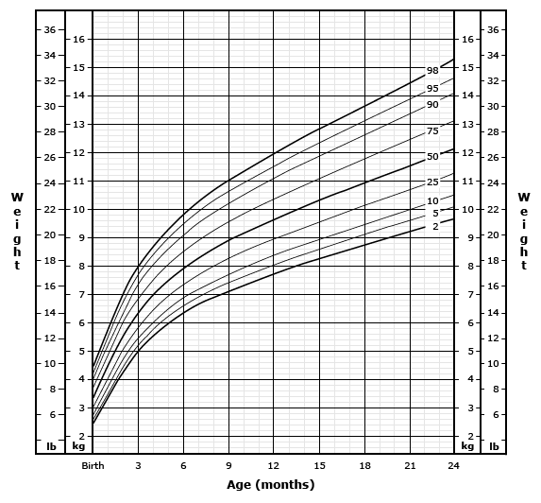

Slide 94
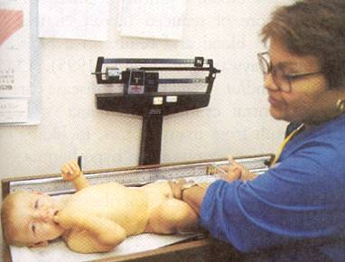
Length Measurement
Infants head is against end point and legs fully extended.

Slide 95
Length-for-age percentiles, boys birth to 24 months, WHO growth standards

Slide 96
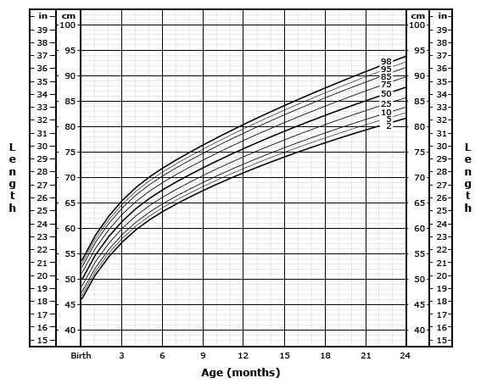

Slide 97
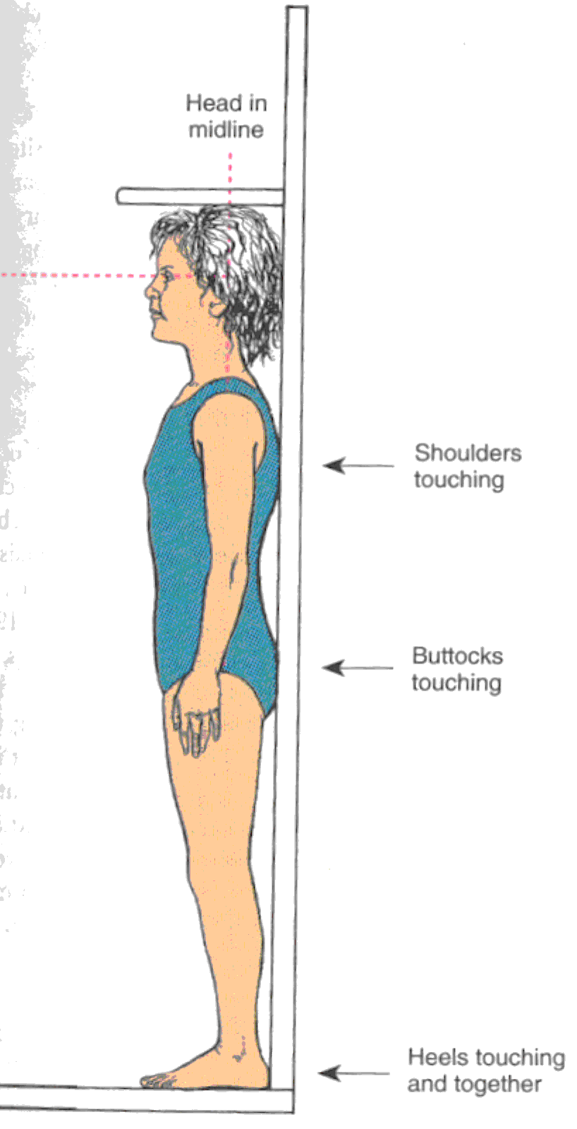
Height Measurement
Child is measured while
standing in stocking or
bare feet with the heels
back and shoulders touching
the wall.

Slide 98
Stature-for-age percentiles, boys, 2 to 20 years, CDC growth charts: United States

Slide 99
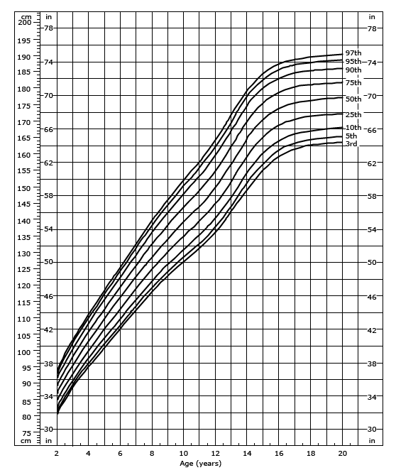

Slide 100
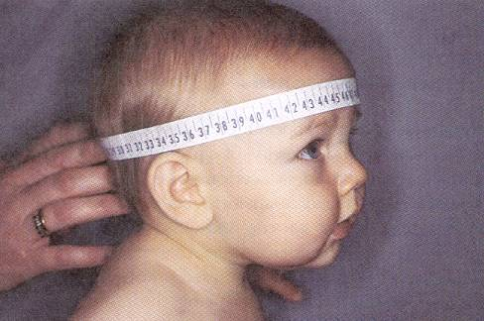
Head Circumference
Head circumference is measured by wrapping the paper
tape over the eyebrows and the around the occipital
prominence.

Slide 101
Head circumference-for-age percentiles, boys 0 to 24 months, WHO growth standards

Slide 102
Head circumference is measured in children from birth to 3 years of age because this is the period of rapid brain growth.
Head circumference also should be measured in older children with abnormal growth because it may be helpful in determining the etiology.
A child with fetal alcohol syndrome, as an example, may have growth deficiency and microcephaly. The measurement should be plotted on a standardized growth chart.

Slide 103
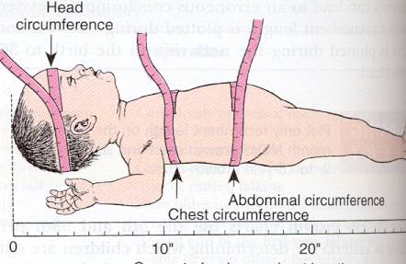
Head, chest, and abdominal circumference.

Slide 104
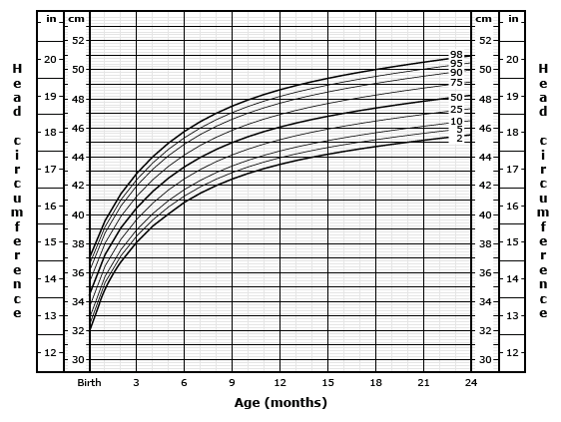

Slide 105
Normal Growth measures
Head circumference : 33- 35.5 cm
Chest circumference : 30.5- 33 cm, 2 cm less than head circumference.
Length: head (cephalic) to heal: 48- 53 cm
Body weight : 2700- 4000 g. ( loses 10% of weight in the first 3 to 4 days after birth).

Slide 106
What is failure to thrive
Children who are unable to thrive do not receive or are unable to adopt, maintain, or use the calories, was supposed to gain weight and grow as expected.

