Slide 1
Pharmaceutical Quality Control & current Good Manufacturing Practice
PHT 436
Lecture 4

Slide 2
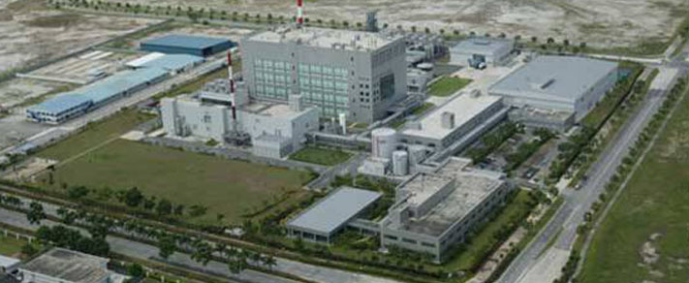
Good Manufacturing Practices Regulations
Subpart C: Building and Facilities

Slide 3
Subpart C: Building and Facilities
211.22. Design and construction features
211.44. Lighting
211.46. Ventilation, Air Filtration, Air Heating And Cooling
211.48. Plumbing
211.50. Sewage and Refuse
211.52. Washing and Toilet Facilities
211.56. Sanitation
211.58. Maintenance

Slide 4
211.22. Design and construction features
a) Any building or buildings used in the manufacturing, processing, packing or holding of drug product shall be of suitable size, construction and location to facilitate cleaning, maintenance and proper operations.

Slide 5
Discussion
There are two main areas of concern regarding the buildings and facilities:
The external environment.
The internal environment.
The external environment:
amenable to the location of well designed and constructed buildings.
It is insufficient that the buildings in which the production operations are to occur are clean, orderly, of suitable size and construction.
E.g. If the land, air or water resources that surround the plant offer the potential for water damage, infestation, or contamination of any type, the facilities are considered unsuitable.

Slide 6
Consideration regarding location prior to purchase, construct, or alter an existing facilities includes the following:
Adequate space for further expansion.
Zoning laws to allow anticipated development while restricting undesirable developments in the vicinity.
Availability of water, power, Fuel, sewage and waste stream removal.
Accessibility for employees (availability of public transportation), materials and visitors (customers, suppliers).
Environmental issues such as site history; soil; water and air quality and geological and topological issues (potential for flooding, earth-quakes, foundation instability).

Slide 7
Proximity of undesirable activities likely to pollute or act as a source of vermin, insects, odor, or microorganism- such as other industries, disposal sites, or open mining.
Availability of a suitable labor force.
Ability to provide adequate security arrangements.
Accessibility to interrelated operations of the company-Research & Development, marketing, internally produced intermediates or components.
Political situation, government stability, trade policies and taxation, financial incentives.

Slide 8
Having identified a suitable location for the facility, the site development plan is prepared and will include:
Compliance with appropriate laws and regulations and any additional company standards.
Site resources and infrastructure such as green spaces, parking, road and rail access, recreation areas, site utilities, tank farms and other external storage, and protection of wetlands and other restricted environments.
Storm water and waste management.
Site security and access- guard posts, cameras.

Slide 9
the site development plan (cont.):
Buildings—sitting layout, usage, function interrelationships for efficiency, possible expansion, surface finishes.
Utilities- design, layout, backup (electricity, nitrogen, chemical operation).
Equipment- design, layout, spares, capacity.
Traffic flow (external and internal).
Safety.
External architecture to take into account local environmental conditions (wind, snow, humidity) and aesthetic appearance blending local atmosphere, comparative image and functionality.

Slide 10
the site development plan (cont.):
Ease of maintenance.
Selection and use of experienced contractors.
Identification of project management responsibility.
Validation plans and effective change control procedure. Provision of design and as-built drawings.
Construction materials:
wall
floors
ceiling
services

Slide 11
the site development plan (cont.):
a) Wall
The position of walls:
should provide an orderly movement of materials and personnel.
Should take into account noise levels to provide acceptable working conditions. (minimize noise)
Should minimize the potential for cross-contamination and for component mix-up during storage and interdepartmental shipping.
The walls in manufacturing areas, corridors and packaging areas should be of plaster finish on high-quality concrete blocks or gypsum board to protect from crawling insects and water seepage.
The finish should be smooth, usually with enamel or epoxy paint.

Slide 12
Prefabricated partitions may be used in packaging areas where flexibility of layout is important.
Prefabricated units have been used in sterile suites where panel joints must be given particular attention.
Walls should be flush without any projections.
Outside walls are sealed to prevent moisture, dust and insects from going through cracks.

Slide 13
the site development plan (cont.): b) Floors
Floor covering should be selected for:
durability,
clean ability,
resistance to the chemicals.
Examples:
Terrazzo:
it is Flooring material consisting of chips of marble or granite set in concrete and polished to give a smooth surface.
It provides a hard-wearing finish.
Tiles: if tiles are used, care must be taken to ensure effective sealing between the tiles, which otherwise could become a harboring area of dirt and microorganisms.
poured-in-place is used in the manufacture areas.

Slide 14
Ceramic and vinyl tiles usually are not recommended for production areas, and if used, the between-tile sealing should be flush and complete.
Welded vinyl sheeting provides an even, easy to clean surface. This is not practical for heavy traffic areas, but can be of value in production areas, especially for injectables. Here the lack of joints improves the ease of cleaning and sanitation.
Epoxy flooring provides a durable and readily cleanable surface.

Slide 15
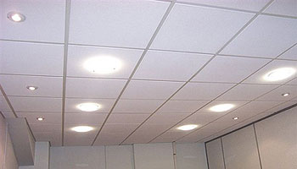
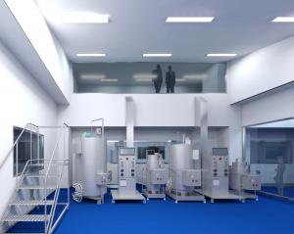
the site development plan (cont.): c) Ceilings
Suspended ceiling
It may be provided in office areas, laboratories, toilets and cafeterias.
It consists of lay-in acoustical panels of nonbrittle, nonfriable, nonasbestos, and non-combustible material.
Seamless plaster or gypsum board
Used in manufacturing areas require a smooth finish.
All ceiling fixtures such as light fittings, air outlets and returns, PA system and sprinkler heads should be designed to assure ease of cleaning and to minimize the potential for accumulation of dust.

Slide 16
the site development plan (cont.): d) Services
In the building design, provisions must be made for drains, water, steam, electricity and other services to allow for ease of maintenance.
Access should, ideally, be possible without disruption of activity within the actual rooms provided with the services.

Slide 17
211.22. Design and construction features
b) Any such building have adequate space for the orderly placement of equipment and materials to prevent mix-ups between different components, drug product containers, closures, labeling, in-process materials, or drug products and to prevent contamination. The flow of components, drug product containers, closures, labeling, in-process materials, or drug products through building or buildings shall be designed to prevent contamination.

Slide 18
Discussion
The design and layout of the facilities must:
minimize the possibility of mix-ups or contamination.
allow adequate separation of adjacent equipment and operations.
E.g. The spatial separation of packaging lines so that packaging components, bulk product and finished product cannot intermix between lines and that dust or spillage from one line cannot result in contamination of adjacent equipment.

Slide 19
A common practice is to introduce a physical barrier between the packaging lines. This need not be a permanent wall, a moveable partition serves the purpose.
The building design should also take into account the flow of materials and people.
Neither people, equipment, nor work in process should be moved through areas in which other operations are occurring. This requires that areas used for processing should each have separate access from corridors.

Slide 20
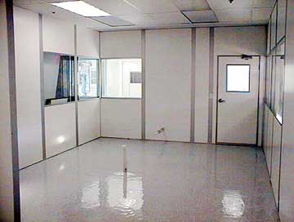
Visitors and design of the facilities
It is also of value to consider access of those visitors who intended only to have an overview of the facility or its operations.
Such visitors should be restricted to personnel corridors having visual access to the operating facilities.
This minimizes any potential environmental impact from additional people,
limits disruption of operational personnel,
and eliminates the need for dressing up to visit.

Slide 21
211.22. Design and construction features
c) Operation shall be performed within specifically defined areas of adequate size. There shall be separate or defined areas or other such control systems for the firm’s operations as are necessary to prevent contamination or mix-ups during the course of the following procedures:
Receipt, identification, storage and withholding from use of components, drug product containers, closures and labeling, pending the appropriate sampling, testing, or examination by the quality control unit before release for manufacturing or packaging.
Holding rejected components, drug product containers, closures, and labeling before disposition.

Slide 22
Cont.
3- Storage of released components, drug product containers, closures, and labeling.
4- Storage of in-process materials.
5- Manufacturing and processing operations.
6- Packaging and labeling operations.
7- Quarantine storage before release of drug products.
8- Storage of drug products after release.
9-Control and laboratory operations.

Slide 23
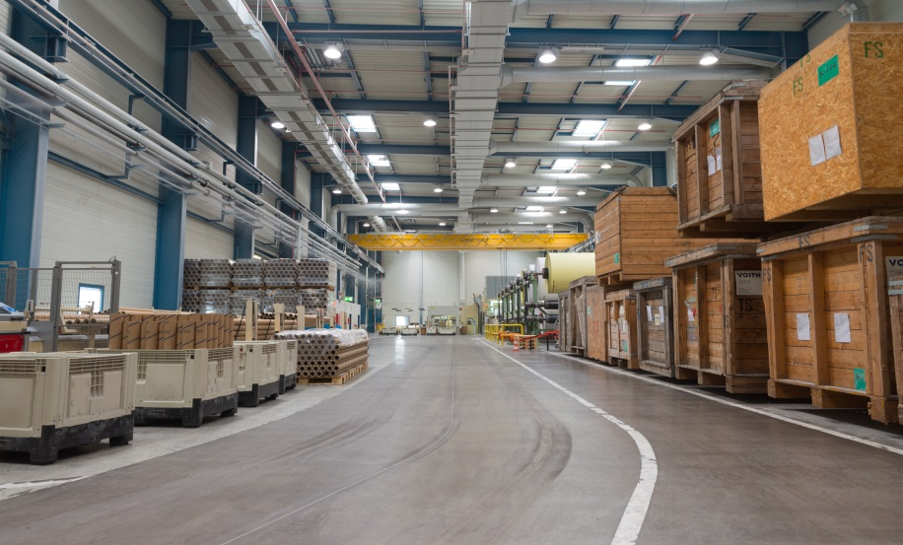
Discussion
Storage
Systems control of storage,
and flow of materials, can be:
more effective than physical separation.
more efficient with respect to space utilization and materials handling.
For example, Physical movement of materials into and out of quarantine, not only adds cost, but by addition another action, actually increases the potential of error.

Slide 24
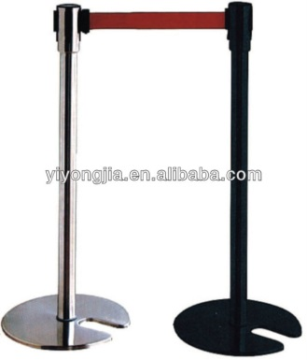
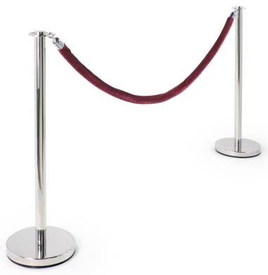
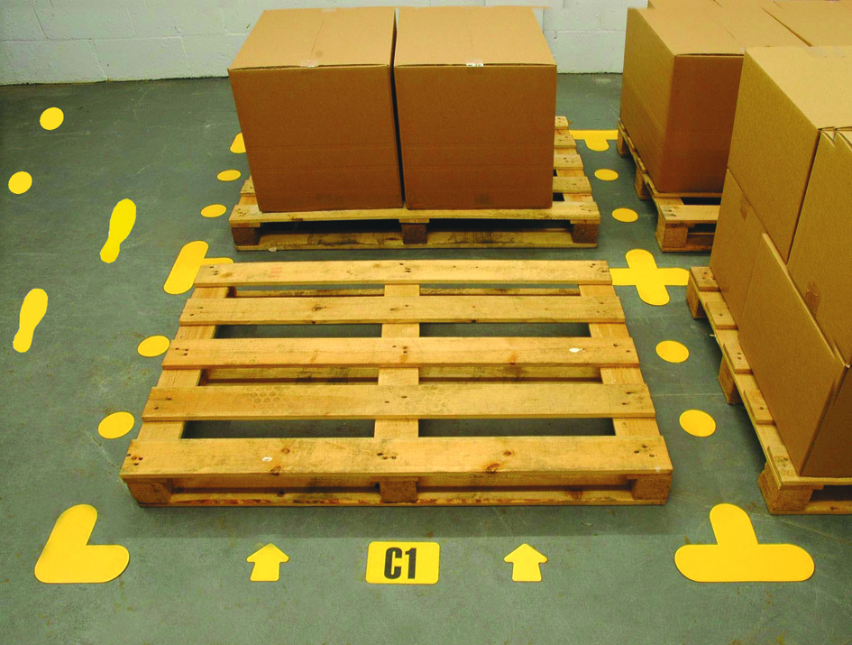
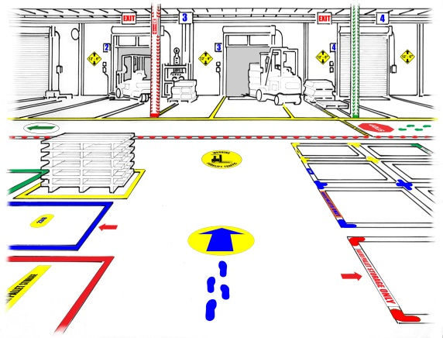
Some companies have found segregation using flexible physical areas to be a satisfactory alternative.
For example, in warehouse, a quarantine area can be designated around the goods simply by:
roping off the quarantine goods OR by placing floor markings.
This arrangement allows easy expansion or contraction of the area to meet changing volumes.

Slide 25
Traditionally most warehouses for components and finished products have been operated under ambient conditions because most pharmaceutical products are sufficiently stable under such conditions and stability data are available to support defined shelf-lives.
The conditions in the warehouse must be monitored.
any particularly sensitive products or components should be provided appropriate environments.
Many warehouses have to install air conditioning to control relatively brief exposure to higher temperature in summer months.

Slide 26
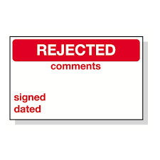
The storage period for rejected materials awaiting destruction should be kept as short as possible. Because:
These materials take up valuable space.
There is always a risk that they may be inadvertently used.

Slide 27
The degree of separation of individual manufacturing and processing operations will be dependent on the nature of these operations.
Raw materials are usually dispensed in an area specifically designed to minimize the potential for mix-ups and for cross-contamination.
Scales are separated by partitions and are supplied with dust extraction and sometimes laminar air flow.
Analysis of air samples confirms that the potential for cross-contamination is negligible.

Slide 28
Where a manufacturing process requires several different pieces of equipment (e.g., blender, granulator, dryer) these may all be contained in one room or suite of rooms.
Processes for different products should use completely segregated facilities.
Packaging and labeling operations are usually kept separate from manufacturing. Even when highly automated process is used, and packaging immediately follows manufacturing, the packaging is usually performed in an adjacent area.

