Slide 1
Pelvic Ultrasound
By. Alaa Malki

Slide 2
Pelvic Area
-UTERES
-OVARIES
-FALLOPIAN TUBES
-RT AND LT ADNEXA
A SUCCESSFUL U/S EXAMINATION OF PELVIC CANNOT BE ACHIEVED WITH OUT KNOWLEDGE OF WOMEN'S FULL CLINICAL HISTORY:
1-AGE
2-USE OF ANY MIDECATION EX: TAMOXFINE (increase the thickness of endo. + Polyp)
3-USE OF CONTRACEPTIVE PILLS (thin endo)
4-POSTMENOPAUSAL

Slide 3
Uterus
- Is a pear-shape organ .
- it found in the midline of the pelvic , ant. To rectum and post. To U/B.
-appearance of the uterus varies depending on the age and stage of
menstrual cycle .
- It divided in to parts:
1-fundus (dome shape)
2-body
3-cervix
4-vagina
- It has a different shape and size:
1-ANTEVERTED
2-RETROVERTED
3-AXIAL
4-ANTI-FLEXED
-postmenopausal (small uterus +invisible endo.)
-after pregnancy (increase size)

Slide 4
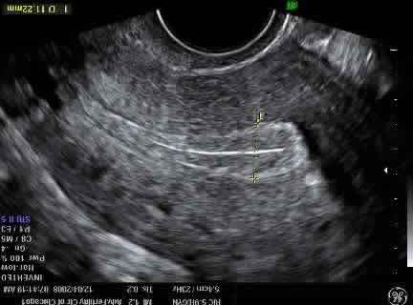
-WALL OF THE UTERUS COMPOSED OF 3 LAYERS:
1) PARAMETRIUM :
thin outer layer, it is highly echogenic on ultrasound and gives the uterus
bright out line .
2) MYOMETRIUM
muscular layer, normally
homogenous.
3) ENDOMETRIUM
-inner most layer of uterus .
-variable depending on the timing
of the menstrual cycle and
effect of drugs.
-range (0.5-1.4) cm ..conceder normal.

Slide 5
-(first half of the cycle: thin and hypoechogenic ).
-(mid cycle: proliferative phase-the central part became hyperechogenic and surrounded by a hypoechogenic rim (3 alyers)).
-(during the menstrual: hyper and thick).

Slide 6
FALLOPIAN TUBES
- Can be seen if significant change occur:
1)hydrosalpinx and pyosalpix (accumulation
of fluid or pus).
2) Ectopic pregnancy .

Slide 7
Ovaries
-Located in the ovarian fossa.
-Inferior to the pelvic vessels on the lateral pelvic wall.
-They are mobile structures .
-Less homogeneous (than uterus).
-OVARIAN FOLLICLES:
-Are simple anechoic cysts with clear and well defined
walls.
-They grow until they reach: 2.0-2.5 cm in diameter before
ovulation.
-In postmenopausal , small ovaries are difficult to see with no
follicles seen.

Slide 8
-Normal small amount of free fluid in bough
of Douglas after ovulation .
INDECATION OF PELVIC U/S:
Vaginal bleeding, pelvic pain ,IUCD ,poly cystic ovary ,
pelvic masses ,,, etc..

Slide 9
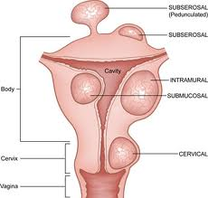
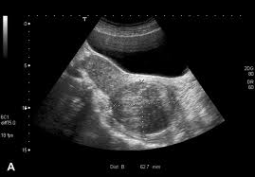
Abnormalities
Fibroids:
-most common gynecological tumor .
-most of the fibroid seen at uterine body and very rare seen on cervix.
-clinical presentation, size and position of the fibroid are very important.
-myometrium (intramural).
-uterine cavity (submucosal).
-serosaul surface (subserousal) .
-(pedunculated )it can be mistaken with adnexal masses .

Slide 10
- it composed of smooth muscles fibers .
-in pregnancy women usually increase in size.
-it can be single or multiple and cause enlargement of uterus.
-it has acoustic shadowing.
-it might be area of calcification .
-highly velocity blood flow .

Slide 11
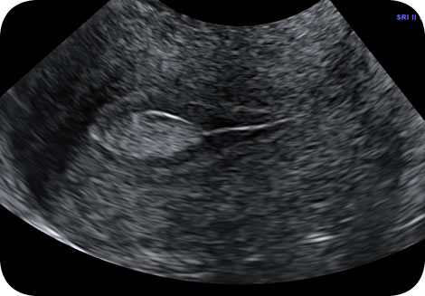
Endometrial polyp :
-common finding in women.
-women present with vaginal bleeding, dysmenorrhea or infertility .
-polyp arise from basal layer of endometrium and usually vascularized
by single vessel.
-they appear as hyperechoic area in the endometrium .

Slide 12
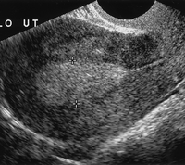
Endometrial hyperpleasia:
-abnormal or irregular vaginal bleeding.
- by U/S , the endometrium is thickened more than (1 cm).
- increase echogenicity with multiple small cystic area seen.

Slide 13
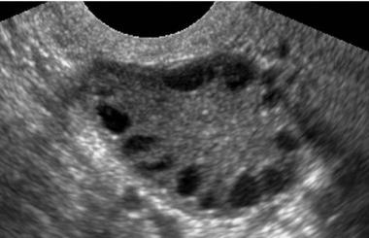
POLYCECTIC OVARIES:
-defined as an ovary that contains more than 10 cysts
measuring (2-8 mm)-follicles.
-increase ovarian stroma

Slide 14
MULTIPLE FOLLICLER OVARY:
-ovary enlarged and contains six or more of
follicles of vary sizes, without stroma.
UNRUPTURED FOLLICLE:
-appear as simple anechoic cyst with thick
vascular wall .
-it might reach a diameter of 3.0 cm.

Slide 15
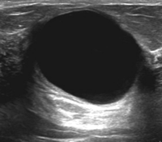
SIMPLE CYST:
-this cyst appear similar to follicle but larger in size.
-it can occasionally reach more than 10 cm in
diameter.

Slide 16
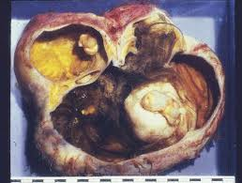
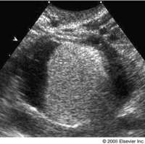
DERMOID CYST:
-located on the ovary .
-this cyst show a great variation in appearance.
-it has cystic and solid area and usually poorly vascularized.
-they display mixed echogenicity ,it might include areas of
calcification due to bone or teeth ,which cast acoustic
shadows. Hair inside the cyst can be recognized by the
presence of speculation .

Slide 17
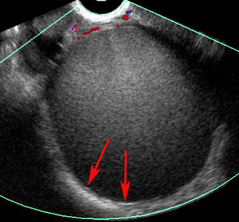
ENDOMETRIOMA:
-located within the ovary .
-these masses are usually having regular internal walls and
contain echogenic fluid of a ground glass appearance .

Slide 18
Thank you

