Slide 1
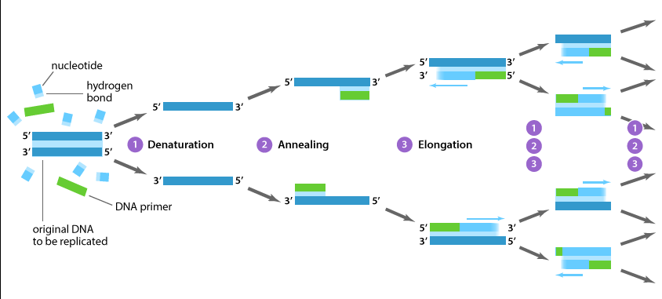
Polymerase Chain Reaction
molecular photocopying!

Slide 2
DNA Amplification
In a crime scene, a sample of DNA was found, however amount of DNA was not enough to be analyzed.
After DNA Extraction, the scientist want to study a specific part of a gene to do sequencing.
How scientist solve these problem

Slide 3
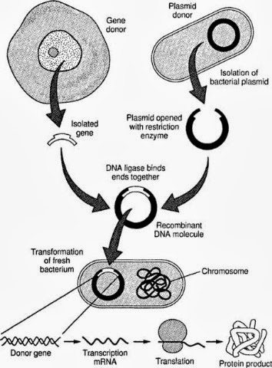
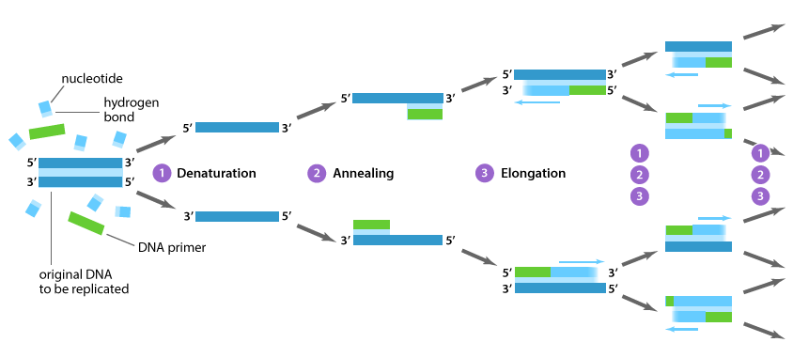
The solution is to do amplification of parts of DNA!!
Mainly there are two methods:
Amplifying segment of DNA
Polymerase chain reaction
Cloning

Slide 4
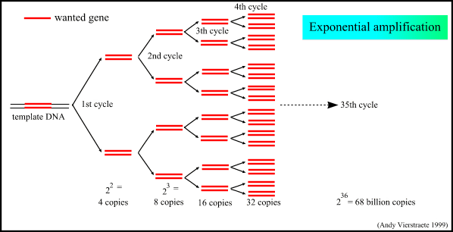
Polymerase Chain Reaction
PCR is a means to amplify a particular piece of DNA
Amplify= making numerous copies of a segment of DNA
PCR can make billions of copies of a target sequence of DNA in short time
It is a laboratory version of DNA Replication in cells

Slide 5
Questions that you must understand
How the amplification will be done?
How you will determine your target sequence?
How the amplification will be specific for certain segment?
PCR does not copy all of the DNA in the sample. It copies only a very specific sequence of genetic code, targeted by the PCR primers

Slide 6
Principle: component
Any PCR reaction should involve the following:
The Amplification: The Cycling Reactions
The Cycling Reactions
There are three major steps in a PCR, which are repeated for 30 or 40 cycles.
Denaturation at around 94°C
Annealing of the Primer to the Template,
Extension at around 72°C
Template DNA
MgCl2

Slide 7
1-Denaturation: (95⁰C)
the double-stranded template DNA is denatured by heating, typically to 95°C, to separate the double stranded DNA (why)

Slide 8
**Annealing:(could be one of these temp 50-65⁰C)
The reaction is rapidly cooled to an annealing temperature to allow the oligonucleotide primers to hybridize to the template (What is the type of the bond?).
It anneal only to sequences that are complementary to them.

Slide 9
Exention:(72⁰C)
The reaction is heated to a temperature, typically 72°C for efﬁcient DNA synthesis by the thermostable DNA polymerase. This means the optimum tempreture of …………………………………..is 72

Slide 10
Example : you want to study a mutation in a DLG3 gene and how it relate to memory,
Find you’re the region from any website, eg.Ensebmle
The segment that you want to amplified is in the blue square
5’
3’
Design the primers using Primer3, then send them to ant companey who will synthesize them
Make sure that the area that you want to study is between the primers
The region to be studied should be between the forward and reverse

Slide 11
PCR cycle steps
1-Denaturation:
The purpose is…………..

Slide 12
2-Annealing:
The purpose is…………..
3-Extension:

Slide 13
3-Extension:

Slide 14
Cycle 2

Slide 16
* *Note on Annealing Temperature:
The single strands of the template are too long and complex to be able to reanneal during this rapid cooling phase.
During this annealing step the thermostable DNA polymerase will be active to some extent and will begin to extend the primers as soon as they anneal to the template.
The annealing temperature chosen for a PCR depends directly on length and GC composition of the primers.

Slide 17
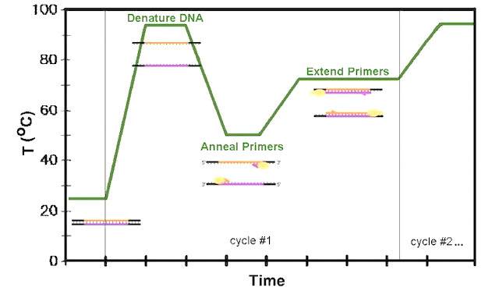

Slide 18
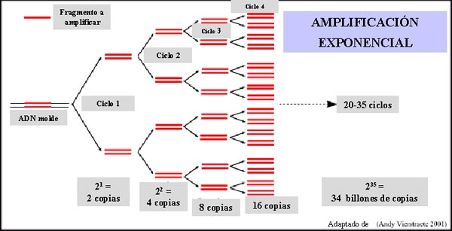
At the end of the PCR reaction, the specific sequence will be accumulated in billions of copies (amplicons). In only 20 cycles, PCR can product about a million (2 20) copies of the target

Slide 19
Steps
Determine your target
(Exactly)
Design your primer
Dilute your primer
Start your optimization

Slide 20
PCR Primer Design Guidelines
1.Primers must be complementary to flanking sequences of target region
2.Primer Length: It is generally accepted that the optimal length of PCR primers is 18-22 bp.
3. Primer Melting Temperature (T_{m}): (what is Tm?)
Primers with T_{m} in the range of 52-58 ºC generally produce the best results.
The GC content of the sequence gives a fair indication of the primer T_{m}.
Tm = (G + C) × 4 + (A + T) × 2
The difference of Tm should be < 5ºC of the forward and reverse primers.

Slide 21
PCR Primer Design Guidelines
4. Primer Annealing Temperature (T_{a}): The primer melting temperature is the estimate of the DNA-DNA hybrid stability and critical in determining the annealing temperature.
(T_{a} = T_{m} – 5)
-Too high T_{a} will produce insufficient primer-template hybridization resulting in low PCR product yield.
-Too low T_{a} may possibly lead to non-specific products caused by a high number of base pair mismatches
5. GC Content: The GC content (the number of G's and C's in the primer as a percentage of the total bases) of primer should be 40-60%.

Slide 22
PCR Primer Design Guidelines
5. GC Clamp: The presence of G or C bases within the last five bases from the 3' end of primers (GC clamp)
6. Di-nucleotide repeats (e.g., GCGCGCGCGC or ATATATATAT) or single base runs (e.g., AAAAA or CCCCC) should be avoided.

Slide 23
It is very important to know your product size, why??
How you will make sure that you target sequence is amplified?

