Slide 2
MATH 1111

Slide 3
Reference:

Slide 4
Office Number and Location: Building 26 , A (9)

Slide 5
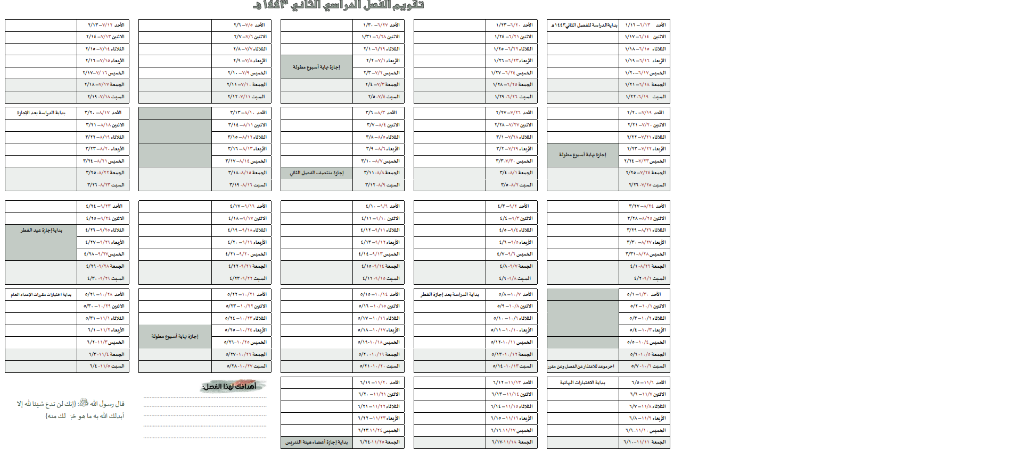
Mid 1
Mid 2

Slide 6
Test dates
First Midterm 7th week
Second Midterm 14th week

Slide 7
Methods of Assessment:
Mark | Course Assessment
30 | Midterm exams
5 | Class activates
5 | Presentations
10 | Homework
10 | Quizzes ( Lms* )
40 | Final Examination
100 | Total
* http://lms.ksu.edu.sa.

Slide 9
Introduction To Number Systems
First Section:
Binary System
Second Section:
Octal Number System
Third Section:
Hexadecimal System

Slide 10
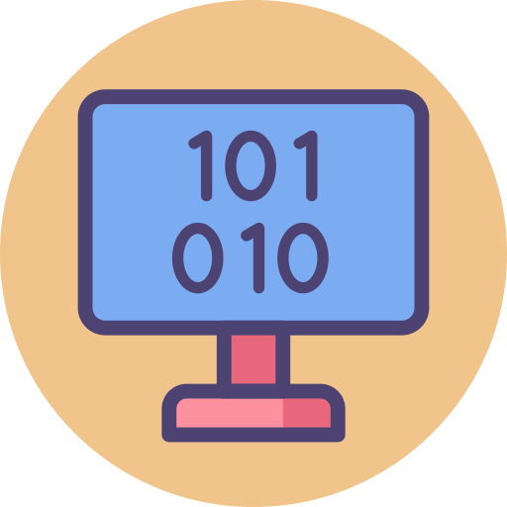
Binary System

Slide 11
The main purpose for this lesson is to introduce the following:
Understand the concept of binary system.
Conversion any number decimal to the binary number and converse.
define how can conversion Binary Fractions.
Use Arithmetic in the Binary System.

Slide 12
Binary System
The binary system is a different number system.
The coefficients of the binary numbers system have only two possible values: 0 or 1.
Each coefficient d is multiplied by 2^{n}.
For example, the decimal equivalent of the binary number 11010.11 is 26.75, as shown from the multiplication of the coefficients by powers of 2:
1x2⁴ + 1x2³ + 0x2² + 1x2¹ + 0x2⁰ + 1x2⁻¹ + 1x2⁻² = 26.75
the digits in a binary number are called bits.

Slide 13
Binary to Decimal Conversion
A binary number can be converted to decimal by forming the sum of powers of 2 of those coefficients whose value is 1.
Example 2
Convert the binary number (1101001)₂ to decimal.
Solution:
(1101001)₂ =1x2⁶ + 1x2⁵ + 0x2⁴ + 1x2³ + 0x2² + 0x2¹ + 1x2⁰
= 64 + 32+ 0 + 8 + 0 + 0 + 1
=105

Slide 14
Binary Fractions
decimal number system, each digit of a number represents an increasing power of ten. This is true for all digits to the left of the decimal point ... for numbers to the right; each digit represents a decreasing power of ten.
In binary, the concept is the same, except that digits to the right of the "binary point" represent a decreasing power of two.

Slide 15
Example3:
Convert the (110.001)₂ to decimal.
Solution:
(110.001)₂ = 1x2² + 1x2¹ + 0x2⁰ + 0x2⁻¹ +0x2⁻² +1x2⁻³
= 4+2+0+0+0+0.125
= 6.125
Example 4
Convert (0.11101)₂ to decimal.
Solution:
(0.11101)₂ = 1x2⁻¹ + 1x2⁻² + 1x2⁻³ + 0x2⁻⁴ + 1x2⁻⁵
= 0.5 + 0.25 + 0.125 + 0 + 0.03125
= 0.90625

Slide 16
Decimal to Binary Conversion
Algorithm 1
To convert from a base-10 integer numeral to its base-2 (binary) equivalent,
the number is divided by two, and the remainder is the least-significant bit.
The (integer) result is again divided by two, its remainder is the next least significant bit.
This process repeats until the quotient becomes zero.

Slide 17
Decimal to Binary Conversion
Example 5
Convert 23₁₀ to binary number.
Solution:
The answer is found by reading "up" from the bottom. Therefore, 23₁₀ = 1 0111₂
 |  | Quotient |  | Remainder
1. | 23 ÷ 2 = | 11 |  | 1
2. | 11 ÷ 2 = | 5 |  | 1
3. | 5 ÷ 2 = | 2 |  | 1
4. | 2 ÷ 2 = | 1 |  | 0
5. | 1 ÷ 2 = | 0 |  | 1
 | sign bit

Slide 18
Decimal to Binary Conversion
Example 6:
Convert 46 ₁₀ to base 2.
Solution:
Therefore, 46₁₀ = 10 1110₂
 |  | Quotient |  | Remainder
1. | 46 ÷ 2 = | 23 |  | 0
2. | 23 ÷ 2 = | 11 |  | 1
3. | 11 ÷ 2 = | 5 |  | 1
4. | 5 ÷ 2 = | 2 |  | 1
5. | 2 ÷ 2 = | 1 |  | 0
6. | 1 ÷ 2 = | 0 |  | 1
 | sign bit

Slide 19
Decimal Fractions to Binary Fractions Conversions
To convert the fractional part successive multiplications are done instead of divisions. In each case the remaining fractional part is used in the succeeding multiplication

Slide 20
Decimal Fractions to Binary Fractions Conversions
Example 7
Convert the decimal fraction 0.59375₁₀ to binary fraction.
Solution:
To convert the fractional part (0.59375)₁₀, successive multiplications are done instead of divisions. In each case the remaining fractional part is used in the succeeding multiplication
Therefore 0.59375₁₀ = 0.10011₂
 |  | Integer |  | Fraction
1. | 0.59375 x 2 = | 1 |  | 0.1875
2. | 0.1875 x 2 = | 0 |  | 0.375
3. | 0.375 x 2 = | 0 |  | 0.75
4. | 0.75 x 2 = | 1 |  | 0.5
5. | 0.5 x 2 = | 1 |  | .0

Slide 21
Decimal to Binary Conversion
Example 8
Convert 46.59375₁₀ to base 2.
Solution:
First, convert the whole number (46) using the previous method.
46₁₀ = 10 1110₂
Next, convert the fractional part (0.59375), also use the previous method.
0.59375₁₀ = 0.10011₂
Therefore, 46.59375₁₀ = 10 1110.10011 ₂

Slide 22
Arithmetic in the Binary System

Slide 23
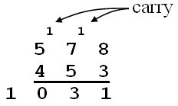
Binary Addition
The process for adding binary numbers is the same in any number system, except that you must be aware of when (and what) to “carry”.
In the decimal system, a carry occurs when the sum of 2 digits is 10 or more. For example,
In binary, a carry occurs when the sum of 2 binary digits is 2 or more. This leaves only four possibilities:
0 + 0 = 0₂ 0 + 1 = 1₂ 1 + 1 = 10₂ (therefore, 0 with a carry) 1 + 1 + 1 = 11₂ (therefore, 1 with a carry)

Slide 24
Binary Addition
Example9:
Add the binary numbers
0011 0010₂ + 0011 0111₂:
Solution:
Addition table
+ | 0 | 1
0 | 0 | 1
1 | 1 | 10

Slide 25
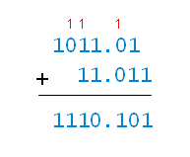
Binary Addition
Example10:
Add the binary numbers
1011.01₂+11.011₂
Solution:
Addition table
+ | 0 | 1
0 | 0 | 1
1 | 1 | 10

Slide 26
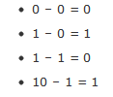
Binary Subtraction
For binary subtraction, there are four facts instead of one hundred:

Slide 27
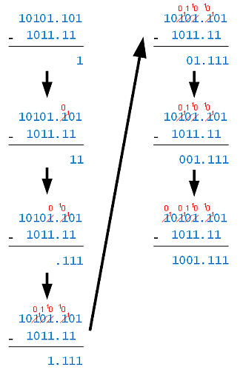
Binary Subtraction
Example 11:
Subtract: 10101.101_1011.11
Solution:
Step 1: 1 – 0 = 1.
Step 5: 1 – 1 = 0.
Step2: Borrow to make 10 – 1 = 1.
Step 6: 0 – 0 = 0.
Step3: Borrow to make 10 – 1 = 1.
Step7: Borrow to make 10 – 1 = 1.
Step 4: Cascaded borrow to make 10 – 1 = 1.

Slide 28
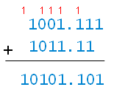
Checking the Answer
You can check the answer in a few ways. One way is to add the result (1001.111) to the subtrahend (1011.11), and check that that answer matches the minuend (10101.101):

Slide 29
Binary Multiplication Binary multiplication uses the same algorithm as in decimal, but uses just three order-independent facts:
0 x 0 = 0,
1 x 0 = 0,
1 x 1 = 1
Example 12:
Multiply 1011.01 x 110.1

Slide 31
Homework
All Exercises Page 10

