Slide 1
Parasytology is the sciences of parasites
A parasite: “a living organism that acquires some of its basic nutritional requirements through its intimate contact with another living organism”. Parasites
may be simple unicellular protozoa or complex multicellular metazoa
Definitive host: “the organism in which the adult or sexually mature stage of the parasite lives”
Intermediate host: “the organism in which the parasite lives during a period of its development only”
Zoonosis: “a parasitic disease in which an animal is normally the host - but which also infects man”
Vector: “a living carrier (e.g.an arthropod) that transports a pathogenic organism from an infected to a non-infected host”. A typical example is the female Anopheles mosquito that transmits malaria

Slide 2
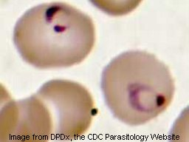
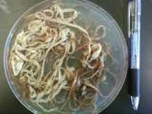
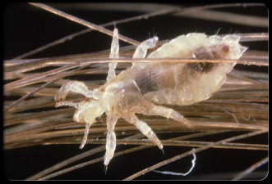
Protozoa: unicellular organisms, e.g. Plasmodium (malaria)
Metazoa: multicellular organisms, e.g. helminths (worms) and arthropods (ticks, lice)
An endoparasite: “a parasite that lives within another living organism” –
.g. malaria, Giardia
An ectoparasite: “a parasite that lives on the external surface of another living organism” – e.g. lice, ticks

Slide 3
major parasitic infections
Parasite | Diseases | No. people infected | Deaths/yr
Plasmodium | malaria | 273 million | 1.12 million
Soil transmitted helminths: Roundworm (Ascaris) Whipworm (Trichuris) Hookworm (Ancylostoma and Necator) | Pnemonitis, intestinal obstruction Bloody diarrhoea, rectal prolapse Coughing, wheezing, abdominal pain and anaemia | 2 billion | 200,000
Schistosoma | Renal tract and intestinal disease | 200 million | 15,000
Filariae | Lymphatic filariasis and elephantiasis | 120 million | Not fatal but 40 million disfigured or incapacitated
Trypanasoma cruzi | Chagas disease (cardiovascular) | 13 million | 14,000
African trypanosomes | African sleeping sickness | 0.3 – 0.5 million | 48,000
Leishamania | Cutaneous, mucocutaneous and visceral leishmaniasis | 12 million; 2 million new cases/yr | 50,000

Slide 4
Taxonomic classification of protozoa

Slide 5
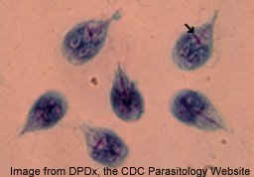
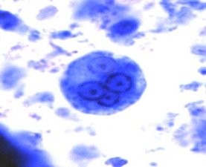
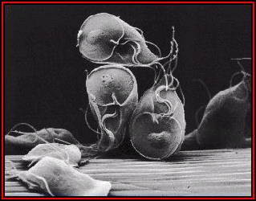
Examples of important intestinal protozoa
Transmitted by the faecal-oral route and cause diarrhoea
Giardia lamblia: world-wide distribution, lives in the small intestine and
results in malabsorption
Entamoeba histolytica: may invade the colon and cause bloody diarrhoea – amoebic dysentery. Also causes ameobic liver abscess.
Balantidium coli: a large motile ciliated parasite that lives in the colon of pigs, humans and rodents and can lead to colonic ulceration
.
Electron micrograph of G. lamblia trophozoites (feeding stage)

Slide 6
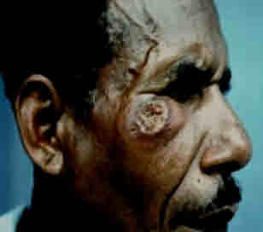
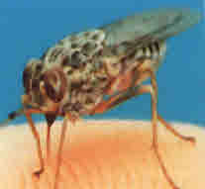
Examples of important systemic protozoa
Detected in the blood
Plasmodium: the cause of malaria. There are 4 species that infect man: P. falciparum, P. vivax, P. ovale and P. malariae
Toxoplasma gondi: transmitted by the ingestion of oocysts from cat faeces. Infection can lead to ocular problems and is also a cause of neonatal toxoplasmosis
Leishmania: transmitted by sand flies, can lead to visceral, cutaneous and mucocutaneous leishmaniasis
Trypanosoma: haemoflagellates which cause
In Africa - sleeping sickness (transmitted by the Tsetse fly)
In South America - Chagas disease (transmitted by the Reduviid bug)
Typical lesion of cutaneous leishmaniasis
Tsetse fly – the vector of African trypanosomiasis It has a painful bite!

Slide 7
Taxonomic classification of helminths
Sub kingdom |  | Phylum |  | Class |  | Genus – examples
Metazoa |  | Nematodes Round worms; appear round in cross section, they have body cavities, a straight alimentary canal and an anus |  |  |  | Ascaris (roundworm) Trichuris (whipworm) Ancylostoma (hookworm) Necator (hookworm) Enterobius (pinworm or threadworm) Strongyloides
 |  | Platyhelminthes Flat worms; dorsoventrally flattened, no body cavity and, if present, the alimentary canal is blind ending |  | Cestodes Adult tapeworms are found in the intestine of their host They have a head (scolex) with sucking organs, a segmented body but no alimentary canal Each body segment is hermaphrodite |  | Taenia (tapeworm)
 |  |  |  | Trematodes Non-segmented, usually leaf-shaped, with two suckers but no distinct head They have an alimentary canal and are usually hermaphrodite and leaf shaped Schistosomes are the exception. They are thread-like, and have separate sexes |  | Fasciolopsis (liver fluke) Schistosoma (not leaf shaped!)

Slide 8
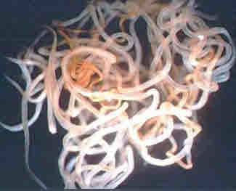
Examples of important metazoa – intestinal nematodes
Trichuris (whipworm)
A soil transmitted helminth
prevalent in warm, humid conditions
Can cause diarrhoea, rectal prolapse and anaemia in heavily-infected people
Ancylostoma and Necator (hookworms)
A major cause of anaemia in the tropics
Strongyloides
inhabits the small bowel
infection more severe in immunospressed people (e.g. HIV/AIDS, malnutrition, intercurrent disease)
Enterobius (pinworm or threadworm)
prevalent in cold and temperate climates but rare in the tropics
found mainly in children
Heavy intestinal infections may occur with Ascaris. Adult worms can be several cms long.
Ascaris (roundworm)
Found world-wide in conditions of poor hygiene, transmitted by the faecal- oral route
Adult worms lives in the small intestine
Causes eosinophilia

Slide 9
Examples of important metazoa –systemic nematodes
Filaria including:
Onchocerca volvulus – Transmitted by the simulium black fly, this microfilarial parasite can cause visual impairment, blindness and severe itching of the skin in those infected
Wuchereria bancrofti – The major causative agent of lymphatic filariasis
Brugia malayi – Another microfilarial parasite that causes lymphatic filariasis
Toxocara
A world-wide infection of dogs and cats
Human infection occurs when embryonated eggs are ingested from dog or cat faeces
It is common in children and can cause visceral larva migrans (VLM)

Slide 10
Examples of important flatworms - cestodes
Systemic
Echinococcus granulosus (dog tapeworm) and Echinicoccus multilocularis
((rodent tapeworm
Hydatid disease occurs when the larval stages of these organisms are ingested
The larvae may develop in the human host and cause space-occupying lesions in several organs, e.g. liver, brain

Slide 11
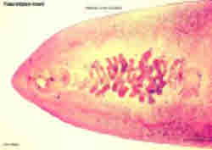
important metazoa –trematodes (flukes)
Intestinal
Fasciolopsis buski - A common parasite of humans and pigs in South- east Asia. This parasite is one of the largest trematodes to infect man (8cm in length) and lives in the upper intestine. Chronic infection leads to inflammation, ulceration and haemorrhage of the small intestine
Adult Fasciolopsis buski trematode
© Dr. Peter Darben, Queensland University of Technology

Slide 12
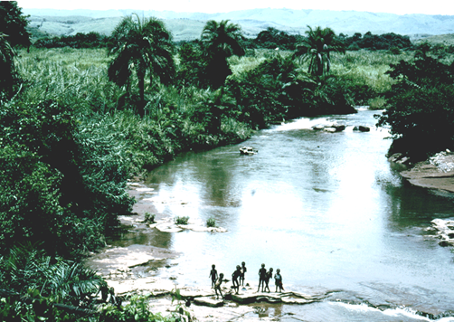
Schistosomiasis (bilharzia)

Slide 13
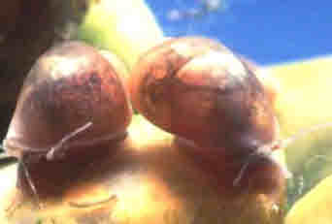
Schistosomiasis (bilharzia)
Epidemiology
200m people in 74 countries infected, 85% of whom live in sub-Saharan Africa
S. haematobium - Africa and middle east (most prevalent)
S. Mansoni - Africa and Latin America
S. japonicum – Pacific region
Life cycle
Transmission occurs in fresh water
Infective cercariae released from snails of the genera Bulinus, Biomphalaria Oncomelania
Cercariae penetrate the skin of people who drink, swim or bathe in infected water
Adult worm live in the veins that drain the urinary system (S. haematobium) or mesentric blood vessels intestines (S. mansoni, S. japonicum) and release eggs into water in urine or faeces
Eggs develop into miracidia which then infect snails
Bulinus globosus, the intermediate host snail for S. haematobium (source: WHO/TDR/Stammers)

Slide 14
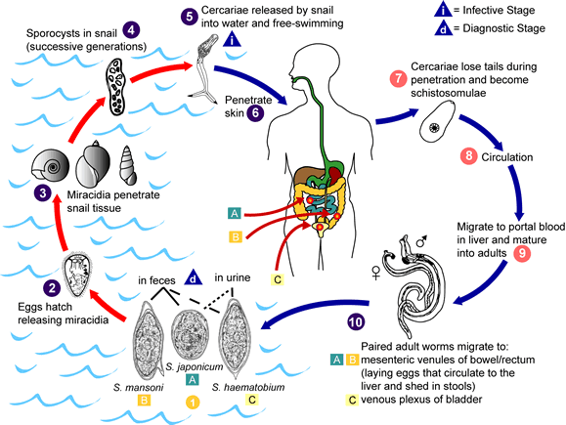

Slide 15
Symptoms and signs
Urinary Schistosomiasis:
S. hamatobium
Gross haematuria
Dysuria
Bladder, ureters and kidneys damaged Cancer of the bladder is common
Intestinal schistosomiasis
S. mansoni, S. japonicum
Gradual enlargement of liver and spleen intestines
hypertension of the abdominal blood vessels which begin to bleed
Blood in the stools

Slide 16
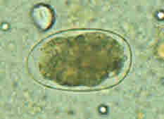
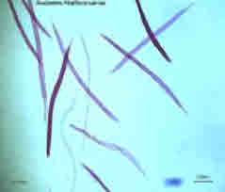
Hookworm (1)
Epidemiology
>1200m infections each year of which 100m are symptomatic
It is due to 2 parasites both of which occur worldwide:
Necator americanus - predominant species in sub-Saharan Africa, south Asia and the Pacific
Ancylostoma duodenale –predominant in S. Europe, N. Africa, western Asia, northern China, Japan and the west coast of America
Egg of A. duodenale in faecal smear (size 57-76 µm by 35-47 µm)
Filariform larvae
© Dr. Peter Darben, Queensland University of Technology
Notes:
Adult worms live in the intestine and excrete eggs in the faeces
In the absence of latrines, eggs contaminate soil and develop in warm, damp conditions
eggs hatch and infective filariform larvae develop in about one week and remain infective in soil for many weeks
filariform larvae penetrate the skin when a person walks barefoot in the soil
larva migrate from the skin to the lungs via the lymphatic and blood systems
larvae penetrate the capillary wall to enter the alveolus
Larvae are propelled up the respiratory tree to the epiglottis where they are swallowed
Develops to adult stage in upper intestine; adult worms are fully mature after about 5 weeks
Eggs are excreted in the faeces
Prevention and control
Educate people to not urinate or defecate in fresh water supplies
Eliminate snail vectors by making the water habitat unsuitable (increase water flow, remove vegetation)
Provide piped water to avoid direct contact with cercariae
Mass drug treatment of communities to reduce reservoir of infection

Slide 17
Symptoms and signs
Minor
Often itchy papules are found at the site where the larva penetrated the skin
There may be cough and wheezing as the larva migrates through the lungs
Major
Hookworm anaemia
Tiredness, aches and pains
Pallor
Breathlessness
Oedema
Diagnosis
Microscopic examination of faecal smears to demonstrate significant numbers of hook worm eggs
Measure Hb, serum ferritin, iron
Exclude other causes of anaemia
Prevention and control
Health education and improve sanitation facilities – install pit latrines
Encourage use of protective footwear
Discourage soil eating (pica)
Mass drug treatment of communities
Iron supplementation in areas of low iron intake

