Slide 1
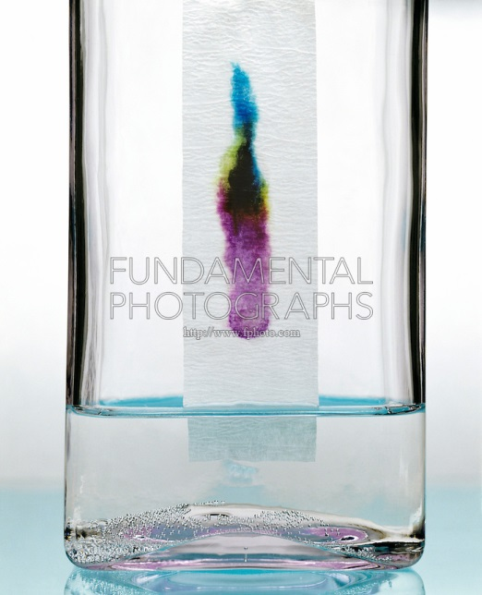
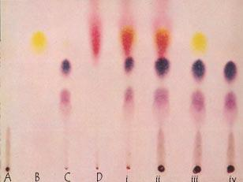
Paper and Thin Layer Chromatography (TLC)

Slide 2
Objectives
Understand the principle of Paper and Thin Layer Chromatography (TLC).
Diagnose two samples of urine for Phenylketonuria and Cystinuria, using paper chromatography and TLC.

Slide 3
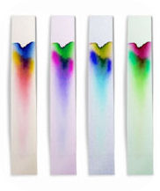
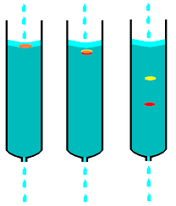
Chromatography
Is the collective term for a set of laboratory techniques for the separation of mixtures.
Chromatography is a method by which a mixture is separated by distributing its components between two phases. The stationary phase remains fixed in place while the mobile phase carries the components of the mixture through the medium being used
-The separation of materials is based on differential partitioning [retardation]between the mobile and stationary phases.

Slide 4
Chromatography
The mobile phase (also known as solvent) may be either liquid or gas.
The stationary phase (also known as sorbent) can be either a solid or liquid, a liquid stationary phase is held stationary by a solid (support or matrix).
The molecules in the mixture to be separated are the solutes

Slide 5
Uses of Chromatography
Uses of chromatography in general
Identifying unknown compounds.
Establishing purity of a sample
To know the property of a specific compound
Can be used as a purification process

Slide 6
Types of Chromatography will be studied in this course
Thin layer chromatography
Paper chromatography
Gel filtration
Ion exchange chromatography

Slide 7
Paper and Thin layer chromatography
Method for testing the purity of compounds and identifying substances.
Useful technique because it is relatively quick and requires small quantities of material.

Slide 8
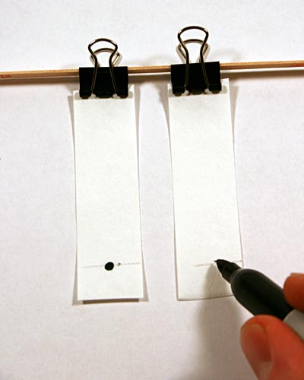
1-Paper chromatography
is one of the types of chromatography procedures which runs on a piece of specialized paper.
[solutes are separated according to their solubility in mobile phase, or their attraction to the stationary phase] -(Depend in the polarity).
.
Two types of paper chromatography:
Phases in which substance will be separated
The stationary phase
is a water molecules bound to an (inert) cellulose matrix
Mobile phase
is the solvent (in our lab butanol with acetic acid)

Slide 9
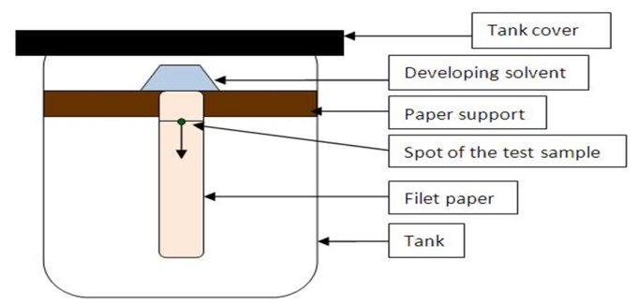
Paper Chromatography
Descending
Ascending
-In this method, the solvent is kept in a trough at the top of the chamber and is allowed to flow down the paper.
-The liquid moves down by capillary action as well as by the gravitational force.
-In this case, the flow is more rapid as compared to the ascending method.
In this method, the solvent moves upward against gravitational force.
The only force that cause the motion[of solvent and the componds] is capillary force. So the speed of the process is slow.

Slide 10
Water molecules bound to cellulose
Paper Chromatography
Organic solvent

Slide 11
2-Thin Layer Chromatography (TLC):
The method is rapid and separations can be completed in less than one hour.
TLC is a widely used.
Phases in which substance will be separated
The stationary phase [Stationary phase: adsorbent]
Mobile phase
is the solvent (in our lab butanol with acetic acid)
Is a thin layer (0.25 – 0.5 mm) of adsorbent like silica gel - a polar substance- , [aluminium oxide or magnesium silicate] spread uniformly over the surface of a flat, inert surface of the glass plastic plate.
[The stationary phase+ support medium →should be inert].
Mixture of solvents.

Slide 12
Separation depend on the following: (the principle)
Partition of a solute between a moving solvent phase and a stationary aqueous phase. The solute moves in the direction of a solvent flow at a rate determined by the solubility of the solute in the moving phase. Thus a compound with high mobility [less polarity] is more attracted to the moving solvent [mobile phase]than to the stationary phase.
Traveling of solvent via capillary action

Slide 13
Silica gel is a form of silicon dioxide (silica). at the surface of the silica gel, the silicon atoms are attached to -OH groups which makes the surface of the silica gel is very polar and can form hydrogen bonds with suitable compounds .

Slide 14
Organic solvent

Slide 15
Samples Analysis 1-visualization:
Spots in paper and TLC chromatograms can be detected in 4 different ways:
By their natural color
By their fluorescence
By their chemical reactions that take place after the paper has been sprayed with various reagents for example: during paper chromatography of amino acids, the chromatograms are sprayed with ninhydrin.
By radioactivity

Slide 16
The paper or plate remaining after the experiment is known as the Chromatogram.

Slide 17
2- Expression of the results.
The spots are usually identified by comparing of standards of known(relative flow) Rf values.
Is the ratio of the distance moved by a solute to the distance moved by the solvent
Under similar conditions, a component
should always travel at the same speed.
Its identity can be found by comparing
the distance it moves relative to the solvent.
R_{f} = distance travelled by the component = Y
distance travelled by the solvent X
X
Y

Slide 18
[Rf] Value:
-If Rƒ value of a solute is closer to zero, the solute has more attraction to stationary phase.
-If Rƒ value of a solute is closer to 1, then the solute has more affinity for the mobile phase and travels further.
-The final chromatogram can be compared with other known mixture chromatograms to identify sample mixes, using the Rf value in an experiment.

Slide 19
Some factors that may affect separation
Some factors that may affect separation(other than the chemical nature of the substance):
Temperature: Since temperature can effect the solubility of the solute in a given solvent. often a chromatography laboratory has a fixed temperature for optimum results
Composition of the solvent: Since some compounds are more soluble in one solvent than in the other the mixture of solvents used affect separation of the compounds.
Any ionized impurities in the support medium will tend to bind or attract oppositely charged ions and will therefore reduce the mobility of these solutes.

Slide 20
Method
To use TLC and paper chromatography in diagnosis of of Phenylketonuri and Cystinuria
Phenylketonuria:
Non-functional phenylalanine hydroxylase enzyme.
This enzyme is necessary to metabolize the amino acid phenylalanine (Phe) to the amino acid tyrosine.
phenylalanine accumulates and is converted into phenylpyruvate (also known as phenylketone), which is detected in the urine.
Cystinuria:
Cystinuria is an inborn error of amino acid transport that results in the defective absorption by the kidneys of the amino acid called cystine. The name means "cystine in the urine.“
When the kidneys do not absorb cystine, this compound builds up in the urine.

Slide 21
Detection of Phenylketonuri and Cystinuria by TLC and paper chromatography
Phenylketonuria:
Non-functional phenylalanine hydroxylase enzyme.
This enzyme is necessary to metabolize the amino acid phenylalanine (Phe) to the amino acid tyrosine.
phenylalanine accumulates and is converted into phenylpyruvate (also known as phenylketone), which is detected in the urine.
Cystinuria:
Cystinuria is an inborn error of amino acid transport that results in the defective absorption by the kidneys of the amino acid called cystine. The name means "cystine in the urine.“
When the kidneys do not absorb cystine, this compound builds up in the urine.

Slide 22
paper chromatography. | (TLC)
cellulose | Wide choice between different adsorbents[stationary phase].
Low resolution but also allow for quantitation. | It has better resolution and to allow for quantitation.
Expanded zonal spread[ not concentrated for quantitation analysis in need ]. | compact zonal spread[concentrated for quantitation analysis in need ].

