Slide 1
King Saud University College of Business Administration Department of Health Administration Masters` Program
PA 505- Introduction to Quality in Healthcare Second Semester 1436/ 1437
Mohammed S. Alnaif, Ph D. alnaif@ksu.edu.sa
Office Phone # 469-3681

Slide 2
PERFORMANCE IMPROVEMENT TOOLS
Learning Objectives
Describe how quality improvement tools are used throughout an improvement project,
Identify commonly used quantitative and qualitative improvement tools,
Apply improvement tools in an improvement project, and
Explain the difference between improvement models and improvement tools.

Slide 3
PERFORMANCE IMPROVEMENT TOOLS
Performance Improvement Tools
During an improvement project, various analytic tools are used to discover the causes of undesirable performance and to plan solutions.
Do not confuse performance improvement models with the analytic tools used throughout an improvement project.

Slide 4
PERFORMANCE IMPROVEMENT TOOLS
Quality tools
One of the difficult things about quality is explaining how a tool is different from a process or a system.
We can observe people using tools and methods for improvement.
We can see them making a flowchart, plotting a control chart, or using a checklist.
These tools and procedures are the logical outcomes of process and system changes that people have put in place or implemented to make improvements or identify a problem.

Slide 5
PERFORMANCE IMPROVEMENT TOOLS
Quality tools
People may use several tools and procedures to make improvements, and these tools may form one part of an improvement system.
Although we can observe people using the tools of the system, the system (e.g., Six Sigma, Lean) itself is invisible and cannot be observed.
Many of the more than 50 quality tools available today were developed to “see” the quality system they are designed to support.

Slide 6
PERFORMANCE IMPROVEMENT TOOLS
Performance Improvement Tools
Think of the improvement model as the recipe—for instance, the steps you follow when baking a cake.
Analytic tools are the ingredients—the materials you use while following the recipe. When baking a cake, you want to use the correct ingredients and add them to the cake mixture at the right time.
The same is true for the analytic tools used during an improvement project.

Slide 7
PERFORMANCE IMPROVEMENT TOOLS
Quality tools
The American Society for Quality has classified quality tools into six categories:
Cause analysis
Evaluation and decision making
Process analysis
Data collection and analysis
Idea creation
Project planning and implementation.

Slide 8
PERFORMANCE IMPROVEMENT TOOLS
Quality tools
This section of the lecture is not intended to be a comprehensive reference on quality tools and techniques but rather highlights some of the more widely used tools.
The following discussion organizes the tools into two categories:
Qualitative tools
Quantitative tools

Slide 9
PERFORMANCE IMPROVEMENT TOOLS
Performance Improvement Tools
Qualitative tools are used to generate ideas, set priorities, maintain direction, determine problem causes, and clarify processes.
Quantitative tools are used to measure performance, collect and display data, and monitor performance.
Exhibit 6.1 is a quick reference guide to the common qualitative and quantitative analytic tools used in each step of a typical improvement project. Notice that some tools can be used in more than one step.

Slide 10
Exhibit 6.1 Quick Reference Guide to Analytic Improvement Tools
A typical project four steps | Qualitative Tools | Quantitative Tools
Step 1: Define the improvement goal | Affinity diagram Brainstorming Decision matrix Force field analysis Multi-voting Nominal group technique Survey | Bar graph Check sheet Control chart Histogram Line graph Pareto chart Scatter diagram Survey
Step 2: Analyze current practices | Brainstorming Cause and effect diagram Five Whys Flowchart Survey Workflow diagram | Bar graph Check sheet Control chart Histogram Line graph Pareto chart Scatter diagram Survey

Slide 11
Exhibit 6.1 Quick Reference Guide to Analytic Improvement Tools
A typical project four steps | Qualitative Tools | Quantitative Tools
Step 3: Design and implement improvements | Affinity diagram Brainstorming Decision matrix Flowchart Force field analysis Nominal group technique Planning matrix Stakeholder analysis Workflow diagram | Bar graph Check sheet Control chart Histogram Line graph Pareto chart Scatter diagram Survey
Step 4: Measure success | Storyboard Survey | Bar graph Check sheet Control chart Histogram Line graph Pareto chart Scatter diagram Survey

Slide 12
PERFORMANCE IMPROVEMENT TOOLS
Performance Improvement Tools
Quantitative tools are typically used during the preliminary performance assessment phase of quality management to display numeric or measurement information in a manageable and useful form.
They also can be used during the actual improvement project for similar purposes.

Slide 13
PERFORMANCE IMPROVEMENT TOOLS
Performance Improvement Tools
Qualitative tools are used throughout an improvement project.
Together with quantitative tools, qualitative tools help the improvement team define the goal, understand how the process works, identify improvement opportunities, and create solutions.

Slide 14
PERFORMANCE IMPROVEMENT TOOLS
Performance Improvement Tools
Brainstorming
Brainstorming is a technique used to quickly generate lots of ideas about a problem or topic. It encourages creative thinking and incites enthusiasm.
The most common brainstorming techniques are structured brainstorming, unstructured brainstorming, and silent brainstorming.

Slide 15
PERFORMANCE IMPROVEMENT TOOLS
Performance Improvement Tools
Brainstorming
The most common brainstorming techniques are structured brainstorming, unstructured brainstorming, and silent brainstorming.
In structured brainstorming, a group leader solicits ideas from group members one at a time.
Participants may skip their turn if they do not have an idea to share.
Structured brainstorming is advantageous in that each person has an equal chance to participate, but it is disadvantageous in that it discourages spontaneity and is restrictive.

Slide 16
PERFORMANCE IMPROVEMENT TOOLS
Performance Improvement Tools
Brainstorming
Unstructured brainstorming is free-form; participants contribute ideas as they come to mind.
Unstructured brainstorming is advantageous in that participants can build on each other’s ideas in a relaxed atmosphere.
It is disadvantageous in that less assertive or lower-ranking participants (such as none leadership staff) may choose not to speak up.
A few rounds of structured brainstorming followed by unstructured brainstorming may help reticent participants open up.

Slide 17
PERFORMANCE IMPROVEMENT TOOLS
Performance Improvement Tools
Brainstorming
In silent brainstorming, participants write their ideas on small slips of paper, which are collected and posted for everyone to see.
Silent brainstorming is advantageous in that everyone’s ideas are captured regardless of his or her level of assertiveness or position in the organization’s hierarchy.
Silent brainstorming is disadvantageous in that the group does not build the synergy of an open session.
Silent brainstorming is often used in combination with other brainstorming techniques.

Slide 18
PERFORMANCE IMPROVEMENT TOOLS
Performance Improvement Tools
Brainstorming
The result of a brainstorming session is a list of ideas. A long list can be narrowed down using another qualitative tool, such as multi-voting or nominal group technique.
Multi-voting
A group decision- making technique used to reduce a long list of items to a manageable number by taking a series of structured votes

Slide 19
PERFORMANCE IMPROVEMENT TOOLS
Performance Improvement Tools
Multi-voting
Suppose an improvement team charged with reducing patient wait times in an outpatient clinic has identified several problems that contribute to service delays. They know they cannot fix all of these problems at once, so they use multi-voting to determine which problems they should address first.

Slide 20
PERFORMANCE IMPROVEMENT TOOLS
Performance Improvement Tools
Multi-voting
The problems are listed on a flipchart in random order.
Team members are given ten self-stick dots (color is irrelevant) and told to place the dots next to the problems they feel are most urgent.
They are instructed to use all ten dots but to place no more than four dots on one problem.
When everyone is done, the number of dots next to each problem is tallied.

Slide 21
PERFORMANCE IMPROVEMENT TOOLS
Performance Improvement Tools
Multi-voting
A few clear winners usually stand out.
The problems with the highest number of dots are addressed first.
Before finalizing the list of high-priority problems, the team may discuss the results to ensure everyone agrees with the selection.

Slide 22
PERFORMANCE IMPROVEMENT TOOLS
Performance Improvement Tools
Nominal Group Technique
A structured form of multi-voting used to identify and rank issues, it involves five steps.
The following example illustrates the use of nominal group technique to select solutions for a performance problem.

Slide 23
PERFORMANCE IMPROVEMENT TOOLS
Performance Improvement Tools
Nominal Group Technique
An ambulatory surgery center forms a team to investigate why patient complaints are increasing and what is needed to fix this problem.
Using nominal group technique, the team leader first states the problem and clarifies it if necessary to ensure everyone understands its nature and consequences.

Slide 24
PERFORMANCE IMPROVEMENT TOOLS
Performance Improvement Tools
Nominal Group Technique
In the second step, each team member silently records potential solutions to the problem and does not discuss them with other team members (as in silent brain- storming).
In the third step, each person shares one idea with the group, and the leader records the idea on a flip chart.

Slide 25
PERFORMANCE IMPROVEMENT TOOLS
Performance Improvement Tools
Nominal Group Technique
The process is repeated until all solution ideas have been recorded.
As in step two, the ideas are not discussed.
In the fourth step, the team clarifies the ideas listed on the flip chart. The leader may ask some team members to explain their ideas.
Comments from other members are not allowed during the explanation. The goal in this step is to ensure that everyone in the group understands the suggested solutions.

Slide 26
PERFORMANCE IMPROVEMENT TOOLS
Performance Improvement Tools
Nominal Group Technique
In the final step, the team votes on the ideas silently. Team members are asked to select five ideas they think are most effective, record them on separate index cards, and rank them in order of importance.
They mark a “5” on the card for most important, “4” for second most important, and so on.

Slide 27
PERFORMANCE IMPROVEMENT TOOLS
Performance Improvement Tools
Nominal Group Technique
When team members have finished ranking their ideas, the leader collects the cards and tallies the votes.
Items that received one or no votes are removed from the list.
Items with the highest total point values are most important to the group and should be addressed first.

Slide 28
PERFORMANCE IMPROVEMENT TOOLS
Performance Improvement Tools
Nominal Group Technique
The primary difference between the results of multi-voting and the results of nominal group technique is that the improvement team considers the total point count for each item (adding up the values of each vote) as well as the number of votes each item received.

Slide 29
PERFORMANCE IMPROVEMENT TOOLS
Performance Improvement Tools
Affinity Diagrams
Affinity diagrams are used to organize large amounts of language data (ideas, issues, opinions) generated by brainstorming into groupings on the basis of the relationships between data items.
This process helps improvement teams sift through large volumes of information and encourages new patterns of thinking.
Affinity diagrams also help improvement teams identify difficult, confusing, unknown, or disorganized performance concerns.

Slide 30
PERFORMANCE IMPROVEMENT TOOLS
Performance Improvement Tools
Affinity Diagrams
To create an affinity diagram, team members write their ideas, issues, or opinions on separate pieces of paper or index cards and scatter them on a large table.
Together, and without speaking, the team sorts related ideas into no more than eight groups.
Sorting the ideas into an affinity diagram should be a creative process, so the groups should not be named until later.
This categorization process takes from 10 to 20 minutes, depending on the number of ideas.

Slide 31
PERFORMANCE IMPROVEMENT TOOLS
Performance Improvement Tools
Affinity Diagrams
Once the ideas are sorted, the team names the groups by creating header cards and placing one at the top of each stack.
The name should describe the thread or topic that ties the cards in the group together. Exhibit 6.2 is a partially completed affinity diagram created by an improvement team in a hospital’s business office.
The team brainstormed the problems associated with billing errors and grouped these problems into categories.

Slide 32
Exhibit 6.2. Affinity Diagram
Training
Internal Communication
Insurance Relations
New billing clerks are not adequately trained.
Procedure charges are not consistently captured in IT system
Insurance companies don’t provide timely feedback
Nurses don’t understand the charge process for supplies
Getting everyone together to fix charge problems is difficult
There is no consistent procedure for confirming patient’s insurance before billing
Despite training on new IT system, some clerks still have difficulty using it
Clerks can wait up to two weeks to be informed of billing process changes
Insurance companies keep hospital billing clerks on hold too long

Slide 33
PERFORMANCE IMPROVEMENT TOOLS
Performance Improvement Tools
Control Chart
A line graph that contains a mean line and upper and lower limits of the normal range (known as control limits) is called a statistical control chart. Developed by Shewhart (1925) in 1924, it has become a primary tool of modern performance assessment.

Slide 34
Exhibit 4.24 Control Chart of Number of Rejected Insurance Claims—Process in Control

Slide 35
PERFORMANCE IMPROVEMENT TOOLS
Performance Improvement Tools
Histograms, is a graphical display of the frequency distribution of a quality characteristic of interest. A histogram makes variation in a group of data apparent and aids analysis of the distribution of data around an average or median value.
Exhibit 4.11 is a histogram illustrating the distribution of patient wait times in a clinic. Wait time data were gathered for one week, and the data were grouped into three wait time categories. The number of patients in each category is also shown.

Slide 36
Exhibit 4.11 Histogram of Clinic Wait Times

Slide 37
PERFORMANCE IMPROVEMENT TOOLS
Performance Improvement Tools
Cause and Effect Diagrams
Cause and effect diagrams are a structured brainstorming technique used to identify all possible causes of an effect (a problem or an objective).
They are sometimes called Ishikawa diagrams—after Kaoru Ishikawa, a quality pioneer who created and first used them in the 1960s for quality control purposes.
They are also called fishbone diagrams because the lines connecting major cause categories resemble the backbone of a fish.

Slide 38
PERFORMANCE IMPROVEMENT TOOLS
Performance Improvement Tools
Cause and Effect Diagrams
The first step in creating a cause and effect diagram is to identify the effect to be placed in the box at the right side of the diagram. The effect can be positive (an objective) or negative (a problem).
The next step is to identify major factors that influence the effect. The four Ms—methods, manpower, materials, and machinery—or the four Ps—policies, procedures, people, and plant—are commonly used as starting points. More than four factors may be identified for complex topics. The factors are placed in boxes at the end of each rib of the backbone.

Slide 39
PERFORMANCE IMPROVEMENT TOOLS
Performance Improvement Tools
Cause and Effect Diagrams
Once the major factors are selected, the team identifies and categorizes the significant causes, which are usually identified through brainstorming and group members’ knowledge and expertise.
After the major causes are positioned on the diagram, the team digs deeper to identify the sub factors influencing the major causes.

Slide 40
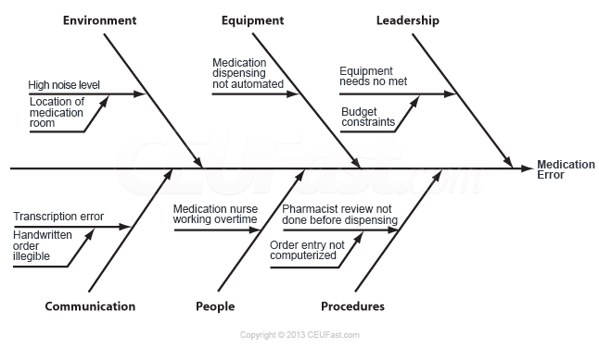
Exhibit 6.3 is a cause and effect diagram created by an improvement team charged with reducing medication error
Environment
Equipment
Leadership
Medication
Error
Communication
People
Procedures

Slide 41
PERFORMANCE IMPROVEMENT TOOLS
Performance Improvement Tools
Cause and Effect Diagrams
Improvement teams usually create a cause and effect diagram at the beginning of an improvement project to clarify the problem. They then use quantitative tools to determine the scope of the problem.
After completing the cause and effect diagram, the clinic will need to gather data to determine which of the presumed causes are in fact contributing to the problem.
These data could be displayed in bar graphs, histograms, Pareto charts, or other graphic or tabular data reports. If the data indicate several problems, the team may use qualitative tools, such as multi-voting or a decision matrix, to prioritize them.

Slide 42
PERFORMANCE IMPROVEMENT TOOLS
Performance Improvement Tools
Pareto charts, are special types of bar graphs that display the most frequent problem as the first bar, the next most frequent as the next bar, and so on; also called Pareto diagrams.
Pareto charts are similar to bar graphs, except that they sort performance data in order of decreasing frequency and include notation of other factors to highlight the Pareto Principle

Slide 43
Exhibit 4.12 Pareto Chart Showing ID Band Problems

Slide 44
PERFORMANCE IMPROVEMENT TOOLS
Performance Improvement Tools
Checksheet
Checksheets are a generic tool designed for multiple data-collection purposes. They are used to capture data measured repeatedly over time for purposes of identifying patterns, trends, defects, or causes of defects. Data collected using a checksheet can be easily converted into data performance tools such as histograms or Pareto charts.

Slide 45
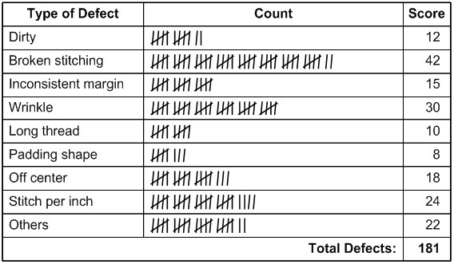
Checksheet

Slide 46
PERFORMANCE IMPROVEMENT TOOLS
Performance Improvement Tools
Decision Matrix
Improvement teams can use a decision matrix (sometimes called a selection matrix or prioritization matrix) to systematically identify, analyze, and rate the strength of relationships between sets of information.
This type of matrix is especially useful when considering a large number of decision factors and assessing each factor’s relative importance.
Teams frequently use this tool to select improvement priorities and evaluate alternative solutions.

Slide 47
PERFORMANCE IMPROVEMENT TOOLS
Performance Improvement Tools
Decision Matrix
Improvement teams can use a decision matrix (sometimes called a selection matrix or prioritization matrix) to systematically identify, analyze, and rate the strength of relationships between sets of information.
This type of matrix is especially useful when considering a large number of decision factors and assessing each factor’s relative importance.
Teams frequently use this tool to select improvement priorities and evaluate alternative solutions.

Slide 48
PERFORMANCE IMPROVEMENT TOOLS
Decision Matrix
In the case study involving Sunrise Home Health Agency in the previous chapter, the director conducted a brainstorming session to solicit ideas on how to make monthly staff meetings more valuable to staff.
Suppose the director had used a decision matrix (Exhibit 6.5) to evaluate the suggested solutions more systematically.
He would list the staff’s recommendations in the first column and list the criteria for evaluating each solution across the top of the remaining columns.
He would then ask each staff member to score the solutions according to the ranking key.
The scores are tallied, and a group average is calculated for each solution.
Solutions with the highest group average are selected for implementation.

Slide 49
Exhibit 6.5. Decision Matrix
 | Evaluation Criteria |  |  |  | Your Total | Group Average
Proposed Solution | Probability of Success | Ease of Implementation | Cost- Effectiveness | Impact on Staff Satisfaction
Hold online meetings
Start meetings on time
Create meeting agenda
Allow staff to suggest agenda items
Ranking key: 4 = excellent; 3 = very good; 2 = satisfactory; 1 = poor

Slide 50
PERFORMANCE IMPROVEMENT TOOLS
Performance Improvement Tools
Decision Matrix
Selection criteria may come from a previously prepared affinity diagram or from a brainstorming activity.
Everyone involved in the improvement initiative should have a clear and common understanding of what the criteria mean.
The selection criteria should be written in a way that makes a high score for each criterion represent a favorable result and a low score represent an unfavorable result.
If some decision criteria are more important than others, appropriate weights can be assigned to them.
The total score for each alternative is then multiplied by the weight

Slide 51
PERFORMANCE IMPROVEMENT TOOLS
Performance Improvement Tools
Five Whys
Before developing solutions, teams need to confirm that they have found the underlying causes of a performance problem.
The Five Whys tool helps an improvement team dig deeper into the causes of problems by successively asking what and why until all aspects of the situation are reviewed and the underlying contributing factors are considered.

Slide 52
PERFORMANCE IMPROVEMENT TOOLS
Performance Improvement Tools
Five Whys
Usually by the time the team has asked and answered five why questions, it will have reached the core problem. Teams often uncover multiple underlying root causes during this exercise.
Exhibit 6.6 is an illustration of the Five Whys process for a common problem— water in a sink is draining too slowly. The root cause is eventually discovered by asking why repeatedly—in this case, only four whys are necessary.

Slide 53
Exhibit 6.6. The Five Whys Process
Water in sink drains too slowly
Problem
Pipe keeps clogging
Why?
Food stuck in drain
Why?
Garbage disposal broken
Why?
Spoon jammed in disposal
Root Cause
Why?

Slide 54
PERFORMANCE IMPROVEMENT TOOLS
Performance Improvement Tools
Flowcharts
Flowcharts, sometimes referred to as process maps, are used to document the flow or sequence of events in a process or to develop an optimal new process during the solution stage of improvement.
They can be used to detect unexpected complexity, problem areas, redundancies, unnecessary steps, and opportunities for simplification.
They also help teams agree on process steps and examine activities that most influence performance.

Slide 55
PERFORMANCE IMPROVEMENT TOOLS
Performance Improvement Tools
Flowcharts
When developing a flowchart, especially in a group environment, the goal is to illustrate the process.
Do not waste time debating the best shapes to use.
A flowchart that does not use these symbols can be just as useful as a chart that does.
When designing a flowchart, write the process steps on index cards or sticky notes.
The team can then rearrange the diagram without erasing and redrawing the chart.

Slide 56
PERFORMANCE IMPROVEMENT TOOLS
Performance Improvement Tools
Flowcharts
After identifying the process adversely affecting performance, the improvement team defines the beginning and end of the process and the steps between these two points.
It then sequences the steps in the order in which they are executed.
The flowchart should illustrate the process in its current state—the way it is operating at that moment.
To test for completeness, the team may validate the flowchart with people outside the team or those who execute the process.

Slide 57
PERFORMANCE IMPROVEMENT TOOLS
Performance Improvement Tools
Flowcharts
When the team is satisfied that the chart represents the process accurately, it asks questions to locate improvement opportunities:
Can any steps be eliminated?
Can any steps be combined with others?
Can any steps be simplified?
Can delays in the process be eliminated?
Can rework loops be eliminated?
Can buildup of paperwork be minimized?
Can handoffs between people or departments be streamlined?

Slide 58
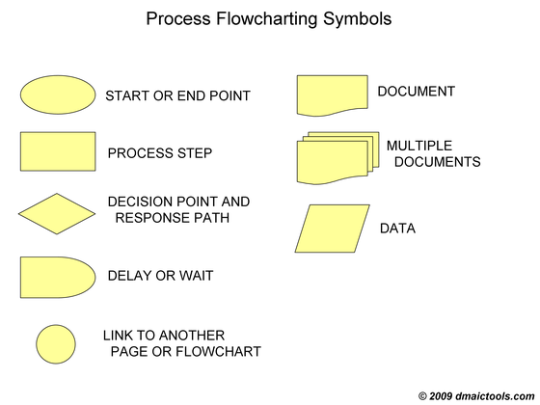
The direction or flow of the process steps

Slide 59
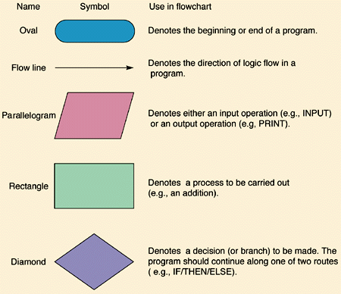
Exhibit 6.7. Standard Flowchart Symbols

Slide 60
PERFORMANCE IMPROVEMENT TOOLS
Performance Improvement Tools
Flowcharts
When the team is satisfied that the chart represents the process accurately, it asks questions to locate improvement opportunities:
Can any steps be eliminated?
Can any steps be combined with others?
Can any steps be simplified?
Can delays in the process be eliminated?
Can rework loops be eliminated?
Can buildup of paperwork be minimized?
Can handoffs between people or departments be streamlined?

Slide 61
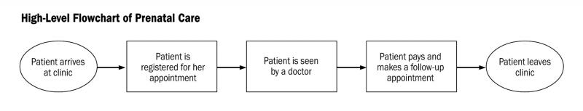
PERFORMANCE IMPROVEMENT TOOLS
High Level Flowchart
Among the different types of flowcharts, high-level, detailed, deployment, and top-down charts are most commonly used. This flowchart is considered high level because minor steps in the process have not been included.

Slide 62
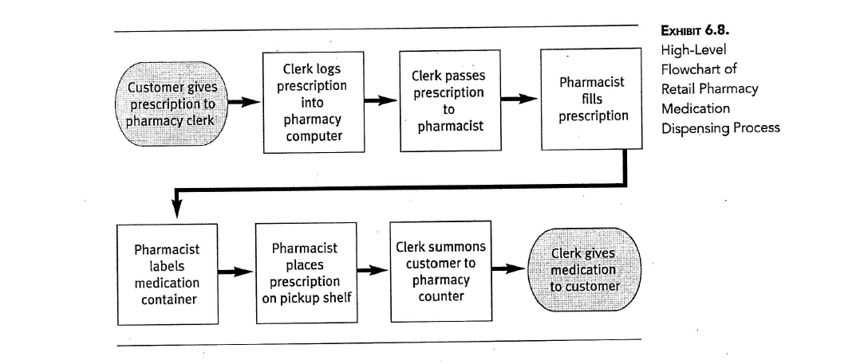
PERFORMANCE IMPROVEMENT TOOLS
High Level Flowchart

Slide 63
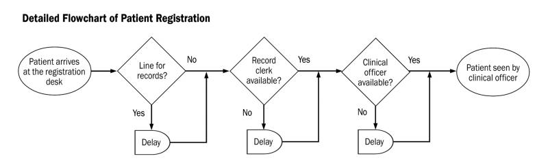
PERFORMANCE IMPROVEMENT TOOLS
Detailed Flowchart
A detailed flowchart maps all the steps and activities that occur in the process and includes decision points, waiting periods, tasks frequently redone, and feedback loops.
This type of flowchart is particularly useful when looking for problems or inefficiencies.

Slide 64
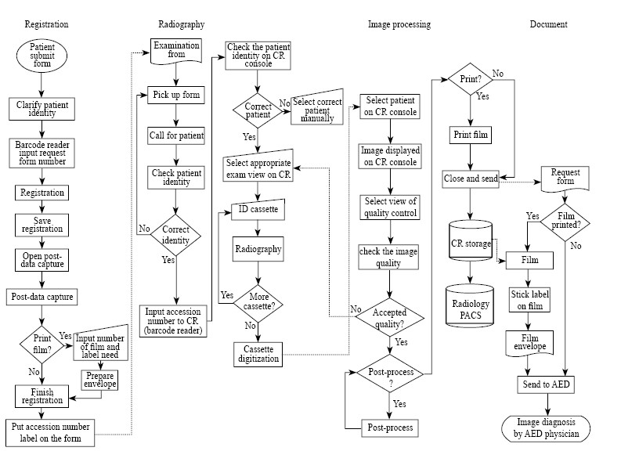

Slide 65
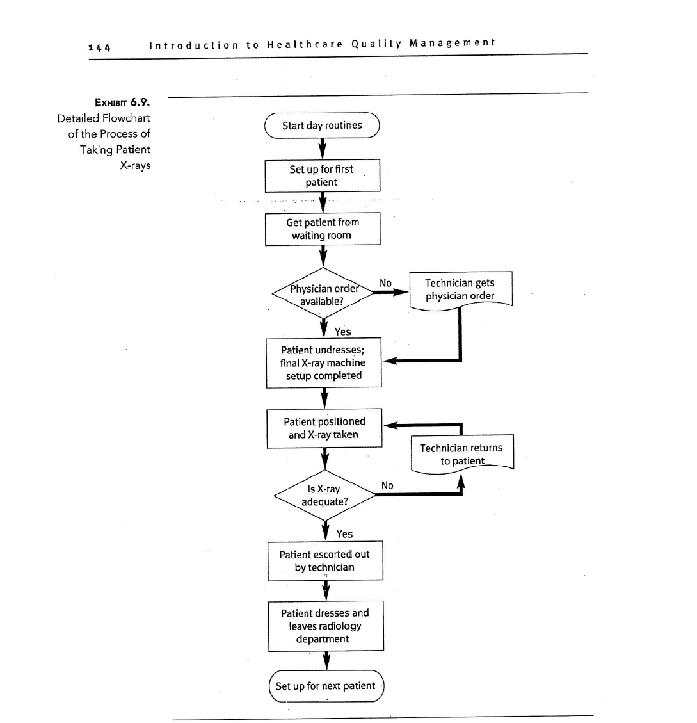
Detailed Flowchart

Slide 66
PERFORMANCE IMPROVEMENT TOOLS
Deployment Flowchart
Deployment flowchart, shows detailed process steps and the people involved in each step.
A deployment flowchart is particularly useful for mapping processes in which information or services are passed between people and groups.
It also may reveal unclear responsibilities, missing information, and unshared expectations that contribute to performance problems.

Slide 67
PERFORMANCE IMPROVEMENT TOOLS
Deployment Flowchart
Exhibit 6.10 is a deployment flowchart of an employee training process. To create this flowchart, the improvement team listed the departments involved across the top of the chart. Next, it arranged the process steps in sequence and positioned each step in the column of the department that executes the step. The process steps are connected with arrows to show where the flow lines cross from one column to the next. A handoff occurs each time the flow line crosses columns. The project team focused improvement solutions on the handoffs in the process because these transitions are prone to errors, miscommunications, and delays.

Slide 68
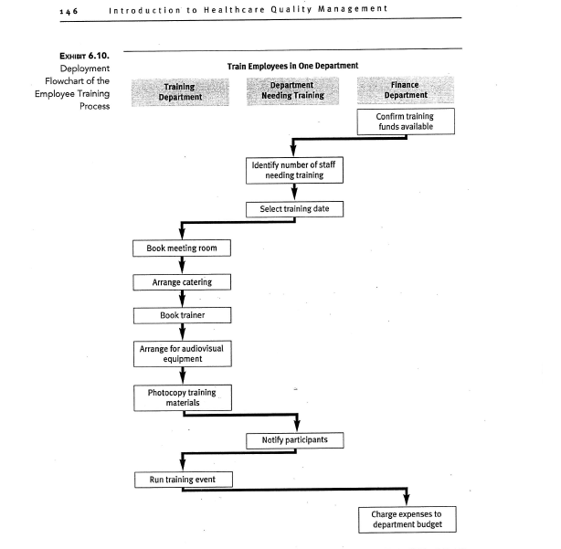
Deployment Flowchart

Slide 69
PERFORMANCE IMPROVEMENT TOOLS
Top-Down Flowchart
In a top-down flowchart, the major steps in a process are arranged sequentially across the top and the detailed steps are listed under each major step (Exhibit 6.11).
Unlike a detailed flowchart, a top-down flowchart does not include decision points or other steps that might be causing inefficiencies.
A top-down flowchart is useful for viewing the process in a systematic manner to better understand the activities involved and their interconnectedness.

Slide 70
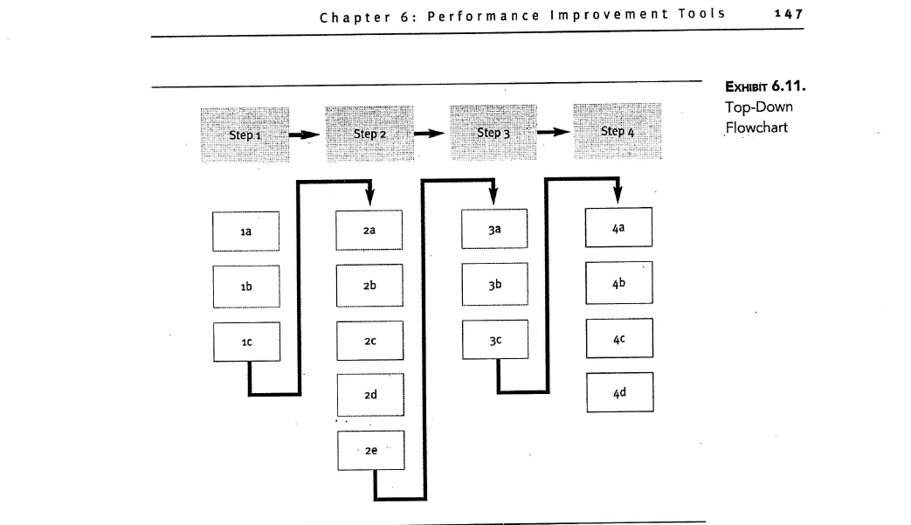
Top-Down Flowchart

Slide 71
PERFORMANCE IMPROVEMENT TOOLS
Flowchart
Each type of flowchart has its strengths and weaknesses.
To choose the best format for the project, the improvement team needs to understand the reason for creating the flowchart.
If the team is unsure about the sub-steps in the process, it should create a high-level flowchart.
When the team understands the process sub-steps and wants to better understand how the steps are carried out, it should create a detailed, deployment, or top-down flowchart.

Slide 72
PERFORMANCE IMPROVEMENT TOOLS
Workflow Diagram
A workflow diagram is a visual representation of the movement of people, materials, paperwork, or information during a process.
The diagram can also illustrate general relationships or patterns of activity among interrelated processes (e.g., all processes occurring in the radiology department).
Workflow diagrams are used to document how work is executed and to identify opportunities for improvement.

Slide 73
PERFORMANCE IMPROVEMENT TOOLS
Workflow Diagram
A common type of workflow diagram is a floor plan of a work site.
Lines are drawn on the floor plan to trace the movement of people, paper, data, and so forth, to identify redundant travel and inefficiencies.
Exhibit 6.12 is a floor plan of a hospital pharmacy department. The lines on the floor plan trace the movements of a pharmacy technician during the process of filling a prescription. To create this workflow diagram, staff from the quality department observed traffic flow in the pharmacy at 12:30 p.m. on a typical day.

Slide 74
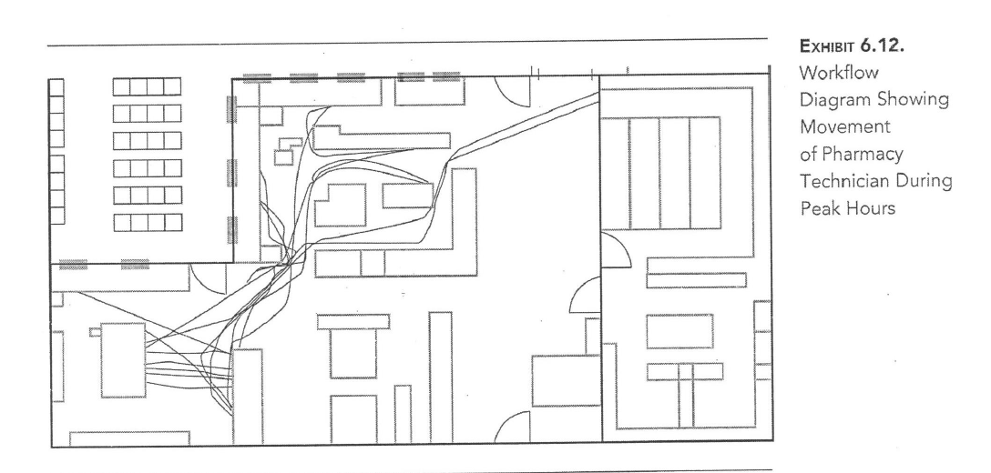
Workflow Diagram

Slide 75
PERFORMANCE IMPROVEMENT TOOLS
Surveys
Surveys are instruments used to gather data or information. The case study at the beginning of Chapter 3 described a survey used at the Redwood Health Center to gather satisfaction information from patients. This survey gathered quantitative (numeric rankings) and qualitative (comments) information. Researchers disagree as to whether surveys are a quantitative tool, a qualitative tool, or a combination of both.

Slide 76
PERFORMANCE IMPROVEMENT TOOLS
Surveys
The two types of surveys are questionnaires and interviews.
Questionnaires are usually paper or electronic instruments that the respondent completes independently.
Interviews are conducted with the respondent face-to-face or over the phone.
The interviewer is responsible for documenting the respondent’s comments.

Slide 77
PERFORMANCE IMPROVEMENT TOOLS
Surveys
Improvement teams typically use questionnaires to gather people’s perceptions of a service or process.
These perceptions are not necessarily factual.
For instance, suppose an improvement team at the Redwood Health Center wants to know how long patients wait in the reception area before they are escorted to an exam room.

Slide 78
PERFORMANCE IMPROVEMENT TOOLS
Surveys
To determine the number of minutes patients wait, the team will need to devise a system that registers the time patients arrive at the clinic and the time they are taken to an exam room.
If the center used a survey to gather wait time data, patients may over- or underestimate the time they spent in the reception area.

Slide 79
PERFORMANCE IMPROVEMENT TOOLS
Surveys
Without adequate planning, the survey results may not yield useful information. Follow the steps listed below when developing and administering surveys:
Define the survey objectives. Clearly define the purpose or intent of the survey. What are you trying to find out, and why do you need this information? Do not select more than five topics; otherwise, the survey will be too long. People may not respond to a request to complete a long survey. Keep the survey focused on high-priority questions that need to be answered to meet your objectives.

Slide 80
PERFORMANCE IMPROVEMENT TOOLS
Surveys
Identify the people to be surveyed. Whom do you need to survey to gather the information you seek? If you know what group of people you want to survey, you will be able to determine the best way to gather their responses. Will you distribute the survey at participants’ work location, or will you mail it to their home? Will you bring participants together to complete the survey, or will you have them complete it on their own time?

Slide 81
PERFORMANCE IMPROVEMENT TOOLS
Surveys
Select the survey population. Ideally, you want to ask everyone who holds an opinion about the topic to respond to the survey. If the population is small (e.g., all employees in the health information management department), you may be able to survey everyone. If you have cost or time constraints, however, you may not be able to survey everyone, especially in a large population (e.g., all nurses who work in the hospital). You may need to settle for a sample of the population, preferably a survey sample that is representative of the entire population.

Slide 82
PERFORMANCE IMPROVEMENT TOOLS
Surveys
Construct the survey. Create a concise survey that is easy to understand and interpret. Do not include questions that might threaten the respondent. Do not include leading questions (i.e., questions that encourage the respondent to answer the way you want them to), and phrase items objectively. Use common rather than obscure terms, and strive for brevity and clarity.

Slide 83
PERFORMANCE IMPROVEMENT TOOLS
Surveys
Test the survey, and prepare the final draft. Even well-designed surveys can pose problems. Improvement teams conduct pretests to identify and correct these problems. To conduct a pretest, prepare a few mock-ups of the survey and recruit volunteers to complete it. When they have finished, ask them for feedback. Did they find flaws or errors in the survey? Were the instructions and questions clear?

Slide 84
PERFORMANCE IMPROVEMENT TOOLS
Surveys
Administer the survey. If possible, have all participants complete the survey at the same time. When completion of the survey is voluntary, the team should encourage a high response rate by using a well-designed survey, offering incentives, making personal appeals, and adopting persuasive techniques. Low response rates are unlikely to produce valid, reliable feedback

Slide 85
PERFORMANCE IMPROVEMENT TOOLS
Surveys
The qualitative information gathered through questionnaires and interviews must be summarized for analysis. Often the information has to be translated into quantitative results before it can be used.

Slide 86
PERFORMANCE IMPROVEMENT TOOLS
Force Field Analysis
The purpose of force field analysis is to determine the potential support for and against (the forces) a particular plan or idea. Once these forces are identified, plans can be devised to strengthen support for the idea and reduce resistance against it. Teams typically use force field analysis during the solution phase of an improvement project but may also use it to prioritize their improvement goals.

Slide 87
PERFORMANCE IMPROVEMENT TOOLS
Force Field Analysis
Exhibit 6.15 is a force field analysis completed by an improvement project team in a children’s hospital. The goal of the project is to increase parents’ participation in the hospital’s quality improvement efforts. To achieve this goal, the team suggested that the hospital host quarterly focus groups with the parents of former patients to solicit ways to improve parent satisfaction.

Slide 88
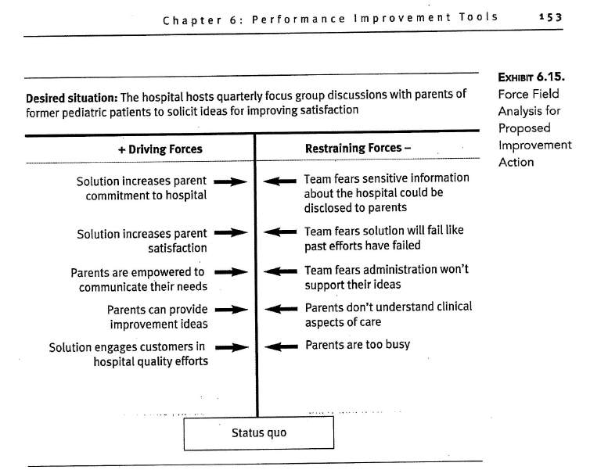
Exhibit 6.15 a force field analysis

Slide 89
PERFORMANCE IMPROVEMENT TOOLS
Stakeholder Analysis
People usually resist change. If the improvement project team does not deal with this resistance, desired performance improvements may not materialize.
Teams can use a stakeholder analysis to identify the individuals or groups that would be affected by a proposed process change.
Each stakeholder is assessed to determine who would readily accept and who would resist the process changes.

Slide 90
PERFORMANCE IMPROVEMENT TOOLS
Stakeholder Analysis
Stakeholders can be grouped into four main categories: allies, associates, enemies, and opponents.
Not all stakeholders are equal; some have more influence on the outcome of the improvement plan than others.
All of these factors are considered in a stakeholder analysis.
Exhibit 6.16, is an example of Stakeholder Analysis of Proposed Radiology Process Change.

Slide 91
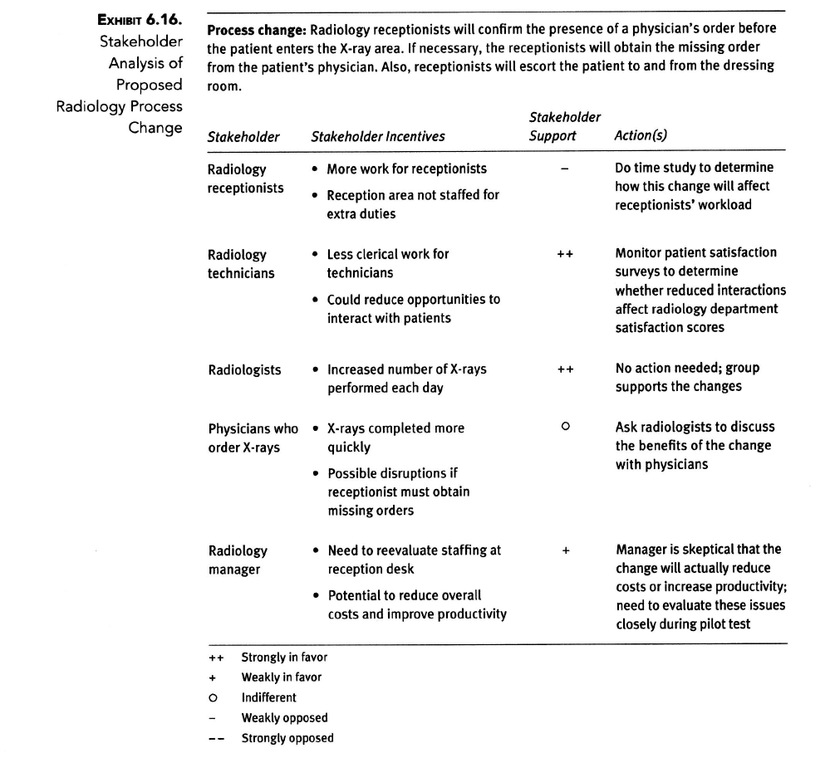

Slide 92
PERFORMANCE IMPROVEMENT TOOLS
Planning Matrix
A planning matrix is a diagram that shows the tasks needed to complete an activity, the people or groups responsible for completing the tasks, and an activity schedule with deadlines for task completion.
A Gantt chart is a graphic planning matrix that displays project activities as bars measured against a horizontal time scale. Most electronic spreadsheet programs have templates for creating Gantt charts.

Slide 93
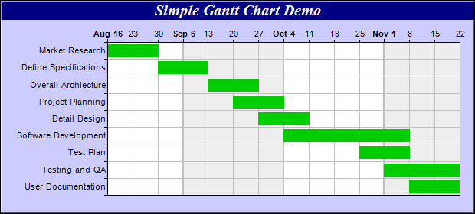
Gantt chart

Slide 94
PERFORMANCE IMPROVEMENT TOOLS
Quality Storyboard
The series of events involved in a quality improvement project can be summarized in a report called a quality storyboard.
Quality Storyboards are made up of a series of words and pictures that illustrate an improvement project from start to finish.

Slide 95
PERFORMANCE IMPROVEMENT TOOLS
Quality Storyboard
Quality storyboards communicate more information and clues about intentionality through graphs and pictures than through words. Someone unfamiliar with the improvement project should be able to determine what was done and why, by following the logic of the storyboards’ graphical displays, data analyses, and conclusions.

Slide 96
PERFORMANCE IMPROVEMENT TOOLS
Quality Storyboard
Teams usually create quality storyboards at the end of an improvement project for communication purposes, but some teams use them throughout their projects as a visual record of their progress.
Quality storyboards also keep team members focused on the project goal.

Slide 97
PERFORMANCE IMPROVEMENT TOOLS
Quality Storyboard
If you are using any of the analytic tools—flowcharts, cause and effect diagrams, matrixes, graphs—discussed in this chapter, include them on the storyboard as well.
Performance measures, data collection forms, and graphs displaying the results are also useful inclusions.
After implementing and evaluating your solution, condense the information on the storyboard and use it to communicate the improvement project story to the rest of the organization.

Slide 98
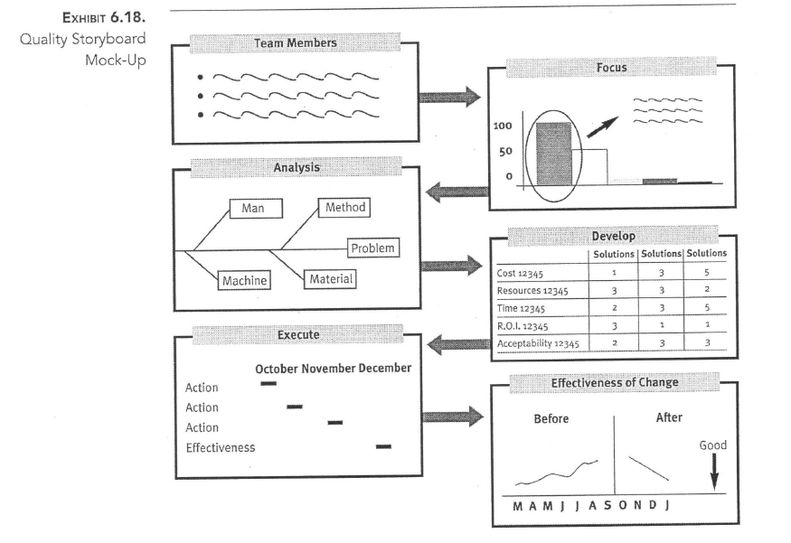
Quality Storyboard

Slide 99
THANK YOU

