Slide 1
Overview of the financial system
Chapter 2

Slide 2
An Overview of the Financial System
Primary Function of the Financial System is Financial Intermediation

Slide 3
Function of Financial Markets
Channels funds from person or business without investment opportunities (i.e., “Lender-Savers”) to one who has them (i.e., “Borrower-Spenders”)
Improves economic efficiency
Critical for producing an efficient allocation of capital, which contributes to higher production and efficiency of overall economy

Slide 4
Function of Financial Markets
Well-functioning markets improve the well being of consumers by allowing them to time their purchases better

Slide 5
Financial Markets Funds Transferees
Lender-Savers
Households
Business firms
Government
Foreigners
Borrower-Spenders
Business firms
Government
Households
Foreigners

Slide 6
Methods of funds transfer
1. Direct financing
2. Indirect financing

Slide 7
Direct financing
Borrowers borrow directly from lenders in financial markets by selling financial instruments which are claims on the borrower’s future income or assets

Slide 8
Direct finance
Securities are assets for the person who buys them
They are liabilities for the individual or firm that issues them

Slide 9
Indirect finance
Borrowers borrow indirectly from lenders via financial intermediaries (established to source both loanable funds and loan opportunities) by issuing financial instruments which are claims on the borrower’s future income or assets

Slide 10
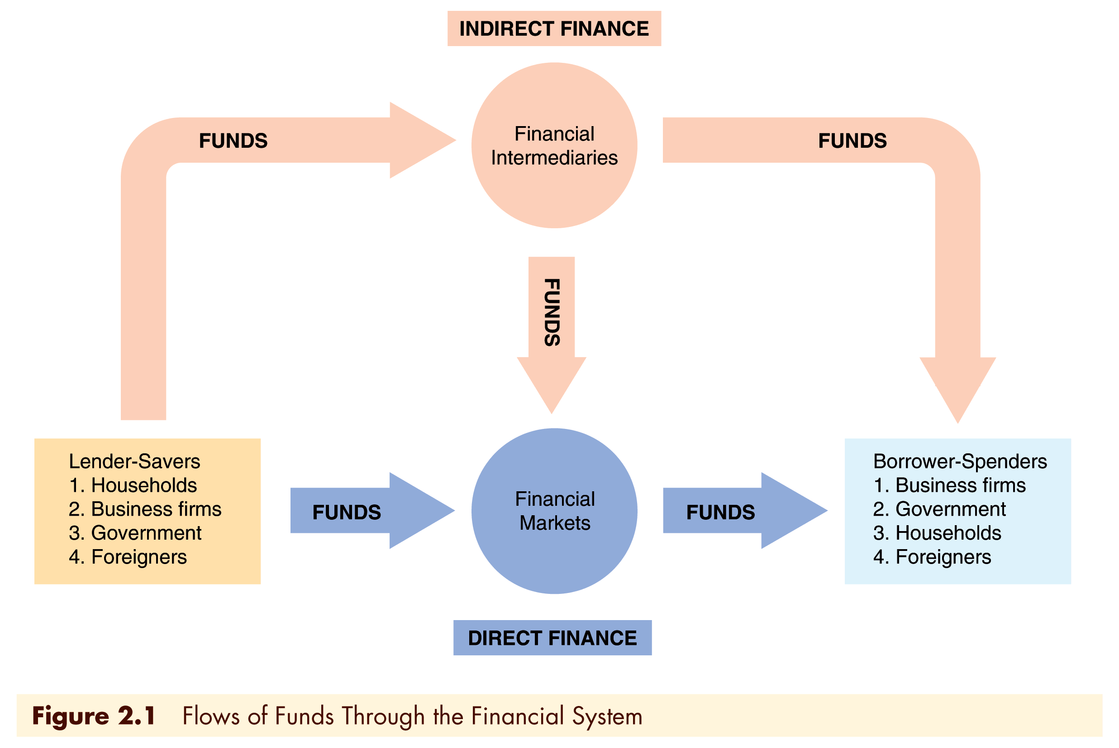
Function of Financial Markets

Slide 11
Importance of Financial Markets
This is important. For example, if you save $1,000, but there are no financial markets, then you can earn no return on this—might as well put the money under your mattress.
However, if a carpenter could use that money to buy a new saw (increasing her productivity), then she’d be willing to pay you some interest for the use of the funds.

Slide 12
Importance of Financial Markets
Financial markets are critical for producing an efficient allocation of capital, allowing funds to move from people who lack productive investment opportunities to people who have them.
Financial markets also improve the well-being of consumers, allowing them to time their purchases better.

Slide 13
Classifications of Financial Markets
Debt Markets
Short-term (maturity < 1 year) – the Money Market
Long-term (maturity > 10 year) – the Capital Market
Medium-term (maturity >1 and < 10 years)

Slide 14
Debt instrument
A contractual agreement by the borrower to pay the holder of the instrument fixed dollar amounts at regular intervals until a specified date (the maturity date) when a final payment is made.

Slide 15
Common stock
Claims to share in the net income and the assets of the business
Often make periodic payments called dividends
Long-term as no maturity date
Residual claimant

Slide 16
Classification of financial markets
1. Primary market
2. Secondary market

Slide 17
Primary market
New security, bond or stock, issues sold to initial buyers by the corporation or government agency borrowing funds
Financial institution that facilitates is investment bank
Does underwriting securities
Guarantees a price for the corporation’s securities and then sells them to the public

Slide 18
Secondary market
Securities previously issued are bought and sold

Slide 19
Secondary markets
Even though firms don’t get any money, per se, from the secondary market, it serves two important functions:
Provide liquidity, making it easy to buy and sell the securities of the companies
Establish a price for the securities

Slide 20
Secondary markets – Organization of exchanges
Organize exchanges where buyers and sellers of securities (or their brokers or agents) meet in one central location to conduct trades
Over the counter market: Dealers at different locations who have an inventory of securities stand ready to buy and sell securities over the counter

Slide 21
Secondary markets
Security brokers and dealers are crucial to well functioning secondary markets
Brokers are agents of investors who match buyers with sellers of securities
Dealers link buyers and sellers by buying and selling securities at stated prices

Slide 22
Money and capital markets
Another way of distinction:
Money market: financial market in which only short-term debt instruments with maturity of one year or less are traded
Capital market: market in which debt instruments with a maturity of more than one year and equity instruments are traded

Slide 23
Function of Financial Intermediaries: Indirect Finance
Instead of savers lending/investing directly with borrowers, a financial intermediary (such as a bank) plays as the middleman:
the intermediary obtains funds from savers
the intermediary then makes loans/investments with borrowers

Slide 24
Function of Financial Intermediaries: Indirect Finance
This process, called financial intermediation, is actually the primary means of moving funds from lenders to borrowers.
More important source of finance than securities markets (such as stocks)
Needed because of transactions costs, risk sharing, and asymmetric information

Slide 25
Transaction costs
Financial intermediaries make profits by reducing transactions costs
Reduce transactions costs by developing expertise and taking advantage of economies of scale
Provide liquidity services

Slide 26
Transaction costs
A financial intermediary’s low transaction costs mean that it can provide its customers with liquidity services
Banks provide depositors with checking accounts that enable them to pay their bills easily
Depositors can earn interest on checking and savings accounts and yet still convert them into goods and services whenever necessary

Slide 27
Risk sharing
FI’s low transaction costs allow them to reduce the exposure of investors to risk, through a process known as risk sharing
FIs create and sell assets with lesser risk to one party in order to buy assets with greater risk from another party
This process is referred to as asset transformation, because in a sense risky assets are turned into safer assets for investors

Slide 28
Risk sharing
Financial intermediaries also help by providing the means for individuals and businesses to diversify their asset holdings.
Low transaction costs allow them to buy a range of assets, pool them, and then sell rights to the diversified pool to individuals.

Slide 29
Function of Financial Intermediaries: Indirect Finance
Another reason FIs exist is to reduce the impact of asymmetric information.
One party lacks crucial information about another party, impacting decision-making.
We usually discuss this problem along two fronts: adverse selection and moral hazard.

Slide 30
Function of Financial Intermediaries: Indirect Finance
Adverse Selection
Before transaction occurs
Potential borrowers most likely to produce adverse outcome are ones most likely to seek a loan
Similar problems occur with insurance where unhealthy people want their known medical problems covered

Slide 31
Asymmetric Information: Adverse Selection and Moral Hazard
Moral Hazard
After transaction occurs
Hazard that borrower has incentives to engage in undesirable (immoral) activities making it more likely that won’t pay loan back
Again, with insurance, people may engage in risky activities only after being insured
Another view is a conflict of interest

Slide 32
Asymmetric Information: Adverse Selection and Moral Hazard
Financial intermediaries reduce adverse selection and moral hazard problems, enabling them to make profits.
Because of their expertise in screening and monitoring, they minimize their losses, earning a higher return on lending and paying higher yields to savers.

Slide 33
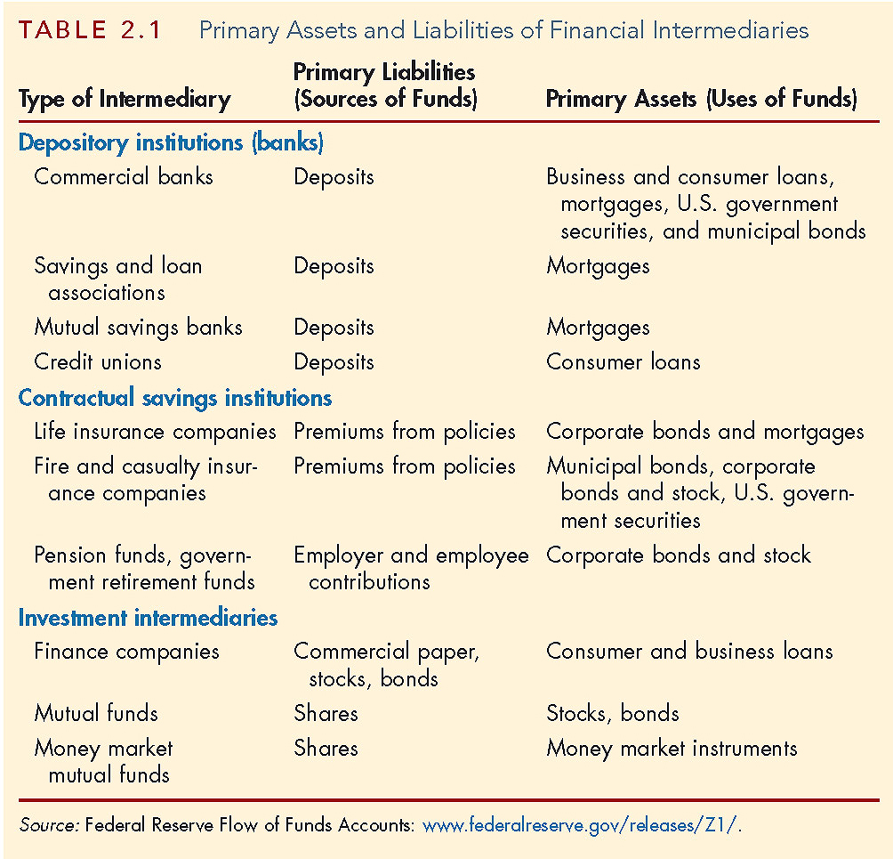
Types of Financial Intermediaries
Notes:
Depository Institutions (Banks): accept deposits and make loans. These include commercial banks and thrifts.
Commercial banks (7,500 currently)
Raise funds primarily by issuing checkable, savings, and time deposits which are used to make commercial, consumer and mortgage loans
Collectively, these banks comprise the largest financial intermediary and have the most diversified asset portfolios
S&Ls, Mutual Savings Banks and Credit Unions
Raise funds primarily by issuing savings, time, and checkable deposits which are most often used to make mortgage and consumer loans, with commercial loans also becoming more prevalent at S&Ls and Mutual Savings Banks
Mutual savings banks and credit unions issue deposits as shares and are owned collectively by their depositors, most of which at credit unions belong to a particular group, e.g., a company’s workers
Thrifts: S&Ls, Mutual Savings Banks (1,500) and Credit Unions (8,900)
Raise funds primarily by issuing savings, time, and checkable deposits which are most often used to make mortgage and consumer loans, with commercial loans also becoming more prevalent at S&Ls and Mutual Savings Banks
Mutual savings banks and credit unions issue deposits as shares and are owned collectively by their depositors, most of which at credit unions belong to a particular group, e.g., a company’s workers
All CSIs acquire funds from clients at periodic intervals on a contractual basis and have fairly predictable future payout requirements.
Life Insurance Companies receive funds from policy premiums, can invest in less liquid corporate securities and mortgages, since actual benefit pay outs are close to those predicted by actuarial analysis
Fire and Casualty Insurance Companies receive funds from policy premiums, must invest most in liquid government and corporate securities, since loss events are harder to predict
Pension and Government Retirement Funds hosted by corporations and state and local governments acquire funds through employee and employer payroll contributions, invest in corporate securities, and provide retirement income via annuities
Finance Companies sell commercial paper (a short-term debt instrument) and issue bonds and stocks to raise funds to lend to consumers to buy durable goods, and to small businesses for operations
Money Market Mutual Funds acquire funds by selling checkable deposit-like shares to individual investors and use the proceeds to purchase highly liquid and safe short-term money market instruments
Investment Banks advise companies on securities to issue, underwriting security offerings, offer M&A assistance, and act as dealers in security markets.

Slide 34
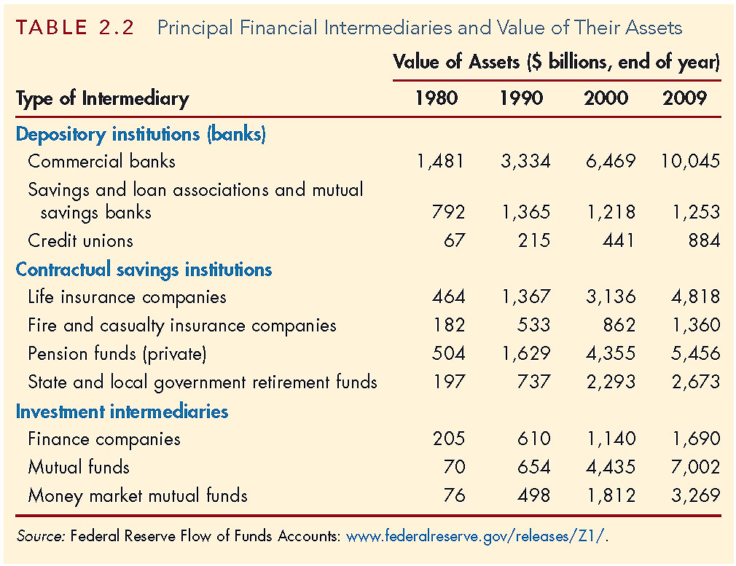
Types of Financial Intermediaries
Notes:
Commercial banks
Raise funds primarily by issuing checkable, savings, and time deposits which are used to make commercial, consumer and mortgage loans
Collectively, these banks comprise the largest financial intermediary and have the most diversified asset portfolios
S&Ls, Mutual Savings Banks and Credit Unions
Raise funds primarily by issuing savings, time, and checkable deposits which are most often used to make mortgage and consumer loans, with commercial loans also becoming more prevalent at S&Ls and Mutual Savings Banks
Mutual savings banks and credit unions issue deposits as shares and are owned collectively by their depositors, most of which at credit unions belong to a particular group, e.g., a company’s workers
All CSIs acquire funds from clients at periodic intervals on a contractual basis and have fairly predictable future payout requirements.
Life Insurance Companies receive funds from policy premiums, can invest in less liquid corporate securities and mortgages, since actual benefit pay outs are close to those predicted by actuarial analysis
Fire and Casualty Insurance Companies receive funds from policy premiums, must invest most in liquid government and corporate securities, since loss events are harder to predict
Pension and Government Retirement Funds hosted by corporations and state and local governments acquire funds through employee and employer payroll contributions, invest in corporate securities, and provide retirement income via annuities
Finance Companies sell commercial paper (a short-term debt instrument) and issue bonds and stocks to raise funds to lend to consumers to buy durable goods, and to small businesses for operations
Mutual Funds acquire funds by selling shares to individual investors (many of whose shares are held in retirement accounts) and use the proceeds to purchase large, diversified portfolios of stocks and bonds
Money Market Mutual Funds acquire funds by selling checkable deposit-like shares to individual investors and use the proceeds to purchase highly liquid and safe short-term money market instruments

Slide 35
Regulation of Financial Markets
Main Reasons for Regulation
Increase Information to Investors
Decreases adverse selection and moral hazard problems
SEC forces corporations to disclose information
Ensuring the Soundness of Financial Intermediaries
Prevents financial panics
Chartering, reporting requirements, restrictions on assets and activities, deposit insurance, and anti-competitive measures
Improving Monetary Control
Reserve requirements
Deposit insurance to prevent bank panics

Slide 36
Regulation Reason: Increase Investor Information
Asymmetric information in financial markets means that investors may be subject to adverse selection and moral hazard problems that may hinder the efficient operation of financial markets and may also keep investors away from financial markets
Regulation takes care of this aspect

Slide 37
Regulation Reason: Increase Investor Information
Such government regulation can reduce adverse selection and moral hazard problems in financial markets and increase their efficiency by increasing the amount of information available to investors.

Slide 38
Regulation Reason: Ensure Soundness of Financial Intermediaries
Asymmetric information makes it difficult to evaluate whether the financial intermediaries are sound or not.
Can result in panics, bank runs, and failure of intermediaries.

Slide 39
Regulation Reason: Ensure Soundness of Financial Intermediaries (cont.)
To protect the public and the economy from financial panics, the government has implemented six types of regulations:
Restrictions on Entry
Disclosure
Restrictions on Assets and Activities
Deposit Insurance
Limits on Competition
Restrictions on Interest Rates

Slide 40
Regulation: Restriction on Entry
Restrictions on Entry
Regulators have created very tight regulations as to who is allowed to set up a financial intermediary
Individuals or groups that want to establish a financial intermediary, such as a bank or an insurance company, must obtain a charter from the state or the federal government
Only if they are upstanding citizens with impeccable credentials and a large amount of initial funds will they be given a charter.

Slide 41
Regulation: Disclosure
Disclosure Requirements
There are stringent reporting requirements for financial intermediaries
Their bookkeeping must follow certain strict principles,
Their books are subject to periodic inspection,
They must make certain information available to the public.

Slide 42
Regulation: Restriction on Assets and Activities
Restrictions on the activities and assets of intermediaries helps to ensure depositors that their funds are safe and that the bank or other financial intermediary will be able to meet its obligations.
Intermediary are restricted from certain risky activities
And from holding certain risky assets, or at least from holding a greater quantity of these risky assets than is prudent

Slide 43
Regulation: Deposit Insurance
The government can insure people depositors to a financial intermediary from any financial loss if the financial intermediary should fail
The Federal Deposit Insurance Corporation (FDIC) insures each depositor at a commercial bank or mutual savings bank up to a loss of $250,000 per account.

Slide 44
Regulation: Limits on Competition
Although the evidence that unbridled competition among financial intermediaries promotes failures that will harm the public is extremely weak, it has not stopped the state and federal governments from imposing many restrictive regulations
In the past, banks were not allowed to open up branches in other states, and in some states banks were restricted from opening additional locations

Slide 45
Regulation: Restrictions on Interest Rates
Competition has also been inhibited by regulations that impose restrictions on interest rates that can be paid on deposits
These regulations were instituted because of the widespread belief that unrestricted interest-rate competition helped encourage bank failures during the Great Depression
Later evidence does not seem to support this view, and restrictions on interest rates have been abolished

Slide 46
Regulation Reason: Improve Monetary Control
Because banks play a very important role in determining the supply of money (which in turn affects many aspects of the economy), much regulation of these financial intermediaries is intended to improve control over the money supply
One such regulation is reserve requirements, which make it obligatory for all depository institutions to keep a certain fraction of their deposits in accounts with the Federal Reserve System (the Fed), the central bank in the United States
Reserve requirements help the Fed exercise more precise control over the money supply

