Slide 1
Introduction To Number Systems
Octal System

Slide 2
Octal System
The octal, or base 8, number system is a common system used with computers.
Because of its relationship with the binary system, it is useful in programming some types of computers.
Octal is fancy for Base Eight meaning eight symbols are used to represent all the quantities. They are 0, 1, 2, 3, 4, 5, 6, and 7.

Slide 3
Octal to decimal conversion
An octal number can be converted to decimal by forming the sum of powers of 8 of the coefficients.
Example1
Convert 764₈ to decimal:
Solution
764 = 7x8²+ 6x8¹+4x8⁰ = 448+48+4 = 500₁₀
Example
65₈= 6x8 +5=53₁₀
Example 2
Convert 0.2358 to decimal:
Solution:
0.235₈=2x8⁻¹ + 3x8⁻² + 5x8⁻³
= 2x0.125 + 3x8⁻² + 5x8⁻³
= 0.30664

Slide 4
Decimal to octal conversion
To convert a decimal fraction to octal, multiply by 8; the integer part of the result is the first digit of the octal fraction. Repeat the process with the fractional part of the result, until it is null or within acceptable error bounds.

Slide 5
Conversion of decimal fraction to octal fraction
Example3:
Convert 0.1640625 to octal:
0.1640625x8= 1.3125 =0.3125 + 1
0.3125 x8= 2.5=0.5+ 2
0.5x8 = 4= 4
Therefore, 0.1640625₁₀ = 0.124₈.
Example4:
convert (0.523)₁₀ to octal equivalent up to 3 decimal places.
Solution
0.523 x 8 = 4.184, its integer part is 4
0.184 x 8 = 1.472, its integer part is 1
0.472 x 8 = 3.776, its integer part is 3
So the answer is (0.413..)₈

Slide 6
Conversion of decimal to octal ( base 10 to base 8)
To convert from a base-10 integer numeral to its base-2 (binary) equivalent, the number is divided by two, and the remainder is the least-significant bit. The (integer) result is again divided by two, its remainder is the next least significant bit. This process repeats until the quotient becomes zero.
Example5:
convert (177)₁₀ to octal equivalent
177 / 8 = 22 remainder is 1
22 / 8 = 2 remainder is 6
2 / 8 = 0 remainder is 2
Answer = 261
Note: the answer is read from bottom to top as (261)₈, the same as with the binary case.

Slide 7
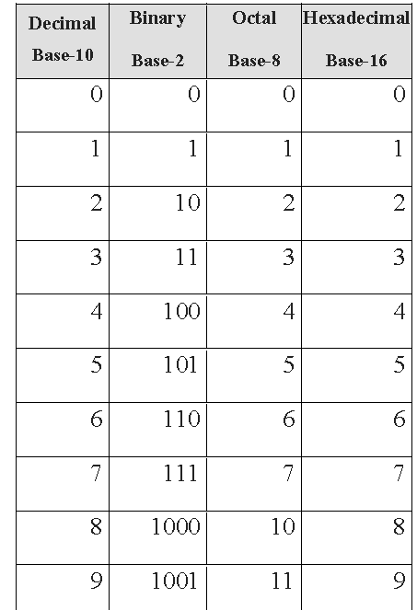
Octal to binary conversion
To convert octal to binary, replace each octal digit by its binary representation in 3 bits, so add zeros to the left if necessary.
Example 6:
Convert 51₈ to binary:
Solution
5₈= 101
1₈=001
Therefore, 51₈ = 101 001₂.

Slide 8
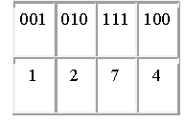
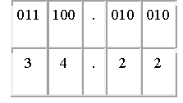
Binary to Octal conversion
In order to convert the Binary number into its equivalent octal numbers, split the given binary number into groups and each group should contain three binary bits (because 2³=8), add zeros to the left if necessary, and then converting each group into its equivalent octal number.
Example 7:
convert binary 1010111100 to octal.
Solution:
1010111100₂ = 1274₈.
Example 7:
Convert binary 11100.01001 to octal:
Solution:
11100.01001₂ = 34.22₈.

Slide 9
Arithmetic in octal system

Slide 10
Octal Addition
Addition of the octal number is carried out in the same way as the decimal addition is performed. The steps are given below:
1. First, add the two digits of the unit column of the octal number in decimal.
2. This process is repeated for each larger significant digit of the octal number.
3. During the process of addition, if the sum is less than or equal to 7, then it can be directly written as an octal digit.
4. If the sum is greater than 7, then subtract 8 from the digit and carry 1 to the next digit position.
5. Note that in this addition the largest octal digit is 7.

Slide 11
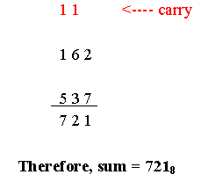
Example 8:
Evaluate:
(162)₈ + (537)₈
Solution:

Slide 12
(ii) (136) ₈ + (636) ₈
Solution:

Slide 13
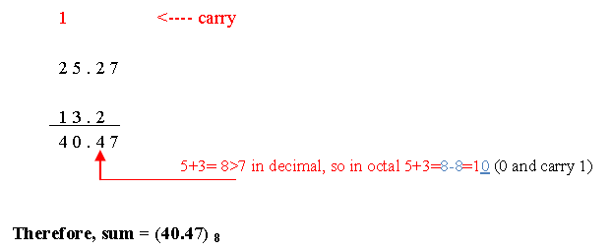
(iii) (25.27)₈ + (13.2)₈
Solution:

Slide 14
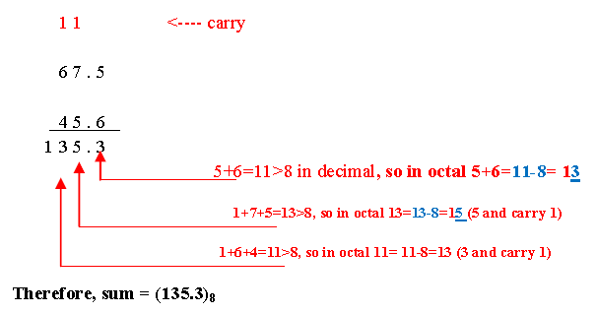
(iv) (67.5)₈ + (45.6)₈
Solution:

Slide 15
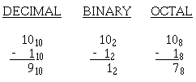
Subtraction of Octal Numbers
The subtraction of octal numbers follows the same rules as the subtraction of numbers in any other number system. The only variation is in the quantity of the borrow.
In the decimal system, you had to borrow a group of 10₁₀.
In the binary system, you borrowed a group of 2₁₀.
In the octal system you will borrow a group of 8₁₀.

Slide 16
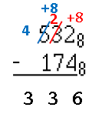
Example 9
Subtract 532₈-174₈
Solution:
Steps:
1. Since 2<4 then borrow 1 from 3 and add 8 to 2.
2. 2+8=10 in decimal so 10-4=6.
3. In the second column we have 2 after borrowing but 2<7, so we need to borrow 1 from 5 and add 8 to 2.
4. 2+8 = 10, 10-7=3
5. We have 4 after borrowing so we have 4-1=3.

Slide 17
Homework
All Exercises Page 18

