Slide 1
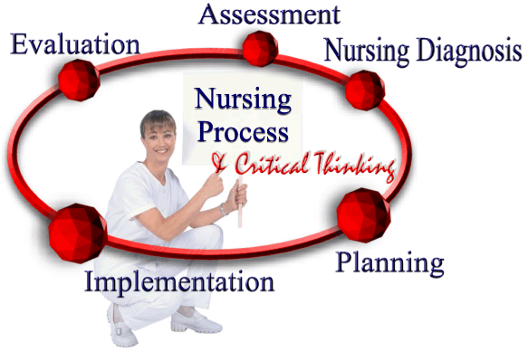
Nursing Process in psychiatric Nursing care
BY: Nada AL-Attar

Slide 2

Learning Objectives
At the end of this cession the students will be able to:
1- Define the most important terms in the nursing process.
2- List and demonstrates the steps of the nursing process.
3- Illustrate each step of nursing process.
4- Explain nursing care plan with examples.

Slide 3
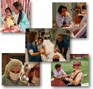
outlines
Introduction
Key terms (terminology) in nursing process.
Steps or Standards of nursing process.
Assessment
Diagnosis
Planning
Implementation &
Evaluation
examples for nursing care plan.
summary. &
Reference.

Slide 4

Introduction
The time tested nursing process continues to guide nurses in clinical practice and
The nurse-patient relationship is the vehicle for applying the nursing process
Nursing process in theory: is a multistep problem solving method in which client problems and needs are assessed ,diagnosed ,treated and resolved.
Nursing process in practice: is amore cyclic approach du to the client's changing responses to health and illness.
N.B: the client's condition is dynamic rather than static, the nurse uses the steps of the nursing process interchangeably and continuously.

Slide 5

Key terms (terminology)
Nursing care plan :
It is a set of actions the nurse will implemented to resolve nursing problem identified by assessment . the creation of the plan is an intermediate stage of the nursing process.
nursing process in psychiatric care:
The nursing process is a process by which nurses deliver care to the psychiatric patients to improve or solve their mental problems.
NANDA:NANDA diagnosis were first developed in1973
NANDA : North American Nursing Diagnosis Association ,
NANDA is the main organization for defining standard diagnosis in north America , now known as NANDA- international.

Slide 6
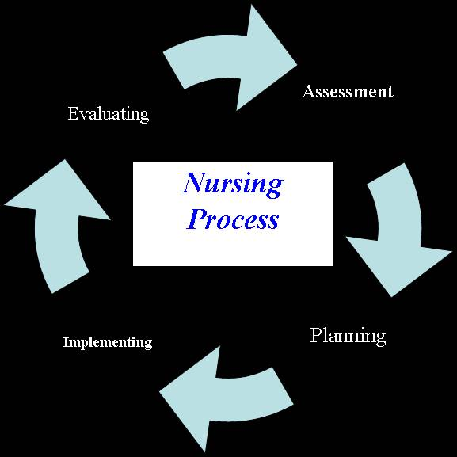

Steps or standards of Nursing process
1- Assessment.
2- Nursing Diagnosis.
3- Outcome Identification.
4- Planning.
5- Implementation
6- Evaluation.

Slide 7
ASSESSMENT
In this phase ,information is obtained from the patient in a direct and structured or indirect manner through observation of verbal and nonverbal behaviors based on the knowledge of normal and dysfunctional behaviors, interviews and examination,
The Assessment may be: subjective or objective.
Subjective assessment: when psychiatric nurse collecting data by herself directly from the patient
Objective assessment: psychiatric nurse can use other information sources ,or from patient’s family rather than patient.
The mental status examination: is the psychiatric-mental health component of client assessment, it is the basic for medical and nursing diagnosis and management of client care.

Slide 8
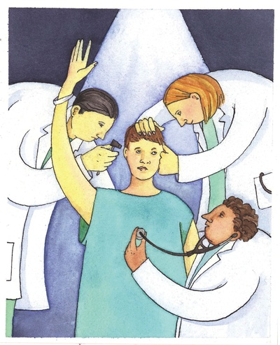
Components of psychiatric Nursing assessment
Components of total client assessment= mental status examination criteria:-
Mental status examination :
Appearance ⇒ dress , hygiene , grooming, facial expression.
Behavior \ activity ⇒ hypo-activity or hyper-activity.
Attitude ⇒ interactions with interviewer.
Speech ⇒ quantity (poverty of speech)
⇒ quality ( monotonous, talkative, repetitious)
Mood and affect ⇒ sad, fearful, anxious.
Perceptions ⇒ hallucinations, illusions.
Thoughts ⇒ flight of ideas , blocking , word salad.
Sensorium\ cognition ⇒ Levels of consciousness, concentration
Judgment ⇒ take responsibility for action, make rational , decision making.
Insight ⇒ ability to understand the cause and nature of own and others situations.
Reliability ⇒ reported information accurately and completely.

Slide 9
ASSESSMENT
Interview=Participant observation
Nursing role in participant observation:
To maintain massages conveyed by the patient
Be aware of her response to the patient
She should be prepared to consult with members or other people knowledgeable about the patient
The nurse also might using other information sources including : the patient's health care record t reports ,nursing care plan, nursing rounds, change of shift reports

Slide 10
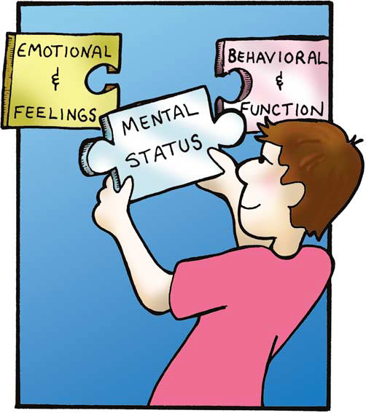

Slide 11

Nursing diagnosis
Nursing diagnosis: is a process whereby nurses interpret data collected during the assessment phase of the nursing process and apply standardized labels to clients' health problems and responses to illness
Nursing diagnosis are statements that describe an individual's health state or alteration in person's life processes.

Slide 12

Components of the nursing diagnosis
PES
Three distinct components of an actual nursing diagnosis statement are:
problem
Etiology &
Signs & symptoms
This format known as the PES format

Slide 13
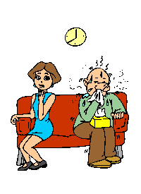
Components of the nursing diagnosis
PES
P=Problem
Its come from the list of approved NANDA nursing diagnosis such as ineffective coping or, Disturbed thought processes
Some N.diagnosis require qualifying statements based on the nature of the problems.

Slide 14
Example of nanda diagnosis & qualifying assessment
NANDA Diagnosis | Qualifying statement
Imbalanced nutrition | Less than body requirements
Self care deficit | Bathing, dressing/grooming, feeding(total)
noncompliance | Medication, milieu activities
Deficient knowledge | Medications, treatment

Slide 15
Components of the nursing diagnosis
PES
E=etiology
known as related factors or contributing factors considered to be the cause of the problem nursing diagnoses
often accompanied by several etiologic factors these factors may by psycho logic biologic relational environmental situational developmental or socio cultural ,For example:
altered thought process related to psychosocial stressors
Altered thought process as a result of the schizophrenic process.

Slide 16

Components of the nursing diagnosis
PES
S=signs and symptoms
Is the observable , measurable manifestations of client, Also known as defining characteristics
often require more specific descriptions to better represent the needs of the client being diagnosed . Ineffective coping has Ineffective problem solving
Example: Believes the others are planning to kill or harm her. (delusion of persecution)

Slide 17
The Complete list of NANDA Nursing Diagnosis for 2012-2014
Below is the list of the 16 new NANDA Nursing Diagnoses
Risk for Ineffective Activity Planning
Risk for Adverse Reaction to Iodinated Contrast Media
Risk for Allergy Response
Insufficient Breast Milk
Ineffective Childbearing Process
Risk for Ineffective Child Bearing Process
Risk for Dry Eye
Deficient Community Health
Ineffective Impulse Control
Risk for Neonatal Jaundice
Risk for Disturbed Personal Identity
Ineffective Relationship
Risk for Ienffective Relationship
Risk for Chronic Low Self-Esteem
Risk for Thermal Injury
Risk for Ineffective Peripheral Tissue Perfusion
Domain 4 Activity/ Rest
  Insomnia
  Sleep deprivation
  Readiness for enhanced sleep
  Disturbed sleep pattern
  Risk for disuse syndrome
  Impaired bed mobility
  Impaired physical mobility
  Impaired wheelchair mobility
  Impaired transfer ability
  Impaired walking
  Disturbed energy field
  Fatigue
  Wandering
  Activity intolerance
  Risk for activity intolerance
  Ineffective breathing pattern
  Decreased cardiac output
  Risk for ineffective gastrointestinal perfusion
  Risk for ineffective renal perfusion
  Impaired spontaneous ventilation
  Ineffective peripheral tissue perfusion
  Risk for decreased cardiac tissue perfusion
  Risk for ineffective cerebral tissue perfusion
  Risk for ineffective peripheral tissue perfusion
  Dysfunctional ventilatory weaning response
  Impaired home maintenance
  Readiness for enhanced self-care
  Bathing self-care deficit
  Dressing self-care deficit
  Feeding self-care deficit
  Toileting self-care deficit
  Self-neglect
  Risk-prone health behavior
  Ineffective health maintenance
  Readiness for enhanced immunization status
  Ineffective protection
  Ineffective self-health management
  Readiness for enhanced self-health management
  Ineffective family therapeutic regimen management
Domain 2 Nutrition
  Insufficient breast milk
  Ineffective infant feeding pattern
  Imbalanced nutrition: less than body requirements
  Imbalanced nutrition: more than body requirements
  Risk for imbalanced nutrition: more than body requirements
  Readiness for enhanced nutrition
  Impaired swallowing
  Risk for unstable blood glucose level
  Neonatal jaundice
  Risk for neonatal jaundice
  Risk for impaired liver function
  Risk for electrolyte imbalance
  Readiness for enhanced fluid balance
  Deficient fluid volume
  Excess fluid volume
  Risk for deficient fluid volume
  Risk for imbalanced fluid volume
Domain 1 Health Promotion
  Deficient diversional activity
  Sedentary lifestyle
  Deficient community health

Slide 18
o Disorganized infant behavior
o Readiness for enhanced organized infant behavior
o Decreased intracranial adaptive capacity
Domain 7 Role Relationships
o Ineffective breastfeeding
o Interrupted breastfeeding
o Readiness for enhanced breastfeeding
o Caregiver role strain
o Risk for caregiver role strain
o Impaired parenting
o Readiness for enhanced parenting
o Risk for impaired parenting
o Risk for impaired attachment
o Dysfunctional family processes
o Interrupted family processes
o Readiness for enhanced family processes
o Ineffective relationship
o Readiness for enhanced relationship
o Risk for ineffective relationship
o Parental role conflict
o Ineffective role performance
o Impaired social interaction
Domain 8 Sexuality
o Sexual dysfunction
o Ineffective sexuality pattern
o Ineffective childbearing process
o Readiness for enhanced childbearing process
Domain 5 Perception/ Cognition
o Unilateral neglect
o Impaired environmental interpretation syndrome
o Acute confusion
o Chronic confusion
o Risk for acute confusion
o Ineffective impulse control
o Deficient knowledge
o Readiness for enhanced knowledge
o Impaired memory
o Readiness for enhanced communication
o Impaired verbal communication
Domain 6 Self-Perception
o Hopelessness
o Risk for compromised human dignity
o Risk for loneliness
o Disturbed personal identity
o Risk for disturbed personal identity
o Readiness for enhanced self-control
o Chronic low self-esteem
o Risk for chronic low self-esteem
o Risk for situational low self-esteem
o Situational low self-esteem
o Disturbed body image
o Stress overload
o Risk for disorganized infant behavior
o Autonomic dysreflexia
o Risk for autonomic dysreflexia
o Risk for ineffective childbearing process
o Risk for disturbed maternal-fetal dyad
Domain 9 Coping/ Stress Tolerance
o Post-trauma syndrome
o Risk for post-trauma syndrome
o Rape-trauma syndrome
o Relocation stress syndrome
o Risk for relocation stress syndrome
o Ineffective activity planning
o Risk for ineffective activity planning
o Anxiety
o Compromised family coping
o Defensive coping
o Disabled family coping
o Ineffective coping
o Ineffective community coping
o Readiness for enhanced coping
o Readiness for enhanced family coping
o Death anxiety
o Ineffective denial
o Adult failure to thrive
o Fear
o Grieving
o Complicated grieving
o Risk for complicated grieving
o Readiness for enhanced power
o Powerlessness
o Risk for powerlessness
o Impaired individual resilience
o Readiness for enhanced resilience
o Risk for compromised resilience
o Chronic sorrow
o Stress overload
o Risk for disorganized infant behavior

Slide 19
Risk for impaired skin integrity
Risk for sudden infant death syndrome
Risk for suffocation
Delayed surgical recovery
Risk for thermal injury
Impaired tissue integrity
Risk for trauma
Risk for vascular trauma
Risk for other-directed violence
Risk for self-directed violence
Self-mutilation
Risk for self-mutilation
Risk for suicide
Contamination
Risk for contamination
Risk for poisoning
Risk for adverse reaction to iodinated contrast media
Risk for allergy response
Latex allergy response
Risk for latex allergy response
Risk for imbalanced body temperature
Hyperthermia
Hypothermia
Ineffective thermoregulation
Domain 12 Comfort
Impaired comfort
Readiness for enhanced comfort
Nausea
Acute pain
Chronic pain
Impaired comfort
Readiness for enhanced comfort
Social isolation
Autonomic dysreflexia
Risk for autonomic dysreflexia
Disorganized infant behavior
Readiness for enhanced organized infant behavior
Decreased intracranial adaptive capacity
Domain 10 Life Principles
Readiness for enhanced hope
Readiness for enhanced spiritual well-being
Readiness for enhanced decision-making
Decisional conflict
Moral distress
Noncompliance
Impaired religiosity
Readiness for enhanced religiosity
Risk for impaired religiosity
Spiritual distress
Risk for spiritual distress
Domain 11 Safety/ Protection
Risk for infection
Ineffective airway clearance
Risk for aspiration
Risk for bleeding
Impaired dentition
Risk for dry eye
Risk for falls
Risk for injury
Impaired oral mucous membrane
Risk for perioperative positioning injury
Risk for peripheral neurovascular dysfunction
Risk for shock
Impaired skin integrity

Slide 20

Example include the components of nursing diagnosis
Problem+ Etiology+ Signs & symptoms
For example:
Ineffective individual coping, related to response crisis ‘’retirement’’, as evidence by isolative behaviour, changes in mood.

Slide 21

Risk nursing diagnosis
Risk factors:
Are used in assessing potential health problems to describe exiting health states that may contribute to the potential problem becoming an actual problem & there is
no defining characteristics and
there is no etiologic factors

Slide 22
Risk nursing diagnosis
Also the risk N.diagnosis carries a two-part statement
Part 1:nursing diagnosis
Risk for other directive violence
Part2 risk factors(predictors of risk problem)
History of violence
Panic state
Hyperactivity, secondary to manic state
Low impulse control

Slide 23
assessment
Actual problem
Nursing diagnosis
Risk problem
Related factors
Risk factors
Signs& symptom if problem actual
Signs & symptoms
planning
Outcome identification
Out come identification
implementation
evaluation

Slide 24

Long and short term goals
Before defining expected outcomes, the nurse must realize that patient often seek treatment with goals of their own.
These goals may be expressed as relieving symptoms or improving functional ability
The expected out comes are derived from diagnosis ,guide later nursing actions and enhance the evaluation of care

Slide 25

Importance point in writing goals
In writing goals psychiatric nurses should remember that they can be classified in to the (ABCs) or three domain of knowledge:
Affective ‘’feeling’’
Behavioral ’’psychomotor’’
Cognitive ’’thinking
For example, it would be of limited help to teach a patient about medication if the patient did not value taking medications based on personal belief system or previous life experiences

Slide 26

Qualities of well written outcome criteria
Specific rather than general
Measurable rather than subjective
Attainable rather than unrealistic
Current rather than outdated
Adequate in number rather than too few or too many
Mutual rather than one sided

Slide 27

Outcomes identification
The psychiatric mental health nurse identifies expected outcomes individualised to the patient.
Example of outcome identification
for example: Ineffective individual coping, related to response crisis ‘’retirement’’, as evidence by isolative behaviour, changes in mood.
Client interacts socially with other clients and staff

Slide 28
Sample of exp .outcome, long & short
term goals
Expected. outcome
Patient will be socially engaged in the community
Long term goal
The p.t will travel about the community independently within 2 months
Short term goal
At the end of 1 week the p.t will walk to the corner and back home.

Slide 29

planning
The nurse develops a plan of care that prescribes interventions
The planning consists of:
Prioritizing the nursing diagnoses
Identifying long & short term goals
Developing nursing interventions
Recording /writing nursing care plan

Slide 30
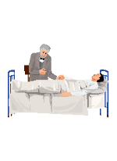
implementation
The implementation phase of the nursing process : is the actual initiation of the nursing care plan.
Involves putting the nursing care plan into
Action
Nursing activities (interventions) to meet the
goals set with the client begin

Slide 31
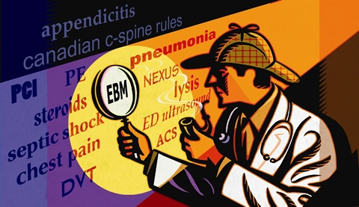

Evaluation
Evaluation is an ongoing process
The evaluation phase consist of two steps:
First, the nurse compares the client's current mental health state with that described in the outcome criteria
Second, the nurse considers all the possible reasons why client outcomes were not attained , it may be too soon to evaluate, and the plan of action needs further implementation

Slide 32
how to write and applied nursing process in psychiatric care
Nursing Diagnosis | Etiologic\ related factors | Defining characteristics, As evidenced by
Anxiety | illness, loss of job, loss of parents | The client verbalizes: *difficulty falling asleep *increase muscle tension.

Slide 33
how to write and applied nursing process in psychiatric care
Outcome identification and evaluation:
1-expresses feeling calm, relaxed with absence of muscle tension.
2- Demonstrates absence of avoidance behaviors (withdrawal , lack of contact with others and relief behaviors.
3- exhibits ability to make decisions and problem-solve.
Planning and implementation :
1- maintain client safety and the safety of the others.
2- show the client how to use slow deep breathing exercises .
3-reduce all environmental stimulation (noise , bright lights , people moving and talking.

Slide 34
Example illustrate how to write nursing care plan
Nursing assessment | Nursing diagnosis | Nursing goal | Nursing intervention | Evaluation
Patient believes that others in the Environment are Plotting evil against him (delusion of Persecution) | Altered thought process related to impaired ability to process and synthesize internal and external stimuli as evidenced by believes that his\her thought are responsible for world events or disasters. | Demonstrate Reality-based Thinking in Verbal and Non –verbal Behavior | 1-Assess the delusion and need behind delusion 2- voicing doubt. 3- change the subject to reality talk. 4- not use rationale or argumentate 5- engage in productive activity. | Patient progress and response to treatment.

Slide 35


summery
In this lecture we discuses together:
The key terms (terminology) in nursing process.
explanation for the steps or standards of nursing process.
examples for nursing care plan.

Slide 36

conclusion
Nursing process is a very important chain in each nursing specialty
The purpose of the nursing process is to achieve scientifically, holistic ,individualized care for the client
&
To achieve the opportunity to work collaboratively with clients and their families or relatives
To achieve continuity of care.

Slide 37

references
Gali.W, 9th eddition,Principles And Practice Of Psychiatric Nursing ,Mosby, Canada,2009.
Fortherine.K.M,Holoday.w,5th eddition,Psychiatric Nursing Care Plans, Mosby,Canada,2007
www.nanda.org

Slide 38


AND GOODBYE

