Slide 1
Nurs 430
Part 9
The Health Care Delivery System

Slide 2
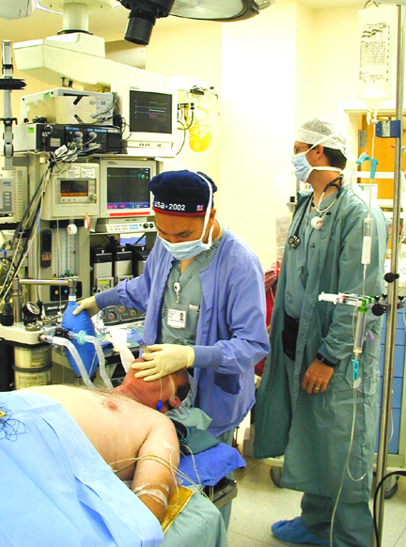
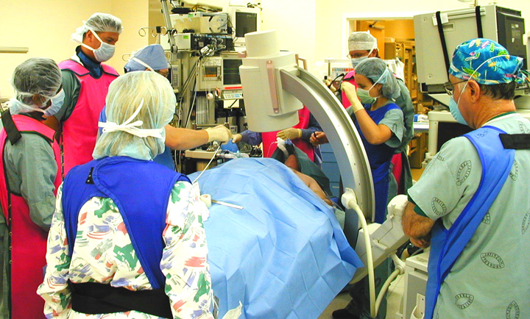
Health care is a complex system

Slide 3
Health Care Delivery System?
Mechanism for providing services that meet the health-related needs of individuals.
Nursing is a major component of any health care delivery system worldwide.

Slide 4
Health Care Delivery System
There are two key objectives of a health care delivery system:
To provide universal access and to deliver services that are cost-effective.
To meet pre-established standards of quality.

Slide 5
Healthcare Delivery
Factors that determine ACCESS to health care
Ability to pay
Availability of service
Payment
Barriers to enablement

Slide 6
United States Healthcare
All major developed countries except for the United States offer national health care programs.
These programs provide universal access through health care delivery systems
that are managed by the respective governments and provide a defined set of health care services to all citizens.

Slide 7
Healthcare Delivery
The system is comprised of a set of interrelated and interdependent components designed to achieve common goals.
The systems framework provides an organized approach to understanding the various components of the health care delivery system and it is comprised of five key components; system foundations, system resources, system processes, system outcomes, and system outlook.

Slide 8
The System Framework
E N V I R O N M E N T
I. SYSTEM FOUNDATIONS
Cultural Beliefs and Values, and Historical Developments

Slide 9
The System Framework System Features
II. SYSTEM RESOURCES
Human Resources
“Health Services Professionals”
Nonhuman Resources
“MedicalTechnology”
“HealthServices Financing”

Slide 10
The System Framework System Features
III. SYSTEM PROCESSES
The Continuum of Care "Outpatient and Primary Care Services”
“Inpatient Facilities and Services”
Special Populations "Long-Term Care”
“Health Services for Special Populations”

Slide 11
The System Framework System Features
IV. SYSTEM OUTCOMES
Issues and Concerns "Cost, Access, and Quality”
Change and Reform "Health Policy”

Slide 12
Terminology
Access - The ability of an individual to obtain health care services when needed.
Access is restricted to
(1) those who have health insurance through their employers,
(2) those covered under a government health care program,
(3) those who can afford to buy insurance out of their own private funds, and
(4) those who are able to pay for services privately. Health insurance is the primary means for ensur­ing access.

Slide 13
Terminology
Balance bill- the billing of leftover sum by the provider to the patient after the insurance has only partially paid the charges initially billed.
Capitation- A set amount (or a flat rate) to cover a person’s medical care for a specified period, usually monthly.
Defensive medicine demand- Excessive medical tests and procedures performed as a protection against malpractice lawsuits, otherwise regarded as unnecessary.
Enrollee- (member) refers to the in­dividual covered under the plan.

Slide 14
Terminology
Continuum of Services - Medical care services are generally classified into three broad categories:
Cura­tive (e.g., drugs, treatments, and surgeries).
Restorative (e.g., physical, occupational, and speech therapies)
Preventive (e.g., prenatal care, mammograms, and immu­nizations).

Slide 15
Terminology “Continuum of Services”
Health care service settings:
No longer confined to the hospital and the physician’s office, where many of the aforementioned services were once deliv­ered.
Several new settings, such as home health, subacute care units, and outpatient surgery centers have emerged in response to the changing configuration of economic incentives.

Slide 16
HOSPITALS
Can be public or private
Private hospitals can be for profit or non-profit
Many different types and classifications
General hospitals treat a wide variety of illnesses and ages

Slide 17
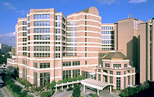
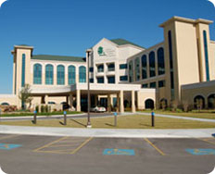
Specialty Hospitals
Specific conditions, age groups, or other ways of grouping patients
For example:
Cancer hospitals
Pediatric hospitals
Psychiatric hospitals
Rehabilitation centers

Slide 18
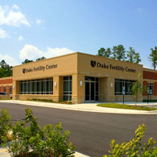
Ambulatory Facilities
Also called “outpatient services” – they often provide diagnostic and treatment services that were previously performed in hospitals
Surgical clinics (surgicenters) outpatient surgery
Urgent care centers
Outpatient clinics
Optical centers
Genetic counseling centers (fertility clinics)

Slide 19
Long Term Care Facilities
Mainly care for elderly patients (residents)
May also care for individuals with disabilities or handicaps
Residential care (nursing homes) – basic physical care
Extended care (skilled nursing) facilities – provide skilled nursing care and rehabilitation services
Assisted (independent) living facilities – provide basic services (meals, housekeeping, etc.) and basic medical care.

Slide 20
Home Health Care
Became more common in late 1980s – now an area of tremendous growth
Nurse or other skilled professional visits patient in his/her home to provide treatment/education
Less expensive than admission to hospital or long term care facility
States require licensing of home health agencies to assure the quality of care

Slide 21
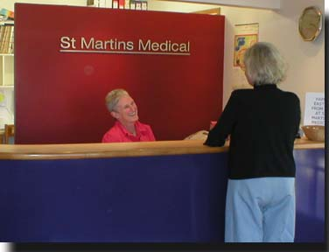
Medical and Dental Offices
Vary from small (one doctor) to large complexes with multiple specialties and other healthcare professionals
Some treat a wide variety of illnesses and conditions, others specialize

Slide 22
Mental Health Services
Counseling centers
Psychiatric clinics and hospitals
Chemical (drug and alcohol) abuse treatment centers
Physical abuse treatment centers, dealing with child abuse, spouse abuse and elderly abuse

Slide 23
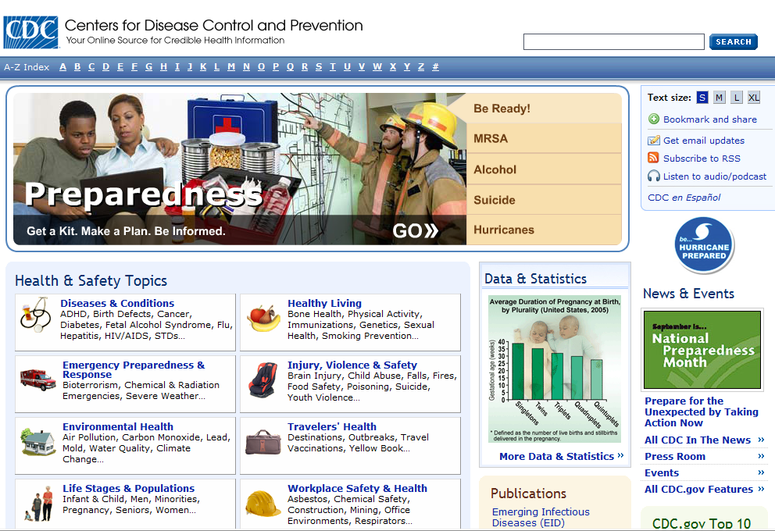
Centers for Disease Control and Prevention (CDC)
U.S. Department of Health and Human Services
Concerned with cause, spread and control of disease, and other health and safety issues, in populations
www.cdc.gov

Slide 24
Food and Drug Administration (FDA)
Federal agency
Responsible for regulating food and drug products sold to the public
www.fda.gov

Slide 25
World Health Organization (WHO)
International agency
Sponsored by United Nations
Compiles disease statistics, promotes healthy living, and investigates serious health problems throughout the world
www.who.int

Slide 26
Public Health System (Health Departments)
Part of the U.S. Department of Health and Human Services
Provide services to states and local communities
Examples of services
Immunizations
Environmental health and sanitation
Collection of health statistics and records
Health education
Clinics for health care and prevention

Slide 27
NON-PROFITS
Also called voluntary agencies
Most deal with specific diseases or groups of diseases
They provide funding for research, promote education, and services for victims of disease.
They also influence laws, create standards, and educate health professionals

Slide 28
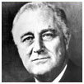
March of Dimes
Founded by President Franklin D. Roosevelt in 1938
He was a victim of paralytic poliomyelitis
Initial goal of March of Dimes – care of polio victims, carry out research, develop vaccine
Today – focus on preventing birth defects and reducing infant mortality
www.marchofdimes.com

Slide 29
American Heart Association (AHA)
Founded in 1915 by a group of cardiologists
Mission is to reduce disability and death from cardiovascular disease and stroke
Research, education and community programs
www.americanheart.org

Slide 30
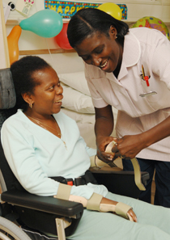
Hospice
Hospice movement began in England, rapidly growing in United States
Provides palliative care (relieves but does not cure) to dying patients and their families
Involves healthcare professionals and volunteers
Emphasis is to make patient’s last days as pain-free and meaningful as possible

Slide 31
Types of Health Care Services
Primary: Health promotion and illness prevention
Secondary: Diagnosis and treatment
Tertiary: Rehabilitation

Slide 32
Three Levels of Prevention

Slide 33
Health Care Team
Nurse (RN)
Physician (MD)
Physician Assistant (PA)
Pharmacist (RPh)
Dentist (DDS)
Dietitian (RD)

Slide 34
Health Care Team
Respiratory Therapist (RT)
Physical therapist (PT)
Occupational Therapist (OT)
Dental Hygienist
Social Worker (SW)

Slide 35
Advanced Practice Registered Nurse
Diagnoses and manages common health problems.
Performs medical procedures (e.g., suturing, casting).

Slide 36
Challenges Within the Health Care System
Negative Perception of Nurses
Female occupation
Long working hours
Working night shifts
Low payment
Nursing shortage

Slide 37
Challenges Within the Health Care System
Nursing Shortage: By 2020 the workforce is forecast to be 20% below requirements.
Fewer people entering the profession
Aging of the nursing population
Other career options offering greater remuneration

Slide 38
Home Health Nursing
The percentage of home health nurses is increasing in numbers, as health care reform places more nurses (as this home health nurse) outside the acute care setting.

Slide 39
Challenges Within the Health Care System
Vulnerable Populations
Children
The elderly
People with AIDS
The homeless
Others living in poverty

Slide 40
Vulnerable Populations
Children
Children are more likely to be insured than adults.
One in five children lives in a family with an income below the poverty level.
The State Children’s Health Insurance Program was passed in 1997 to expand health insurance coverage to uninsured low income children.

Slide 41
Vulnerable Populations
The Elderly
A large number of elderly people live in rural areas.
Many elderly have no health insurance.
Many hospitals in rural areas have been closed due to economic pressures.

Slide 42
Vulnerable Populations
People with AIDS
Over 300,000 Americans have been diagnosed with AIDS.
Approximately 800,000 Americans are infected with HIV.
The most rapid spread of the disease is occurring among women, children, and IV drug users and their sexual partners.

Slide 43
Ten Focus Areas of Nursing’s Agenda for the Future
Leadership and planning
Delivery systems
Legislation/regulationpolicy
Professional/nursing culture
Recruitment/ retention
Economic value
Work environment
Public relations/ communication
Education
Diversity

Slide 44
Nursing’s Response to Health Care Challenges
Standards of care
Advanced practice
Public versus private programs
Public health
Community health
School nursing
Long-term care

