Slide 1
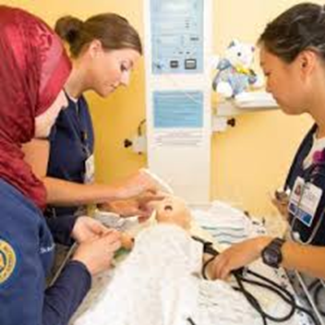
Nurs 430 Part 6: Critical Thinking

Slide 2
Unit 1
Learning Objectives:
After completion of lecture-discussions, students are expected to be able to:
Differentiate critical thinking, judgement, clinical reasoning, clinical decision, and clinical decision making
Analyze situations or cases demonstrating clinical thinking, judgement, clinical reasoning, clinical decision, and clinical decision making
Value the importance of learning the appropriate way of critically thinking, judgement, clinical reasoning, clinical decision and clinical decision making

Slide 3
Requirements from newly qualified nurses
To be critical thinkers
To have ability to critique evidence
To apply best evidence in clinical practice to inform judgement and decision making
(Dowding et al., 2012))

Slide 4
Requirements from beginning practitioners
to exhibit sound judgment and decision making skills through
developing knowledge or domain expertise in their field of practice
possessing the thinking skills to use that knowledge effectively
understanding what constitutes good decision making practice
(Dowding et al., 2012))

Slide 5
Critical thinking skills (definition)
refer to cognitive skills such as analysis, evaluation, inference, deductive reasoning, inductive reasoning, interpretation, explanation and self-regulation (Beckie et al., 2001, Hicks et al., 2003, Lyons, 2008).
purposeful, self-regulatory judgment: an interactive, reflective, reasoning process of making a judgment about what to believe or do (Beckie et al., 2001)
(Dowding et al., 2012))

Slide 6
Critical thinking skills (definition) (continued)
“a dynamic, purposeful, analytic process that results in reasoned decisions and judgments” (Lyons, 2008)
“a set of dispositions and skills that enhance decision-making processes through such cognitive abilities as analysis, inference and evaluation” (Hicks et al., 2003).
(Dowding et al., 2012))

Slide 7
Clinical reasoning (definition)
the process by which individuals make judgements and decisions, and incorporates the skills of critical thinking
The outputs of the reasoning process are judgements
(Dowding et al., 2012))

Slide 8
Clinical reasoning (definition) (Hoffman, 2007; Kraischsk & Anthony, 2001; Laurie et al., 2001) (continued)
process by which nurses (and other clinicians)
collect cues
process the information
come to an understanding of a patient problem or situation
plan and implement interventions
evaluate outcomes, and
reflect on and learn from the process
http://www.utas.edu.au/__data/assets/pdf_file/0003/263487/Clinical-Reasoning-Instructor-Resources.pdf

Slide 9
Nature of clinical reasoning process
is dependent upon a critical thinking disposition (Scheffer & Rubenfeld, 2000)
is influenced by a person’s
Attitude
philosophical perspective
preconceptions (McCarthy, 2003).
Clinical reasoning is not a linear process but can be conceptualized as a series or spiral of linked and ongoing clinical encounters.
http://www.utas.edu.au/__data/assets/pdf_file/0003/263487/Clinical-Reasoning-Instructor-Resources.pdf

Slide 10
Why is Clinical Reasoning Important?
effective clinical reasoning skills have a positive impact on patient outcomes
poor clinical reasoning skills often fail to detect impending patient deterioration resulting in a “failure-to-rescue” (Aiken, Clarke, Cheung, Sloane, & Silber, 2003).
http://www.utas.edu.au/__data/assets/pdf_file/0003/263487/Clinical-Reasoning-Instructor-Resources.pdf

Slide 11
Top 3 Reasons for Adverse Patient Outcomes
failure to properly diagnose
failure to institute appropriate treatment
inappropriate management of complications
http://www.utas.edu.au/__data/assets/pdf_file/0003/263487/Clinical-Reasoning-Instructor-Resources.pdf

Slide 12
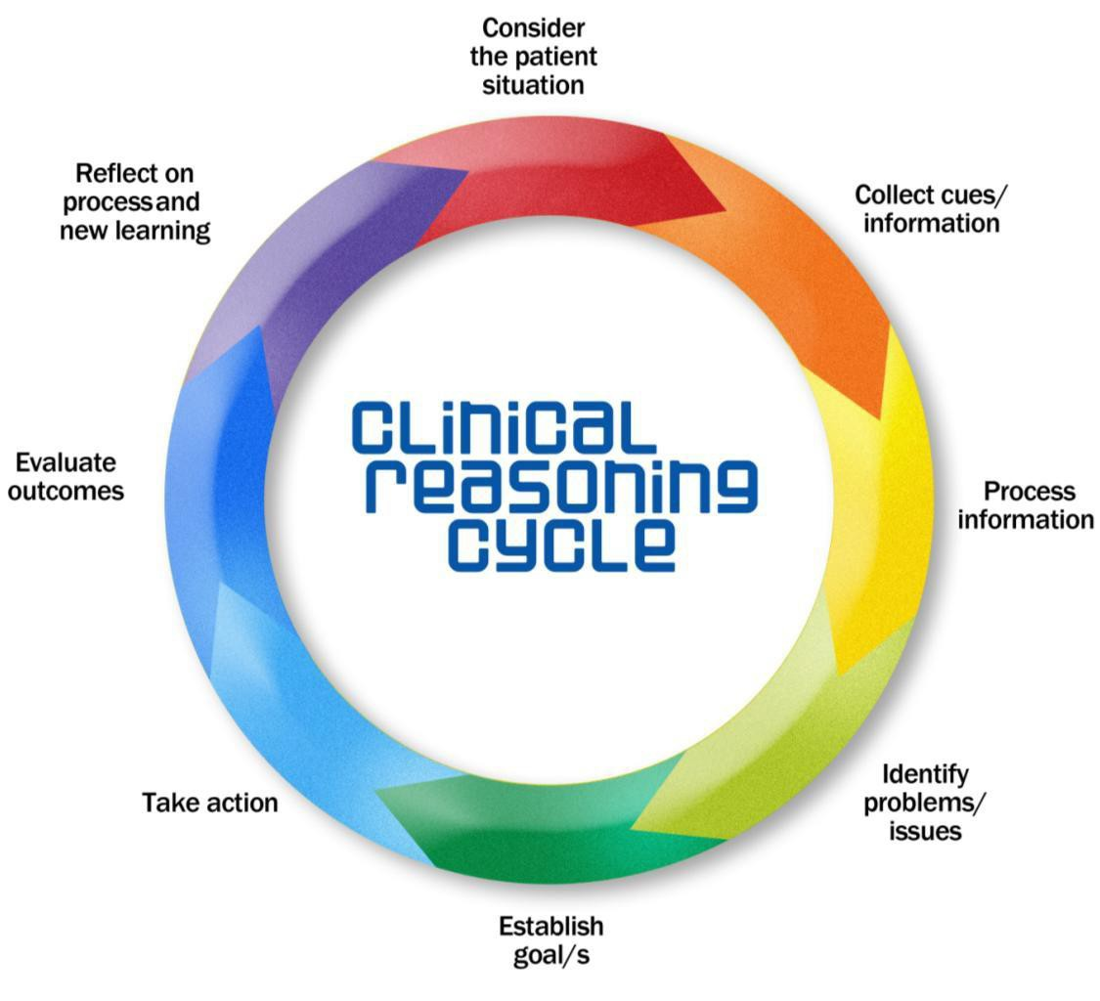
Clinical Reasoning Cycle
http://www.utas.edu.au/__data/assets/pdf_file/0003/263487/Clinical-Reasoning-Instructor-Resources.pdf

Slide 13
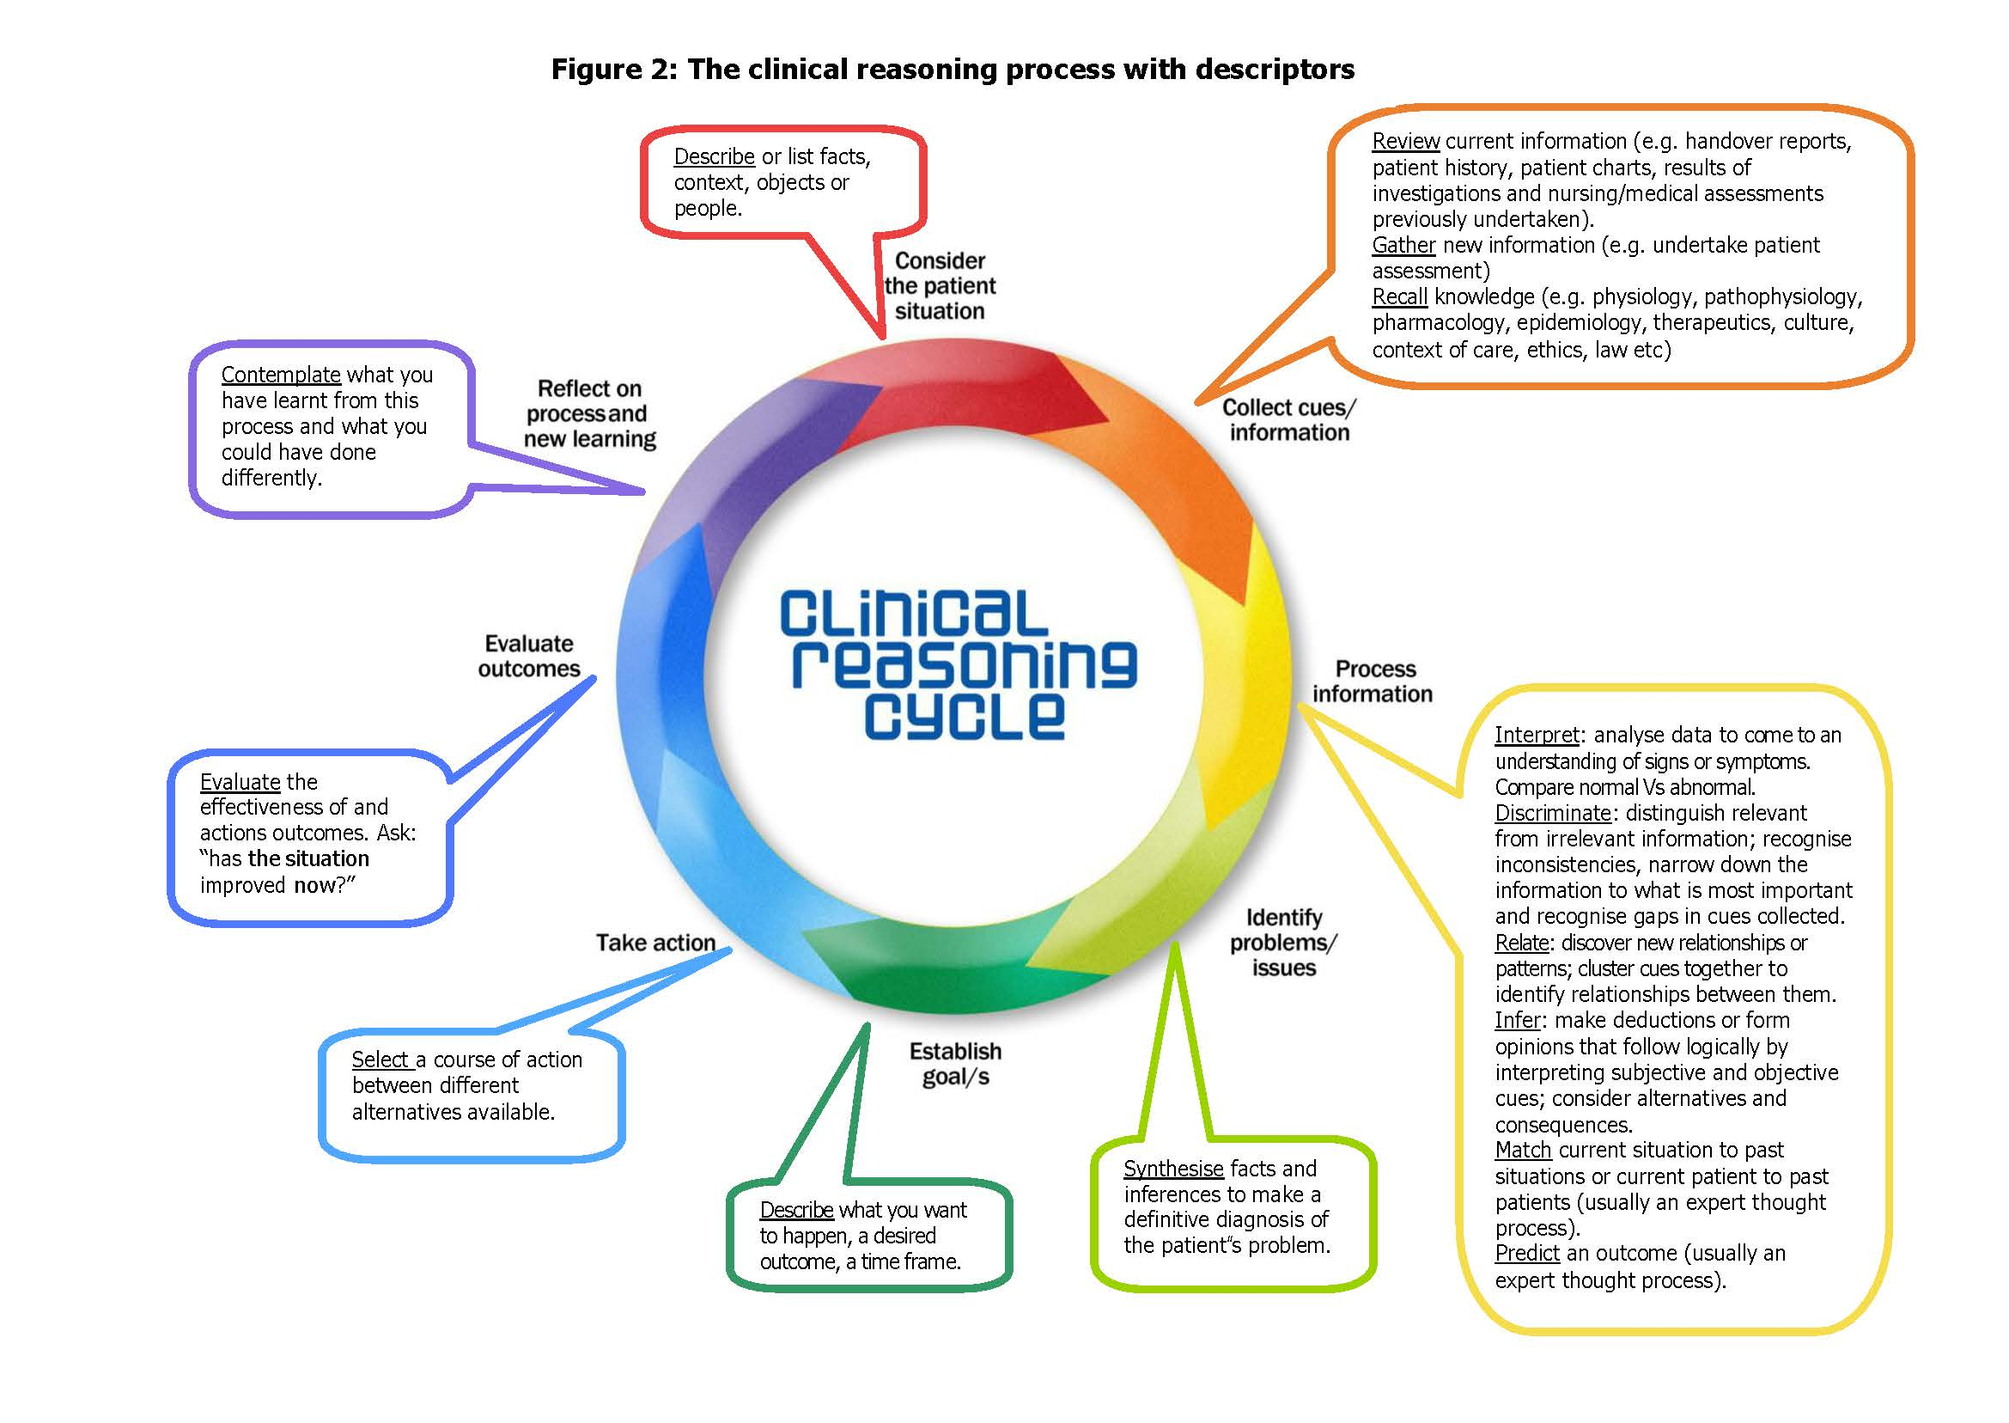
http://www.utas.edu.au/__data/assets/pdf_file/0003/263487/Clinical-Reasoning-Instructor-Resources.pdf

Slide 14
Judgement (definition)
‘an assessment between alternatives’
Decisions (definition)
‘a choice between alternatives’ (Dowie, 1993)
(Dowding et al., 2012))

Slide 15
Types of reasoning process used to reach judgements and decisions (Thompson and Dowding, 2009a)
hypothetico- deductive reasoning
analytical reasoning using algorithms and decision support tools (such as decision analysis or Bayes’ theorem)
(Dowding et al., 2012))

Slide 16
Judgement
Opinions about other people (Weiss et al., 2006)
Example in healthcare: health status and functional ability, predictions of future behavior
An assessment between alternatives (Dowie, 1993)
A process that involves the integration of information about a person to reach an evaluation or assessment of their state or condition (Crow et al., 1995; Maule 2001)
Example in nursing: information such as vital sign readings, how they look at patient’s condition or behavior
(Thomson & Dowding, 2009, p3)

Slide 17
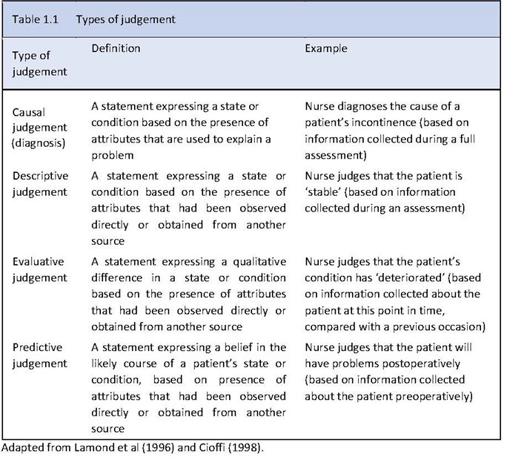
(Thomson & Dowding, 2009, p4)

Slide 18
Clinical decisions (definition)
Choice between alternatives (Dowie, 1993)
Produce some kind of outcome in the form of an action
Example: ‘To do’ or ‘not do’ something
Decisions in healthcare are usually made under conditions of uncertainty—we do not know (with certainty) what will happen because of our decision or action
(Thomson & Dowding, 2009, p3)

Slide 19
(Thomson & Dowding, 2009, p4)

Slide 20
Clinical decision making (definition)
The process that involve weighing up of potential costs and benefits associated with each option you are considering, before deciding on a course of action (Baron, 2000)
Decisions normally follow judgments (see case)
The nurse made a number of judgments
The patient is “unwell”, that his problem has ‘probably’ been caused by a ‘new event’.
On the basis of these judgments (as well as discussion with the consultant) the nurse decides that the best course of action (the decision) is to admit the patient to hospital.
(Thomson & Dowding, 2009, p6)

Slide 21
Importance of why nurses need to know about
‘decision making’
to be recognized as autonomous decision making professionals
Develop nursing in ways that provide enough freedom to practice and exercise judgment with the minimum of interference in the relationship between patient and nurse
Opportunity to rethink the ways in which we
train, develop, and self-regulate the profession
establish and market our contribution to enhanced patient outcomes
(Thomson & Dowding, 2009, p6)

Slide 22
Dowding, D.W., Gurbutt, R., Murphy, M., Lascelles, M., Pearman, A., & Summers, B. (2012). Conceptualising decision making in nursing education. Journal of Research in Nursing, 17(4), 348-360.
Thompson, C. & Dowding, D. (2009). Essential Decision Making and Clinical Judgement for Nurses. China: Churchill Livingstone Elsevier.
Clinical reasoning: Instructor resources. Available from http://www.utas.edu.au/__data/assets/pdf_file/0003/263487/Clinical-Reasoning-Instructor-Resources.pdf

