Slide 1
2nd Class Research & Evidence Based Practice
NUR500
Latifah Almater RN, PhD
17.9.2018

Slide 2
What is Research?
A process to discover a new knowledge
A systematic investigation
Scientific methods
Inductive and deductive
Analytical in nature
It is all about the data

Slide 3
What are the Benefits of Research
To fill a knowledge gab (explore, explain, understand, define, create )
To solve a problem

Slide 4
Level of Evidence
LEVEL A
Randomized control trials:
Systematic review or meta-analysis
Clinical practice guidelines
LEVEL B:
Well-designed control trials without randomization.
Clinical cohort study
Case-controlled study
Uncontrolled study
Epidemiological study
Qualitative study/quantitative study
LEVEL C
Consensus viewpoint and expert opinion
Meta-synthesis
Oxford Centre for Evidence-Based Medicine, 2011

Slide 5
What is Evidence-Based Practice?
The National Council of State Boards of Nursing explains it as “the integration of the best research with clinical expertise and patient values.”

Slide 6
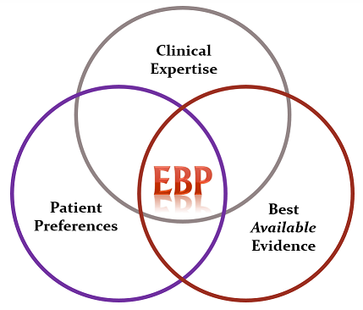
David Sackett, 1996

Slide 7
Research vs Evidence Based Practice
Why do we struggle to understand the difference between evidence-based practice and nursing research?
“ It is often a matter of education and experience”
“Research is a foreign language. You must be able to speak and understand it to truly do it”
“Evidence-based practice is used to close the gap between the research being conducted and the practice—the ‘research/practice gap,’
“A lot of nurses know research but haven’t done research, If you don’t understand the concepts and rules of research, there’s potential for confusion.”
Flaugher 2010

Slide 8
What is a Research Paradigm?
A research paradigm is “the set of common beliefs and agreements shared between scientists about how problems should be understood and addressed” (Kuhn, 1962)

Slide 9
What is a Research Paradigm?
According to Guba (1990), research paradigms can be characterised through their:
Ontology – What is reality?
Epistemology – How do you know something?
Methodology – How do you go about finding it out?

Slide 11
What is the Importance of Paradigm?
Create a holistic view of how knowledge is viewed
How we can see ourselves in relation to this knowledge, and the methodological strategies we use to un/discover it.
Awareness of philosophical assumptions will increase quality of research and can contribute to the creativity of the researcher.
You will be asked about it in your viva/thesis defence and are expected to narrate it when you write up your research findings.

Slide 12
Which Research Paradigm Does my Research Belong to?
Positivists believe that there is a single reality, which can be measured and known, and therefore they are more likely to use quantitative methods to measure and this reality.

Slide 13
Which Research Paradigm Does my Research Belong to?
Constructivists believe that there is no single reality or truth, and therefore reality needs to be interpreted, and therefore they are more likely to use qualitative methods to get those multiple realities.

Slide 14
Which Research Paradigm Does my Research Belong to?
Pragmatists believe that reality is constantly renegotiated, debated, interpreted, and therefore the best method to use is the one that solves the problem

Slide 15
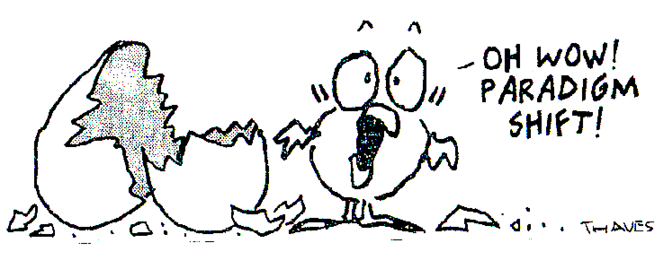

Slide 16
Questions?

