Slide 1
Nosocomial infections: Any infection acquired by a patient while being hospitalized, which were not present nor incubating during admission. incubation period is at least 48 hours after admission.

Slide 2
Sources of nosocomial infections: 1. ENDOGENOUS SOURCES ------(50%) Patients own flora - - Auto-Infection 2. EXOGENOUS SOURCES----(50%)
Other patients
Health care prsonnel ”carriers”
Medications & treatments
Visitors
Fomites (bed sheets, instruments)
Hospital Environment (Air, food, water)

Slide 3
Predisposing factors of nosocomial infections
HOST FACTORS
Age
Health status
underlying disease
Immune status

Slide 4
2. TREATMENT
Surgery
Instruments & foreign bodies introduced
Theraputic agents
Immunosuppressive drugs
Ionizing radiation
Broad spectrum antibiotics
Length of hospitalization

Slide 5
Classification of surgical procedures Clean no entry into GI/GU/Resp tract low risk infection usually exogenous Clean contaminated no significant spillage e.g. cholecystectomy infection rates 5-10 % Contaminated Significant spillage of bacteria expected Infection rate 18-20% Dirty Perforated viscus drainage of abscess Infection rate often >30%

Slide 6
3. ENVIRONMENT
Overcrowding of patients
Air & inaniment objects
Medical devices

Slide 7
IMPORTANT CROSS-INFECTION ORGANISMS

Slide 8
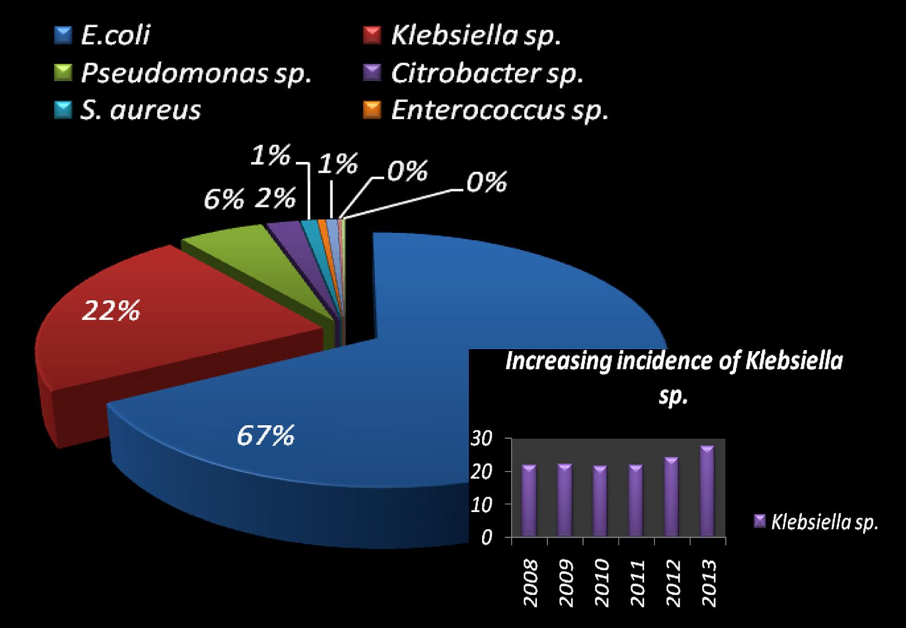
Rate of CROSS-INFECTION ORGANISMS

Slide 9
Methicillin resistant Staph. aureus(MRSA) Resistant to Flucoxacillin and usually others Sources: - Hospital personnel carriers Colonization on nares, axilla, perineum, hands - Patients Wounds/Lesions May cause : Wound infection Bacteraemia Skin/soft tissue infection U.T.I. Pneumonia etc.

Slide 10
Methicillin resistant Staph. aureus(MRSA)------(cont) Spread By: Hands Fomites Aerosols Becoming more common in the Community Control: Eradication of carriers Barrier nursing Screening of other patients Staff

Slide 11
TUBERCULOSIS Open pulmonary TB (Sputum smear positive for AFB) VIRAL INFECTIONS Chicken Pox (Hepatitis B HIV)

Slide 12
Resistant Gram Negative Bacteria Resistance to multiple antibiotics Organisms: E .coli Proteus Enterobacter Acinetobacter Pseudomonas aeruginosa

Slide 13
Resistant Gram Negative Bacteria----(cont) May Cause: Bacteraemia U.T.I. Pneumonia Wound infection Control: Antibiotic Policy Control of Infection Guidelines Prevention of Cross Infection especially on high risk areas

Slide 14
Implications of nosocomial infections
Consequences for patients:
Affects approx. 10% of all in-patients
delays discharge
delay post-operative wound healing
prolonged suffering
direct cause deaths
2. Consequences for the community:
Healthy personnel acquire infections
Dessiminate pathogens to the community”carriers”

Slide 15
Implications of nosocomial infections-----cont
3. Consequences for the hospital:
Malpractice suits.
Financial loss
(estimated loss > 2 billion$/year)

Slide 16
General preventive principles Good general ward hygiene: - No overcrowding - Good ventilation - Regular removal of dust - Wound dressing early in day - Disposable equipment - Preventing cross infection  HAND WASHING most important - Before and after patient contact Before invasive procedures

Slide 17
PREVENTING CROSS INFECTION If known or suspected on admission to hospital, or detected following admission: - Isolation (barrier precautions) - Inform Infection Control team - Treatment - if appropriate - Regular surveillance

Slide 18
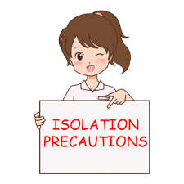

Slide 20
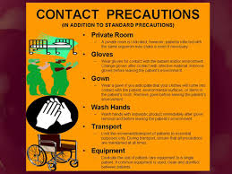
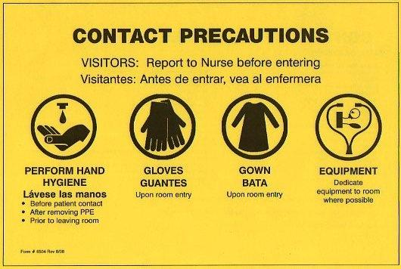
Wound, skin & blood precations

Slide 21
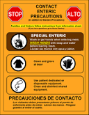
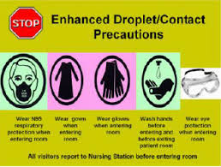
Enteric precautions
Respiratory precautions

Slide 22
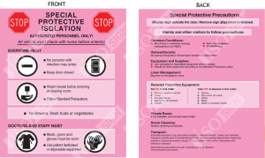
Protective isolation

Slide 23
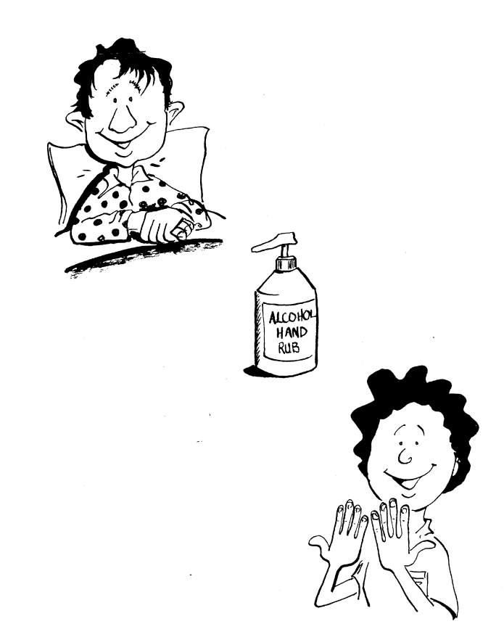
Hand hygiene is the simplest, most effective measure for preventing hospital-acquired infections.

Slide 24
Hospital proceedures that lead to colonizationof germs on hands
Healthcare workers can get 100s to 1000s of bacteria on their hands by doing simple tasks like:
pulling patients up in bed
taking a blood pressure or pulse
touching a patient’s hand
rolling patients over in bed
touching the patient’s gown or bed sheets
touching equipment like bedside rails, overbed tables, IV pumps

