Slide 1
Helminths
Nematodes

Slide 2
Types of Nematodes:
1- Intestinal (bowel nematode).
Can be in:
Large intestine eg. Whip worm, pin worm
Small intestine eg. Round, thread, hook worms
2- Systemic (Tissue nematodes - adults or larval stage in tissue).

Slide 3
1- Trichuris trichiura (Whipworm)
Habitat: large intestine.
Epidemiology: in some areas 90-100% of population.
Needs a warm climate.
Spread by fecal – oral.

Slide 4
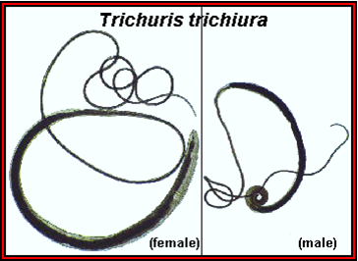
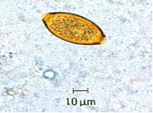
Morphology:
Infective stage: emberyonated egg (larvated egg).
Differentiate between male and female.
Egg is yellowish (brownish) in color, barrel shape with bipolar ends.

Slide 5
Clinical picture and diagnosis:
99% are asymptomatic.
Heavy load gives dysentery + anaemia.
Complications: rectal prolapse.
Diagnosed by: Stool examination.

Slide 6
Enterobius vermicularis (Pinworm)
Habitat: large intestine.
Epidemiology: common in all geographic areas.
The commonest nematode in children.
Spread: fecal- oral, Autoinfection.

Slide 7
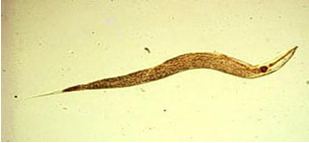
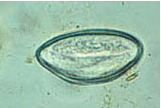
Morphology:
Ault female: approx. 10 mm long.
Egg: egg approx. 55 µm long, colorless and like a compressed D-shape.

Slide 8
Clinical picture+ Diagnosis:
Most asymptomatic
Anal pruritis; nocturnal perianal itching , rarely vaginitis (caused by irritation by the migrating female worm).
Complications: Severe itching may lead to pyogenic infection.
Diagnosis: less than 5% found in stools, i.e. not a useful examination;
Pinworm swab (anal swab) - cellophane tape swab.

