Slide 1
Neck trauma
MOHAMMED ALESSA MBBS,FRCSC
Consultant Otolaryngology , Head & Neck Surgery
King Saud University

Slide 2
Introduction
Physiology
Anatomy
Classification
Management
Conclusion

Slide 3
Introduction
Knowledge of ballistics, injury patterns, and pertinent anatomy are all essential to the assessment and management of potentially serious injuries.
Each case of neck trauma presents a unique set of problems, but despite the diversity of injuries, specific management guidelines can be applied.
Severity of injury and delay in treatment correlate with poor outcome.

Slide 4
Introduction
The overall mortality rate for penetrating neck trauma
is 3% to 6%.
The major cause of death in patients with penetrating neck trauma is exsanguinating hemorrhage from a vascular injury.
Most series report at least some mortality from missed esophageal injuries, which usually manifest as sepsis.
The assessment and management of patients who have sustained a penetrating neck injury has historically been an issue surrounded by significant controversy.

Slide 5
Mechanism of injury

Slide 6
Physiology
KE = ½ MV 2
high-velocity projectiles :
impart significantly larger amounts of energy into the tissue impacted.
Firearms :
low velocity (<1,000 ft/s)--- tissue damage
high velocity (>1,000 ft/s)--- tissue loss
Gunshot wounds cause tissue injury by two main mechanisms:

Slide 7
Classification
Horizontal entry zones of the neck for penetrating injuries to the neck. Modified from Jurkovich GJ.
Based on anatomical configurations

Slide 8
Classification
Zone I :
Below the inferior border of the cricoid cartilage.
Zone II :
Between the angle of the mandible and the inferior border of the cricoid cartilage,
Zone III :
Above the angle of the mandible up to the
skull base.

Slide 9
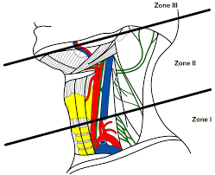
Anatomy Zone I
Boundaries:
Clavicles and sternal notch up to cricoid cartilage
Vasculature :
Arch of Aorta
Innominate vessels
Subclavian vessels
Proximal Carotid Arteries
Vertebral Arteries
Aerodigestive
Trachea,
Lung apices
Esophagus
Thoracic duct
Neurologic
Brachial plexus
spinal cord

Slide 10
Anatomy Zone II
Boundaries:
Cricoid cartilage to angle of mandible
Vasculature
Common Carotid
Internal and External Carotids
Jugular veins
Aerodigestive
Larynx,
Hypopharynx,
Proximal Esohpagus
Neurologic
Cranial Nerves
Spinal cord
Sympathetic chain

Slide 11
Anatomy Zone III
Boundaries:
Angle of mandible to base of skull
Vasculature
Internal Carotid
External Carotid ( terminal branches)
Vertebral Artery
Prevertebral venous plexus
Jugular veins
Aerodigestive
Oral cavity
Pharynx
Neurologic
Cranial nerves (trunk of VII),
Spinal cord

Slide 12
Classification
Disadvantages :
Depth of the penetration is a key
Viscous , vascular & neural structures involvement is cardinal features
Managements are not considered .

Slide 13
Classification
Larynx and trachea --- 10%
Pharynx and esophagus -- 10%
Vascular structures
Internal jugular vein (9%)
Internal and common carotid arteries (7%)
Subclavian artery (2%)
External carotid artery (2%)
Vertebral artery was injured in only (1%)
** A careful clinical exam is often an accurate predictor of the extent of injury.
McConnell DB, Trunkey DD. Management of penetrating trauma to the neck. Adv Surg 1994

Slide 14
Clinical assessment
Extensions | Symptoms/signs
Vascular | Hematoma Hemorrhage Pulse deficit Neurologic deficit Bruit or thrill in neck
Esophageal | Subcutaneous emphysema Hematemesis Dysphagia or odynophagia
Laryngeal | Subcutaneous emphysema Airway obstruction Sucking wound Hemoptysis Dyspnea

Slide 15
General management
The basic principles of trauma management apply to all patients with penetrating trauma( ABCDE) .
The overall prevalence of cervical spine fracture in patients with
isolated facial trauma is (5% to 8%). in-line neck stabilization
Most patients can be carefully intubated trans orally
Surgical airway :
Bleeding or edema ( oral cavity/pharynx) .
Probing entry and exit wounds or removing blood clots should be avoided.
All patients with penetrating neck trauma should be considered for tetanus prophylaxis.

Slide 16
Management
Neck exploration Conservative
Observation

Slide 17
Management
Extensions | Management
Vascular | Doppler ultrasound CT angiogram Angiogram Neck exploration
Esophageal | Contrast esophagogram Esophagoscopy Neck exploration
Laryngeal | CT scan Laryngotracheoscopy Neck exploration

Slide 18
Neck exploration
Refractory shock.
Uncontrollable hemorrhage.
Evolving neurologic deficit.
Airway obstruction
Platysmal penetration :
Morbidity of the surgery : low
Morbidity of a missed injury :high
Negative exploration ( 30-50%)
it is not main option now a days :
Advanced in imaging & endoscopies
vascular injuries :amenable to definitive endovascular treatment by the interventional radiologist

Slide 19
Management algorithm

Slide 20
Management: esophageal injuries
Alarming signs : Subcutaneous emphysema, hematemesis & hypopharyngeal blood:
Neck exploration
Symptomatic ( dysphagia /odynophagia) :
Contrast esophageogram
CT neck ---- sensitivity 90-100%
Esophageoscopy
+/- neck exploration
Asymptomatic :
Observation
Contrast esophageogram
CT neck ---- sensitivity 90-100%
Esophageoscopy

Slide 21
Management Contrast esophageogram
 | Gastrograffin | Barium
Consistency | Thin | Thick
Risk of Aspiration | Common | Rare
Risk of mediastnitis | No | Yes
Leak detection | Large leaks | Can detect small injuries

Slide 22
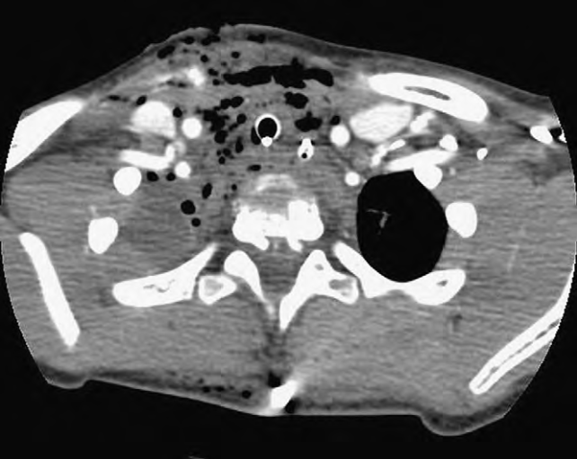
Management

Slide 23
Management : esophageal injuries Neck exploration
It should be closed directly within 24 hours .
Watertight closure
Drainage
Hypopharyngal injuries ( above arytenoids )
Conservative measures ( NPO , NGT feeding , parenteral Abx)

Slide 24
Esophageal injuries Management
82% primary repair ,
+/- 16% requiring muscle flaps .
11% drainage (late presentation )
3-4% complex: resection/diversion or resection/anastomosis
41% esophageal complication in delayed repair (vs. 19%)
Empyema, abscess, mediastinitis

Slide 25
Vascular injuries Diagnosis
formal catheter angiography,
CT angiography ( CTA) most practical
Color Doppler ultrasound

Slide 26
Vascular injuries Doppler U/S
91% sensitive,
98.6% specific
100% sensitive for clinically significant injuries
Advantages:
Feasibility & availability
No radiation
Disadvantages :
Operator dependent
No soft tissue/bony detail
Not useful in zone I & III
Non therapeutic

Slide 27
Vascular injuries CTA
The resolution of multidetectors excellent
Evaluation is quite sensitive, even to small intimal injuries
Sensitivity : 90% to 100%,
specificity : 94% to 100%,

Slide 28
Vascular injuries CTA
Advantages :
Quick , easily processed
Useful in penetrating trauma for aero digestive tract too
Ability of identifying trajectory a stabbing implement
Decreased negative exploration rate cuts OR & cost
Disadvantages :
Radiation
Non therapeutic
Contrast related side effects & limitations ( renal & diabetic)
Metal & dental artifacts

Slide 29
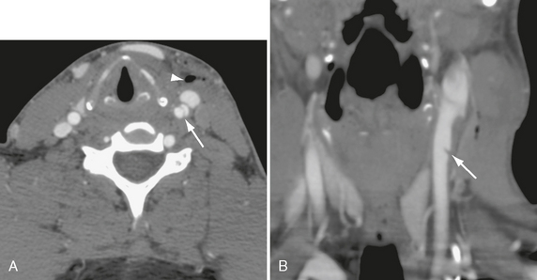
Vascular injuries CTA
Contrast extravasation, lack of vascular enhancement
Irregular vessel margins, filling defects
Vessel caliber changes

Slide 30
Vascular injuries 4 vessels angiography
Advantages :
Allow for both diagnostic assessment and endovascular intervention
Disadvantages :
invasive,
Increase the local and intracranial complication
** requires the presence of an interventional radiologist

Slide 31
Vascular injuries
Compression
Anticoagulation with heparin
Endovascular intervention
Surgical control
Ligation
Repair --- revascularization

Slide 32
Vascular injuries compression
Temporary control of haemorrhage should ideally be achieved.
Simple external compression is ineffective,
Foley balloon catheter tamponade.
Insertion of an 18- or 20-gauge Foley catheter.
The balloon is then inflated with 5 mL of water or until resistance is felt,
Clamping proximal end of the catheter to prevent bleeding through the lumen.
The more superficial neck wound can then be packed or closed with sutures.

Slide 33
Vascular injuries compression
Foley balloon catheter tamponade

Slide 34
Vascular injuries endovascular management
Covered stent graft: pseudoaneurysm, lacerations.
Embolization or coiling: pseudoaneurysm
Endovascular occlusion: injured vertebral arteries
Test balloon occlusion prior to ligation

Slide 35
Carotids injuries
Primary repair of the injured vessel is ideal.
( favor by vascular surgeon )
Ligation or embolization
Coma
High carotids injury
Endovascular repair
Intimal flap
Anticoagulte
Blunt injury

Slide 36
Vertebral injuries
Endovascular management
Ligation
Embolization
Anticoagulte
Blunt injury

Slide 37
Management algorithm
Munera F et al. Penetrating injuries of the neck: use of helical computed tomographic angiography. J Trauma. 2005;

Slide 39
Management algorithm

Slide 40
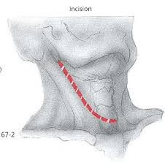
Neck exploration
Anterior sternocleidomastoid incision ( most common approach )

Slide 41
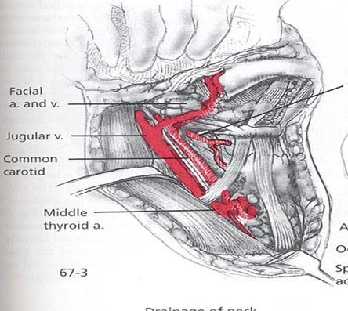
Neck exploration

Slide 42
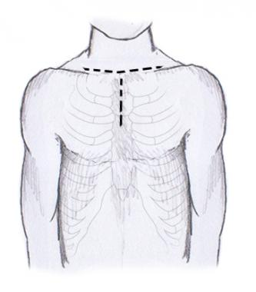
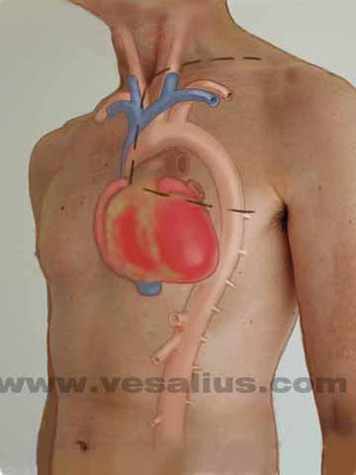
Neck exploration zone i
Median sternotomy with extension to an anterior sternocleidomastoid incision or supraclavicular incision with or without clavicular head resection

Slide 43
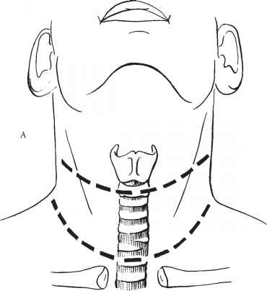
NECK EXPLORATION ZONE II
Cervical collar incision may provide access to both sides of the neck, with the potential to extend along the anterior sternocleidomastoid muscle

Slide 44
Neck exploration zone iii
subluxation, dislocation, or resection of the mandible may be necessary to gain operative vascular control.
Endovascular techniques have become a useful adjunct and an addition to the armamentarium available for the management of the acutely injured patient

Slide 45
Conclusion
The assessment and management of penetrating neck trauma remains a challenge and has historically been fraught with controversy.
Consensus slowly appears to be evolving with regard to certain aspects of this topic.
most centres have now moved away from a policy of mandatory exploration for all injuries deep to the platysma,
Increasing acceptance of the role of CT angiography to investigate potential arterial injuries.
The heterogeneous nature of cervical trauma means that no one approach will be appropriate for all patients with penetrating neck injuries.

