Slide 1
Roberto Tuberosa (Congress Chair)
Neil Turner (Congress Vice-Chair)
Mehmet Cakir (Australian Organising Committee Chair)

Slide 2
Conference Themes
Coping with drought in agriculture - a Global Perspective.
Maximizing water productivity in dry land and limited irrigation cropping systems.
Maximizing dry-land crop production – crop design.

Slide 7
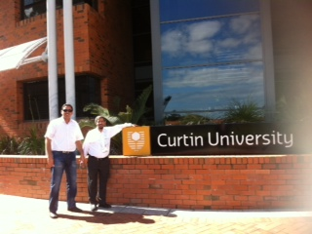

Slide 8
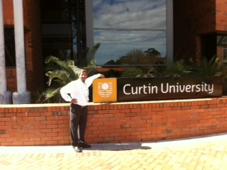

Slide 9
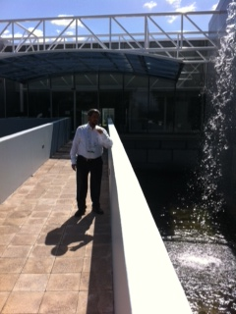

Slide 10
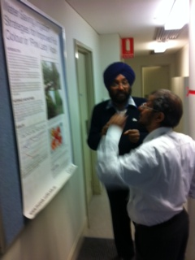

Slide 11
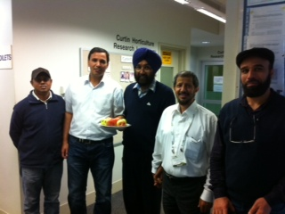

Slide 12
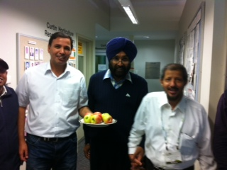

Slide 13
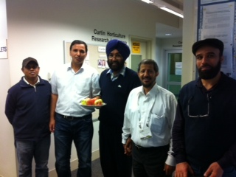

Slide 14
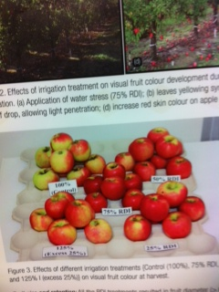

Slide 15
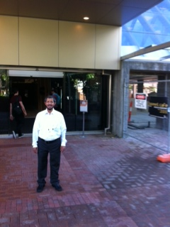

Slide 16
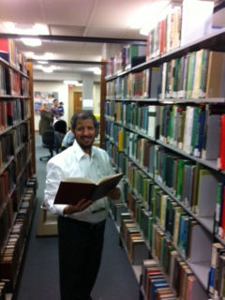

Slide 17
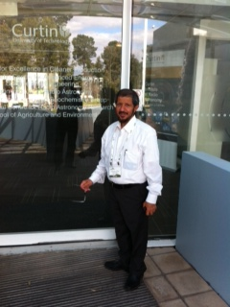

Slide 18
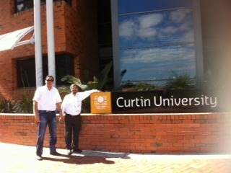

Slide 19
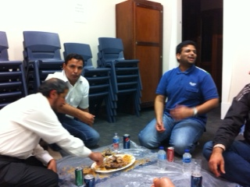

Slide 20
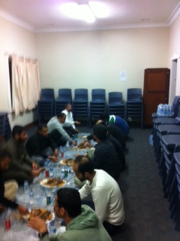

Slide 21
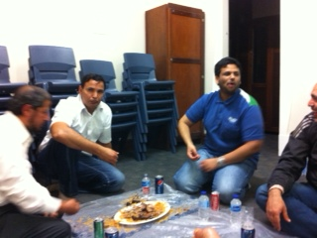

Slide 22
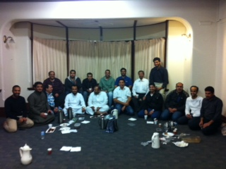

Slide 23
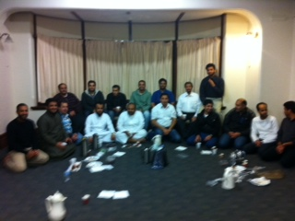

Slide 26
