Slide 1


Gordon Research Conference
Salt & Water Stress in Plants
June 24-29, 2012
The Chinese University of Hong Kong
Hong Kong, China
Using Magnetic Technologies in Management of Water Irrigation Programs in the Arid and Semi-Arid Ecosystem of Saudi Arabia
By
A.A. Alderfasi*, M.M. Selim and N. A. Al-Suhaibani
Plant Production Department, College of Food and Agriculture Sciences, King Saud University, Riyadh- Saudi Arabia

Slide 2

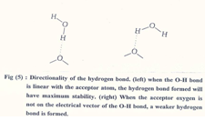
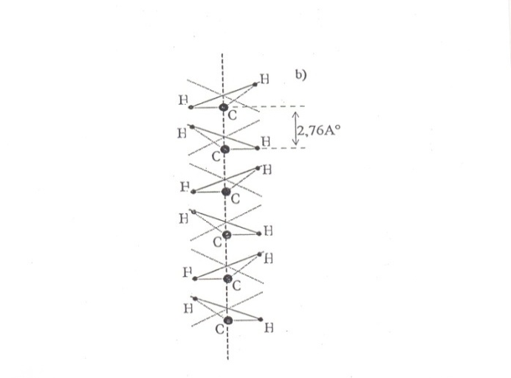
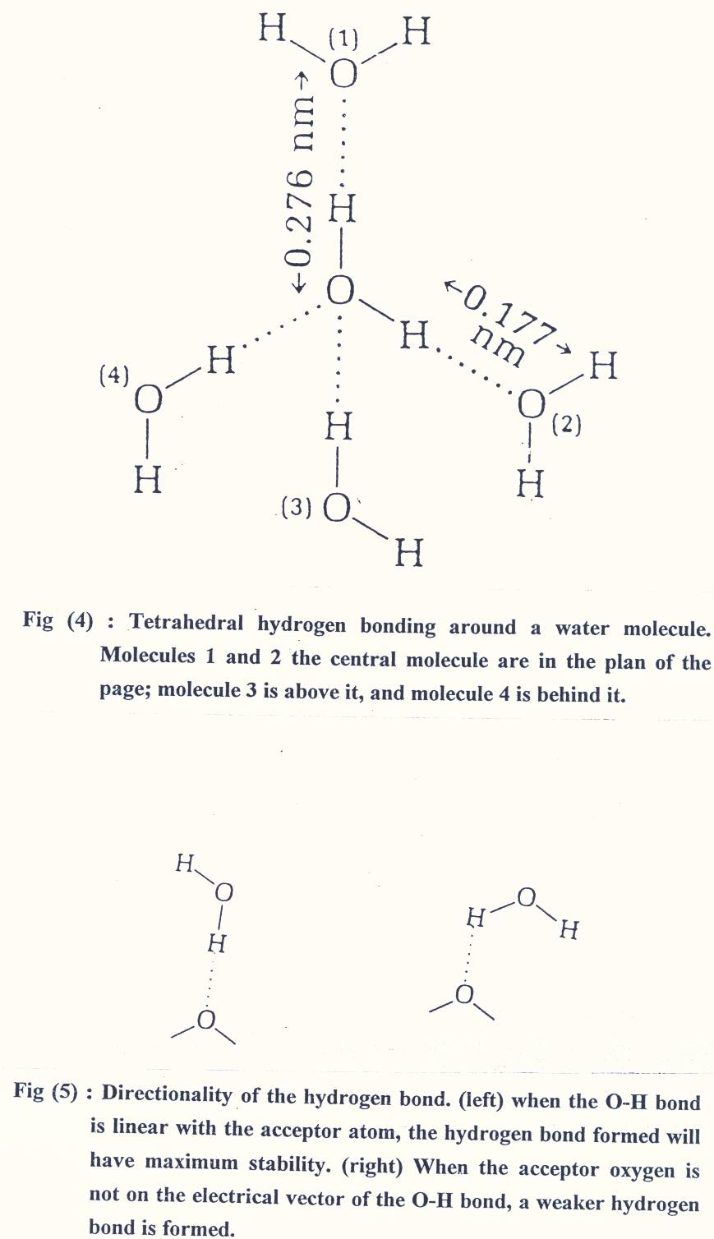
*Scientific Basic
The starting point of any discussion on the effectiveness of magnetic water treatment is generally descriped of the general properties of both magnetization and water structure .
Structure of water molecule :
water molecule consists of one atom of oxygen and two atoms of hydrogen H₂O joined by a chemical bond (hydrogen bond).. Such structure gave water some physical and chemical properties viz., high melting point ,boiling point heat of vaporization and surface tension. Molecule possesses a positive charge on one end and a negative charge on the other which are known (dipole state ), causing it to act like a small bar magnet.

Slide 3

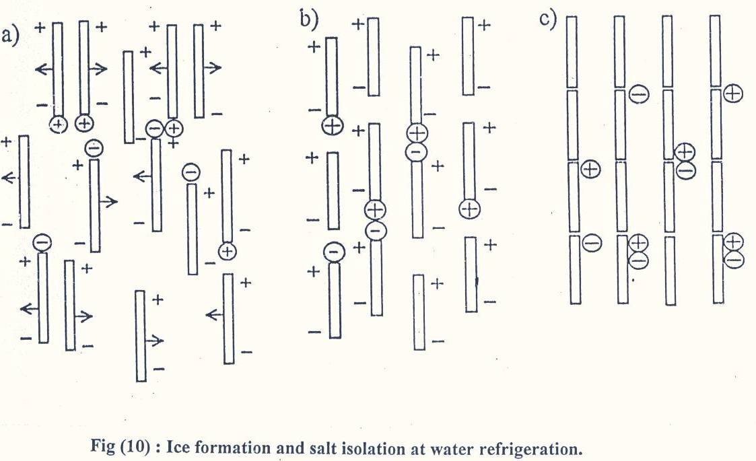

Theory of magnetic water treatment
As any magnetic material ,water solutions and water colloids are easily magnetized when passing through magnetic field and will acquire a magnetic moment for 24-48 hours after crossing the magnetic field. However, such time is good enough for magnetized irrigation water to impose magnetic effect on the soil – plant – water system.
Magnetic treatment of water has been reported to change some of the physical and chemical properties of water, mainly hydrogen bonding, polarity, surface tension, conductivity, pH and solubility of salts .

Slide 4

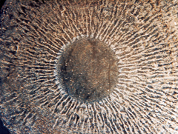
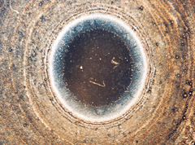
(A): Disassociated dissolved molecules of CaCO3 in water have a tendency to recombine by forming scale which adheres to the inner walls of the piping system, containers, steam vessels, etc.
For Example
(B):Magnetic field causes preferentially the recombination of
the disassociated CaCO3 molecule into aragonite form
water flows through a magnetic field
B. Magnetically treated water
A. Untreated raw water
Source : C. Jack Quinn, I Magnetic treatment of water is an effective method for preventing or drastically reducing the formation of scale or corrosion without the use of chemicals. iron and Steel Engineer July ,pp.47-53 ,1997.

Slide 5
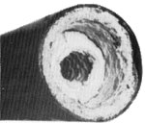
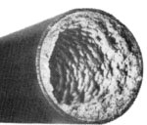
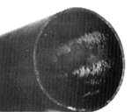
Magnetically Treated Water
Pipe almost closed with salt build-up caused by continual irrigation with untreated water.
The same section of the pipe after a short time of irrigation with magnetically treated water.
After continual treatment, most scale is removed and will be prevented as long as the system is in operation.

Slide 6
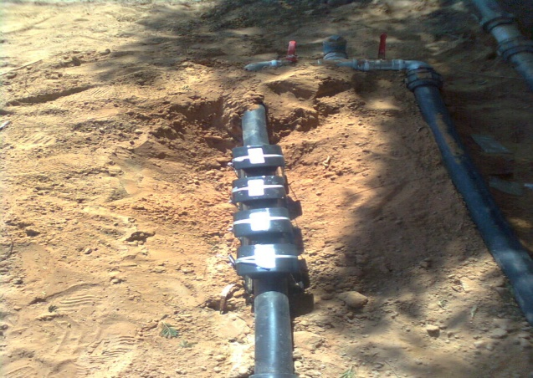
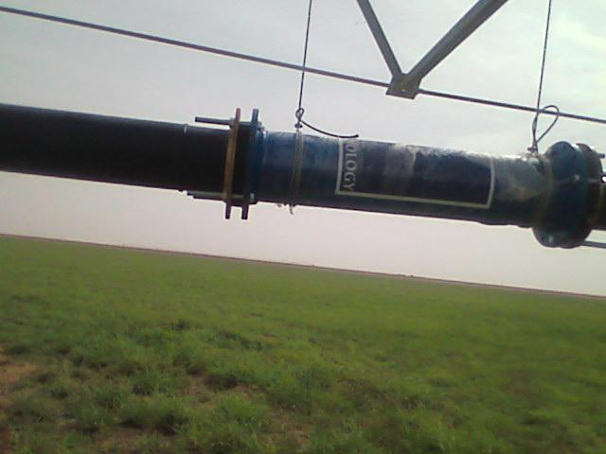
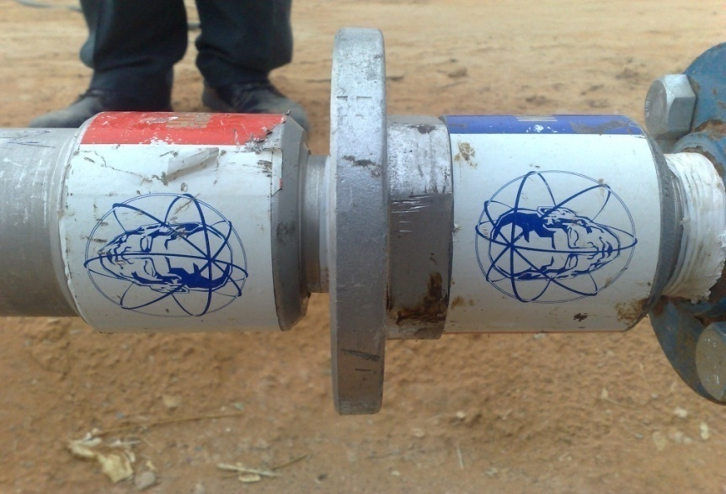
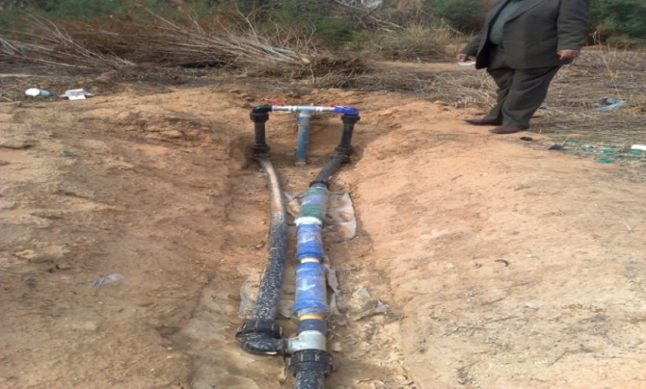

Slide 7
Review of Literature:
The experiment of Oleshko et al., 1981 and Tkatchenko 1997, highlight the using of cheap magnetic energy to improve the properties of soil and water quality.
The response of biological systems to magnetic fields have been reported by various researchers [Goodman et al., 1983; Vakharia et al., 1991; Paradisi et al., 1993; Danilov et al., 1994; Alexander and Doijode, 1995; Blank, 1995; Amaya et al., 1996; Duarte Diaz et al., 1997; Moon and Chung, 2000; Reina et al., 2001; De Souza et al., 2006, 2008; Tenuzzo et al., 2006; Chou, 2007; Florez et al., 2007; Trebbi et al., 2007; Maheshwari and Grewal, 2009].
Magnetic field (MF) affected various characteristics of plants like germination of seeds, root growth rate seedlings growth, reproduction and growth of the meristems cells and chlorophyll quantities. In addition to, the effect of MF on the productivity of different crops ( Aladjadjiyan, 2002; Oldacay, 2002; Aladjadjiyan 2003; Aladjadjiyan and Ylieva 2003; Celik et al., 2008 and selim, 2008).

Slide 8
How to Handel the problem
In
The Present Work

Slide 9
-Field experiments in winter season of 2009/2010 and 2010/2011 were carried out in split plot design with 4 replications at Agriculture Research Station, College of Food and Agriculture Sciences, Derab, near Riyadh, King Saud University, Saudi Arabia.
- The experiment included two factors viz., irrigation with saline under ground water compared to magnetizing water (for magnetizing water, magnetron type U.T 6, with 6 inch diameter was used) and treated waste water were arranged in main plots , whereas selected crops( wheat, barley and triticale) were occupied the subplots.
- soil samples within 0-30 cm depth from eight sites were taken for physical and chemical analyses
-Results showed that soil texture was sandy clay loam ( 50 % sand,26 % silt and 24 % clay ) with high CaCO₃ (29.9),soil pH in 1:25 soil water (8.15) , EC (2.1 dS/m) in extracted soil paste ( 2:1).Soil macronutrients N,P and K were 120.6,270.0 and 124.0 mg/kg soil, respectively . Soil micronutrients in mg/kg soil were 2.4, 15.1, 13.1 and 0.3 for Fe, Zn, Mn and Cu, respectively. Both sources of water irrigation were also analyzed according to the methods described by (APHA
Notes:
Prof. Dr. Mostafa Selim

Slide 10
Water Pump
Magnetic
Magnetron
Under ground brackish
 |  |  |  |  | Border zone (3.0 .m )
 | M .S |  |  |  |  | N.S
 | R1 | R2 | R3 | R4 |  | R1 | R2 | R3 | R4
Wheat
Barley
Triticale
 |  |  |  |  |  | Border zone
Barley
Triticale
Wheat
Treated waste water

Slide 11
RESULTS

Slide 12
RESULTS
* Effect on Germinating Seeds:
- Water previously treated in a stationary magnetic field caused significant effect on germinating seeds. Nearly, full germination rate 93.33 % was obtained after 12 days from sowing.
- Triticale succeeded to produce significantly highest values of germination percentage 90.00 % compared to 79.67 and 87.00 for wheat and barley, respectively.
*Effect of magnetic treatments on micronutrients concentration:
magnetized water caused significant effect on micronutrients concentration Fe, Zn and Mn at heading stage for the three crops under investigation

Slide 13
Effect of magnetic treatments on Growth criteria:
Most of growth criteria under the present study viz., main stem height cm; number of tillers/m²; fresh and dry weight g/m² at tillering and heading stages were increased significantly as the result of irrigation with magnetizing water as compared to irrigation with either underground or treated waste water .
Effect of magnetic treatments on yield and yield component characters:

Slide 14
Discussion:
the effect of magnetic field in rearrange ions of water molecular which reflected in water properties
the manner magnetic field decreases the effect of germination inhibitors due to increase in pH of the cell juice and can substitute for such expensive material, which finally reflected in seed germination percentage.
Magnetic treatment of water has been reported to change some of the physical and chemical properties of water, mainly hydrogen bonding, polarity, surface tension, conductivity, pH and solubility of salts [Smikhina, 1981; Srebrenik et al., 1993; Amiri and Dadkhah, 2006; Otsuka and Ozeki, 2006; Chang and Weng, 2008].
Such increment due to magnetized water may be attributed to the effect of MF in increasing ions mobility in root zone and ions uptake by plant, which are differed greatly from element to another according to element magnetic.

Slide 15
Mechanical and chemical analysis of the experimental soil sites
O.M % | CaCO₃ % | Mechanical analysis |  |  |  | salinity | pH | Depth | Texture
 |  | Clay % | Silt % | Fine Sand % | Coarse sand % | EC dS/m
0.45 | 29.9 | 24.0 | 26.0 | 15.1 | 34.9 | 1.5 | 8.6 | 0 - 30 | sandy clay loam
Chemical composition of treated wastewater and under ground brackish water used in irrigation
Water sources | EC dS/m | pH | SAR | Cations, (meq/l) |  |  |  | Anions (meq/l)
 |  |  |  | Ca+ | Mg+ | Na+ | K+ | CO₃⁻ | HCO₃⁻ | CL⁻ | SO₄⁻⁻
Wastewater | 1.4 | 6.2 | 2.7 | 100 | 30 | 121.4 | 13.7 | 1.48 | 83.9 | 146.3 | 408.2
Under ground water | 6.6 | 8.0 | 7.7 | 360 | 216 | 752.1 | 22.2 | 18.8 | 198.3 | 896.4 | 1744.6
Magnetizing water | 6.5 | 7.8 | 7.7 | 360 | 216 | 752.1 | 22.2 | 18.8 | 198.3 | 896.4 | 1744.6

Slide 16
Water treatment | Crop | Grain yield ton/ha. | Straw yield ton/ha. | Biological yield ton/ha.
Magnetic water | Wheat | 5.606 | 3.045 | 8.652
 | Barely | 7.965 | 2.996 | 10.961
 | Triticale | 9.300 | 3.762 | 13.062
General Mean of Magnetic Treatment |  | 7.624 | 3.268 | 10.892
Under-ground water | Wheat | 5.340 | 2.483 | 7.823
 | Barely | 6.790 | 2.543 | 9.333
 | Triticale | 7.500 | 3.277 | 10.777
General Mean of under-ground water |  | 6.543 | 2.768 | 9.311
Treated waste water | Wheat | 5.780 | 3.195 | 8.975
 | Barely | 8.330 | 3.200 | 11.530
 | Triticale | 9.700 | 3.933 | 13.633
General Mean of Treated waste water |  | 7.937 | 3.446 | 11.379
General Mean of different crops: Wheat Barley Triticale |  | 5.575 7.695 8.833 | 2.908 2.913 3.657 | 8.48 10.61 12.49
LSD for : Water sources Crop Interaction |  | 1.00 1.87 2.12 | 0.26 0.66 0.57 | 1.34 2.00 1.54

Slide 17
Germination percentage for some cereal crops as affected by different water irrigation sources (Means of two seasons)
Water treatment | Crop | Emergence hills Counts, in 3 lines one meter length after |  |  | Germination Percentage (%)
 |  |  |  |  | 6 days | 9days | 12 days
 |  | 6 days | 9days | 12 days
Under ground brackish water | Wheat | 21 | 30 | 42 | 35 | 50 | 70
 | Barley | 24 | 36 | 48 | 40 | 60 | 80
 | Triticale | 34 | 44 | 48 | 57 | 74 | 80
General Mean of under ground water |  | 26.33 | 36.67 | 46.0 | 44.0 | 61.33 | 76.66
Magnetized water | wheat | 34 | 42 | 53 | 57 | 70 | 89
 | Barley | 36 | 46 | 56 | 60 | 77 | 94
 | Triticale | 39 | 47 | 58 | 65 | 79 | 97
General Mean of Magnetic Treatment |  | 36.33 | 45.00 | 55.67 | 60.67 | 75.33 | 93.33
Treated waste water | wheat | 28 | 36 | 48 | 47 | 60 | 80
 | Barley | 33 | 42 | 52 | 55 | 70 | 87
 | Triticale | 35 | 45 | 56 | 59 | 75 | 93
General Mean of Treated waste water |  | 32.00 | 41.00 | 52.00 | 53.67 | 68.33 | 86.00
General Mean of different crops: Wheat Barley Triticale |  | 27.67 31.00 36.00 | 36.00 41.33 45.33 | 47.67 52.00 54.00 | 46.33 51.67 60.33 | 60.00 69.00 76.00 | 79.67 87.00 90.00

Slide 18
Conclusion :
Now research project funded by KING ABDULAZIZ CITY For SCIENTIF TECHNOLOGY is successfully start to evaluate the effectiveness of some magnetic apparatus
These changes in water properties may be capable of affecting the growth of plants.

