Slide 1
Monorail Technology

Slide 2
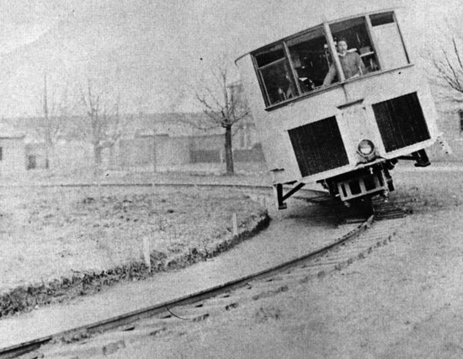
HISTORY OF MONO RAIL
Monorails have been around since the 1800s, the first monorail was made in Russia in 1820 by Ivan Elmanov, but only really came to public attention in the 1950s when Walt Disney installed one in his new theme park: Disneyland, California.
Gyro Monorail in 1909

Slide 3
Monorail at Disneyland, California

Slide 4
Modern monorails are based on a single solid beam that supports and guides the train; the carriages are either suspended beneath the track, or sit on top. A steel or reinforced concrete beam in the range of 2 to 3 feet (0.61 to 0.91 m) wide is used as track. The straddle-beam style was popularized by the German company ALWEG. Conductive shoes on the carriages then transmit the current to the train. Monorail is raised at a minimum height of 5.5 meters from ground level on columns.
The carriages have pneumatic rubber tyres, which drive along the top of beam. Rubber-tired carriage contacts the beam on the top and both sides for traction and to stabilize the vehicle and to prevent side-to-side swaying of the train, and also helping to guide the carriages.

Slide 5
Wheel Arrangement Of Monorail

Slide 6
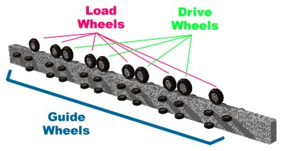

Slide 7
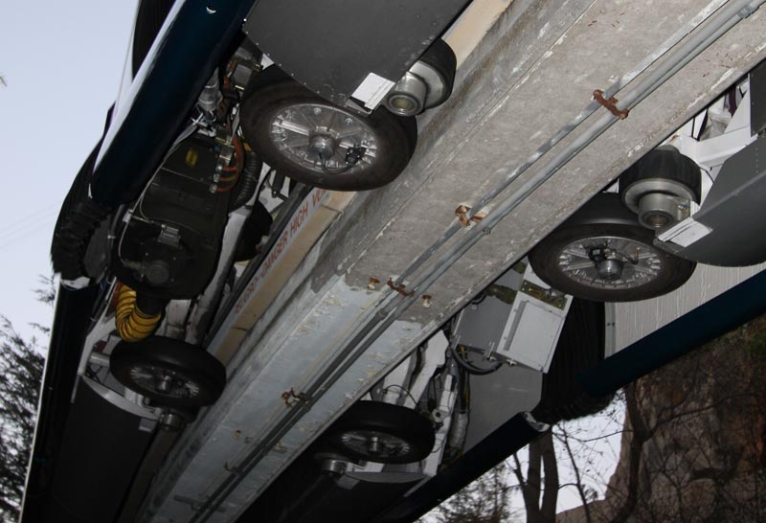

Slide 9
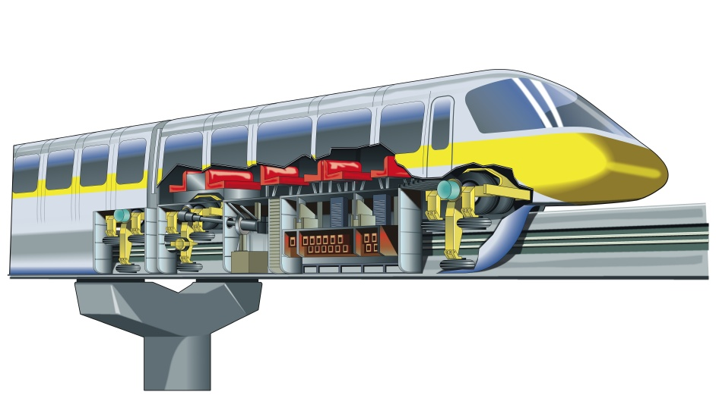
Almost all modern monorails are powered by electric motors fed by dual third rails, contact wires or electrified channels attached to or enclosed in their guidance beams. However, diesel-powered monorail systems also exist.

Slide 10
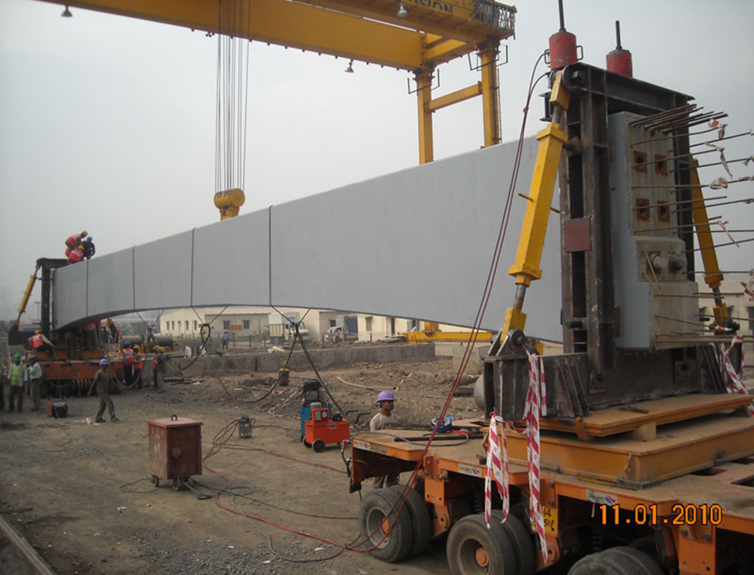
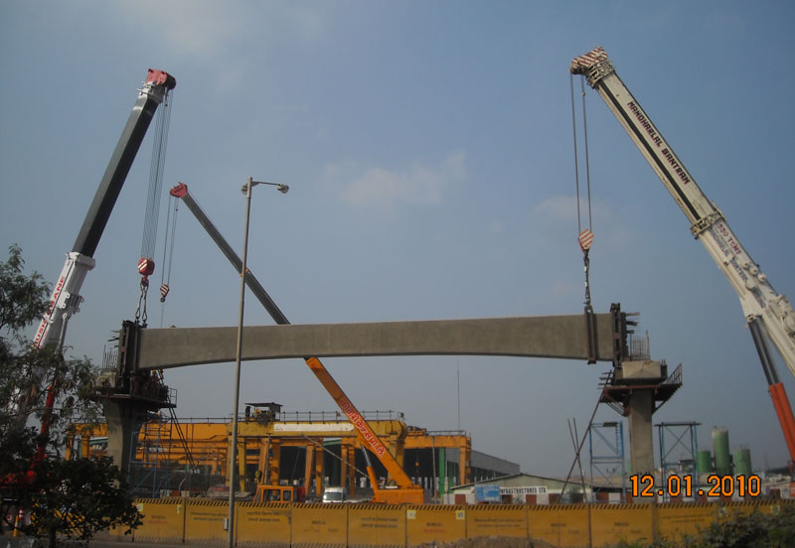
Construction of Monorail Track
Laying Saddle beam

Slide 11
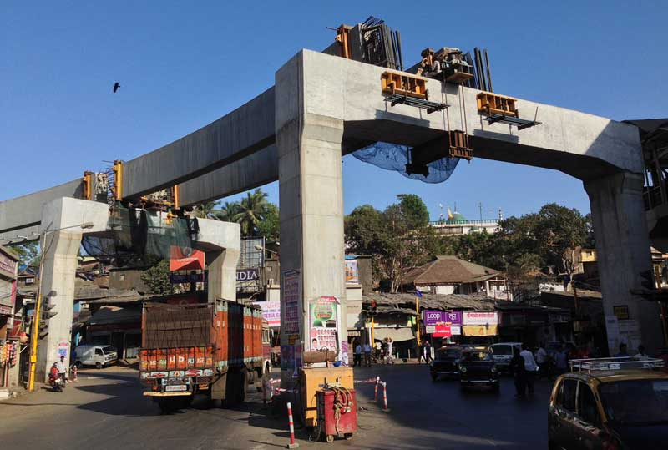
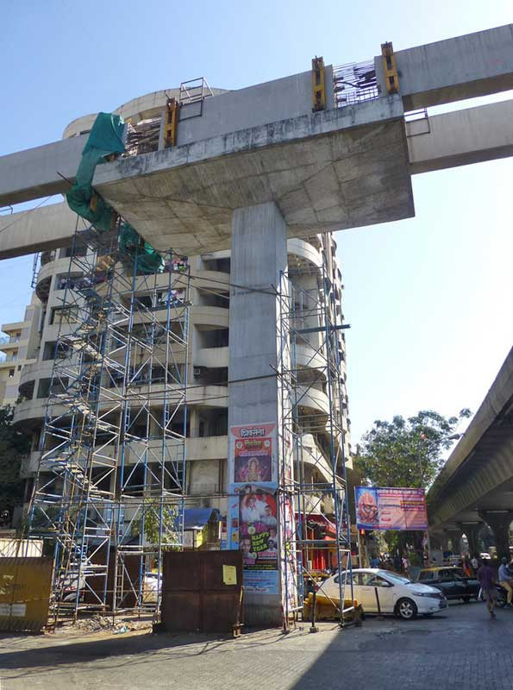

Slide 13
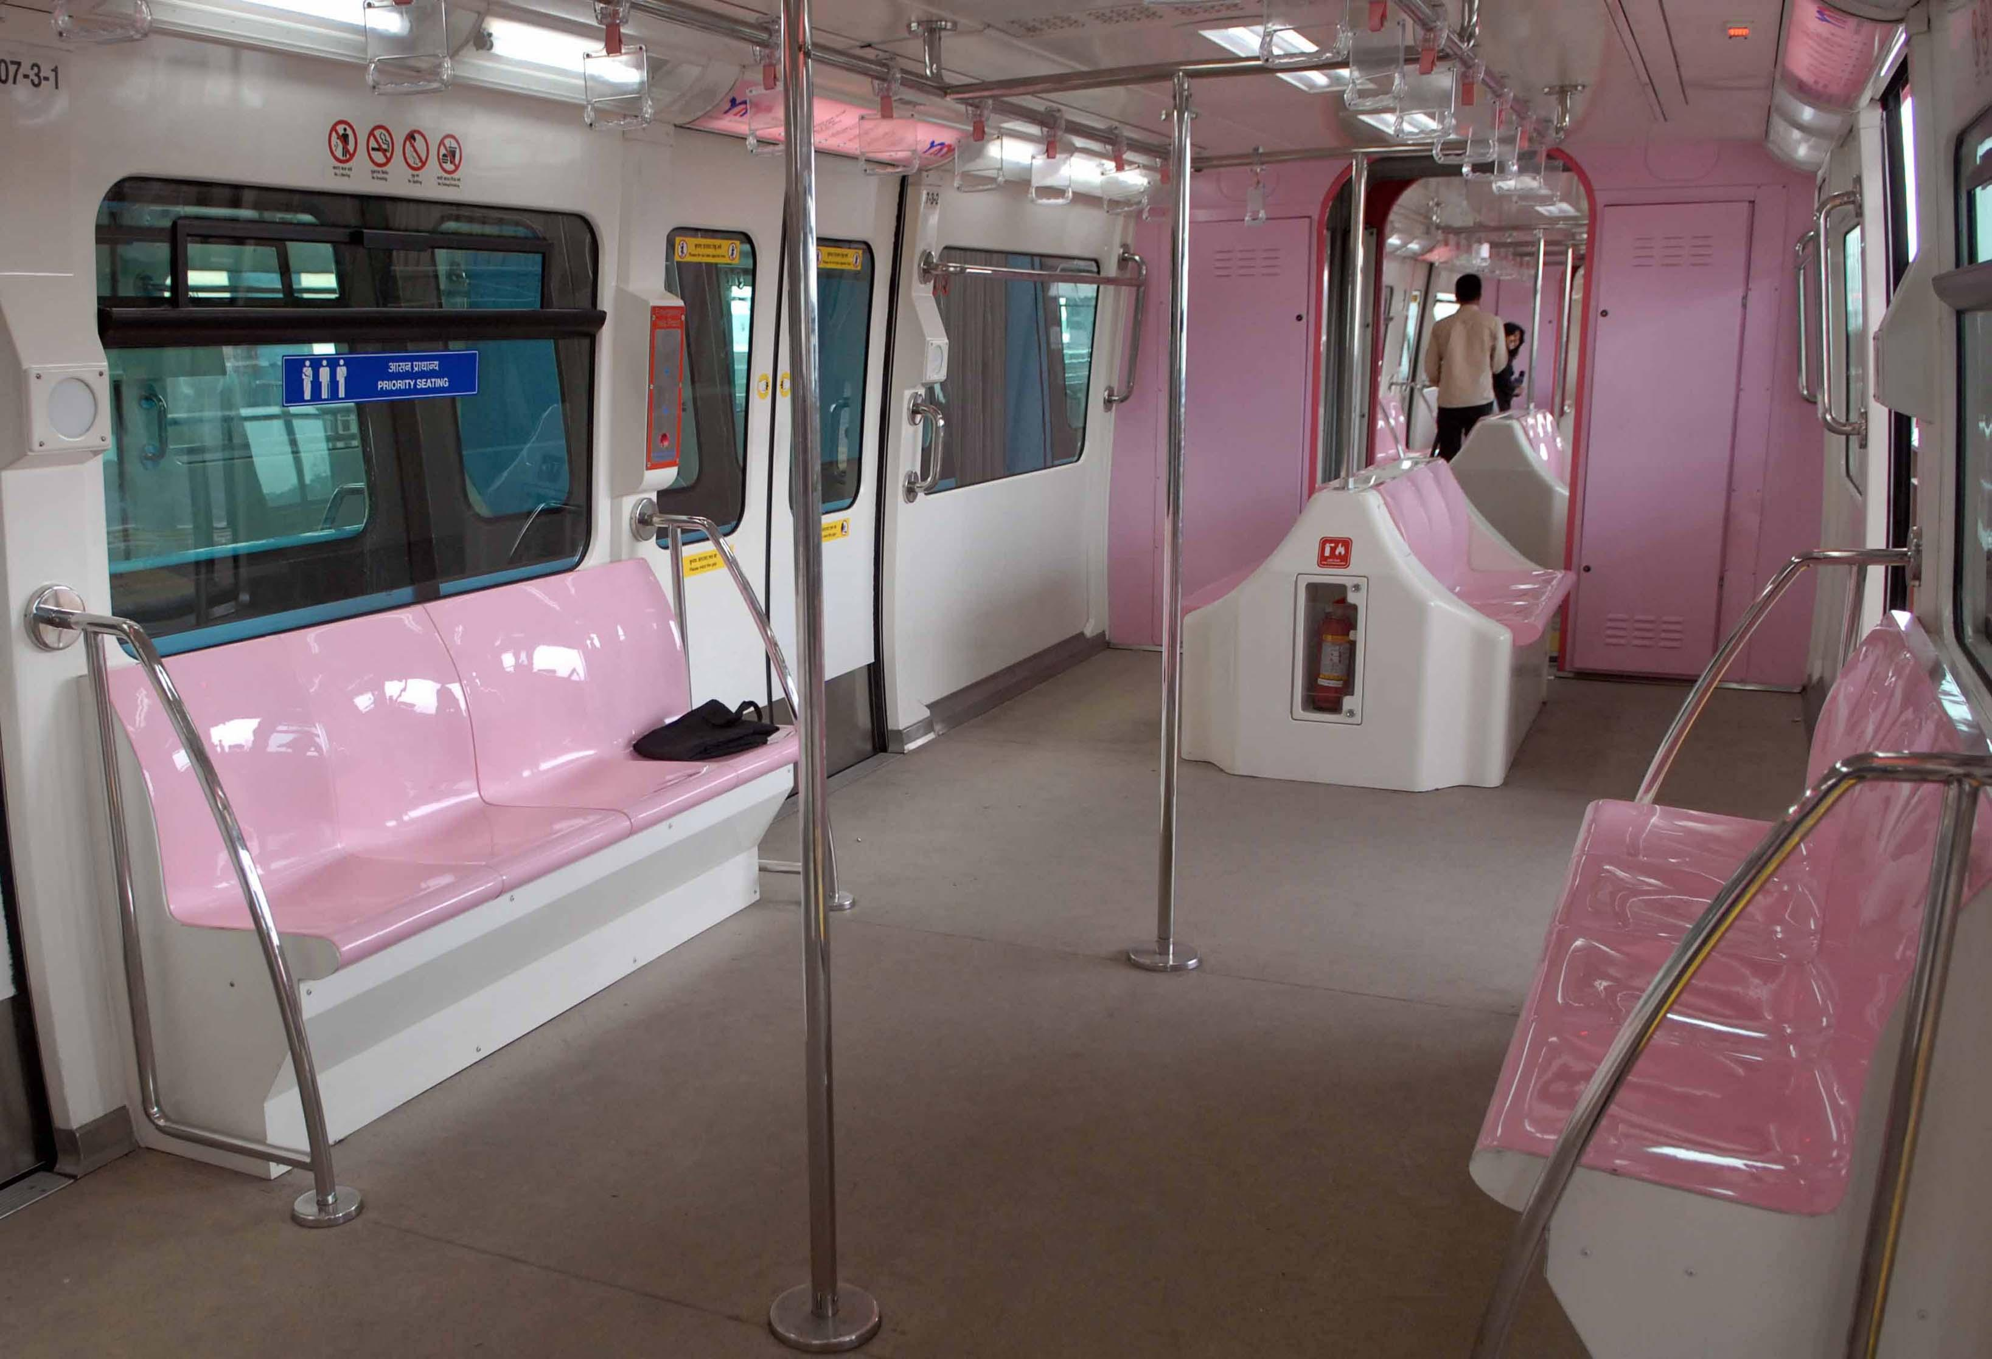
Inside Monorail

Slide 14
CONCLUSION :
The advantages of monorail technology are tremendous. For overpopulated Indian urban areas, it seems to be the best solution for safe, quality, and inexpensive mass public transportation.
After successful run in Mumbai, this technology, will become the solution for urban public transportation in 21st century for India.

