Slide 1
The Money Markets

Slide 2
Characteristics
Sold in large denominations
Have low default risk
Mature in one year or less from their original date of issue
Do not take place in any one particular location
Trades usually over phone and completed electronically

Slide 3
Characteristics
Active secondary market
Wholesale markets

Slide 4
Why do we need money markets?
In unregulated world, money markets are not needed
Why?

Slide 5
Banks
Provide short-term loans
Accept short-term deposits
Have an efficiency advantage in gathering information
Should eliminate the need for money markets

Slide 6
Banks
Enjoy continuing relationship with customers
Enjoy efficiency advantage in gathering information
Evaluation of each borrower every time a new security is offered is easier for banks
Should be able to offer loans more cheaply in diversified markets
Should eliminate the need for money markets

Slide 7
Banks
Short term securities offered for sale in the money markets are neither as liquid nor as safe as deposits placed in banks and thrifts
Exist primarily to mediate the asymmetric information problem between saver-lenders and borrower-spenders
Capture economies of scale while providing this service

Slide 8
Why do money markets exist?
Where asymmetric information problem is not severe, the money markets have a distinct cost advantage over banks in providing short-term funds
How?

Slide 9
Banks
Subject to more regulations and governmental costs than are the money markets
Don’t invest 100% of their deposits
Put aside a portion of their deposits in the form of reserves that are held without interest at the Central Bank
Must pay less interest rate to depositors than if full deposit could be invested

Slide 10
Banks
Interest rate regulations existed historically to reduce competition among banks
Before it was repelled, money markets were established

Slide 11
Money markets
However, cost structure of banking industry makes it unable to compete effectively in the market for short-term funds against less restricted money markets

Slide 12
Purpose of money markets
Cash inflows and outflows are rarely synchronized
Ideal for firm or financial institution to ‘warehouse’ surplus funds until they are needed
Provide low-cost source of funds for firms, the government, and intermediaries that need a short-term infusion of funds

Slide 13
Participants of money markets
Treasury department:
Always a demander of money market funds and never a supplier
Issues treasury bills to raise funds until tax revenues are received

Slide 14
Participants of money markets
Federal Reserve System:
Treasury’s agent for the distribution of all government securities
Holds vast quantities of treasury securities
Sells treasury bills if money supply should be reduced
Buys treasury bills if money supply should be expanded

Slide 15
Participants of money markets
Commercial Banks:
Buy treasury securities
Issue negotiable certificates of deposit, banker’s acceptances, federal funds, and repurchase agreements
Offer individual investor accounts that invest in money market securities

Slide 16
Participants of money markets
Businesses:
Buy and sell various short-term securities as a regular part of their cash management

Slide 17
Participants of money markets
Investment companies
Finance companies (commercial leasing companies)
Insurance companies
Pension funds
Individuals
Money market mutual funds

Slide 18
Money market instruments

Slide 19
Treasury bills
Most liquid
Discount securities
zero default risk
Inflation risk low because of short maturity
Market is deep and liquid

Slide 20
Treasury bills
Deep market: many different buyers and sellers
Liquid market: securities can be bought and sold quickly and with low transaction costs
Investors in markets that are deep and liquid have little risk as they can buy and sell securities when they want

Slide 21
Discounting the price of treasury securities to pay interest

Slide 22
Discounting
Most money market securities do not pay interest
Investor pays less for the security than it will be worth when it matures and the increase in price provides a return

Slide 23
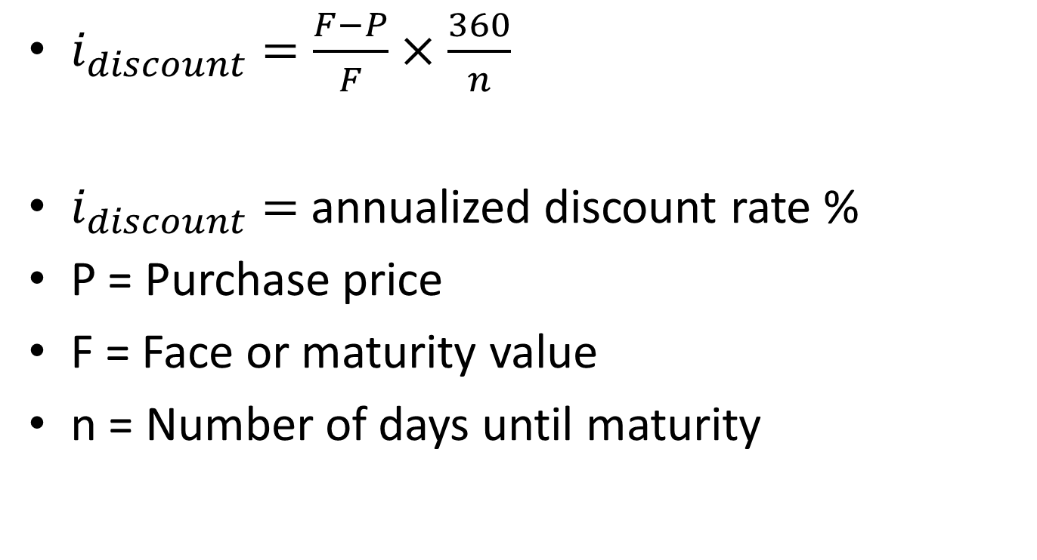
Annualized discount rate calculation
$i_{discount}=\frac{F−P}{F}×\frac{360}{n}$
$i_{discount}=$ annualized discount rate %
P = Purchase price
F = Face or maturity value
n = Number of days until maturity

Slide 24

Investment rate calculation
What investor earns
$i_{investment}= \frac{F−P}{P}×\frac{365}{n}$

Slide 25
Federal funds
Short-term funds transferred (loaned or borrowed) between financial institutions usually for a period of one day
Banks with excess reserves loan them to banks that need them

Slide 26
Repurchase agreements
Nonbanks participate
A firm can sell treasury securities in a repurchase agreement whereby the firm agrees to buy back the securities at a specified future date
Collateralized with treasury securities
Carry low risk and hence low interest rate

Slide 27
Negotiable certificates of deposit
Bank issued security that documents a deposit
Specifies the interest rate and the maturity date
Term security
Bearer instrument

Slide 28
Commercial paper
Unsecured promissory notes issued by corporations
Normally mature in 270 days
Only largest and most creditworthy corporations issue
Interest rate the corporation is charged reflects the firm’s level of risk

Slide 29
Banker’s acceptances
An order to pay a specified amount of money to the bearer on a given date
International trade

Slide 30
Eurodollars
Dollar-denominated deposits at foreign banks or foreign branches of American banks
Deposits of large sums, time deposits of less than 6 months
Eurodollar CD – liability of a non-US branch of a bank
Less liquid and more risky than domestic CDs and offer higher yields

Slide 31
Interest rates
All the money market instruments move closely as all have low risk and short term
Deep markets and priced competitively
Close substitutes

Slide 32
Liquidity
How quickly, easily and cheaply security can be converted into cash
Depth of the secondary market is the determinant
Treasury bills are most liquid
Commercial paper are least liquid
Money market mutual funds provide liquidity intervention

Slide 33
Valuation of money market securities
PV = FV/(1+i)^n

