Slide 1
Hello! CHAPTER#1 Survival model part(1): probability functions
Salma Alsuwailem

Slide 2
Future life time notations!
Let (x) represent a life aged x. Note that x must be greater than or equal to zero, with (0) representing a newborn (i.e., a life aged 0).
(Tx) is a continuous random variable for the future lifetime of (x).
Sx(t)=Pr[(x)survives at least t-years]=Pr[Tx>t]
Fx(t)=Pr[(x)dies within t-years]=Pr[Tx≤t]
Salma Alsuwailem

Slide 3
Salma Alsuwailem

Slide 4
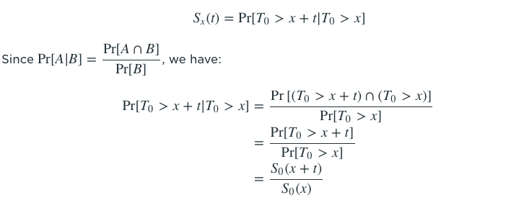
Survival function
Salma Alsuwailem

Slide 5
There are three properties that Sx(t) must satisfy:
Sx(0)=1 The probability that a life currently aged x survives 0 years to age x is 1, as that life is currently alive at age x.
Sx(∞)=0 The probability that a life aged x survives to infinity is 0, as no one lives forever.
From Properties 1 & 2, observe as t increases from 0 to ∞, Sx(t) decreases from 1 to 0. Thus, Sx(t) is a non-increasing function of t. This means the probability of (x) surviving a longer amount of time should never exceed the probability of (x) surviving a shorter amount of time.
Salma Alsuwailem

Slide 6
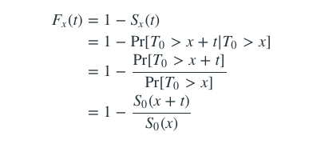
Cumulative Distribution function
Salma Alsuwailem

Slide 7
There are three properties that fx(t) must satisfy:
Fx(0)=0 The probability that a life currently aged xx dies within 0 years before age 0 is 0, as that life is currently alive at age x.
Fx(∞)=1 The probability that a life aged x dies within an infinite amount of years is 1, as no one lives forever.
From Properties 1 & 2, notice as t increases from 0 to ∞, Fx(t) increases from 0 to 1. Thus, Fx(t)is a non-decreasing function of t. This means the probability of (x) dying within a shorter amount of time should never exceed the probability of (x) dying within a longer amount of time.
Salma Alsuwailem

Slide 8
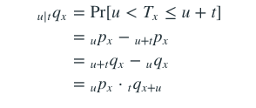
Actuarial notations
1
2
3
Probability of Survival
Probability of Death
tqx=Fx(t)
tqx=1−tPx
Deferred Probability of Death
u|tqx, is the probability that a life aged x survives u years and then dies within the following t years.
tPx=Sx(t)
tPx=Px⋅Px+1⋅⋯⋅Px+t−1
Salma Alsuwailem

Slide 9
Curtate Future life time
we have discussed Tx, a continuous random variable. We now introduce Kx, a discrete random variable.
Tx is called the future lifetime variable for a life aged x.
Kx is called the curtate future lifetime variable for a life aged x (K stands for kurtate). Both Tx and Kx are important in many insurance applications.
Kx is the discrete random variable for number of completed future years by a life aged x prior to death Kx=⌊Tx⌋.
Salma Alsuwailem

Slide 10
Curtate Future life time
Observe:
If a life aged x dies within the first year, how many future years has that life completed? 0. Thus, Kx=0.
If a life aged x survives one year and then dies within the following one year, how many future years has that life completed? 1. Thus, Kx=1
If a life aged x survives k years, becomes age x+k, and then dies within the following one year, how many future years has that life completed? k. Thus, Kx=k
Salma Alsuwailem

Slide 11
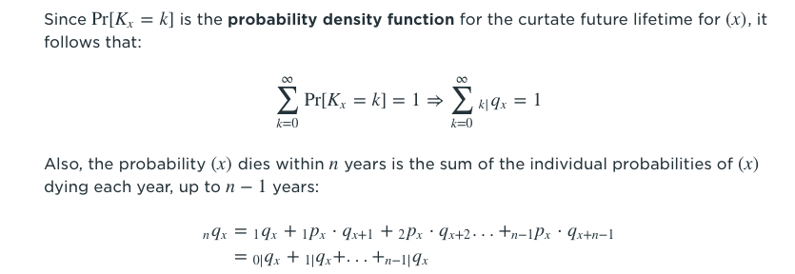
Curtate Future life time
Pr[Kx=k]= Pr(k ≤Tx < k+1) =kPx⋅qx+k=k|qx
Salma Alsuwailem

Slide 12
examples
You are given a survival function $S_{0}$(x)=1−0.01x for 0<x≤100.
Determine the median future lifetime of a life aged 10. (Note: the 100pth percentile of the future lifetime of a life aged x is the value πp such that Pr[Tx≤πp]=p.)
A 40
B 45
C 50
D 55
E 60
Salma Alsuwailem

Slide 13
Which of the following can serve as survival functions for x≥0?
I $S_{0}$(x)= exp(x)
II. $S_{0}$(x)= $\frac{1}{{(1+X)}^{2}}$
III. $S_{0}$(x)= exp(${−X}^{2}$)
A I and II only
B I and III only
C II and III only
D I, II and III
E The correct answer is not among the other choices.
Salma Alsuwailem

Slide 14
You are given the following survival function of a newborn:
Calculate the probability that (30) dies within the next 20 years.
A 0.13
B 0.15
C 0.17
D 0.19
E 0.2
Salma Alsuwailem

Slide 15
You are given:
qx+k =0.1(k+1), k=0,1,2,...,9.
Calculate the following:
(a) Pr(Kx = 1) (b) Pr(Kx ≤ 2)
Salma Alsuwailem

Slide 16
For (x):
(i) K is the curtate future lifetime random variable.
(ii) qx+k =0.1(k+1), k=0,1,2,...,9
Calculate Var(K ∧ 3).( Note: The notation ∧ means “minimum”. So here K ∧ 3 means min(K, 3). )
A 1.1
B 1.2
C 1.3
D 1.4
E 1.5
Salma Alsuwailem

Slide 17
Express the probabilities associated with the following events in actuarial notation.
(a) A new born infant dies no later than age 35. (b) A person age 10 now survives to age 25. (c) A person age 40 now survives to age 50 but dies before
attaining age 55. Assuming that $S_{0}$(t)= = exp(−0.005t) for t ≥ 0, evaluate the probabilities.
Salma Alsuwailem

Slide 18
You are given:
$f_{0}$(t)= $\frac{{(30−t)}^{2}}{9000}$ , for 0 ≤ t < 30
Find an expression for t$P_{5}$
Salma Alsuwailem

Slide 19
You are given:
(i) 2px = 0.98
(ii) px+2 = 0.985
(iii) 5qx = 0.0775
Calculate the following:
(a) 3px
(b) 2px+3
(c) 2|3qx
Salma Alsuwailem

Slide 20
THANKS!
Any questions?
Salma Alsuwailem

