Slide 1

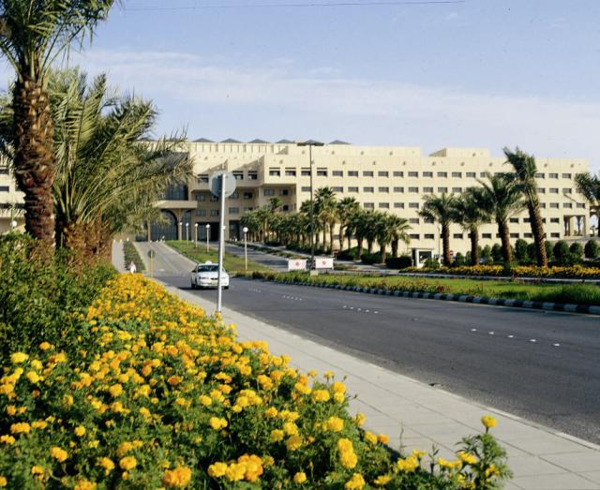
قسم الصيدلانيات
كلية الصيدلة
جامعة الملك سعود
PHT 432)) Industrial Pharmacy
Dr. Fars Alanazi
AA101

Slide 2
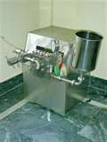
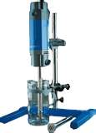
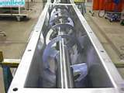
6-7
Lectures
Mixing

Slide 3
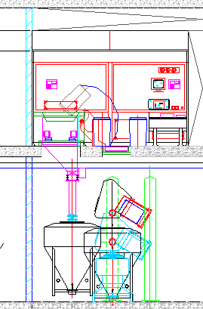
Solid Dose Form Operations
Weighing
  Dispensing/Pharmacy/
  Subdivision
Mixing
  Dry Blend
  Wet Blend
Particle Sizing
  Screening
  Milling
  Micronizing
Granulation/Drying/Coating
  High Shear
  Fluidized Bed
  Compaction
  Micro-encapsulation

Slide 4
Solid Dosage Process Flow
Raw
Materials
Granulation/
Drying/
Milling
Ingredient
Dispensing
Blending
Compression
Granulation
Solution
Prep
Coating
Solution
Prep
Coating
Packaging

Slide 5
Outline of the lecture:
Mixing
Definition and objectives
Mixing equipment
Impellers for liquids
Mixers of dry powders
  Factors affecting mixing of solids
  Tumbling mixers
  Agitator mixers
  Special mixers for powders
  Entolator impact when mixer
  Pneumatic mixer
  V-type mixer
Mixers for semisolids
  Types of flow in semisolids
  Beaters
  Kneaders
  Mixer-Extruders

Slide 6
Definition:
It is the intermingling of two or more dissimilar portions of materials resulting in attainment of a desired level of uniformity either physically or chemically.
Perfect mixing:
It is that state in which any sample removed from the mixture will have exactly the same composition as any sample taken from any point of the mixture.

Slide 7
Random mixing:
It is the state in which there is a probability of finding the particles of a given components the same at all points in the mixture and is in the same ratio of components in the entire mixture.
Objectives of mixing:
Attainment of complete and mutual distribution of the constituent materials.
Increasing the contact surface thus promoting chemical and physical reactions.

Slide 8
Mixing equipment:
These are classified according to materials intended to be mixed into:
    Impellers for liquids
    Mixers for powders
    Mixers for semisolids or pastes.

Slide 9
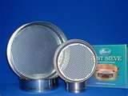
Outline of the lecture:
Mixing
Definition and objectives
Mixing equipment
Impellers for liquids
Mixers of dry powders
  Factors affecting mixing of solids
  Tumbling mixers
  Agitator mixers
  Special mixers for powders
  Entolator impact when mixer
  Pneumatic mixer
  V-type mixer
Mixers for semisolids
  Types of flow in semisolids
  Beaters
  Kneaders
  Mixer-Extruders

Slide 10
I. Impellers for liquids
There are three types:
1- Paddle 2- Turbine 3- Propeller
The performance for impeller mixer depends on :
Creation of a current or stream of liquid which penetrate to all point of mixing vessel or tank.
Turbulence movement to carry the current in all places of the tank.

Slide 11
Types of flow in liquids:
Tangential flow (Rotational): the liquid flows as circles around the impeller shaft.
Radial flow: flow of liquid in a direction to­ward the walls of the tank verti­cal to the impeller shaft.
Axial or longitudinal flow: flow of liquid up and down parallel to the impeller shaft

Slide 12
Propeller mixers for liquids:
(a) propeller centered, vertical, unbaffled ; (b) pro­peller central vertical, baffled ; (c) propeller off center, inclined, unbaffled; (d) side­ entering arrangement for large tanks .
The three types may exist and in this case efficient mixing occurs.

Slide 13
Disadvantage of tangential flow:
If the tangential flow predominates, vortex forms also symmetry of apparatus (i.e. presence of shaft in center) leads to vortex formation.
Disadvantages of vortex:
  No real mixing.
  Settling of solid particles in the bottom and no dissolution
  Air may be entrapped in solution causing degradation of oxdisable materials.

Slide 14
Suppression of vortex:
To avoid vortex formation:
(1) In small tanks: Off-centering of the shaft or put the shaft inclined

Slide 15
(2) In large tanks: One use baffles on the wall or near to it
3) In very large tanks : The shaft is introduced from the side of the tank in a horizontal position.

Slide 16
Types of impellers for mixing liquid dosage forms:
1- Paddles
Revolution 20 -120 (r.p.m)
The current are tangential and radial, there is no axial current.
The diameter of the shaft is 50 - 80 % of the diameter of mixing tank
Width of the blade is 1/6 – 1/10 its length.
It is suitable for mixing thin liquids having viscosity of about 1000 centi­poises.

Slide 17
Gate Paddle can be used for viscous liquids
Disadvantages:
It Cannot be used for liquids with viscosities more than 1000 centi­poises.
They are ineffective in suspending heavy solids because of absence of axial flow.

Slide 18
2- Turbines
Resemble paddles but the blades are more.
Revolution: 110 - 200 revolution/min.
Diameter of the shaft: 30 - 50% of the inside diameter of the container
Orientation of baffles and angles of blades

Slide 19
The blades may be straight, curved, vertical or pitched (inclined with angle 45°).
The currents in these turbines may be radial and tangential ( increasing velocity cause increase in the radial current)
The turbine mixers are effective in mixing liquids with viscosities up to 100,000 centipoises.

Slide 20
3- Propellers
a - Aircraft propeller b- Marine Propeller
Revolution: 400 - 1750 revolution / min.
Currents: Axial and tangential
Uses: They are used for suspending heavy solid particles to be kept in suspension. Also they are suitable for rapid mixing of thin liquids. They are not used for liquids having viscosities more than 5000 cen­tipoises (due to absence of radial flow)

Slide 21
Special mixers for liquids
Cone mixer:
Moves with higher speeds so give efficient mixing.

Slide 22
Disc impeller :Round discs of different configuration are mounted on the rotating shaft to increase mixing efficiency.
In mixing of syrups , liquid dosage forms light suspensions in pharmaceutical industry, one use the stainless steel steam jacktet mixing tanks.

Slide 23
II. Mixers for dry powders
Purposes of dry powder mixing:
For preparation of multidose dry powder, e.g., effervescent salts or antacids. So the constituents must be well mixed to give a uniform dose.
Mixing of ingredients before compressed as tablets or filled into capsules or for preparing any solid dosage form.

Slide 24
Scale of Scruting:
It is the smallest amount of a drug that can be mixed well .If the dose of the drug in the mixture is less than the scale of scruting, the normal mixing methods fail to attain efficient mixing.In this case geometric ,i.e., dilution mixing must be adopted .
Mechanisms of Powder mixing:
During the mixing process of dry powder the particles may be subjected to three types of forces :
1- Compression
2- Tensile force (Tension)
3- Shear(change in the positions of the mixture components)

Slide 25
In mixing of powder one need for application of shearing force to change the position of particles and give efficient overall movement of particle.
Localized shear forces are applied as agitator or ribbon. This cause overall movement of powder giving efficient mixing, but may cause some sort of size reduction which would be undesirable.

Slide 26
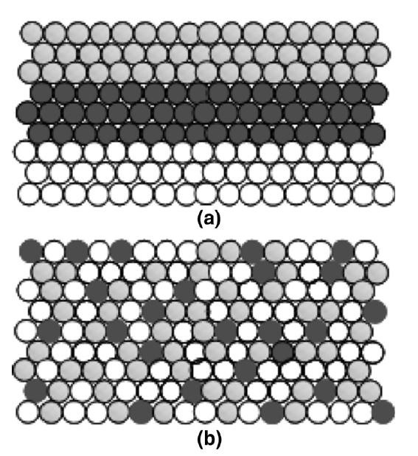

Slide 27
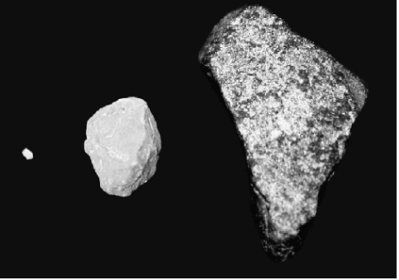
Factors affecting mixing of solids:
Particle size:
  The particle sizes must be nearly similar in all particles of the mixture.
  Increasing the difference in particle size will lead to segregation (size separation), since small particles can fall through the voids between the larger particles.
  Constant movement of the mixer may lead to suspension of fine particles in air. So stop the mixer immediately or remove the air.

Slide 28
2- Density
  The difference in densities among mixed particles will lead to segregation. The heavy particles settle down while light ones will rise up.
  This is aggravated if the heavy particles are coarse and the light particles are finer
  So mixed particles would be equal in density to attain good mixing.

Slide 29
3- Electrostatic charges:
  These charges are formed due to constant friction among the mixed particles.
  Similar charges repel particles from each others leading to segregation.
  This can be overcome by:
    Stopping the mixing equipment. (no increase in time of mixing)
    Adding wetting agent or surface active agent which neutralize similar developed charges on the particles
    Adding some water and evaporate it after the mixing operation is completed (if water do not affect stability of components)

Slide 30
Conditions to for good mixing
Capacity of mixer: the mixer must not be overfilled or low - filled. Overfilling reduces the efficiency and do not allow sufficient space for dilation of the powder. Overfilling prevents the movements of the powders.
Application of shear force to cause change of the posi­tion of powders so give complete and efficient mixing.
Optimum time for mixing (determined by experience). Increasing the time of mixing will cause segregation while decreasing the time of mixing will not give complete mixing.
Light handling of powder to prevent segregation.
Mixer operates in three dimensions

Slide 31
Outline of the lecture:
Mixing
Definition and objectives
Mixing equipment
Impellers for liquids
Mixers of dry powders
  Factors affecting mixing of solids
  Tumbling mixers
  Agitator mixers
  Special mixers for powders
  Entolator impact when mixer
  Pneumatic mixer
  V-type mixer
Mixers for semisolids
  Types of flow in semisolids
  Beaters
  Kneaders
  Mixer-Extruders

Slide 32
Type of mixers for powder
I- Tumbling mixers:
Here, the movement of particles occurs by tilting the material beyond angle of repose using gravity to impel flow

Slide 33
1- Tumbling barrel or drum mixer :
Consist of cylindrical vessel rotating on its horizontal axis. Gravity impels flow.
To increase the efficiency, put the mixer in­clined.
It gives light movement so it is suitable for friable particles when. Disadvantageous in low shear force

Slide 34
2- Cubical - shaped blender
Mixing occurs by sliding of powder on its wall and gives mixing in three di­mensions if hanged from the corner.
Disadvantages:
Difficult in cleaning due to presence of different corners.
Sliding action causes abrasion of particles

Slide 35
3- Double cone blender: Composed of two cones joined to short cylindrical section. It is easily cleaned. It is charged by 50 % of its capacity by powder to ensure complete transfer of powder in the two cones.
Advantages:
  No dead spots in mixing
  It is easily cleaned,
  It contains no corners.

Slide 36
4- Twin -shell or V -shaped mixer: It gives more efficient and more pre­cise mixing due to high shearing force

Slide 37
Factors for good mixing in tumbling mixers:
  Capacity of the mixer must not more than 50% of its capacity.
  Optimum time of mixing.
  Optimum speed of the mixer ,increasing the speed causes adhesion of powder on the walls of the mixer.
  Light handling of the powders to minimize size reduction.
  The method of charging the powders in the tumbling mixers is important: The materials must not be placed in layers. If placed in layers, mixing will affect the upper layer only. So, materials are pre-mixed or put side - by – side and mixing starts immediately.

Slide 38
Advantages of tumbling mixers:
  They are mild equipment (not aggressive).Thus they are suitable for friable materials.
  They are preferable when different particle sizes and densities powders are to be mixed due to repeated reversal of direction of flow.
  If some mixers trough contains an arm which rotates to transmit shearing action to parti­cles representing an advantage.

Slide 39
Mixing
Definition and objectives
Mixing equipment
Impellers for liquids
Mixers of dry powders
  Factors affecting mixing of solids
  Tumbling mixers
  Agitator mixers
  Special mixers for powders
  Entolator impact when mixer
  Pneumatic mixer
  V-type mixer
Mixers for semisolids
  Types of flow in semisolids
  Beaters
  Kneaders
  Mixer-Extruders

Slide 40
II. Agitators mixers:
In these mixers, shear is applied by means of agitating ribbon force.
Example : Ribbon blender

Slide 41
Ribbon blender:
There is an outer spiral ribbon to move the materials in one direction and an inner spiral ribbon to move materials in the opposite direction.
The outer ribbon must have a fairly close clearance with the wall so no material remains in the bottom sur­face.
It is used for blending of materials (or powders) tend to aggregate or don't flow freely.

Slide 42
Disadvantages:
It is not precise .
Consumption of powder is more than that in tumbling.
Grinding of materials may occur.
It is not used for fragile particles

Slide 43
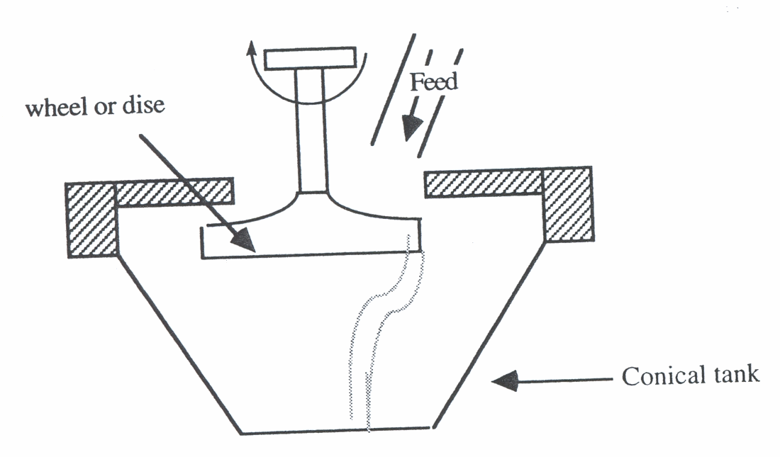
3- Special Mixers for Powder
  Impact wheel mixer.
  Pneumatic mixer.
Entolator impact wheel mixer:

Slide 44
This is based on rotating a disc or a wheel 20-68 cm in diameter, rotate 1750 - 3500 revolution / min.
The materials are feed from above in the center of the disc. The shear force developed cause continuous powder mixing.
The particles of powder are then ejected by the centrifugal force from the disc periphery onto the walls of a conical tank which gives the mix­ture a spiral movement towards the bottom

Slide 45
4- Pneumatic mixer: (Airmix mixer)
Here, the driving force is the com­pressed air which is introduced through nozzles present at the lower part. These nozzles are arranged in a man­ner that escaped air stream in a vertical mo­tion gives a chance for powder to settle.

Slide 46
Evaluation of a blend of powder after mixing :
The sample mixture is taken and evaluated by:
Microscopic Counting if particles are different in shape.
Analytical techniques for the drug and other components in the mixture
Screen analysis of the mixture, if the powder mixture is different in size.

Slide 47
V- Type mixer:
It has two motors :One for rotating the shell and the other for rotating the baffled shaft in opposite direction.
Advantages of the V-type mixer:
  It is efficient in mixing
  It has no dead spot
  It has variable speed rotation
  Easily cleaned

Slide 48
Mixing
Definition and objectives
Mixing equipment
Impellers for liquids
Mixers of dry powders
  Factors affecting mixing of solids
  Tumbling mixers
  Agitator mixers
  Special mixers for powders
  Entolator impact when mixer
  Pneumatic mixer
  V-type mixer
Mixers for semisolids
  Types of flow in semisolids
  Beaters
  Kneaders
  Mixer-Extruders

Slide 50
III. Mixers of pastes and plastic masses (semi - solids)
The equipment are similar to liquid mixers but heavy built so shearing action is distributed to all parts of apparatus.
Types of flow in semisolids:
Materials are classified according to the type of flow into:
1- Newtonian flow:

Slide 51
2- Non-Newtonian Flow:
Plastic

Slide 52
pseudo-plastic

Slide 53
c)Dilatant:

Slide 54
d)Thixotropic systems :

Slide 55
Types of mixers for semisolids and pasts: There are four classes of equipment:
(1) Beaters (2) Kneaders
(3) Mixer extruders (4) Mixing rolls.

Slide 56
1. Beaters:
These are similar in principle to the agitator mixers for powders and liquids, but are more heavily built to handle materials of greater consistency. The agitator arms are designed to give a pulling and kneading action, and the shape and the movement of these arms are such that there are no "dead spots" in the mixing vessel. An example of such mixers is the Hobart's Mixer shown in the following Figure
Hobart's Mixer: (a) The mixer (b) Planetary motion.

Slide 57
2. Kneaders:
Kneading involves squashing the material flat, folding it over on itself, and squashing it once more. Most kneading machines also tear the mass of material apart and shear it be between a moving arm and a stationary surface.
Double-Arm Mixer

Slide 58
Blades of various designs as those shown in the following Figure are available for several kneading purposes:
Blades of Various Designs: (a) Sigma blade (b) double-naben blade, (c) Dispersion Blade.

Slide 59
3- Mixer-Extruders:
The operation of a mixer-extruder depends essentially upon cutting and folding the material in a mixing chamber by means of special blades, and extruding It through a die, thereby subjecting the material to additional shear.
Mixer-extruders continuously mix materials that are difficult to mix such as clays and thermoplastics.
An example of such mixers is the "Roto-feed Mixer" shown in the following figure.
Roto-feed mixer

Slide 60
4. The Mixing Rolls:
In mixing rolls, the materials subjected to intense shear by passing between smooth metal rolls turning at different speeds. By repeated passage between such rolls, solid additives can be thoroughly distributed into pasty or plastic materials.
An example of such mixing rolls is the "Triple-Roll Mill".

Slide 61
Outline of the lecture:
Mixing
Definition and objectives
Mixing equipment
Impellers for liquids
Mixers of dry powders
  Factors affecting mixing of solids
  Tumbling mixers
  Agitator mixers
  Special mixers for powders
  Entolator impact when mixer
  Pneumatic mixer
  V-type mixer
Mixers for semisolids
  Types of flow in semisolids
  Beaters
  Kneaders
  Mixer-Extruders

