Slide 1
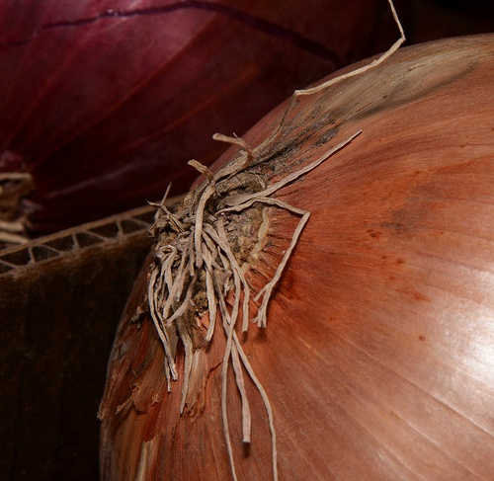
Mitosis in the root tips of Onion Squash method

Slide 2
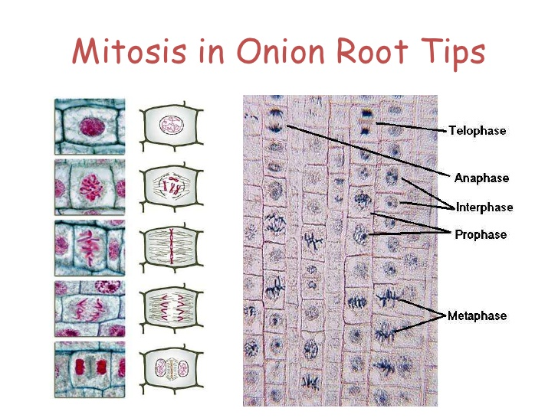

Slide 3
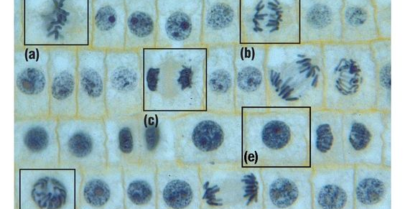
In this experiment ,We used the onion root to tip to better understand process of mitosis and visualize all the stages of mitosis.

Slide 4
Materials
hgnn
1- Developing the summit of the roots
of the onion.
2- Anatomy instruments (forceps-
scalpel-scissors).
3- Slids and covers.
4- Petri dishes-tubes.
5- Distilled water.
6- Karnoa solution.
7- 70% alcohol.
8- Dilute hydrochloric acid HCL.
9- A water bath at 60°.
10-A losatoouricin dye.
11-Optical microscope.

Slide 5
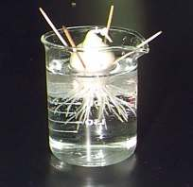
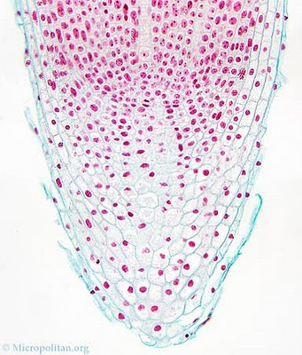
Method
1- Onion is placed in water for several days in order to give
it roots within the length of 2-3 cm.
2- Using scissors, cut 2 roots tips about 3 cm long, and
transfer them into a plastic micro-tube (One of the
roots will be an extra one).

Slide 6
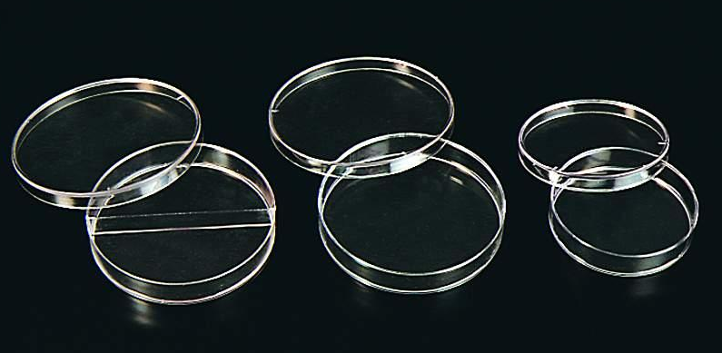
3- Using forceps, carefully transfer the root tips to
a small petri dish containing the solution for
Karnoa for 8 min.
What is Karnoa solution?
karnoa or Fixative
Consist of :
+
3 Ethanol : 1 Acetic Acid
Karnoa solution
The aim of the use:
Fixation of the cells on their final shape

Slide 7
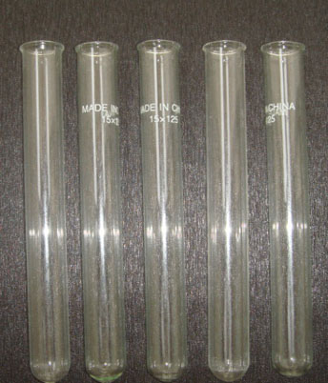
4- The movement of radicals using tweezers to petri dish containing distilled water H2O.
+
Distilled water
5- Transfer the roots into a tube. Fill the tube about 5 ml of 1N HCI. Place the tube in 60 C° water bath, and allow the roots to incubate for 7 minutes.
1N HCI
+
+
6- Using forceps, carefully transfer the root tips to a small petri dish containing distilled water.

Slide 8
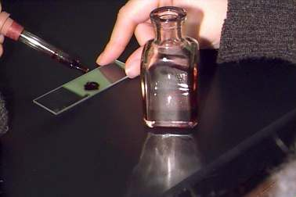
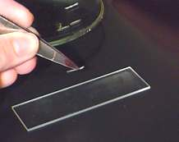
7- Wash the slide with 70 % alcohol.
8- placed the roots in a clean slide and add a drop or two drops of tincture Alosatoouricin then leave for 5 minutes

Slide 9
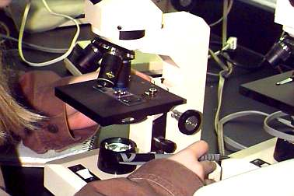
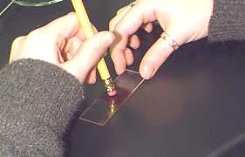
9- Cover the root tip with a cover slip, and then carefully push down on the cover slide with the wooden end of a dissecting probe. Push hard, but do not twist or push the cover slide sideways. The root tip should spread out to diameter about 0.5-1 cm.

Slide 10
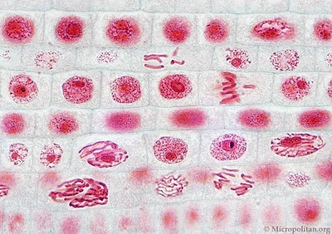
Onion cells in different phases of the cell cycle

Slide 11
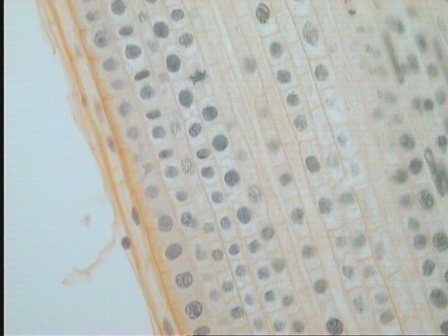
Mitosis in the root tips of Onion ( prophase)

Slide 12
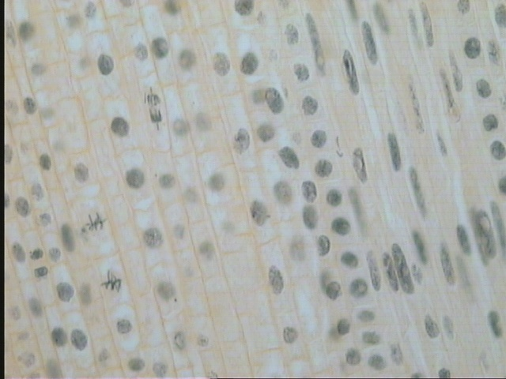
Mitosis in the root tips of Onion ( Metaphase )

Slide 13
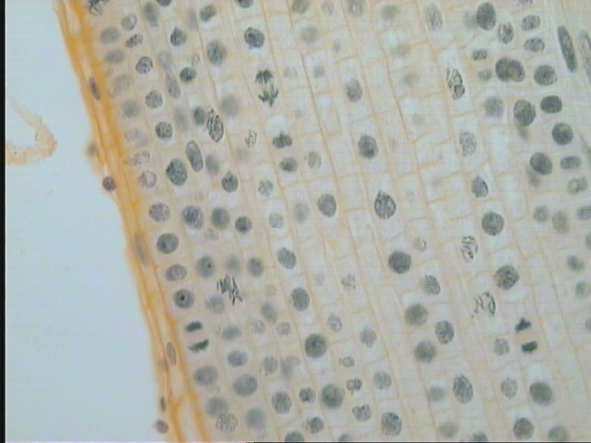
Mitosis in the root tips of Onion ( Anaphase )

Slide 14
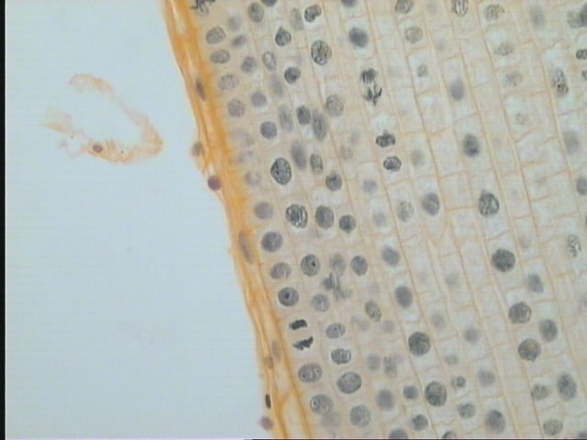
Mitosis in the root tips of Onion ( Telophase )

Slide 15
Make a report consist of:
Introduction
Materials
Method
Results
Discussion

