Slide 1
Microsoft Excel – Part I
MIS 201 Management Information Systems
Lab Session 2

Slide 2
Outline
Part I (Basics)
Sum (Total)
Average
Count Numbers
Maximum and Minimum Value
Simple IF function
IF Function (multiple tests)
Part II (Financial formulas)
PV
FV
NPV
IRR

Slide 3
SUM Function
Summary
The Excel SUM function returns the sum of values supplied as multiple arguments. SUM can handle up to 255 individual arguments, which can include numbers, cell references, ranges, arrays, and constants.
Purpose
Add numbers together
Return value
The sum of values supplied.
Syntax
=SUM (number1, [number2], [number3], ...)
Reference: https://exceljet.net/excel-functions/excel-sum-function

Slide 4
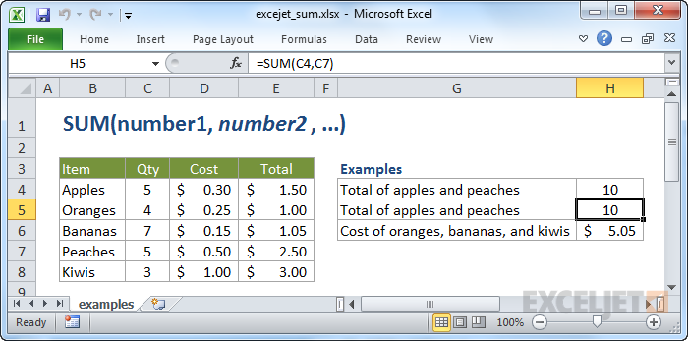
SUM Function
Reference: https://exceljet.net/excel-functions/excel-sum-function

Slide 5
Average Function
Summary
The EXCEL AVERAGE function returns the average of values supplied as multiple arguments. AVERAGE can handle up to 255 individual arguments, which can include numbers, cell references, ranges, arrays, and constants.
Purpose
Get the average of a group of numbers
Return value
A number representing the average.
Syntax
=AVERAGE (number1, [number2], ...)
Reference: https://exceljet.net/excel-functions/excel-average-function

Slide 6
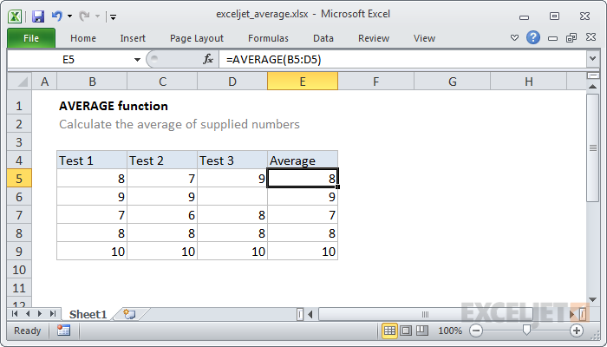
Average Function
Reference: https://exceljet.net/excel-functions/excel-average-function

Slide 7
Count Function
Summary
The Excel COUNT function returns the count of values that are numbers, generally cells that contain numbers. Values can be supplied as constants, cell references, or ranges.
Purpose
Count numbers
Return value
A number representing a count of numbers.
Syntax
=COUNT (value1, [value2], ...)
Reference: https://exceljet.net/excel-functions/excel-count-function

Slide 8
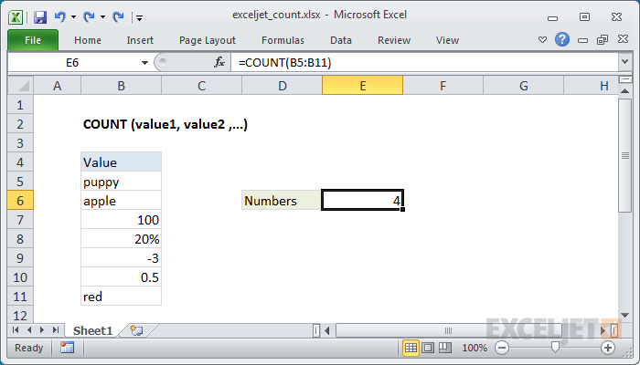
Count Function
Reference: https://exceljet.net/excel-functions/excel-count-function

Slide 9
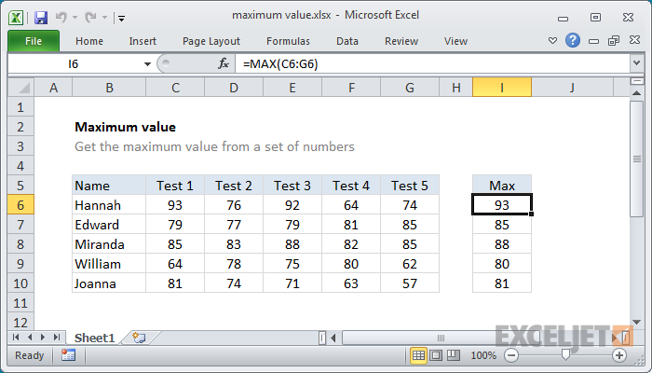
Maximum and Minimum Value
To get the maximum and minimum value from a set of numbers.
The MAX and MIN function is fully automatic. It accepts one or more arguments, which can be numbers or cell references that point to numbers, then returns the value.
Reference: https://exceljet.net/formula/maximum-value

Slide 10
Simple IF Function
Summary
The IF function can perform a logical test and return one value for a TRUE result, and another for a FALSE result. For example, to "pass" scores above 70: =IF(A1>70,"Pass","Fail"). More than one condition can be tested by nesting IF functions.
Purpose
Test for a specific condition
Return value
The values you supply for TRUE or FALSE
Syntax
=IF (logical_test, [value_if_true], [value_if_false])
Reference: https://exceljet.net/excel-functions/excel-if-function

Slide 11
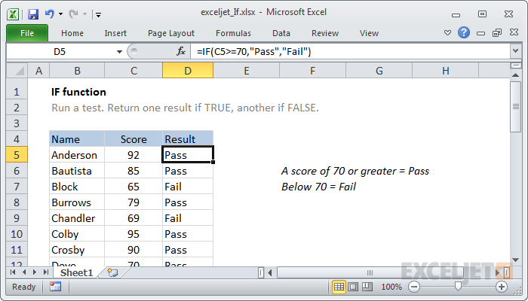
Simple IF Function
Reference: https://exceljet.net/excel-functions/excel-if-function

Slide 12
IF Function (Multiple Tests)
Summary
Runs multiple tests and returns a value corresponding to the first TRUE result. Use the IF function to evaluate multiple conditions without multiple nested IF statements. IF allows shorter, easier to read formulas.
Purpose
Test multiple conditions, return first true
Return value
Value corresponding with first TRUE result
Syntax
=IF (test1, value1, [test2, value2], ...)
Arguments
test1 - First logical test.
value1 - Result when test1 is TRUE.
test2, value2 - [optional] Second test/value pair.
Reference: https://exceljet.net/excel-functions/excel-ifs-function

Slide 13
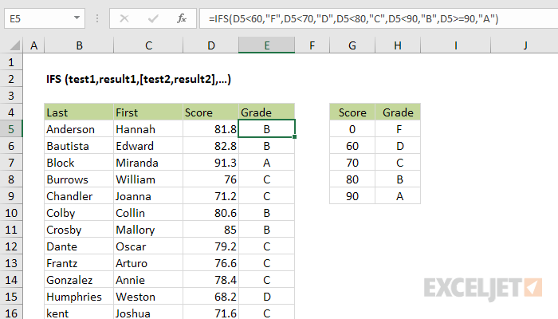
IF Function (Multiple Tests)
Reference: https://exceljet.net/excel-functions/excel-ifs-function

Slide 14
End of Part I

