Slide 1
Medical Records Sara Alosaimy, bsc pharm

Slide 2
OBJECTIVES
Why we need them
Who writes in them
Patient information
Physical parts
Front Sheet
Medical record number
Medical Record file
Discharge Summary
Pharmacist Role
Confidentiality

Slide 3
Why
• To document the course of the patient's illness and treatment;
• To communicate between attending doctors and other health care professionals providing care to the patient
• Continuing care of the patient
• Research of specific diseases and treatment
• Collection of health statistics.

Slide 4
Who writes in it
Administrative
Demographic and socioeconomic data such as the name of the patient (identification), sex, date of birth, place of birth, patient’s permanent address, and medical record number
Legal data
A signed consent for treatment by appointed doctors and authorization for the release of information

Slide 5
Who writes in it
3) Financial data
The payment of fees for medical services and hospital accommodation
4) Clinical data
Whether admitted to the hospital or treated as an outpatient or an emergency patient.

Slide 6
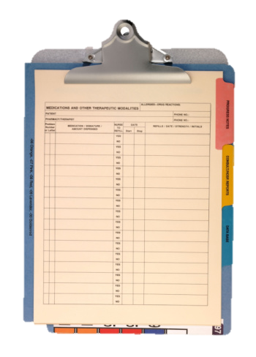
Physical parts
• a clip or fastener to hold
the papers together
• dividers between each admission and
outpatient notes
medical record forms
• a medical record folder.

Slide 7
Front sheet

Slide 8
SOMETHING ABOUT A PATIENT THAT DOES NOT CHANGE
EFFECTIVE PATIENT IDENTIFICATION IS THE BEGINNING OF AN EFFICIENT MEDICAL RECORD SYSTEM
Notes:
• identify the patient and ensure that each patient has one medical record number and one medical record.
• to find a particular patient's medical record whenever they come to the health
care facility;
• to link a patient's previous admission or outpatient attendance to the current
admission using his or her medical record number;
• to find the correct medical record of patients when there are more than one
patient with the same name.

Slide 9
MUST HAVE
• a national identification number;
• a social security number;
• date of birth;
• health insurance number;
• mother's maiden name;
• mother's first name;
• father's first name
• in the case of a new-born infant a biological characteristic, e.g. fingerprint or footprint.
Notes:
• Where a person lives is NOT a unique patient characteristic because it can
change;
• A person's age is NOT a unique patient characteristic because it DOES
change;
• Although it should not change, it is important that a patient’s birthplace is NOT
used, as it is often identified by most people as being the place where they
"come from" as opposed to the place where they were actually born.

Slide 10
Medical Record Number (mrn)

Slide 11
MRN
The hospital number, patient identification number, unit record number or medical record number.
MEDICAL RECORD NUMBERING SYSTEMS are HOW WE GIVE A NUMBER to medical records. FILING SYSTEMS are HOW WE FILE THE RECORD after a number has been given.
ONE PATIENT→ ONE MEDICAL RECORD NUMBER =
ONE MEDICAL RECORD
Notes:
If an error has occurred and a patient is found to have two medical record numbers
and subsequently two medical records the DUPLICATE number should be cancelled,
and NOT used again, and the medical records combined under the FIRST number.
As will be discussed under the Master Patient Index, a cross-reference must be
made to the duplicated number and medical record.

Slide 12
Belong to the patient for the rest of his or her life and should never be given to another patient. Even if a patient has died.

Slide 13
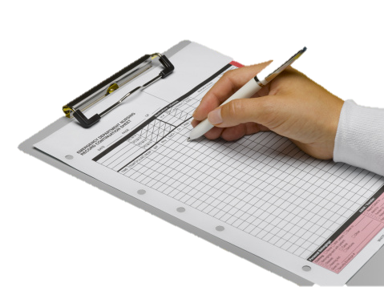
Medical Record Form

Slide 14
components
• Front sheet
• Consent for treatment signed by the patient at the time of admission
• Correspondence and legal documents received about the patient
• Discharge summary
• Admission notes (patient’s family medical history, the patient’s past medical history, presenting symptoms, results of a physical examination, provisional diagnosis , proposed tests and care)
• clinical progress notes recording the patient's daily treatment nurses’ progress notes recording daily nursing care including temperature, pulse and respiration charts, blood pressure charts etc.

Slide 15
components
• operation report
• other health care professional notes, e.g., physiotherapy, Social Workers, etc.;
• pathology reports including haematology, histology, microbiology,
• other reports – X-ray, etc.;
• orders for treatment and medication forms
• special nursing forms

Slide 16
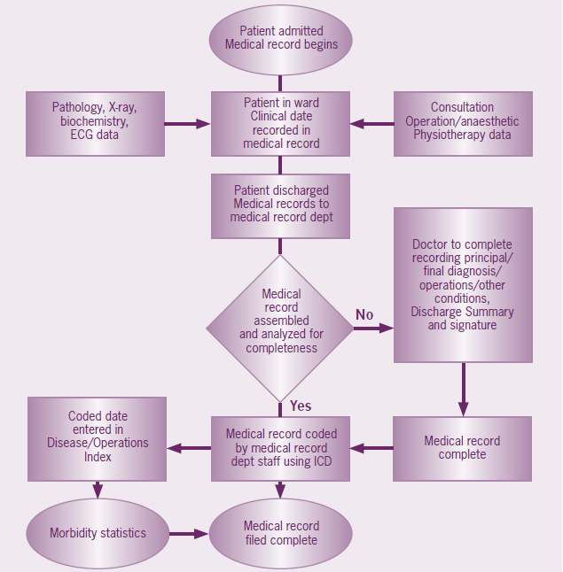

Slide 17
Pharmacist’s role

Slide 18
Primary concerns
The patient profile system must contain a complete and accurate record of the refill history of all medical and prescription orders dispensed at the pharmacy practice site.
Each such profile must be maintained so as to be readily retrievable at the pharmacy practice site for at least two (2) years from the date of the last dispensing recorded on the profile.
Medication reconciliation form
Clinical pharmacists notes

Slide 19
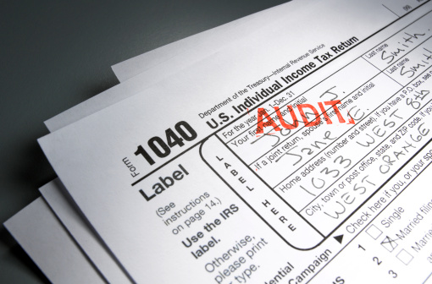
Medico-Legal issues and policies

Slide 20
Who owns it ?
•Physical medical record is considered to be the PROPERTY OF THE HOSPITAL and the information in the medical record is the PROPERTY OF THE PATIENT, information cannot be released without the consent of the patient.
Exceptions:
Health professionals for the continuing care of the patient;
Medical research and health care statistics where the patient is NOT identified
Notes:
As the person in charge of the Medical Record Department, they
are responsible for seeing that UNAUTHORIZED PERSONS DO NOT have access to the
medical record and that information is not given out without the patient’s written consent.

Slide 21
Certain conditions
• If a patient is under the age of 14 years or otherwise subject to a guardianship order, any consent for access to information should be given in writing by the patient's parents or legal guardian.
• In the case of a patient who has died, the written consent to access information from the patient's medical record should be provided by the next of kin shown on the medical records or by the administrator of the patient's estate.

Slide 22
Instances in which Medical Records are used as Legal Evidence
Insurance Cases
Worker's Compensation
Personal Injury Claims
Malpractice Claims
Will Cases
Criminal Cases:
o Assault cases
o Violent or unexplained death
o Sexual assault cases
o Mental competency.
Notes:
Insurance Cases: Used by the patient for proof of injury and/or disability in personal
accident cases or by the insurance company to disclaim responsibility.
• Worker's Compensation: In most countries, a person injured in the course of his
or her duties and while acting in the scope of his or her employment is entitled
to compensation for bodily injury and disability. The medical record is used as
evidence to show the date of injury, the type and severity of injury, and the patient’s
expected recovery.

Slide 23
Further readings
Medical Record department
Medical Records committee
Patient master index PMI
Computerized health informatics
Notes:
Insurance Cases: Used by the patient for proof of injury and/or disability in personal
accident cases or by the insurance company to disclaim responsibility.
• Worker's Compensation: In most countries, a person injured in the course of his
or her duties and while acting in the scope of his or her employment is entitled
to compensation for bodily injury and disability. The medical record is used as
evidence to show the date of injury, the type and severity of injury, and the patient’s
expected recovery.

Slide 24
references
Medical Records Manual: A Guide for Developing Countries. Manila, Philippines: World Health Organization, Regional Office for the Western Pacific, 2002. Print.
"Department of HealthJohn J. Dreyzehner, MD, MPH, Commissioner." Tennessee Department of Health: Board of Pharmacy Applications, Publications, and Information. N.p., n.d. Web. 05 Apr. 2013.

