Slide 1
Medical Parasitology
Introduction

Slide 2
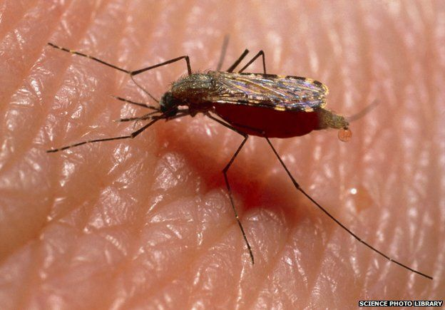
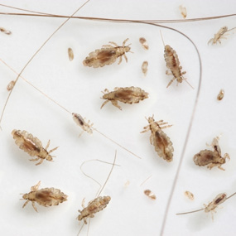
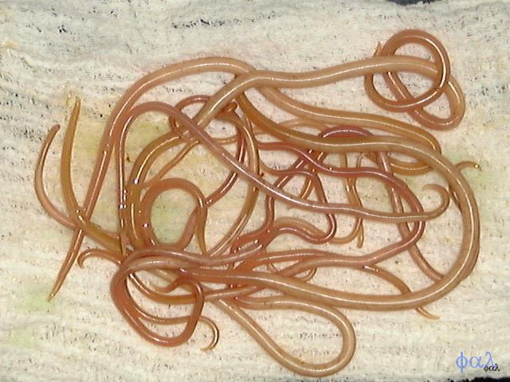
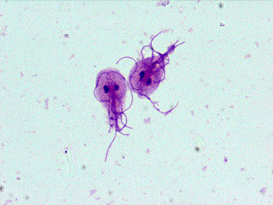
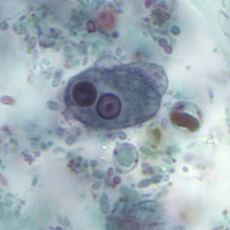

Slide 3
Definitions:
1- Parasite
Types of parasites:
Obligatory parasite
Facultative parasite
Accidental parasite
2- Host
Types of hosts:
Definitive host
Intermediate host

Slide 4
3- Life cycle
4- Parasitic infection
5- Parasitic disease
6- Parasitic infestation
7- Habitat
8- Commensalism
9- Symbiosis
10- Reservoir host
11- Vector: mechanical vector or biologic vector

Slide 5
12- carrier
13- Zoonosis
14- Infective stage
15- Diagnostic stage
16- Protozoa
17- Eukaryote

Slide 6
Sources of infection
1- Soil
2- Water
3- Food
4- Insect vector
5- Animals
6- Other persons
7- Self

Slide 7
Modes of infection
1- Oral transmission
2- Skin transmission
3- Vector transmission
4- Direct transmission

Slide 8
Taxonomy

Slide 10
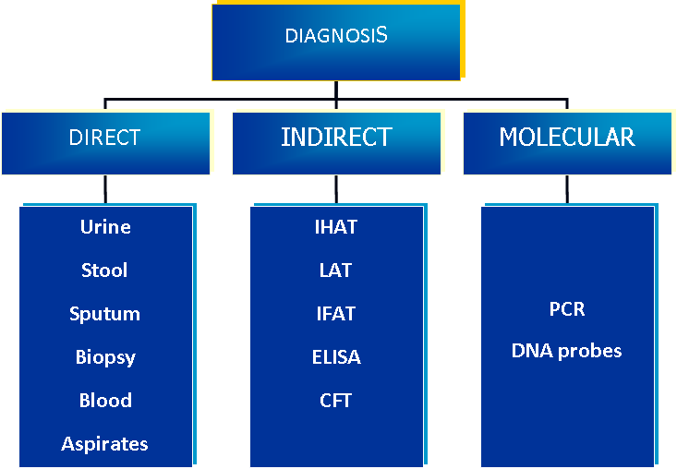

Slide 11
Collection of the specimens:
1- Delivery:
2- Safety:
All fresh specimens should be handled carefully, since each specimen represents a potential source of infection.
3- Number of specimens:

Slide 12
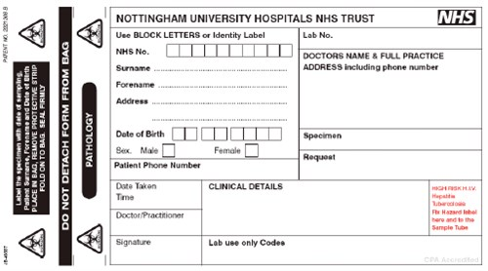
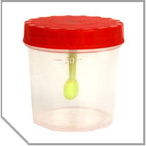
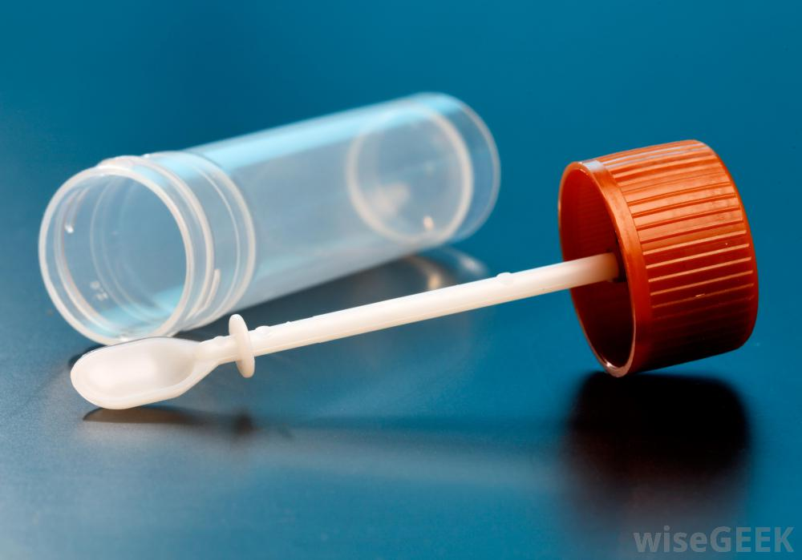
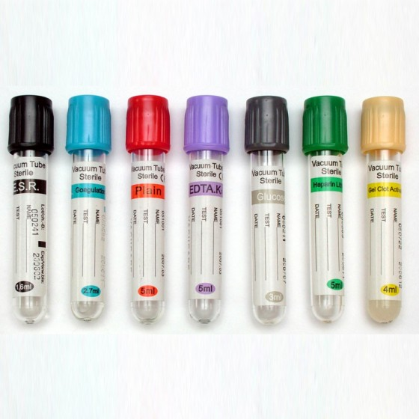

Slide 13
4- Collection time:
5- Specimen type and stability:
Liquid specimens:
Soft (semi-formed) specimens
Formed specimens

Slide 14
Preservation of stool specimens:
Aim:
1- To preserve protozoan morphology.
2- To prevent the continued development of some helminthic eggs and larvae.
The most common preservative used is 10% formalin.

Slide 15
INDIRECT IMMUNOLOGICAL METHODS
1- Scanty infection.
2- Tissue parasite having no portal of exit (Hydatid disease)
3- Migratory stage:(Fasciola)
4- Chronic infection:fibrosis (Bilharziasis)

Slide 16
The commonly used tests are:
Indirect Haemagglutination Test (IHA)
Indirect Fluorescent Antibody Test (IFA)
Enzyme linked Immunosorbant Assay (ELISA)
Complement fixation test (CFT)
Agar gel Immunodiffusion (AGID)
Immunodiagnostic strip tests (Dip stick test)

Slide 17
Subkingdom Protozoa
Phylum Sarcomastigophora:
Subphylum – Mastigophora
Subphylum - Sarcodina
Phylum Apicomplexa
Phylum Ciliophora
Phylum Microspora

Slide 18
Subkingdom - Metazoa
Phylum – Nematoda
Phylum – Platyhelminthes:
Class Trematoda
Class Cestoidea

Slide 19
Division (reproduction):
1-Asexual reproduction:
Binary fission:
Multiple fission:
2- Sexual reproduction:
Union of two gametes following reduction division.

