Slide 1
Medical Mycology Lecture Slides
AL-HEDAITHY

Slide 2
List of Contents
AL-HEDAITHY
Primary Systemic Mycoses 63
Blastomycosis 65
Histoplasmosis 67
Coccidioidomycosis 70
Paracoccidioidomycosis 73
Candidosis and Oropharyngeal 75
mycosis (For Dental Students)
Fungal Eye Infections 83
Selected references 89
Basic mycology 2
Superficial Mycoses 9
Pityriasis versicolor 10
Tinea Nigra 12
Piedra 14
Dermatophytoses 17
Mycetoma 25
Rhinosporidiosis 35 Lobomycosis
Phaeohyphomycosis 37
Chromoblastomycosis 38
Sporotrichosis 41
Zygomycosis 43
Aspergillosis 48
Pneumocystosis (PCP) 51
Candidiasis 53
Cryptococcosis, 60
Trichosporonosis, Geotrichosis
1

Slide 3
Basic Mycology
AL-HEDAITHY
Mycology: Mykes = Mushroom = Fungi
Logos = Study of
= Study of fungi
Kingdom myceteae (= K. fungi)
Characteristics (distinguishing features)
1) All Eukaryotic organisms
2) Heterotrophic – do not have chlorophyll (Achlorophyllous)
3) The cell is surrounded by rigid cell wall made up of chitin & complex carbohydates (Chitosan,Mannan,glucan,galactomannan)
4) Have simple structure – most of them microscopic.
5) Reproduce by spore formation sexually or asexually.
Saprobic
Symbiotic
Parasitic
2

Slide 4
Structure of Fungi
AL-HEDAITHY
1) Unicellular – Yeasts Examples:
Saccharomyces cerevisiae
True yeasts Candida albicans
cells retain individuality
Cells attach to each others
side - by – side forming Pseudohypha
2) Filamentous – molds Examples: Aspergillus, Penicilium Rhizopus
Hypha - Hyphae - Septum
Yeast-like
Septate hypha
Nonseptate hypha (coenocytic hypha)
Interwoven hyphae = Mycelium
Dimorphic: Have two forms depending on change in the environmental factor like Temp., Medium and culture Vs Host
Monomorphic: Only one form regardless of environment.
3

Slide 5

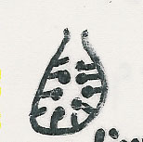
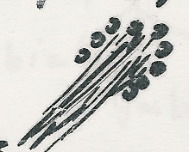
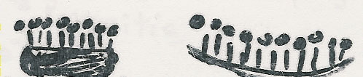
Reproduction in Fungi
AL-HEDAITHY
I) Asexual: Only mitotic cell division
1) Somatic Yeasts by budding
Molds by hyphal fragmentation
2) Spore formation:
a) Sporangiospores in sporangia
b) Chlamydospores in or on hyphae
c) Conidia (conidium) on hypha or on conidiophores
Many types of conidia like:
Blastospore, arthrospore, aleuriospore, sympodulospore…etc
Asexual reproductive structures:
Conidiophore
Conidium
Pycnidium
Synnema
Sporodochium
Acervulus
Imperfect fungi = Deuteromycetes: Do not reproduce sexually or their sexual reproduction not known
e.g. Aspergillus, Fusarium, Candida
4

Slide 6

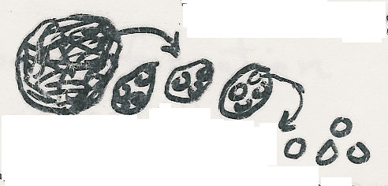

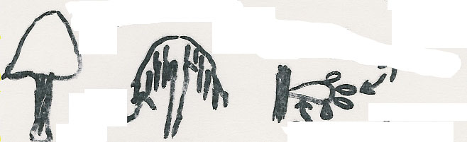
AL-HEDAITHY
II) Sexual: Fusion, mitosis, meiosis
Sexual spores: Oospore, Zygospore, Ascospore, Basidiospore
Zygospore
Zygomycetes
e.g. Rhizopus, Mucor
Ascocarp
Ascus
Ascospore
Basidiocarp
Basidiospore
Ascomycetes
e.g. Truffles
Terfezia & Termania
Gills
Basidium
Basidiomycetes
e.g. Mushrooms & Podaxis pistillaris
(Agaricus campestris)
5

Slide 7
AL-HEDAITHY
Groups of Fungal Infections:
Superficial Mycoses
Cutaneous Mycoses
Subcutaneous Mycoses
Systemic Mycoses
Opportunistic Mycoses
Actinomycetous Infections
6

Slide 8
Classification of Fungi
AL-HEDAITHY
Taxonomy: Based on morphological, Physiological, Genetic & Molecular characteristics.
Taxon = Classification rank.
Kingdom: Myceteae
Binomial system
Division: Amastigomycota
Subdiv: Deuteromycotina
Latin
Class: Deuteromycetes
Author
Sub. class: Hyphomycetidae
M.canis Bodin
Order: Moniliales
Family: Moniliaceae
Primary Pathogen
Genus: Microsporum
Opportunistic Pathogen
Species: Canis
Variety
Strain
7

Slide 9
Classification of Fungi
AL-HEDAITHY
Kingdom Myceteae
1- Div. Gymnomycota: naked (No cell wall), phagotrophic
Myxamoeba, slime molds
Class Acrasiomycetes, Cl. Protosteliomycetes
Cl. Myxomycetes – e.g. Dictyostelium
2- Div. Mastigomycota: flagillated, motile
Cell wall, absorptive nutrition, if mold nonseptate hyphae
Chytridiomycetes, Hyphochytridiomycetes
Plasmodiophoromycetes, Oomycetes – e.g. Phythium, Phytophthora
3- Div. Amastigomycota: Non flagellated, Non-motile
Yeasts & molds: Septate hyphae & non-septate
Cl. Zygomycetes, Trichomycetes, Ascomycetes, Basidiomycetes
Deuteromycetes (Fungi Imperfecti = Imperfect fungi)
e.g. Aspergillus, Penicillium, Fusarium, Candida
8
Old terms: Phycomycetes, Aquatic, Lower fungi, Higher fungi

Slide 10
AL-HEDAITHY
Superficial Mycoses
These affect the uppermost dead layers of skin or hair shaft.
They are painless and usually do not provoke the immune system
They primarily include:
1- Tinea versicolor (= Pityriasis versicolor)
Brown or discolored or white patches on the skin.
2- Tinea nigra (T.n. palmaris)
Dark brown or grey macular lesions – usually on palm of hand but can be on sole of foot or others.
3- Piedra
Nodules of the etiologic fungus on hair shaft;
  a. Black piedra
  b. White piedra
9

Slide 11
Superficial Mycoses (Continued)
AL-HEDAITHY
Pityriasis Versicolor (= Tinea versicolor)
Brown or discolored, or white patches on skin
Affect the stratum corneum
The white lesions do not tan in the sun
Endogenous source of infection
Etiology: Malassezia furfur
It is a Yeast (= Pityrosporum orbiculare)
Blastomycetidae, bipolar budding, Skin flora
Lipophilic: oleic acid Or Mineral oil
Laboratory Diagnosis:
Specimen is skin scrapings
10% Or 20% KOH will show short hyphal segments and
round yeast cells (spaghetti & meat ball appearance)
Culture on SDA and Mycobiotic medium (=SDA+ Chloramphenicol+ Cycloheximide = Actidione) with oily substance.
10

Slide 12
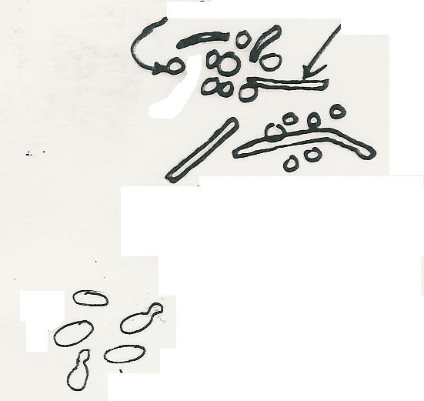

Superficial Mycoses (Continued)
AL-HEDAITHY
Pityriasis Versicolor
Round cell
Hyphal segment
Scrapings in KOH
M. furfur
In culture
11

Slide 13
AL-HEDAITHY
Superficial Mycoses (Continued)
Tinea nigra (= T.n. palmaris)
Macular brown lesions or black stripes on palm of hand or sole of foot.
Acquired by Piercing of skin with plant material in Agricultural soil.
Etiology:
Dematiaceous imperfect mold fungus; Phaeoannellomyces werneckii
(=Exophiala werneckii)
In vegetation debris
In culture it produces annellospores from annellids,unicellular or two celled.
Laboratory Diagnosis:
Skin scrapings: - In 10% or 20% KOH will show brown septate hyphae
Culture on SDA & Mycobiotic. Will grow the dematiaceous fungus.
Do Lactophenol teased mount (LTM) & LPCB (Lactophenol cotton blue)
for identification.
12

Slide 14
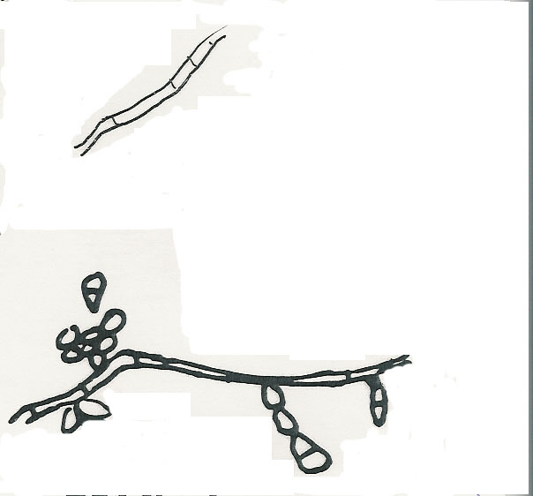
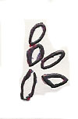
AL-HEDAITHY
Superficial Mycoses (Continued)
Tinea nigra
Petri plate
In KOH
3 wk old colony
Conidia
Phaeoannellomyces werneckii
(Exophiala werneckii)
13

Slide 15


Piedra
AL-HEDAITHY
Nodules or Encrustations on hair shaft
The nodules are composed of fungal elements
On scalp hair / - mustache, beard
Usually in Tropics & subtropics
Black piedra
Assostroma with asci & ascospores
Hyphal strands
Firm, hard, dark brown nodules
Piedraia hortae is the etiology
Ascomycete – Loculoascomycetidae
Cerebriform colony
Hair
Black piedra nodule on hair shaft
Ascostroma, Asci, ascospores
KOH
Hair with nodule
10% -20% KOH – culture on
Mycobiotic & SDA
Colony of Piedraia hortae in culture
14

Slide 16
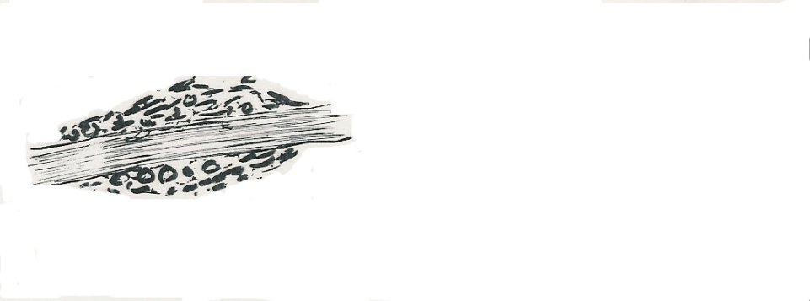

AL-HEDAITHY
Piedra (Continued)
Spores & cells
White piedra
Soft, brown, cream less firm
Hair
Etiology:
Trichosporon beigelii
Imperfect yeast
Friable nodules
Pseudohyphae, blastospores, arthrospores
Culture on SDA no cycloheximide
Cream – beig Yeast with wrinkled surface
White piedra nodule on hair shaft
KOH
Arthrospore
Blastospore
Yeast cell
Pseudohypha
Culture
15

Slide 17
AL-HEDAITHY
Treatment of Superficials
2% salicylic acid, 3% sulfur ointments, whitfield’s ointment Ketoconazole
Cut or shave hair for Piedra & clean with mild fungicide (e.g. 1:2000 bichloride of mercury)
Or apply 2% salicylic acid
Or 3% sulfur ointment.
Now: Nizoral shampoo for Piedra
Nizoral = Ketoconazole
(Benzoic acid)
16

Slide 18
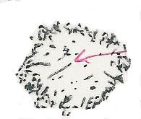
AL-HEDAITHY
Dermatophytoses
These are fungal infections of the Keratinized tissues of the body (Stratum corneum, Hair, nail)
Contageous
Necrotic scaley center
S/S:Skin lesion Tinea(=Ringworm)
Active fungus in margin
Causes itching – present anywhere in body
T.capitis in the scalp, barber’s itch
The skin, hair folicles, and hair are infected. Infected hair fall-off
Endothrix hair infection and Ectothrix
T.corporis : In glabrous skin
t. circinata, t.imbricata
T.pedis (=Athlete’s foot) = swimming pool itch
T.cruris: In groin = jock itch = Dhobie itch
t.unguium (nail)
t.barbae (beard)
t.manuum (hand)
17

Slide 19
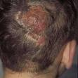

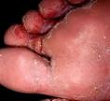


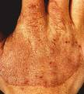


Slide 20
Dermatophytoses (Continued)
AL-HEDAITHY
Other advanced lesions in scalp:
Kerion (pustular)
Favus (=t.favosa) with scutulum (yellow crusts) + unpleasant smell
Wood’s lamp Emits filtered U.V. light, infected hair
fluoresce especially microsporum spp. lesions.
Epidemiology:
-Affect children + adults + males and females. More seen in school-age children
-Found everywhere in the world.
-Contageous – caused by primary pathogens
Cats Dogs
-Acquired: from infected persons and Pets
-And Livestock Animals (goats, sheep, camel, cows, horses
-Familial cross infection occurs
18

Slide 21
Dermatophytoses (Continued)
AL-HEDAITHY
Etiology:
Dermatophytes Imperfect moniliaceous mold fungi,Primary pathogens
Characteristics of dermatos:
1) Produce alkaline substance
2) Sensitive to: <20 μg/ml griseofulvin
3) Resistant to: 500 μg/ml cycloheximide
4) Have peculiar Hyphal structures like
Raquet hyphae, nodular bodies, pectinate hyphae, hyphal coils (=spirals), favic chandeliers
Natural Habitats: All are Keratinophilic fungi
- Anthropophilic, Zoophilic, Geophilic
19

Slide 22
Dermatophytoses (Continued)
AL-HEDAITHY
The dermatophytes are in 3 genera:
Trichophyton: T.mentagrophytes in rodents,dogs,livestocks.T.violaceum in human
Infect skin + hair + nail
T.verrucosum in cows. T.rubrum in human
Microsporum: M. canis in cats. M.audouinii in human, M.gypseum in soil
Infect skin + hair, but not nail
Epidermophyton floccosum in human
Infect skin + nail, but not hair
They reproduce asexually forming conidia by which can be identified.
Perfect stage: In gymnoascaceae,
Plectomycetidae ascomycetes
Trichophyton in Arthroderma
Microsporum in Nannizzia
20

Slide 23
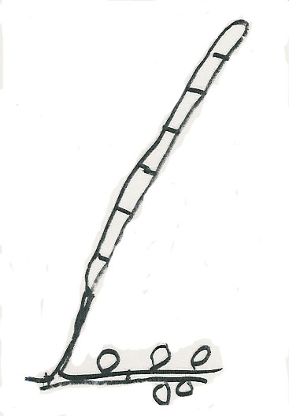
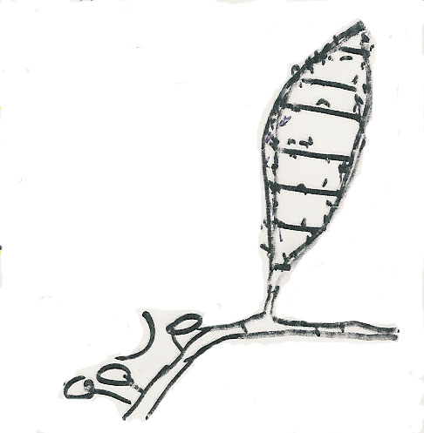
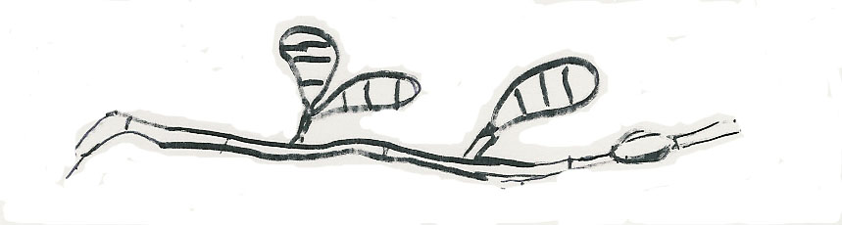
AL-HEDAITHY
-Elongated
-Smooth wall
-Round tip
-Spindle
-Rough
-Pointed
Macroaleuriospore (macroconidium)
Microaleuriospore (Microconidium)
Microsporum
Trichophyton
-Round tip
-Club shape
-Smooth wall
Epidermophyton
21

Slide 24
Dermatophytoses (Continued)
AL-HEDAITHY
Dermatophyte test medium (DTM):
This is a special medium for the identification of dematophytes
It has pH 5.6, Antibacterial, Antifungal, and Phenol red (Amphoteric dye)
In Acidic pH yellow, in alkaline red
Positive DTM test is growth of the fungus and red color. It is 98% accurate.
Identification Tests:
Endothrix & Ectothrix hair infection
Hair perforation test
Urease test
Pigment production in PDA & CMA media
Nutrient requirement such as – Trichophyton series Agar 1-7
22

Slide 25
Dermatophytoses (Continued)
AL-HEDAITHY
Laboratory Diagnosis:
Specimens:
-Skin scrapings, Hair, Nail
20% or 10% KOH will show hyaline Septate hyphae, or spores or both.
Culture on SDA and Mycobiotic medium. Identify
Treatment:
Griseofulvin Topical or systemic
Azoles Topical
-Miconazole (Daktrin), Clotrimazole (Canesten), Econazole
Azoles Systemic: Itraconazole - others
Allylamines Topical, Terbinafine (Lamisil)
Tolnaftate 1% solution (=Tinactin = Tinaderm)
23

Slide 26
AL-HEDAITHY
Dermatomycoses
Other non-dermatophyte skin infections
Skin and Onychomycosis
These are caused by:
Candida albicans, Scytalidium, Scopulariopsis,Fusarium, Acremonium,Aspergillus,and others
Ear (Otomycosis)
Eye (oculomycosis)
- Mycotic keratitis
Corneal ulcer,corneal abscess
- Endophthalmitis
24

Slide 27
AL-HEDAITHY
Mycetoma (=Madura Foot)
Chronic localized subcutaneous infection that involve underlying bone later in the disease course.
  The lesions are multiple abscesses.
  Main symptoms/signes are cold swelling of the affected site (tumefaction), formation of sinuses that drain pus to the surface of the skin, and presence of grains.
  Grains are granules (small colonies), about 1-2 mm diameter, of the etiologic agent with different color.
  The commonly affected site is the foot, however, it can be in leg, thigh, hand, arm, shoulder, or head.
25

Slide 28
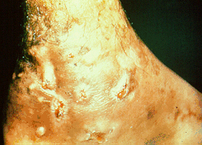
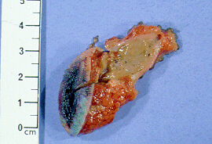

Slide 29
AL-HEDAITHY
Mycetoma (=Madura Foot) (continued)
  Infection is acquired following trauma to the skin by plant material from trees, shrubs, or vegetation debris. Thus more seen in rural areas (in farmers, Sheppards, walking bare-foot in agricultural land or city parks).
    “Madura foot” referring to the first case seen in “Madura” region of India which was in the foot of that patient.
  Infection is very chronic takes months to be fully established and years to deal with. It is not contageous. More seen in tropics and subtropics.
  Etiologies are fungi which cause eumycotic mycetoma (Eumycetoma) or actinomycetes which cause actinomycotic mycetoma (actinomycetoma). Their natural habitats are plant materials.
26

Slide 30
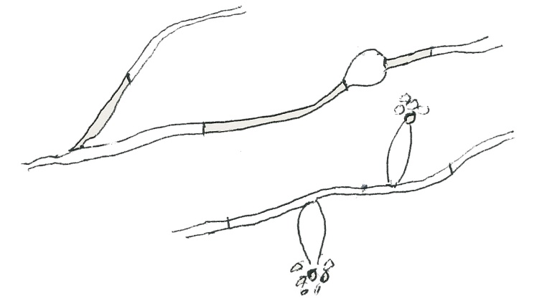
Mycetoma (=Madura Foot) (Continued)
AL-HEDAITHY
Etiology:
  Eumycetoma: caused by several mold fungi.
    The color of grains in this type of mycetoma is black or white.
    Fungi include: Madurella, Pseudallescheria (Scedosporium), Pyrenochaeta (Pycnidia producer), Acremonium, and the ascomycetes Leptosphaeria and Neotestudina, others.
    The common etiologies in Saudi Arabia and neighboring countries are:
      Madurella mycetomatis causes the majority of the cases with black grains. It is imperfect dematiaceous mold with brown colonies and diffused honey – colored pigment. Produces phialoconidia from phialides, and chlamydospores
      Madurella grisea
      Another species of Madurella, similar to M.mycet. but with grey colonies.
Chlamydospore
Phialoconidia
Phialide
Madurella mycetomatis
27

Slide 31
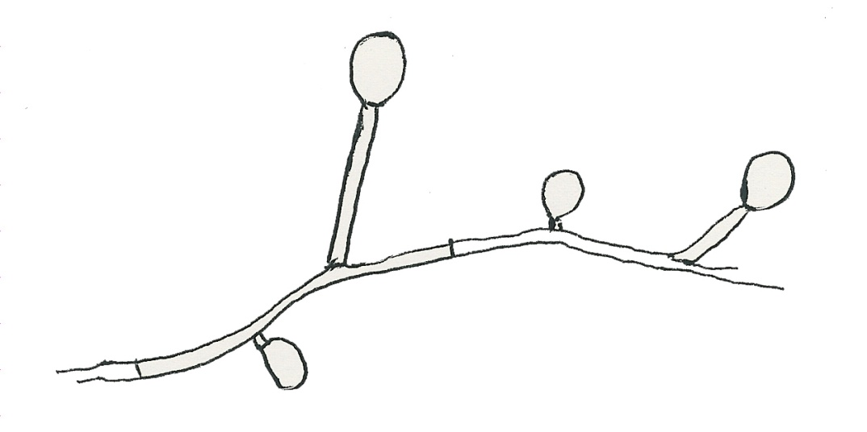
Mycetoma (=Madura Foot) (Continued)
AL-HEDAITHY
      Pseudallescheria boydii – causes white grain mycetoma. It is Ascomycete mold forming cleistothecia and ascospores. The imperfect of it is the moniliaceous mold: Scedosporium apiospermum which forms annelloconidia from annellids.
Annelloconidia
Annellid
Scedosporium apiospermum
28

Slide 32
Mycetoma (=Madura Foot) (Continued)
AL-HEDAITHY
  Actinomycetoma: Caused by about 10 species of aerobic actinomycetes.
    Color of grains yellow, white, yellowish-brown, pinkish – red.
    Actinomycetes are filamentous higher bacteria. The filaments (very thin about 1.0 μm wide) appear as long branching, beaded, or as long rods. They are Gram-positive.
    Main etiologies:
      Streptomyces somaliensis- causes the majority of the cases – color of grains yellow to yellow-brown.
      Actinomadura madurae – white or yellow grains.
      Actinomadura pelletieri – pinkish-red grains
      Nocardia brasiliensis – white grains.
      N.asteroides, N. caviae, N.coeliaca – white or yellow grains.
      Latter species of Nocardia usually cause Nocardiosis (which is subcutaneous, pulmonary, or brain abscess infection).
29

Slide 33
Mycetoma (=Madura Foot) (Continued)
AL-HEDAITHY
      Nocardia is acid-fast to partially acid fast when stained by Ziehl-Nelsen stain (ZN) while Streptomyces and Actinomadura are nonacid-fast.
    These actinomycetes are differentiated by their decomposition pattern of casien, tyrosine, xanthine, hypoxanthine, urea, and gelatin. Also by few other biochemical tests and colony morphology (They have adherent dry colonies). See Table of characteristics.
    The anaerobic actinomycete; Actinomyces israelii causes the infection: “Actinomycosis” which is subcutaneous, cervicofacial, pulmonary, abdominal, uterine, or brain abscess infection. It also causes dental caries. The organism is filamentous and will have yellow grains (sulfer granules).
30

Slide 34
AL-HEDAITHY
Characteristics of the main species of the above Actinomycetes
 | Ca | Ty | Xa | Hx | Urea | Growth in 0.4X salt | Gelatin | Colony
S. somaliensis | + | + | - | - | - | - | + | Brown
A.madurae | + | + | - | + | - | + | + | Brown
A.pelletieri | + | + | - | + | - |  | + | Brown
N.Brasiliensis | + | + | - | + | + |  | + | Orange
N.asteroides | - | - | - | - | + |  | - | White
Decomposition of Ca= Casien, Ty = Tyrosine, Xa = Xanthine, Hx = Hypoxanthine
31

Slide 35
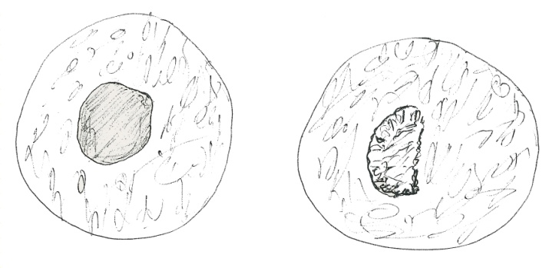
Mycetoma (=Madura Foot) (Continued)
AL-HEDAITHY
Laboratory Diagnosis:
  Specimen: Visible grains, Biopsy tissue (not skin pinch), curettings of sinuses, pus, blood for serology.
    First determine color of the grains – it helps identify etiology and initiate treatment.
    Make histologic sections, or grinde tissue and crush grains and make smears – stain by: Hematoxylin-Eosin, Gram, ZN; if fungi do 20% KOH or Periodic acid schiff stain.
    Extract serum for serology.
  Direct Microscopy:
    Will reveal grains in tissue;
      Homogenous texture actinomycetes.
      Heterogenous texture fungi
    Actinomycete grains will not reveal filaments easily.
    Fungal grains will contain easily seen hyphae and chlamydospores.
    Grains will have different morphology and color (white, black, yellow, pink, …. etc) depending on etiology.
Microscope field (10X)
Actinomycotic grain
Eumycotic grain
In tissue section
32

Slide 36
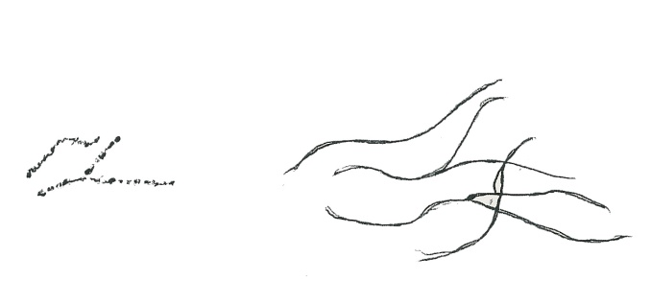
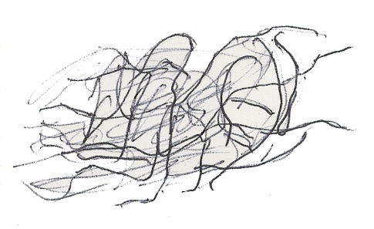
Mycetoma (=Madura Foot) (Continued)
AL-HEDAITHY
    Direct microscopy of specimen from Nocardiosis and actinomycosis will show branching thin filaments by silver stain
Beaded filaments
Nocardia (Gram +ve)
Actinomycete filaments (Silver stain)
  Culture: On SDA, Neutral – SDA, BHI-A, Blood agar and incubate at 37ºC and at 25 -30ºC aerobically.
    For actinomycosis also culture
    on cooked meat medium
    and incubate anaerobically at 37ºC
    The organisms will grow slowly
    and may be contaminated with skin flora – purify – identify.
  Serology:
    Test for Antibody using known antigen from each etiologic agent.
    Methods used immunodiffusion (I.D), and /or
    counterimmunoelectrophoresis (C.I.E.)
    Serology is good for Dx and monitoring treatment
Actinomycete filaments from culture (Gram +ve)
33

Slide 37
Mycetoma (=Madura Foot) (Continued)
AL-HEDAITHY
Management:
    Usually actinomycetoma respond better to treatment than eumycetoma.
    Generally if bone is infected the response to treatment is poor.
  Actinomycetoma:
    Trimethoprim – Sulfamethoxazole (Cotrimoxazole/ Septrin) + Streptomycin sulfate
    Or: Dapsone + Streptomycin sulfate
    Or: Doxycycline + Cefachlor
    For Actinomycosis: Penicillin G
  Eumycetoma:
    Ketoconazole (Nizoral) tablets or
    Itraconazole or voriconazole.
  If drugs not effective and bone is infected Amputate the limb or debride tissue and continue Rx.
  Treatment duration is long – up to years
34

Slide 38

Rhinosporidiosis
AL-HEDAITHY
Clinical:
Mucocutaneous fungal infection
Sites: Nasal, Oral (Palate, epiglottis), Conjunctiva.
Lesion: Polyps, Papillomas, wart-like lesions
More seen in communities near swamps
Etiology:
  Rhinosporidium seeberi
Obligately parasitic fungus
Believed to be hyphochytridiomycetes, does not grow on artificial media (e.g. SDA)
But has been grown in tissue culture
Laboratory Diagnosis: Specimen: Biopsy tissue
endospores
Direct Microscopy: Stained sections or smears or KOH, will show spherules with endospores
Culture on SDA negative
spherule
Management:
Cryosurgical excision of lesion-relapse common.
35

Slide 39
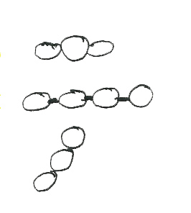
Lobomycosis
AL-HEDAITHY
Clinical:
Cutaneous – subcutaneous fungal infection
Lesion: Keloidal – verrucoid - nodular
Site: face, ear, arms, legs
Chronic – localized
Etiology:
Lacazia loboi
(=Loboa loboi)
Obligately parasitic fungus
Does not grow in culture like SDA media or tissue culture
Laboratory Diagnosis: The specimen is Biopsy tissue – Direct Microscopy will show chains of cells
Culture of specimen will be negative
Management: Surgical excision of lesion
36

Slide 40
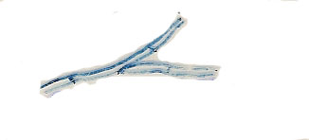
Phaeohyphomycosis
AL-HEDAITHY
Clinical:
  Subcutaneous or brain Abscess caused by dematiaceous fungi
  Affected site: Thigh, legs, feet, arms, ….etc, brain (cerebral)
Etiology
    Dematiaceous imperfect mold fungi. Mainly: Cladosporium, Exophiala, Wangiella, Cladophialophora bantiana (Cladosporium bantianum), Ramichloridium (Rhinocladiella) mackenziei, Bipolaris, Drechslera, Rhinocladiella
C.cladosporoides, E.jeanselmei, W.dermatitidis
Brown
Neurotropic fungi cerebral PHM as R.mack, C.bant.
Pus specimen in KOH
Naturally in woody plants, woods, agricultural soils
Laboratory Diagnosis:
Specimens: Pus, biopsy tissue
Direct Microscopy: KOH & smears brown septate hyphae
Culture: On SDA & Mycobiotic – very slow growing black or grey colonies.
37

Slide 41
AL-HEDAITHY
Chromoblastomycosis (=Chromomycosis)
Clinical:
The lesions are Hyperkeratotic, Verrucous, Pedenculus, Violaceous,Cauliflower, Initially Ulcerative, Autochthonous spread
Affected sites: extremitees, mainly feet & legs
Etiology:
Dematiaceous imperfect mold fungi in woods and woody plants.
Phialophora verrucosa, Fonsecaea pedrosoi, Exophiala, Cladosporium
Laboratory Diagnosis: Specimen, Biopsy tissue
Direct Microscopy: KOH & smears brown cells with septa, Brown Muriform cells (=sclerotic bodies)
Culture: On SDA and Mycobiotic
Very slow growing
Dematiaceous fungi
In KOH
38

Slide 42
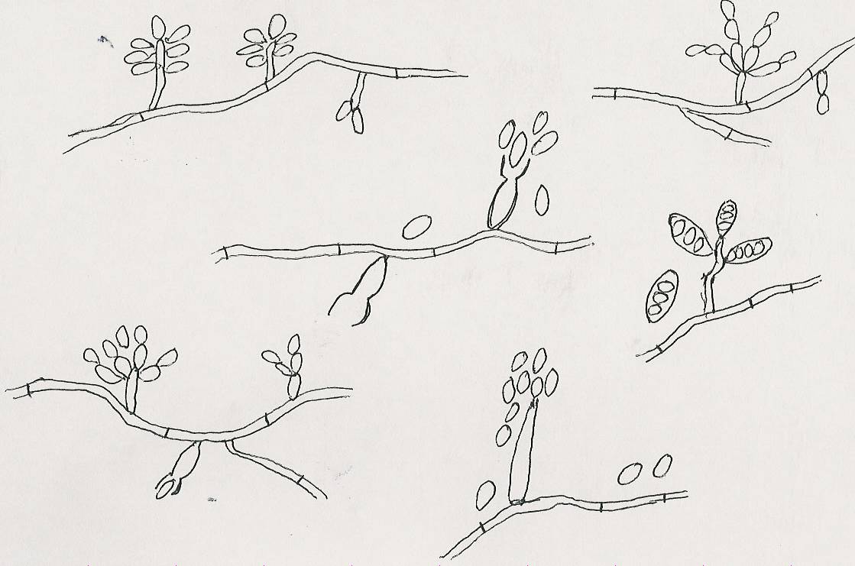
AL-HEDAITHY
Ramichloridum mackenziei
Cladosporium
Phialophora
Bipolaris
E.J.
Blastospore
Fonsecaea pedrosoi
Drechslera
Exophiala
39

Slide 43
AL-HEDAITHY
Management: Phaeophypho. & Chromoblasto.
Subcutaneous:
Clean surgical excision of the lesion + Antifungal
Cerebral phaeohypho: Aspiration of Pus - Antifungals
Amphotericin B, 5-Fluorocytosine (5-FC)
  Azoles (e.g. Voriconazole, Posaconazole)
  Caspofungin
40

Slide 44
Sporotrichosis
AL-HEDAITHY
Clinical:
  Lymphocutaneous and subcutaneous granulomatous lesions - suppurate, ulcerate. The lesions are nodules or ulcers in local lymphatics
Affected sites: extremities, joints.
In agricultural communities
Etiology:
Dimorphic, imperfect fungus in trees, shrubs, plant debris
Sporothrix schenckii. Yeast in human tissue & at 37ºC in culture. Mold in culture at room temperature with flowerettes of conidia.
Laboratory Diagnosis: Specimen:Biopsy tissue,ulcerative material
Direct Microscopy: smear Finger-like yeast cells or Cigar Some are oval. Also asteroid bodies may be seen.
Culture: On SDA at room temperature to grow mold, and on blood agar at 37ºC to grow yeast.
Treatment:
Septrin, KI
41

Slide 45
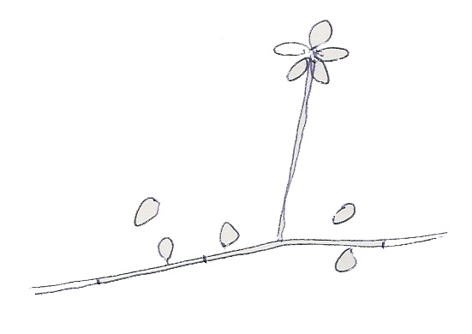
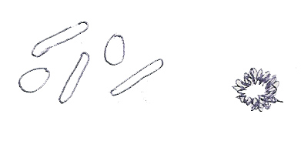
AL-HEDAITHY
Conidium
Yeast cells
Asteroid body
In clinical specimen and in culture at 37ºC
Mold in culture at room temperature
Sporothrix schenckii
42

Slide 46
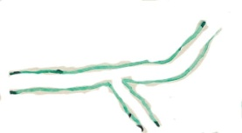
Zygomycosis
AL-HEDAITHY
(= Phycomycosis)
Infections caused by Zygomycete fungi of the orders Mucorales & Entomophthorales. Zygomycetes are:
Fast growing, moniliaceous molds, nonseptate hyphae, perfect
I- Subcutaneous zygomycosis
(= Entomophthoromycosis)
Clinical:
Chronic localized. Subcutaneous masses, cellulitis
Rhinofacial or other like Hand,Arm,Leg, thigh. Firm swelling of site with intact skin-Distortion.
Acquired via nasal mucosa or insect bite, Cont. debris
Etiology:
Conidiobolus coronatus, Basidiobolus ranarum, and few mucorales. These are perfect fungi that form Sporangia (conidia) and Zygospores.
Laboratory Diagnosis:
Specimen: Biopsy tissue
Direct microscopy: stained sections or smears will show broad non-septate hyphae with eosinophils.
Culture on SDA (no antifungals), fungi will grow fast.
Zygomycetes are inhibited by Cycloheximide
In specimen
Treatment:
43
KI orally or KI + Ampho B or Septrin

Slide 47

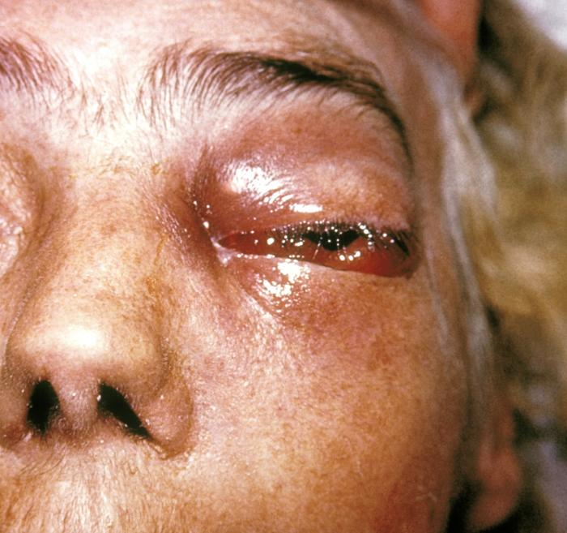

Slide 48
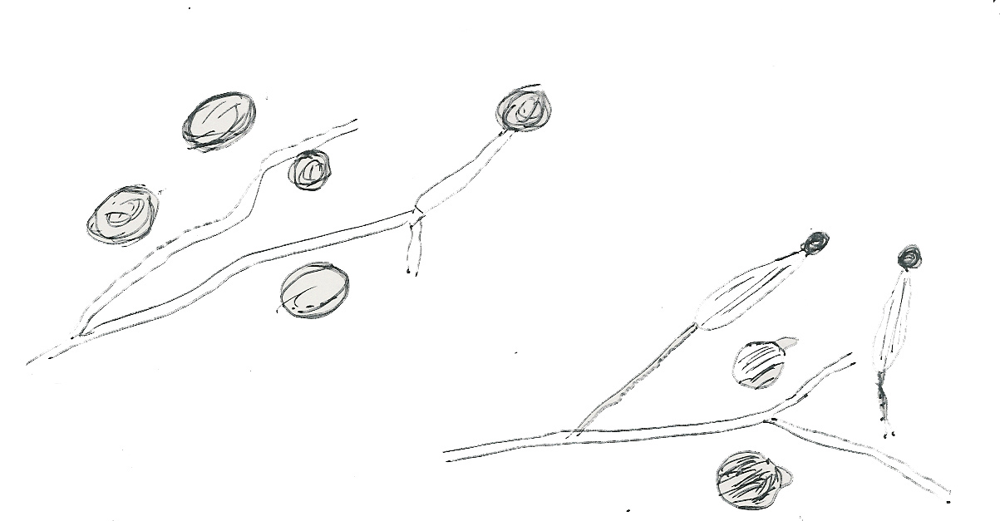
AL-HEDAITHY
Zygomycosis
Sporangium
Zygospore
Conidiobolus coronatus
Busidiobolus ranarum
44

Slide 49
Zygomycosis (Continued)
AL-HEDAITHY
II- Rhinocerebral zygomycosis
(=Mucoromycosis)
Clinical:
Paranasal sinusitis, orbital cellulitis
Rhinofacial – orbital – craneal
Usually acute, affects compromised host especially Diabetics with acidosis. Opportunistic
Acquired Via nasal mucosa
VERY SERIOUS – ACUTE - FATAL
Etiology:
Fast growing Zygomycetes have Nonseptate hyphae of the Mucorales order maily;
Rhizopus, Mucor,Absidia,Rhizomucor, others. Rhizopus arrhizus
Reproduce sexually and asexually forming Sporangia with sporangiospores & Zygospores
45

Slide 50
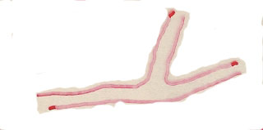
Zygomycosis (Continued)
AL-HEDAITHY
II- Rhinocerebral zygomycosis (=Mucoromycosis)
Laboratory Diagnosis:
Specimen: Biopsy tissue
Direct microscopy: Stained sections or smears will show broad nonseptate hyphae
Nonseptate hyphae In clinical specimen
Culture on SDA (no antifungal “Cycloheximide”).The fungi will grow fast within 2-3 days.
Prompt Dx & action are essential to save life
Treatment:
Aggressive surgical debridement + Amphotericin B – other antifungals.
III- Gastrointestinal (GI) Zygomycosis
This is a chronic zygomycete infection affecting the GI., mainly liver and intestine. The lesions are masses or abscesses in these sites.
Seen in children (6 -12 -Year old) often
Caused by Basidiobolus ranarum primarily.
Specimen: fine needle biopsy Direct Microscopy will show nonseptate hyphae & culture will grow the fungus.
Treatment: Medical with Itraconazole prognosis is good
There is mucorales G.I. Zygo which acute & Fatal. It is rare
IV- Pulmonary Zygomycosis
46
This is chronic or acute. Other aspects similar to mucoromycosis

Slide 51
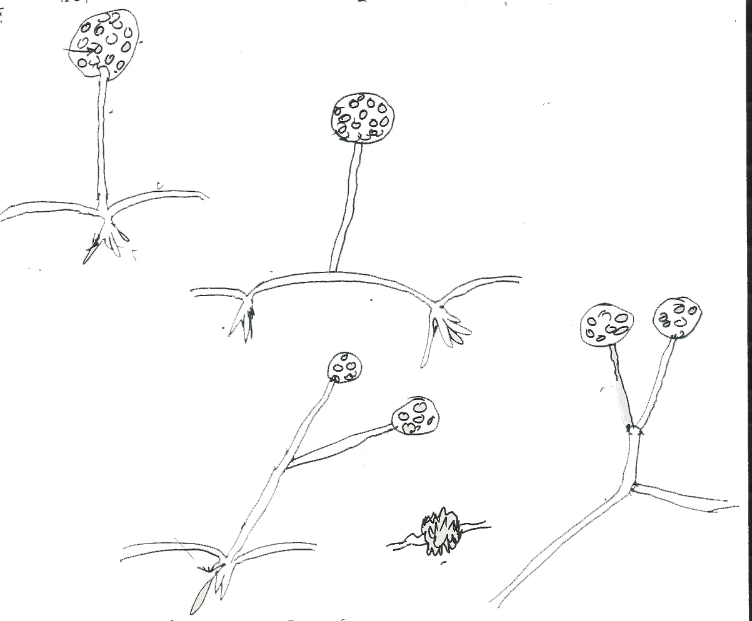
AL-HEDAITHY
Zygomycosis
Sporangium
Nonseptate hyphae
Sporangiospore
(Stolon)
Rhizopus
← Sporangiophore
Rhizoid
Absidia
Mucor
Zygospore
Rhizomucor
47

Slide 52
Aspergillosis
AL-HEDAITHY
This is any infection caused by Aspergillus–Affecting compromised individuals.
  The systemic forms of this infection are opportunistic infections.
In few occasions it is non opportunistic
The clinical manifestations vary from allergy to skin to systemic forms.
Clinical Types:
1- Allergic Aspergillosis
  Asthma
  Allergic Bronchopulmonary Aspergillosis (ABPA)
IgE antibodies present. In ABPA also IgG
2- Colonizing aspergillosis
(=Aspergilloma = Aspergillus fungus ball)
Pulmonary aspergilloma signs include:Cough,hemoptysis, variable fever
CXR will show coin – like mass in the lung
There will be a radiolucent crescent (=Monod’s sign = Grelot) over the mass
3- Invasive Aspergillosis - pulmonary
Signs: Cough , hemoptysis, Fever, Pneumonia, Leukocytosis
Lab investigation (direct microscopy and culture) may be negative
especially if specimen is noninvasive like sputum.
48

Slide 53
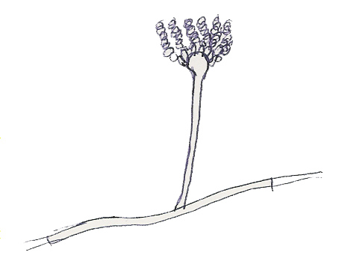
Aspergillosis (Continued)
AL-HEDAITHY
4- Aspergillus sinusitis (= Nasal-orbital):
Nasal polyps – sinusitis – eye – craneum (Rhinocerebral)
The most common cause is Aspergillus flavus (also other fungi can cause sinusitis)
5- Eye infection Corneal ulcer – endophthalmitis
6- Ear infection Otitis externa – otitis media
7- Nail & skin infection
8- Toxicosis due to ingestion of aflatoxin
9- Disseminated form – rare, in debilitated patients.
Etiology:
Conidia
Any species of Aspergillus. It is a moniliaceous imperfect mold – Ubiquitous in distribution
Conidiophore
It has hyaline septate hyphae, conidiospores with chains of unicellular conidia.
Aspergillus
The common species are Aspergillus fumigatus, A. flavus, A. niger, A.terreus, and others
The perfect stage is: Eurotium species an Ascomycete fungus.
49

Slide 54
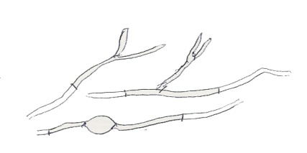
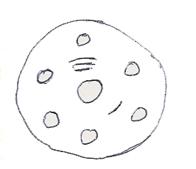
Aspergillosis (Continued)
AL-HEDAITHY
Laboratory Diagnosis:
Specimen: Respiratory specimens (Sputum, bronchoscopic, Lung biopsy), Surgically removed Aspergilloma, Mass, Scrapings, Blood, etc.
Lab. Investigations: Direct miroscopy – culture - serology
Direct Microscopy:
KOH, Giemsa, Grecott methenamine silver stain (GMS)
Periodic Acid Schiff (P.A.S); will show Septate hyphae with Dichotomous branching
Septate hyphae with Dichotomous branching
Culture on SDA (no cycloheximide) fast growing – If nonsterile specimen (e.g. sputum) rule-out contaminant possibility by repeat specimen
Serology: Primarily test for Antibody using Aspergillus polyvalent Ag, Aspergillys terreus Ag, Aspergillus nidulans Ag.
Using I.D (Immunodiffusion)and/or C.I.E (Counterimmunoelectrophoresis).SP-RIA (Solid phase radioimmunoassay) more sensitive.
Multiband identity lines
Multiband identity lines will be seen in aspergilloma
E.I.A. test for Antigen is available.
I.D. Plate
There is latex agglutination test available
Management:
Surgical + Medical – Or Medical only
Drugs Used: Amphotericin B, Liposomal Ampho. B, Itraconazole, Voriconazole, Caspofungin
50

Slide 55
AL-HEDAITHY
Pneumocystosis
Opportunistic fungal pneumonia
It is interstitial pneumonia of the alveolar area.
Signs include; Dyspnea. Cyanosis
Affect compromised host
Especially common in AIDS patients.
Infection commonly known as PCP (should be PJP)
51

Slide 56
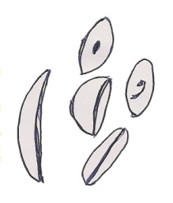
Pneumocystosis (Continued)
AL-HEDAITHY
Etiology:
Pneumocystis jirovecii
Previously thought to be a protozoan parasite.
It has been proven to be a fungus based on:
1- RNA studies – similar to fungi
2- Chitinase enzyme attacks the cell wall of the cyst so it has chitin like fungi
Does not grow in media like SDA, others
Other species naturally found in rodents and other mammals. P. cariniii in rats. Humans contract it during childhood.
Laboratory Diagnosis: Patient specimen: Bronchoscopic specimens (B.A.L.), Sputum, Lung biopsy tissue.
Histologic sections or smears stained by
Silver stain (GMS). If (+) there will be cysts of hat-shape, cup shape, crescent, parentheses, comma
Cysts (4-5 μm)
Can be detected by specific antibodies
Treatment: Trimethoprim – sulfamethoxazole (septrin)
52

Slide 57
Candidiasis (=Candidosis)
AL-HEDAITHY
(Old name Moniliasis)
General :
This is any infection caused by any species of the yeast fungus Candida or few other yeasts.
It is considered opportunistic infection affecting compromised individuals.
Predisposing factors:
  Young age and elderly, Cancer patients (Malignancies, Lymphoma, Leukemia), Broadspectrum antibacterial antibiotics, Altered immunity (AIDS, Inhereted).
  Certain drugs (steroids, immunosupressives, cytotoxic)
For Vaginitis, Pregnancy – B.C.P. – IUCD – Adult female
Malnutrition & Iron deficiencies, Diabetes, Dentures, Xerostomia, Intensive care patients & other hospitalized patients
The source of infection is Endogenous because Candida species are normal flora of the body.
53

Slide 58
Candidiasis (Continued)
AL-HEDAITHY
Clinical types:
A- Mucocutaneous & Cutaneous:
Oral thrush: White or grey Pseudomembranous patches on oral surfaces especially tongue with underlying erythema. Common in neonates, infants, children, elderly, compromised host, AIDS.
Diaper (Napkin) rash: Rash on groin of diapeer wearers.
Mycotic vaginitis (vulvovaginitis) = vaginal thrush
  Whitish or erythematous patches on vaginal mucosa.
  Signes: vaginal discharge (whitish-yellow) & pruritus.
  Adult ladies especially pregnant, contraceptive users (B.C.P., IUCD), even virgin girls, Husbands may develop balanitis.
Intertrigneous candidiasis: erythematous lesions on body skin folds. More seen in over weight individuals.
Paronychea – Infection of tissue distal to nail
Onychomycosis: Nail infection
54

Slide 59
Candidiasis (Continued)
AL-HEDAITHY
B- Bronchopulmonary candidiasis: Bronchitis/Pneumonia in compromised host – Diagnosis difficult
C- Other opportunistic systemic candidiasis:
Urinary Tract Infection – 10⁵ c.f.u./ml msu
More seen in catheterized patients
Septicaemia: - Blood infection – more than one (+) culture
  Transient candidemia (Yeast fungemia)-Only one (+) culture
Meningitis in compromised host.
Endocarditis in compromised host.
55

Slide 60
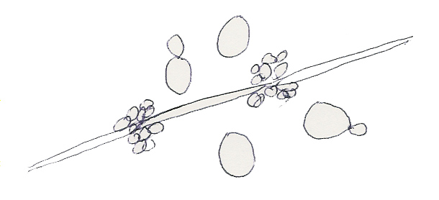
AL-HEDAITHY
Candidiasis (Continued)
Etiology:
Any species of the genus Candida. Candida is a yeast fungus. It is imperfect, reproducing asexually by budding.
It has cream moist colony, Fast growing on Sabouraud Dextrose agar (SDA) and Blood agar.
Structure on Cornmeal agar (CMA): Budding yeast cells Pseudohyphae, and blastospores.
Blastospores
Pseudohypha
It is part of the body flora & other habitats
Budding yeast cell
There are many species of Candida. The common ones to cause infection are Candida albicans, C.glabrata, C.tropicalis, C.Krusei, C.parapsilosis.
In CMA medium
56

Slide 61
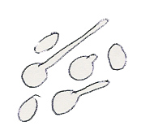
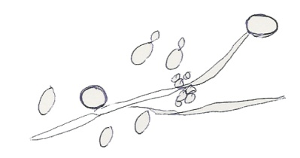
Candidiasis (Continued)
AL-HEDAITHY
C.albicans is the most common species to cause infection among all yeasts (causes about 50% to 60% of the cases), therefore there are short-cut tests to identify it which are:
G.T.
Germ tube test in serum
Chlamydospore
Germ tube test
2. Chlamydospore production in CMA
C.albicans in CMA
3. Resistance to 500 μg/ml Cycloheximide (will grow on Mycobiotic Medium)
If these 3 are (+), yeast is C.albicans, if not other yeasts.
The test to identify any yeast in the clinical lab. is Carbohydrate assimilations. There are commercial kits available for this like: API 20C, ID32.
Yeasts other than Candida that may cause Candidiasis include: Saccharomyces cerevisiae, Trichosporon beigelii, Rhodotorula species
57

Slide 62
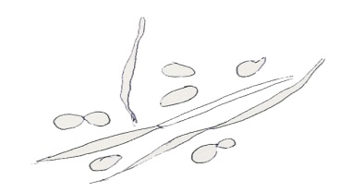
Candidiasis (Continued)
AL-HEDAITHY
Laboratory Diagnosis:
Specimen obtained depend on site of infection.
- Swabs, Urine, Blood, Respiratory specimens, CSF, Blood for serology If available
In the Lab. Direct microscopy (D.M.), culture & Serology
Direct M. If (+) Pseudohyphae and budding yeast cells will be seen in stained smear or KOH.
Pseudohyphae
Budding yeast cell
In clinical specimen (Direct Microscopy)
Culture: on SDA & Blood agar at 37ºC, If (+) creamy moist colonies in 24 - 48 hours.
Identify: GTT, Chlamydospore, Cycloheximide, Carbohydrate assimilation.
Serology: patient serum: test for Ag (Mannan, enolase, proteinase) or Ab.Use Immunodiffusion (I.D) or Counterimmunoelectrophoresis (C.I.E.). Also latex agglutination test.
58

Slide 63
AL-HEDAITHY
Candidiasis (Continued)
Treatment:
Oropharyngeal: Topical Nystatin suspension,
Clotrimazole troches (Lozenges),Miconazole, Fluconazole suspension.
Vaginitis: Topical; Miconazole, Clotrimazole, Nystatin
Systemic Rx: Amphotericin B, Liposomal amphotericin B, Fluconazole, Caspofungin, Voriconazole
If resistant to Rx request antifungal sensitivity.
59

Slide 64
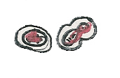
Cryptococcosis
AL-HEDAITHY
Clinical:
Opportunistic Yeast infection, caused by Cryptococcus neoformans
Meningeal (cryptococcal meningitis) and / or Pulmonary
It affects compromised host.
Skin infection by C.albidus
Etiology:
Cryptococcus neoformans. True Yeast.
Mucoid yellowish colonies on SDA
True yeast with encapsulated yeast cells.
Naturally in Pigeon habitats-it is urease (+) has melanin pigment
It produces phenol oxidase / hence forms chocolate colonies on Caffeic acid / Bird seed agar media
Perfect stage is Filobasidiella neoformans which is a Basidiomycete
60

Slide 65

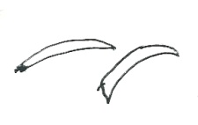
AL-HEDAITHY
Cryptococcosis (Continued)
Laboratory Diagnosis: Specimens: C.S.F. / Body fluids / tissue
Direct Microscopy: - India ink (Or Nigrosin negative stain) will show encapsulated budding yeast cells
- Or stained smears
- Lunar cells may be seen in tissue (=Crescent cells)
Culture on SDA – BHI-A at 37ºC will grow fast 1-2 days.
Serology: - Latex agglutination – Rapid
I.D. /C.I.E. tests for antibodies; Cross reactivity with Rhumatoid factor (RF)
Treatment: Amphotericin B – and 5–FC. Others.
61

Slide 66
AL-HEDAITHY
Trichosporonosis
Opportunistic Yeast infection usually pulmonary.
Etiology is Trichosporon beigelii
In culture: Yeast with Pseudohyphae, arthrospores and blastspores. It is urease (+)
In clinical specimen: budding yeast cells and Pseudohyphae.
Geotrichosis
Opportunistic yeast infection, usually pulmonary
Etiology is Geotrichum candidum
In culture: Pseudohyphae, hyphae & arthrospores.
In clinical specimen: Pseudohyphae and budding yeast cells.
Treatment: Amphotericin B – others
62

Slide 67
AL-HEDAITHY
Primary Systemic Mycoses
General:
  These are primary fungal infections. They do not require risk factors to occur. They affect normal and compromised subjects.
  They start as respiratory diseases, and if not cured, they disseminate to other body sites like: bone, skin and subcutaneous tissues, central nervous system, bone marrow, …etc.
  Contracted by inhalation of fungal elements in dust.
  Symptoms include flue signs initially, then fever, cough, chest pain, loss of weight, night sweats –other signs of sites they disseminate to.
63

Slide 68
AL-HEDAITHY
Primary Systemic Mycoses (Continued)
  Common in North America and to a lesser extent South America. Not common in other parts of the World.
  Etiologies are dimorphic fungi. In nature found in soil of restricted habitats.
  Drugs of choice for treatment: Amphotericin B, Liposomal amphotericin B,Voriconazole, Caspofungin, other new antifungals.
  They include: Blastomycosis, Histoplasmosis,
  Coccidioidomycosis, and Paracoccidioidomycosis.
64

Slide 69
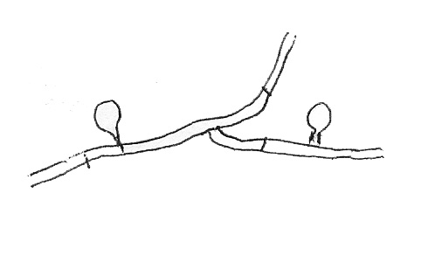
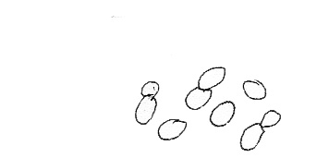
Blastomycosis
AL-HEDAITHY
The general statements about the primary systemics apply to this infection.
  The pulmonary form is progressive, and if not treated it disseminates to skin, subcutaneous tissue, bone, central nervous system (CNS).
Etiology: Blastomyces dermatitidis
  Dimorphic, imperfect, moniliaceous fungus.
  It is mold in nature and in-culture at ≤30ºC. But yeast in human body and in-culture at 37ºC.
    The mold is white with
    septate hyphae and lateral unicellular conidia.
    The yeast cells are large 8-15μm
    with broad-base attachment of bud to mother cell.
    In nature, it is present in soil rich in organic matter
Conidium
Mold phase
Yeast phase
65

Slide 70
Blastomycosis (Continued)
AL-HEDAITHY
The perfect stage of the fungus has been discovered and it is an ascomycete reproduce sexually forming ascospores. Named, Ajellomyces dermatitidis
Laboratory Diagnosis: Specimens: respiratory (sputum, bronchoscopic) or biopsy tissue from site, blood for serology
  Direct microscopy: Yeast cells with broad-base budding
  Culture: On SDA, blood agar, BHI-A
  At ≤30ºC Mold; at 37ºC Yeast
  Serology: Test for Ab using known Ag (Blastomycin)
  Methods: I.D, C.I.E, complement fixation (CF).
  There is cross-reactivity with others.
Treatment: As mentioned in the general statements.
66

Slide 71
Histoplasmosis (Cave Disease)
AL-HEDAITHY
This is an intracellular infection of the reticuloendothelial system (RES).
  Starts as respiratory- could be self-limiting.
  The pulmonary form similar to tuberculosis – there is caseation and fibrosis. Disseminates to RES (liver, spleen, bone marrow …. Macrophages).
  Seen more in U.S.A., reported from other parts of the World.
Etiology: Histoplasma capsulatum
  Dimorphic, imperfect, moniliaceous fungus.
    Mold in nature and in culture at ≤30ºC
    Yeast in human body and in culture at 37ºC
    There are two varieties of the species, differing mainly in the yeast phase and having same mold phase. These varieties are:
      H.cap. var. capsulatum; Has small (2-3 x 3-4 μm) oval yeast cells. Causes the usual histoplasmosis.
      H.cap. var. duboisii; Has large yeast cells (7-15μm), causes African histoplasmosis.
67

Slide 72
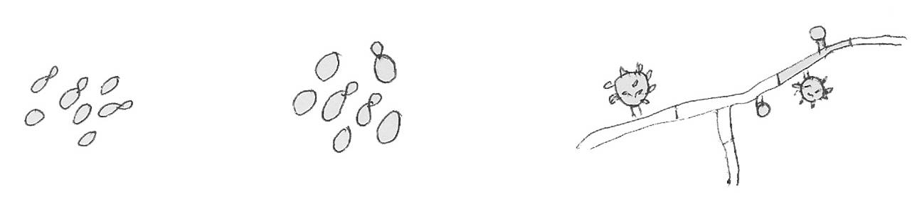
Histoplasmosis (Cave Disease) (Continued)
AL-HEDAITHY
  The mold phase has white colonies, septate hyphae, produces two types of conidia; Tuberculated macroconidia (8-14μm), and smooth microconidia (2-5 μm).
Tuberculated macroconidium
Microconidium
H.cap.var.cap. Yeast phase
H.cap.var.dub. Yeast phase
Histoplasma capsulatum Mold phase
  The natural habitat of the fungus is specific soils rich in animal excreta especially bat guano and droppings of certain birds. Because caves harbor bats – Thus called “Cave Disease”.
  The perfect stage of the fungus has been known; it is ascomycete producing ascospores sexually called Ajellomyces capsulatus.
68

Slide 73
Histoplasmosis (Cave Disease) (Continued)
AL-HEDAITHY
Laboratory Diagnosis: Specimen: Respiratory, biopsy tissue of affected site, blood, bone marrow.
  Direct microscopy: Intracellular yeast cells in macrophages – small for var. capsul. and large for var. douboisii.
  Culture: On SDA, BHI-A, BHI-A-blood (biphasic medium) Incubate at 30ºC and 37ºC. Slow growth for primary isolation- may take weeks.
  Serology: Test for Ab in patient serum using known Ag (Histoplasmin Ag, H and M Ags.) using I.D., C.I.E, C.F. There is cross reactivity.
Treatment: As mentioned in the general statements.
69

Slide 74
AL-HEDAITHY
Coccidioidomycosis (Valley Fever)
Starts as respiratory – could be self limiting
  If pulmonary not cured – It may disseminate
  Endemic in Southwestern U.S.A. (Southern California, and Arizona), where it is known as Valley fever, children summer sickness and adults flue.
  Rarely seen out of America
Etiology: Coccidioides immitis
  Dimorphic, imperfect, moniliaceous fungus.
    Mold in nature and in culture at ≤30ºC
    The other phase is spherules with endospores in human body and in modified converse medium at 37ºC.
70

Slide 75
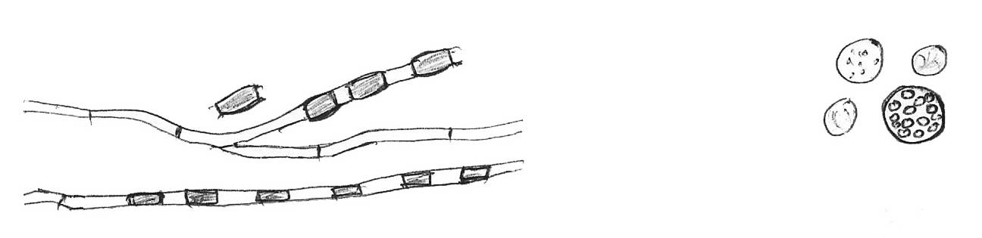
Coccidioidomycosis (Valley Fever) (Continued)
AL-HEDAITHY
  The natural habitat of the fungus is soil in rodent-burrows or around them in hot dry deserts.
    The mold phase has white colonies with septate hyphae. It produces berrel-shape arthrospores (2.5 - 4 x 3 - 6 μm) that alternate with disjunctor cells.
    The spherule phase will have large spherules (30-60 μm) upon maturity with endospores.
Arthrospore
Endospores
Disjunctor cell
Spherules
Mold phase
Coccidioides immitis
71

Slide 76
Coccidioidomycosis (Valley Fever) (Continued)
AL-HEDAITHY
Laboratory Diagnosis: Specimens: Respiratory (Sputum, bronchoscopic), biopsy tissue from site of infection, blood for serology)
  Direct Microscopy: Presence of spherules, mature spherules with endospores.
  Culture: Grows readily on SDA at room-temperature or 37ºC. On modified converse medium at 37ºC and reduced oxygen the spherules will be produced readily.
  Serology:Test for Ab in patient serum using known Ag (Coccidioidin Ag). Methods include C.F., Tube precipitin test, I.D, and C.I.E. Serology is good-rising titers Infection. Declining titers remission.
Treatment: As in general statement
72

Slide 77
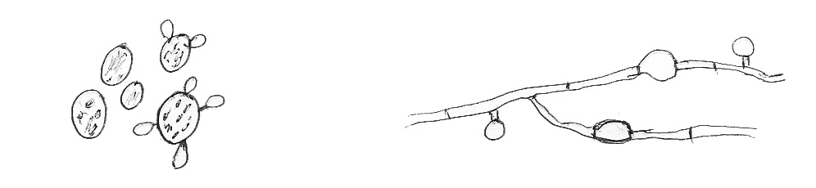
Paracoccidioidomycosis (South American Blastomycosis)
AL-HEDAITHY
General Statements about primary systemics
  Additional symptoms: Ulcers in buccal mucosa and lymphadenopathy
  The infection is more seen in South American countries (Brazil, Venezuella, Argentina, Chile, …etc.) It is rarely seen elsewhere.
Etiology: Paracoccidioides brasiliensis
  Dimorphic, imperfect, moniliaceous fungus.
  It is mold in nature and in culture at ≤30ºC, And large yeast in human body and in culture at 37ºC on blood agar.
    The mold grows as white colonies with septate hyphae having Chamydospores and lateral unicellular conidia.
    The yeast phase has large yeast cells (some up to 30 μm diam) with multiple nuclei and multiple buds; known as mariner’s wheele cell or micky mouse cell.
Mickey mouse cell
Conidium
Mariner’s wheele cell
Chlamydospore
Yeast phase
Paracoccidioides brasiliensis
Mold phase
73

Slide 78
Paracoccidioidomycosis
(South American Blastomycosis) (Continued)
AL-HEDAITHY
Laboratory Diagnosis: Specimens: Respiratory, Aspirates, ulcerative material, biopsy tissue from site of infection, blood for serology.
  Direct Microscopy: Presence of budding yeast cells some large with multiple nuclei and buds; Marriner’s wheele cells/ Mickey mouse cells
  Culture: On SDA incubate at room temperature to grow mold phase, and on Blood agar at 37ºC to grow the yeast phase
  Serology: Test for Ab
Treatment: As in general statement. Mild cases can be treated with sulfonamides.
74

Slide 79
AL-HEDAITHY
Candidiasis (=Candidosis ) (Old name Moniliasis)
(For Dental Students)
Definition: Any infection caused by any species of the yeast fungus Candida or similar other yeasts..
It is considered opportunistic infection affecting compromised individuals.
Predisposing factors:
  Young age and elderly, Cancer patients (Malignancies, Lymphoma, Leukemia), Broad spectrum antibacterial antibiotics, Altered immunity (AIDS, genetic), Certain drugs (Steroids, immunosupressive, cytotoxic), Diabetes, Pregnancy – B.C.P. – IUCD, Malnutrition & Iron deficiencies, Dentures, Xerostomia, Intensive care patients and other hospitalized patients.
75

Slide 80
Candidiasis (=Candidosis ) Continued
AL-HEDAITHY
Clinical Types (Features)
There are many clinical types of Candidiasis
The source of infection is Endogenous because Candida species are normal flora of the body.
Mucocutaneous and cutaneous
Systemic Infections
  The first group include a common mucocutaneous infection:
  Oropharyngeal Candidiasis
These are infections of mouth; tongue, throat, palate, pharynx,
buccal mucosa, gingiva by Candida species.
  More seen in malnorished children, Infants, AIDS patients, Hospitalized patients ….etc.
76

Slide 81
Oropharyngeal Candidiasis (Continued)
AL-HEDAITHY
There are 3 Clinical types of Oropharyngeal Candidiasis:
  Oral thrush (=Pseudomembraneous)
  Appears as white-creamy plaques on the mucosa with underlying erythema when white patches wiped the erythematous (red) surface is exposed and may bleed.
  Atrophic (erythematous) candidiasis: Appears as red patches on palate or tongue more seen in denture wearers and xerostomia.
  Leukoplakia (chronic hyperplastic candidiasis)
    Lesions are whitish plaques but cannot be wiped off as in thrush. Often involve tongue and inner commissures of lips.
    More seen in smokers and patients with secretor blood group.
    In AIDS patients differentiate from Hairy leukoplakia which is caused by Epstein Barr virus.
77

Slide 82
AL-HEDAITHY
Oropharyngeal Candidiasis (Continued)
Candida also can infect the commissures of lips producing fissured red lesions that cause pain and burning It is called:
Perleche or angular cheilitis (=stomatitis)
Complications of Oropharyngeal candidiasis:
(a) esophagitis (b) Septicaemia
Other Infections by Candida
  Diaper rash, Mycotic vaginitis (vaginal thrush), Intertrigeounus Candidiasis,Paronychia and onychomycosis, Systemic Infections (In hospitalized patients), Bronchopulmonary, UTI, Septicaemia, Meningitis, Endocarditis.
78

Slide 83
AL-HEDAITHY
Oropharyngeal Candidiasis (Continued)
Etiology:
Any species of the genus Candida. Candida is a unicellular yeast fungus. It is imperfect reproducing by Asexual means budding
Structure: Budding yeast cells, blastospores, and Pseudohyphae.
  Creamy colony,fast growing on Sabouraud Dextrose agar (SDA), Blood agar, and on CMA (Cornmeal agar)
It is part of the body flora in mucocutaneous tissue (Mouth, Vagina),
RT, GI, UT., Skin, also other habitats .
There are many species of Candida
The common species are: Candida albicans, C.glabrata, C.tropicalis, C.Krusei, C.parapsilosis
79

Slide 84
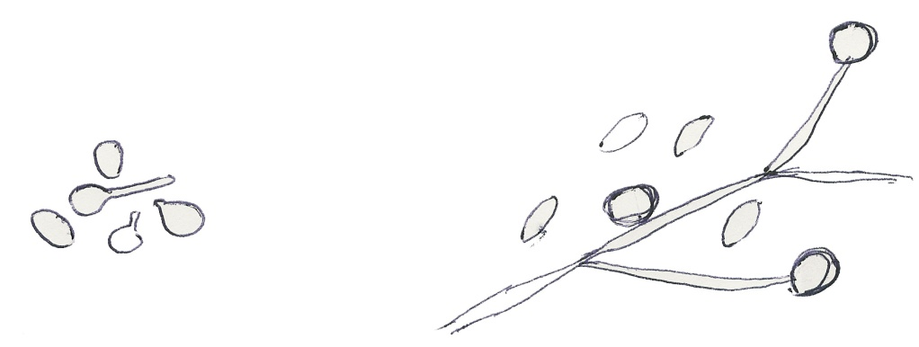
AL-HEDAITHY
Oropharyngeal Candidiasis (Continued)
C.albicans is the most common species to cause infection among all yeasts (causes ~ 50% - 60% of the cases)
Therefore there are short-cut tests to identify it:
1) Germ tube 2) Chlamydospore production in CMA.
3) Resistance to 500 μg/ml Cycloheximide (growth on Mycobiotic)
    If these 3 (+), yeast is C.alb. If not other yeasts.
The test to identify any yeast in the clinical lab. is by Carbohydrate assimilation tests. There are commercial kits for this; API 20C, ID 32.
There are yeasts other than Candida that may cause Candidiasis, of these Saccharomyces cerevisiae, Trichosporon beigelii, Rhodotorula spp.
Yeast cell
Chlamydospore
Germ tube
Yeast cell
Pseudohypha
C.albicans
80

Slide 85
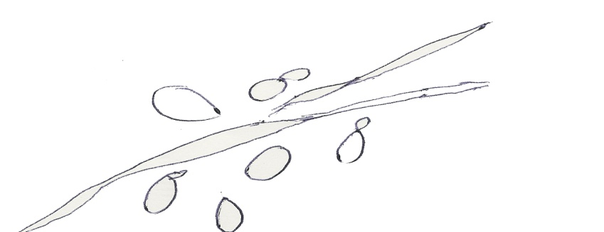
Candidiasis (Continued)
AL-HEDAITHY
Laboratory Diagnosis:
  Specimen: Depend on site of Infection.
  Oropharyngeal: Swab from lesion
  Blood for serology If available
  Syst. Inf.: Other systemic specimens (e.g. C.S.F. respiratory specimens, MSU)
  In the Lab. Direct microscopy (D.M.), culture, and serology
  Direct M. If (+) Pseudohyphae and budding yeast cells in stained smear or KOH
  Culture: On SDA and Blood agar at 37ºC and at 25-30ºC.
  If (+), creamy moist colonies will develop within 24 – 48 hrs.
  Identify: GTT, Chlamydo, Cycloh., Carboh. assim.
  Serology: Patient serum test for Mannan antigen (Ag) or antibody(Ab). Use Immunodiffusion (I.D.) or (C.I.E.) counterimmunoelectrophoresis. Ag Serol. Good for Dx.
Pseudohypha
Budding Yeast cell
Candida in patient specimen
81

Slide 86
Candidiasis) (Continued)
AL-HEDAITHY
Treatment:
  Oropharyngeal: Topcial Nystatin suspension, Clotrimazole troches (Lozenges),Miconazole, or Fluconazole suspension
  Systemic: Amphotericin B, Fluconazole, Caspofungin, Voriconazole
  If resistant to Rx request antifungal sensitivity
  Other Oral Fungal Infections
  Yeast: Cryptococcus neoformans
  Mold infections: Aspergillosis, Zygomycosis Histoplasmosis, Blastomycosis, Rhinosporidiosis.
82

Slide 87
AL-HEDAITHY
Fungal Eye Infections
Oculomycoses
THREE TYPES:
I- Mycotic Keratitis (= keratomycosis)
Fungal infection of cornea
Corneal ulcer, corneal abscess
Risk Factors:
Canaliculitis. Trauma, Surgery, Corticosteroids, none
Lesion with hyphated margin Hypopyon usually present fungi usually (Shaggy margin) deep in C.tissue not in surface
83

Slide 88
AL-HEDAITHY
Fungal Eye Infections (Continued)
Etiology: Environmental fungi
Commonly, fast growing moniliaceous fungi viz, Fusarium solanii, F.oxysporum, Aspergillus fumigatus, A. flavus, A.niger Candida albicans, Candida sp., Acremonium, Pseudallescheria (Scedosporium)
Dematiaceous fungi: Scytalidium, Curvularia, Exophiala.
Rhinosporidiosis – Rhinosporidium seeberi
84

Slide 89
Fungal Eye Infections (Continued)
AL-HEDAITHY
Laboratory Diagnosis: Specimens: Corneal scrapings – swabs no good, conjunctival scrapings
Direct microscopy Exam
Smears, 10% KOH, Calcofluor
Gram stain, Giemsa, Silver stain (GMS)
If positive : Septate hyphae, Hyphal fragments, Yeast cells, Pseudohyphae
Culture on Sabouraud dextrose agar (SDA) with no Cycloheximide, BHI, BA. C-cut inoculation
Diagnostic:
Direct microscopy (+) & culture (+) or (+) culture from repeated specimens, or (+) culture from multiple sites of inoculation.
85

Slide 90
AL-HEDAITHY
Fungal Eye Infections (Continued)
II- Endogenous Oculomycosis(Endophthalmitis):
This is ocular infection by dissemination of systemic disease. Dissemination usually hematogenous Affect any eye tissue; eye orbit, conjunctiva, Sclera, Iris,Lenz,retina, optic nerve …
Endophthalmitis infection. May occur with no systemic disease.
Common etiology; Candida but also disseminated Histoplasmosis, Blastomycosis, Cryptococcosis & others. Fusariosis, Scytalidium has caused endophthalmitis.
Specimen for Lab.: Aquous & vitreous fluids Biopsy tissue.
86

Slide 91

AL-HEDAITHY
Fungal Eye Infections (Continued)
III- Extension Oculomycosis:
Extension of a fungal infecion in tissue adjacent to eye. It extends to involve eye orbit
The common type is rhinocerebral zygomycosis (rhinocerebral mucoromycosis) caused by Zygomycete fungi very serious. Have broad nonseptate hyphae in tissue Rhizopus, Mucor
Subcutaneous zygomycosis: Basidiobolus, Conidiobolus
Nasal-orbital aspergillosis, Sinusitis Brain involvement serious
Act promptly – aggressive measures
Also:
87

Slide 92
AL-HEDAITHY
Fungal Eye Infections (Continued)
Treatment:
Pimaricin (natamycin) (5% solution)
Q 1º – 3º
Nystatin
Miconazole (subconjunctival injects & drops)
Amphotericin B (fungizone), Flucytosine or Ambisome
Or Medical + surgical
Other systemic antifungals: Itraconazole, Fluconazole
Voriconazole
Caspofungin
88

Slide 93
AL-HEDAITHY
SELECTED REFERENCES
Kwon Chung, J.J. and Bennett, J.E. 1992. Medical Mycology. Lea & Febiger, Philadelphia.
Rippon, J.W. 1988. Medical Mycology, The pathogenic fungi and the pathogenic actinomycetes. 3rd ed. W.B. Saunders Co., Philadelphia
Anaissie, E., McGinnis, M., Pfaller, M. 2003. Clinical Mycology. Churchill Livingstone. Philadelphia, U.S.A.
Evans and Richardson. 1989. Medical Mycology, a practical approach. IRL Press, Oxford.
Larone, D. 2002. Medically Important fungi, A guide to identification. American Society for Microbiology. Washington DC.
Campbell MC, Stewart JL. 1980. The Medical Mycology Handbook. John Wiley and Sons. New York, U.S.A.
Koneman et al. 3rd ed. Practical Laboratory Mycology. Williams and Wilkins. Baltimore, London.
Barnett, H.L. and Hunter, B.B. 1972. illustrated genera of imperfect fungi. 3rd ed. Burgess Publishing Comp., Minneapolis.
McGinnis, M.R. 1980. Laboratory Handbook of Medical Mycology. Academic Press, London, N.Y.
89

Slide 94
AL-HEDAITHY
Beneke, E.S. and Rogers, A.L. 1980. Medical Mycology Manual. 4th ed. Burgess Publishing Comp., Minneapolis.
Chandler, F., Kaplan,W., Ajello, L. 1980. Color Atlas and Text of the Histopathology of Mycotic Diseases. Year Book Medical Publishers, Inc. Chicago, U.S.A.
Moore, G.S. and Jaciow, D.M. 1979. Mycology for the Clinical Laboratory. Reston Publishing Comp., Inc. Reston, Virginia, U.S.A.
Al-doory, Y. 1980. Laboratory Medical Mycology. Lea & Febiger. Philadelphia, U.S.A.
Murray, P. et al. 2003. Manual of Clinical Microbiology. 8th ed. American Society for Microbiology. Washington D.C.
Isenberg, H.D. 2004. Clinical Microbiology Procedures Handbook, Vol. I and II. 2nd ed. American Society for Microbiology. Washington, D.C.
Alexopoulos, C.W. and Mims, C.W. 1979. Introductory Mycology. 3rd ed. John Wiley & Sons, N.Y.
Ainsworth, G.C. 1983. Ainsworth & Bisby’s Dictionary of the fungi. 7th ed. Commonwealth Mycological Institute, Kew, Surrey.
Some Periodicals In Medical Mycology
Medical Mycology. Taylor & Francis, Abingdon, Oxon. U.K.
Mycoses. Blackwell Verlag, Berlin. Vienna.
Journal de Mycologie Medicale. Paris.
90

