Slide 1

Chapter 2
The Forecast Process, Data Considerations, and Model Selection
© 2019 McGraw-Hill Education. All rights reserved. Authorized only for instructor use in the classroom. No reproduction or further distribution permitted without the prior written consent of McGraw-Hill Education.
Notes:
1

Slide 2
The Forecast Process
Forecasting Method | Data Pattern | Quantity of Historical Data (Number of Observations) | Forecast Horizon
Naive | Stationary | 1 or 2 | Very short
Moving averages | Stationary | Number equal to the periods in the moving average | Very short
Exponential smoothing
Simple | Stationary | 5 to 10 | Short
Adaptive response | Stationary | 10 to 15 | Short
Holt's | Linear trend | 10 to 15 | Short to medium
Winters' | Trend and seasonality | At least 4 or 5 per season | Short to medium
Bass model | S-curve | Small, 3 to 10 | Short to medium
Regression-based
Trend | Linear and nonlinear trend with or without seasonality | Minimum of 10 with 4 or 5 per season if seasonality is included | Short to medium
Causal | Can handle nearly all data patterns | Recommend a minimum of 10 per independent variable | Short, medium, and long
Time-series decomposition | Can handle trend, seasonal, and cyclical patterns | Enough to see two peaks and two troughs in the cycle | Short, medium, and long
ARIMA | Stationary or transformed to stationary | Minimum of 50 | Short, medium, and long
Specify objectives.
Determine what to forecast.
Identify time dimensions.
Data considerations.
Model selection.
Model evaluation.
Forecast preparation.
Forecast presentation.
Tracking results.
Notes:
2
2

Slide 3
Typical Time Series Patterns
Trend
Seasonal
Cyclical
Irregular (often called random)
Notes:
3
3

Slide 4
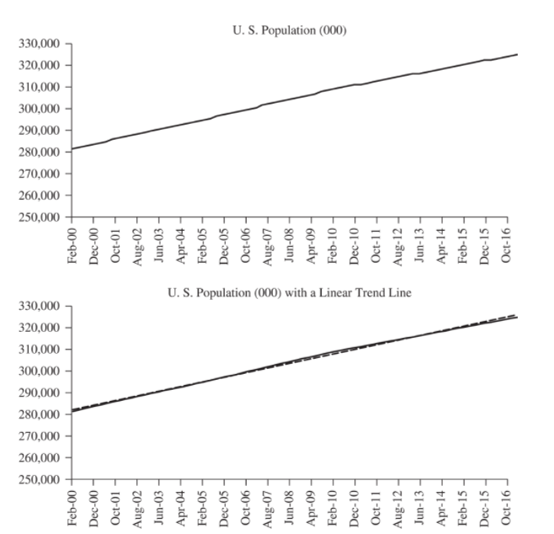
Figure 2.1
Jump to long description
Notes:
4
4

Slide 5
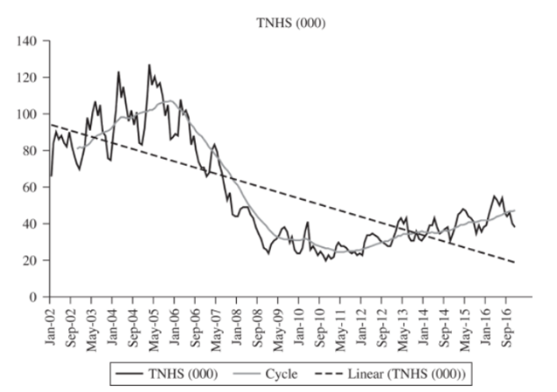
Figure 2.2
Jump to long description
Notes:
5
5

Slide 6
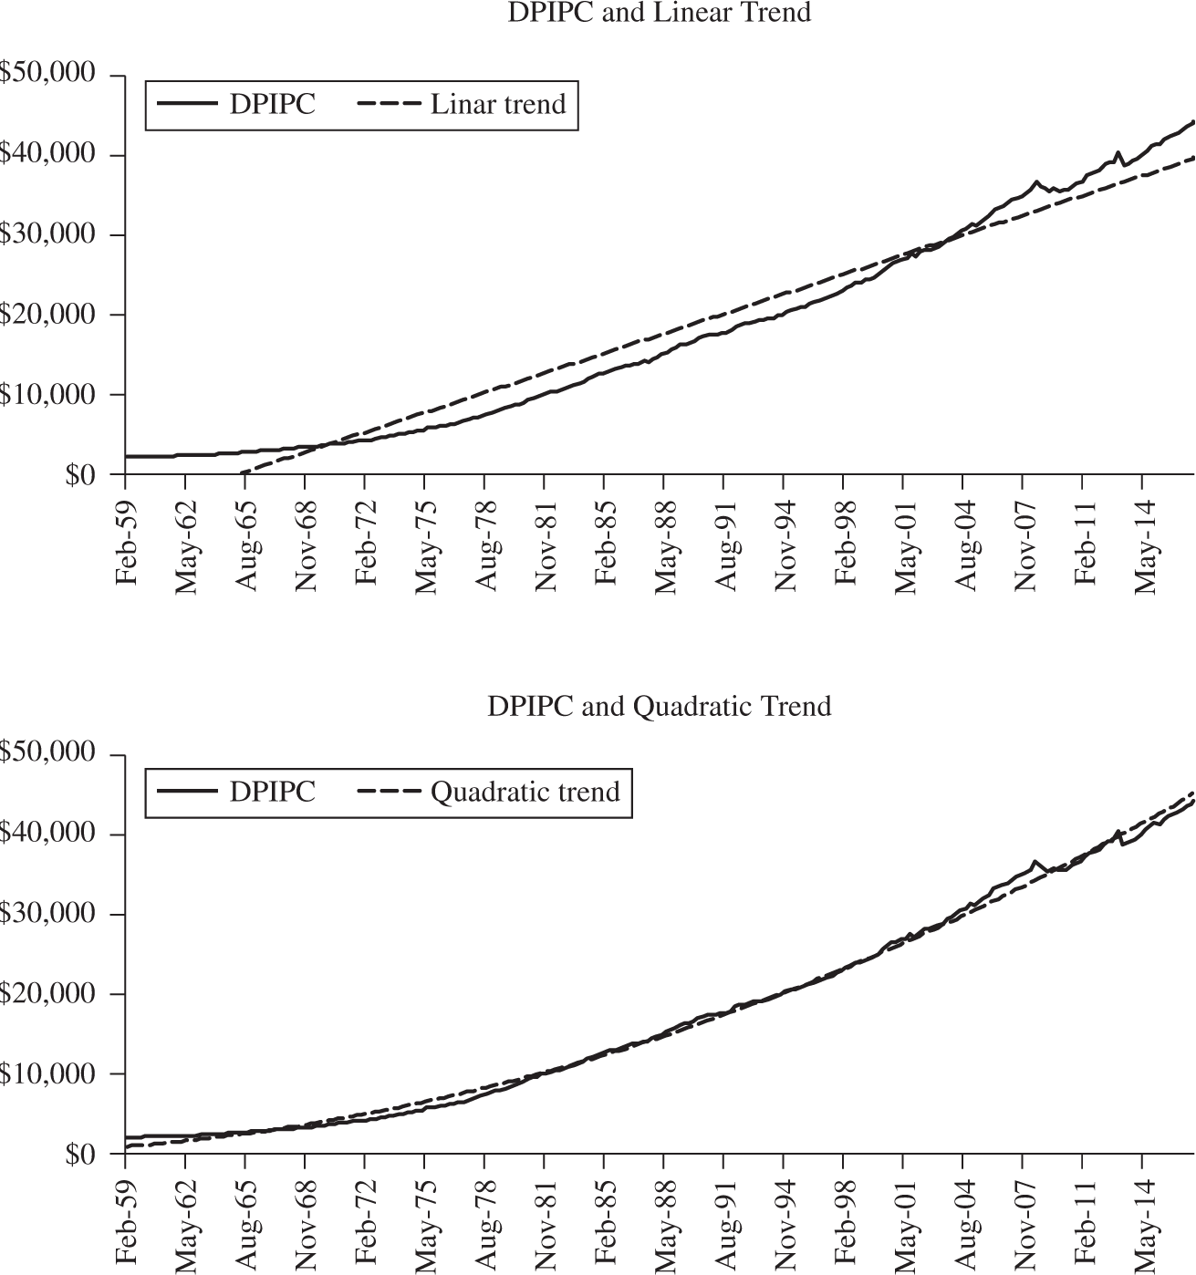
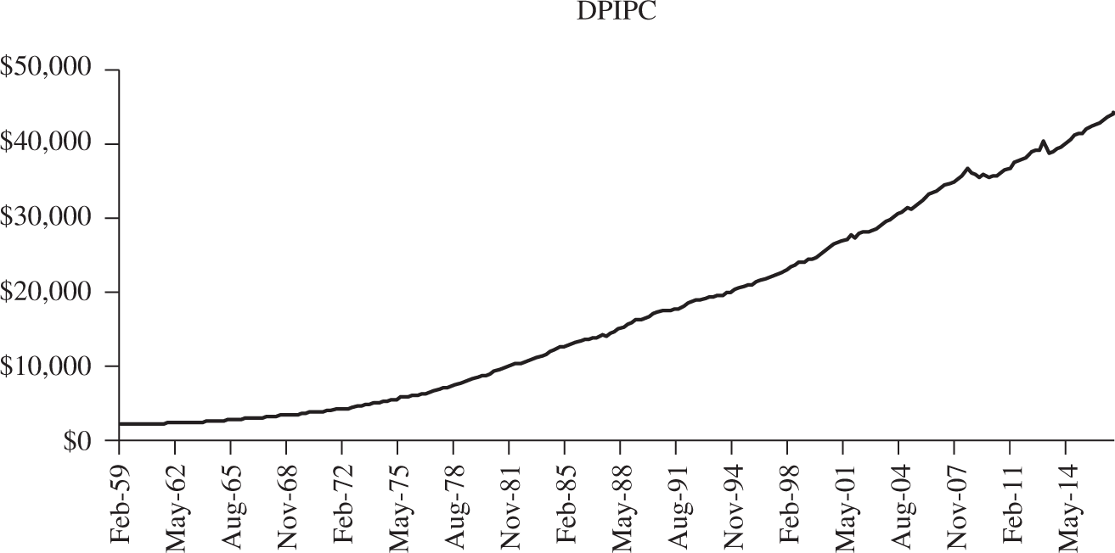
Figure 2.3
Notes:
6
6

Slide 7
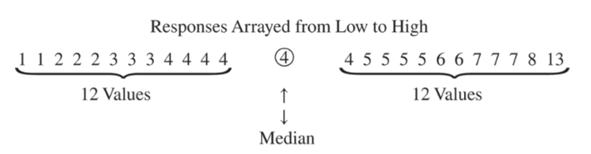
Statistical Review
Jump to long description
Notes:
7
7

Slide 8
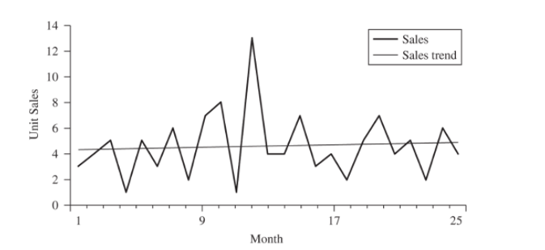
Figure 2.4
Jump to long description
Notes:
8
8

Slide 9
calculation of sample and population standard deviations and variances
 | For a Sample | For a Population
Standard deviation
Variance
Notes:
9
9

Slide 10
Distributions 1
Many everyday processes generate values of variables, and the likelihood of occurrence of specific values can be gauged with the help of one or another of certain common probability distributions, such as the normal distribution or the student’s t-distribution.
Notes:
10
10

Slide 11
Distributions 2
The distribution of a variable is a description of the relative numbers of times each possible outcome will occur in a number of trials.
The function describing the probability that a given value will occur is called the probability function (or probability density function, abbreviated PDF).
Notes:
11
11

Slide 12
Distributions 3
The population of a continuous variable has an underlying distribution.
Throwing enough rocks at a spot on the earth will soon form a pile that would then represent the distribution of the process of the particular rock thrower throwing rocks at that spot from a fixed distance.
If the rocks are magnetic the pile would be more peaked (higher kurtosis).
If the distance to the point is increased, the pile will be less peaked and likely have a more skewed, less bell shape (normal/gaussian) distribution.
If half the rocks are thrown by one person and the other half by another, the pile is likely to have two peaks (bi-modal).
Notes:
12
12

Slide 13
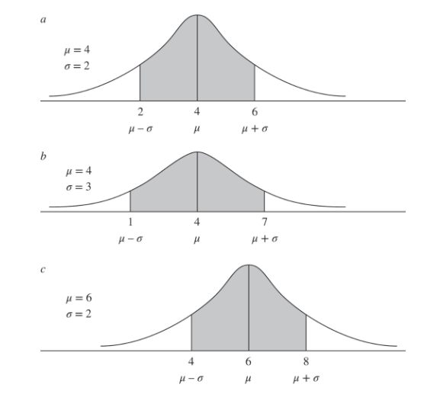
Figure 2.5 Three Normal Distributions
Jump to long description
Notes:
13
13

Slide 14
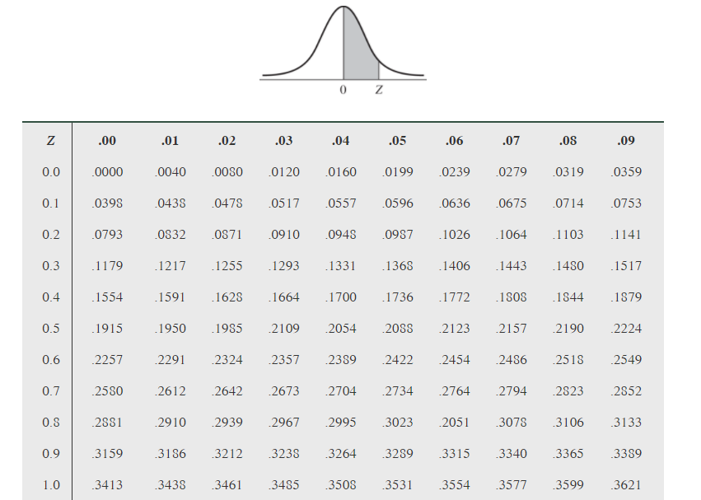
Table 2.4 Standard Normal Distribution
A common bell-shaped curve used to calculate probabilities of events that tend to occur around a mean value (zero for the standard normal) and trail off with decreasing likelihood. Also called Gaussian Distribution. Values are grouped about a central value with symmetrical variance (bell curve).

Slide 15
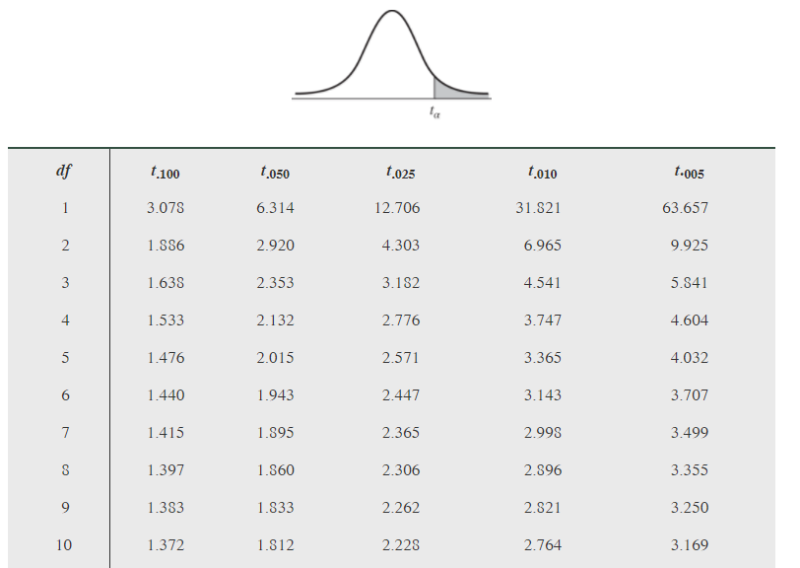
Figure 2.5 The Student’s t-Distribution
When the population standard deviation is not known, or when the sample size is small, the Student’s t-distribution should be used rather than the normal distribution. The Student’s t-distribution resembles the normal distribution but is somewhat more spread out for small sample sizes.

Slide 16
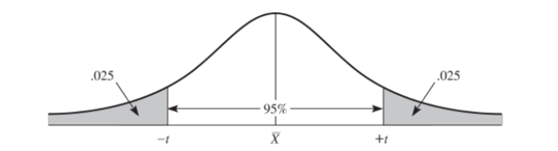
Statistical Inference
Number of Degrees of Freedom | t-Value for 95% Confidence Interval
5 | 2.571
10 | 2.228
20 | 2.086
50 | 1.960
100 | 1.960

Slide 17
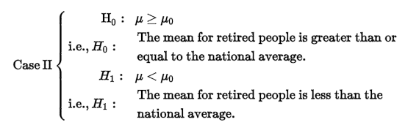
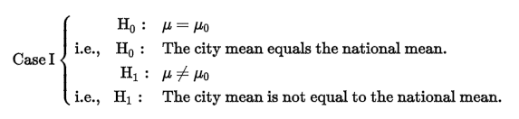
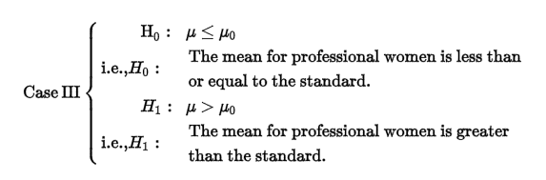
Hypothesis Testing
The process begins by setting up two hypotheses, the null hypothesis (designated H₀:) and the alternative hypothesis (designated H₁:). These two hypotheses should be structured so that they are mutually exclusive and exhaustive.
Jump to long description
Notes:
17
17

Slide 18
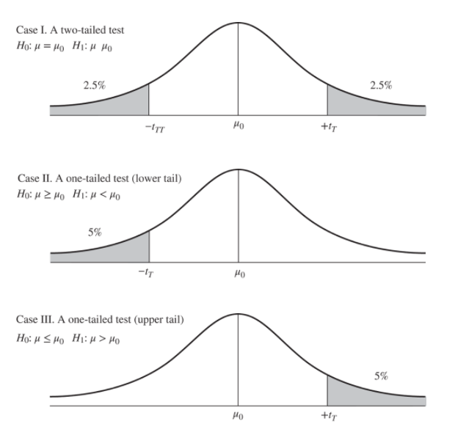
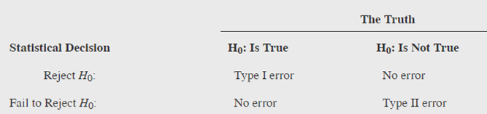
Table 2.6 Type I and Type II Errors
Jump to long description
Notes:
18
18

Slide 19
The Correlation Coefficient and its Significance
Notes:
19
19

Slide 20
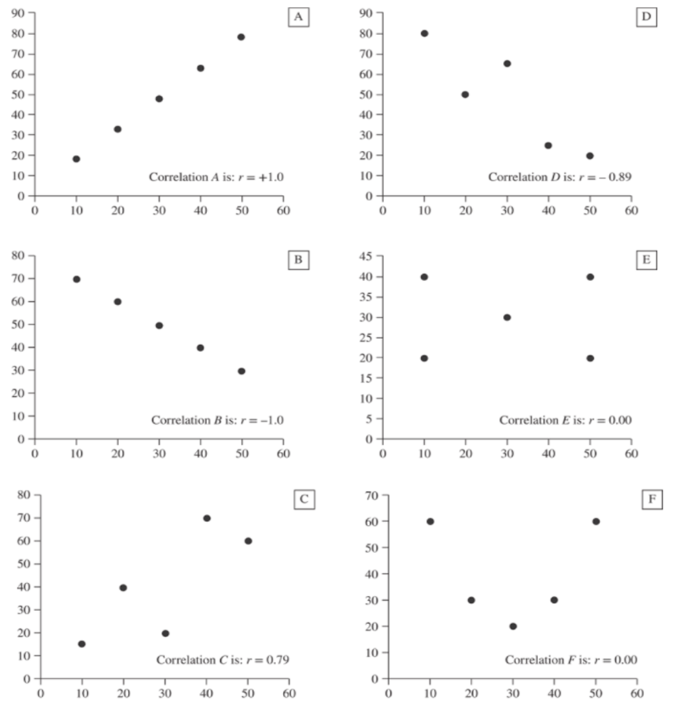
Figure 2.6
Representative scatterplots with the corresponding correlation coefficients. These scatterplots show correlation coefficients that range from a perfect positive correlation (A) and a perfect negative correlation (B) to zero correlations (E and F).
Jump to long description
Notes:
20
20

Slide 21
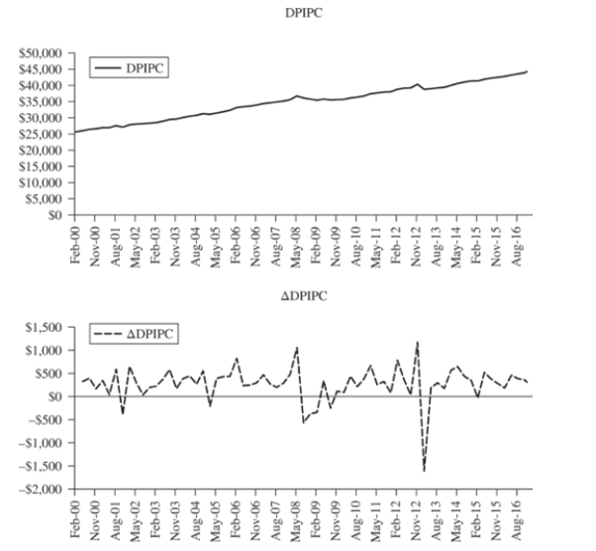
Figure 2.7
In evaluating a time series of data, it is useful to look at the correlation between successive observations over time. This measure of correlation is called an autocorrelation.
Jump to long description
Notes:
21
21

Slide 22
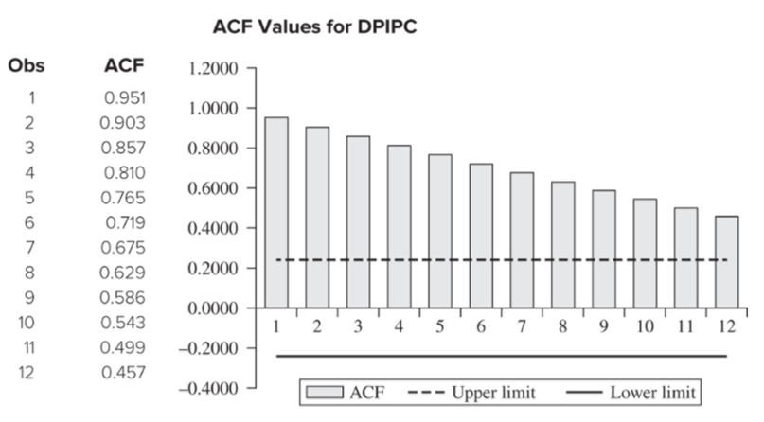
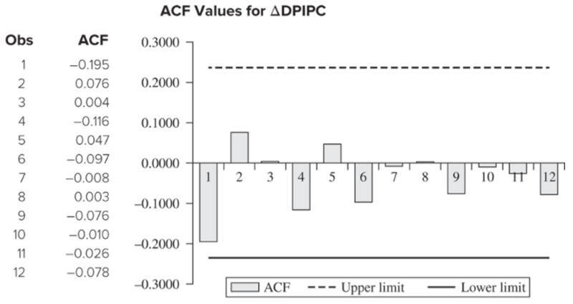
Figure 2.8 ACF Graphs for DPIPC and ∆DPIPC
ACF is the correlation between points separated by time periods.
PACF is the ACF for the change in the variable lagged.
Jump to long description
Notes:
22
22

Slide 23
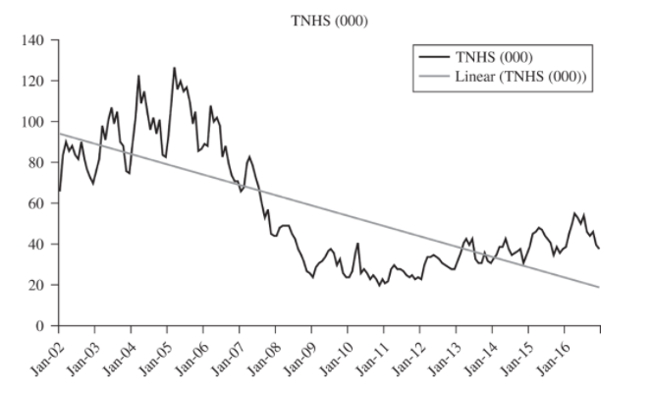
Figure 2.9 Total New Houses Sold
In evaluating a time series of data, it is useful to look at the correlation between successive observations over time. This measure of correlation is called an autocorrelation.
Jump to long description
Notes:
23
23

Slide 24
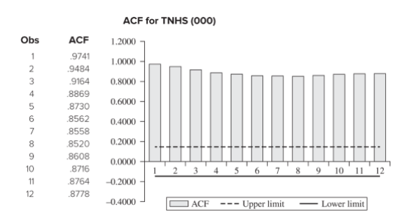
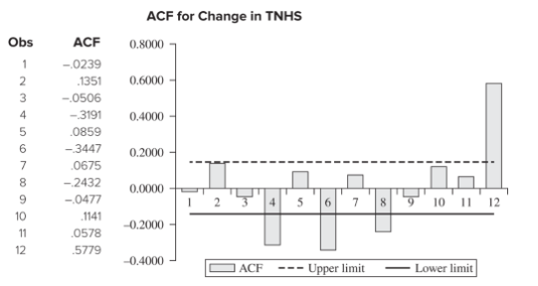
Figure 2.10 ACF Graphs for TNHS and ∆TNHS
ACF is the correlation between points separated by time periods.
PACF is the ACF for the change in the variable lagged.
Jump to long description
Notes:
24
24

Slide 25
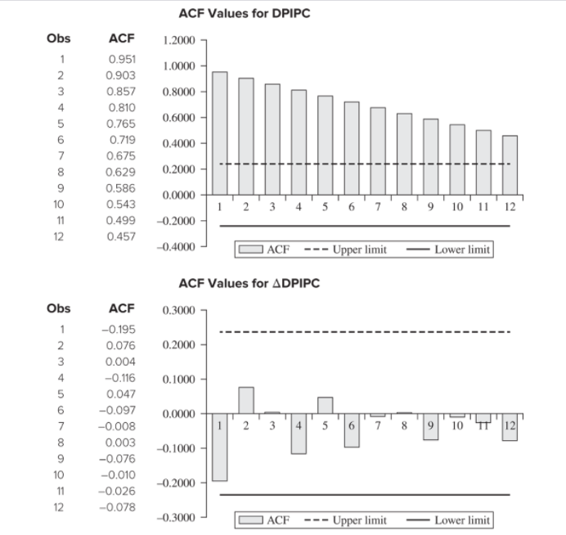
Figure 2.8
ACF is the correlation between points separated by time periods.
PACF is the ACF for the change in the variable lagged.
Jump to long description
Notes:
25
25

Slide 26
Appendix of Image Long Descriptions

Slide 27
Figure 2.1 - Appendix
The relationship is nearly perfectly linear beginning with about 2.8 million and ending with about 3.2 million. The trendline is nearly a perfect fit.
Jump to the image

Slide 28
Figure 2.2 - Appendix
The total number of new homes sold is cyclical, but the overall trend was increasing from 2002 to 2006, decreasing from 2006 to 2009, then slowly increasing from 2009 to 2016. The linear trendline is negative showing that even though home sales is increasing, it is not near where it was in the early 2000s.
Jump to the image

Slide 29
Statistical Review - Appendix
There are 25 values total, so there are 12 values in the lower half of the data set, 12 values in the upper half of the data set and there is one value in the center, which is the median = 4.
Jump to the image

Slide 30
Figure 2.4 - Appendix
The number of unit sales varies greatly from month to month. The overall sales trend is nearly constant (flat).
Jump to the image

Slide 31
Figure 2.5 Three Normal Distributions - Appendix
The first one has a mean of 4 and standard deviation of 2. The second has a mean of 4 and a standard deviation of 3. The third has a mean of 6 and a standard deviation of 2. In each curve one standard deviation above and below the mean is indicated and the center area is shaded.
Jump to the image

Slide 32
Hypothesis Testing - Appendix
(Top left) The null hypothesis is mu equals mu-naught, or The city mean equals the national mean.
The alternative hypothesis is mu is not equal to mu-naught, or The city mean is not equal to the national mean.
(Top right) The null hypothesis is mu is greater than or equal to mu-naught, or The mean for retired people is greater than or equal to the national average.
The alternative hypothesis is mu is less than mu-naught, or The mean for retired people is less than the national average.
(Bottom) The null hypothesis is mu is less than or equal to mu-naught, or The mean for professional women is less than or equal to the standard.
The alternative hypothesis is mu is greater than mu-naught, or The mean for professional women is greater than the standard.
Jump to the image

Slide 33
Table 2.6 Type I and Type II Errors - Appendix
(Left image) A Type I error occurs when the Statistical Decision is to Reject H-naught, but H-naught is actually true. A Type II error occurs when the Statistical Decision is Fail to Reject H-naught, when H-naught is not true. In the other two instances, the Statistical Decision matches the Truth, so no error is made.
Three normal curves are shown:
Case I. A two-tailed test, where H-naught is mu equals mu-naught and H1 is mu is not equal to mu-naught. The two tails are shaded with 2.5% of the area in each tail.
Case II. A one-tailed test with the lower tail, where H-naught is mu is greater than or equal to mu-naught and H1 is mu is less than mu-naught. The left tail is shaded with 5% of the area in the tail.
Case III. A one-tailed test with the upper tail, where H-naught is mu is less than or equal to mu-naught and H1 is mu is greater than mu-naught. The right tail is shaded with 5% of the area in the tail.
(Right image) All three have a mean of mu sub 0. The first curve is labeled Case I and shows the shading required for a two-tailed test. The alternative hypothesis is "not equal to" and both tail areas of 2.5% are shaded. Case II shows a lower one tailed test with the lower 5% of the curve shaded. The alternative hypothesis contains a less than sign. Case II shows an upper one-tailed test with the upper 5% of the curve shaded. The upper 5% of the curve is shaded.
Jump to the image

Slide 34
Figure 2.6 - Appendix
Scatterplot A has a correlation of 1 and is in a perfect positive line. Scatterplot B has a correlation of negative 1 and the data is in a perfect negative line. Scatterplot C has a correlation of 0.79 and the data is increasing and is fairly linear. Scatterplot D has a correlation of negative 0.89. In this plot, as x increases, y tends to decrease. The data also falls in a fairly strong linear pattern. Scatterplot E has a correlation of 0. The data is not in a positive or negative pattern and is very scattered. Scatterplot F has a correlation of 0 and the data is in the pattern of a parabola.
Jump to the image

Slide 35
Figure 2.7 - Appendix
A second graph shows the change in DPIPC from quarter to quarter from February 2000 to August 2016, which is nearly flat.
Jump to the image

Slide 36
Figure 2.8 ACF Graphs for DPIPC and ∆DPIPC - Appendix
(Left image) The ACF values are 0.951, 0.903, 0.857, 0.810, 0.765, 0.719, 0.675, 0.629, 0.586, 0.543, 0.499, 0.457. All of these exceed the upper limit of the confidence interval.
(Right image) The ACF values are negative 0.195, 0.076, 0.004, negative 0.116, 0.047, negative 0.097, negative 0.008, 0.003, negative 0.076, negative 0.010, negative 0.026, and negative 0.078. All of these values are within the confidence limits.
Jump to the image

Slide 37
Figure 2.9 Total New Houses Sold - Appendix
The total number of new homes sold is cyclical, but the overall trend was increasing from 2002 to 2006, decreasing from 2006 to 2009, then slowly increasing from 2009 to 2016. The linear trendline is negative showing that even though home sales is increasing, it is not near where it was in the early 2000s.
Jump to the image

Slide 38
Figure 2.10 ACF Graphs for TNHS and ∆TNHS - Appendix
(Left image) The ACF values are 0.9741, 0.9484, 0.9164, 0.8869, 0.8730, 0.8562, 0.8558, 0.8520, 0.8608, 0.8716, 0.8764, 0.8778. All of these values exceed the upper limit of the confidence interval.
(Right image) The ACF values are negative 0.0239, 0.1351, negative 0.0506, negative 0.3191, 0.0859, negative 0.3447, 0.0675, negative 0.2432, negative 0.0477, 0.1141, 0.0578, and 0.5779.
Jump to the image

Slide 39
Figure 2.8 - Appendix
(Top image) The ACF values are 0.951, 0.903, 0.857, 0.810, 0.765, 0.719, 0.675, 0.629, 0.586, 0.543, 0.499, 0.457. All of these exceed the upper limit of the confidence interval.
(Bottom image) The ACF values are negative 0.195, 0.076, 0.004, negative 0.116, 0.047, negative 0.097, negative 0.008, 0.003, negative 0.076, negative 0.010, negative 0.026, and negative 0.078. All of these values are within the confidence limits.
Jump to the image

