Slide 1
MATLAB (Lecture 2)
BY:MAHA ALMOUSA

Slide 2
Some Basic Commands
who | lists all of the variables in your matlab workspace
clc | Clears the command window
whos | list the variables and describes their matrix size
clear | erases variables and functions from memory
Clear x | erases the matrix 'x' from your workspace
; (semicolon) | prevent commands from outputting results
% (percent sign) | comments line
… | A line can be terminated with three periods (...), which causes the next line to be a continuation line

Slide 3
The Colon Operator
For example: 1:10
is a row vector containing the integers from 1 to 10:
1 2 3 4 5 6 7 8 9 10
To obtain non-unit spacing, specify an increment. For example: 100:-7:50 will give you
100 93 86 79 72 65 58 51

Slide 4
Input Function
The input function displays a prompt string in the Command Window and then waits for the user to respond.
my_val = input( ‘Enter an input value: ’ );
displays prompt as a prompt on the screen, waits for input from the keyboard, and returns the value entered in my_val.
in1 = input( ‘Enter data: ’ );
in2 = input( ‘Enter data: ’ ,`s`);
returns the entered string as a text variable rather than as a variable name or numerical value.

Slide 5
disp
The disp( array ) function
>> disp( 'Hello' )
Hello
>> disp(5)
5
>> disp( [ 'Bilkent ' 'University' ] )
Bilkent University
>> name = 'Alper';
>> disp( [ 'Hello ' name ] )
Hello Alper

Slide 6
The ‘Fprintf’ function
The fprintf( format, data ) function
%d integer
%f floating point format
%e exponential format
%g either floating point or exponential format, whichever is shorter
\n new line character
\t tab character

Slide 7
>> fprintf( 'Result is %d', 3 )
Result is 3
>> fprintf( 'Area of a circle with radius %d is %f', 3, pi*3^2 )
Area of a circle with radius 3 is 28.274334
>> x = 5;
>> fprintf( 'x = %3d', x )
x = 5
>> x = pi;
>> fprintf( 'x = %0.2f', x )
x = 3.14
>> fprintf( 'x = %6.2f', x )
x = 3.14
>> fprintf( 'x = %d\ny = %d\n', 3, 13 )
x = 3
y = 13

Slide 8
The ‘feval(..,..)’ function

Slide 9
Function with One Output M-file function that returns a single result Define a function in a file named average.m that accepts an input vector, calculates the average of the values, and returns a single result.

Slide 10
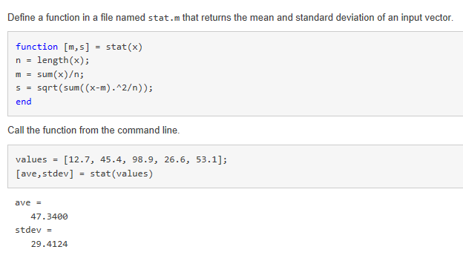
Function with multiple outputs Define a function in a file named stat.m that returns the mean and standard deviation of an input vector.

Slide 11
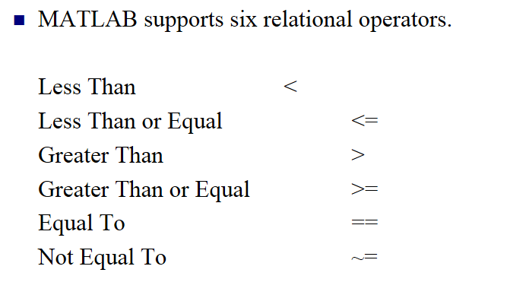
Relational operations

Slide 12
Results of comparison using relational operators:
ZERO, if comparison is false.
False = 0
ONE, if comparison if true.
True = 1
If comparing numbers, any non-zero is considered “true”

Slide 13
Example
>> x=2;
>> y=3;
>> z=x<y; % same as z = (x<y)
>> u=x==y; % same as u = (x==y)
>> z,u
z =
1
u =
0

Slide 14
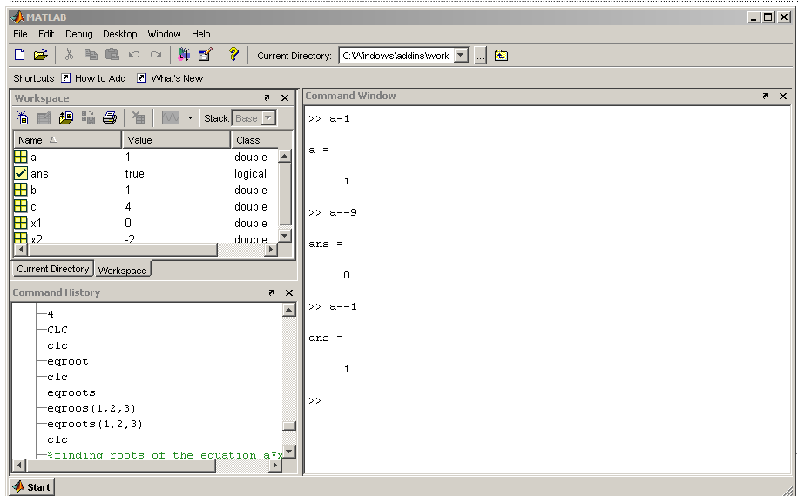
The difference between ‘=‘ and ‘==‘

Slide 15
Logical operations
~ (NOT): | z = ~x.
& (AND): | used to link logical expressions: z =(x<y) & (a>b).
| (OR): | used to link logical expressions: q =(x<y) | (a>b).
&& (Short-Circuit AND): | used for operations on 2 scalar logical expressions.
|| (Short-Circuit OR): | used for operations on 2 scalar logical expressions. (Note | is the shift-\ key, above Enter).
xor (exclusive OR) | is used to link logical expressions: w = xor(A, B).

Slide 16
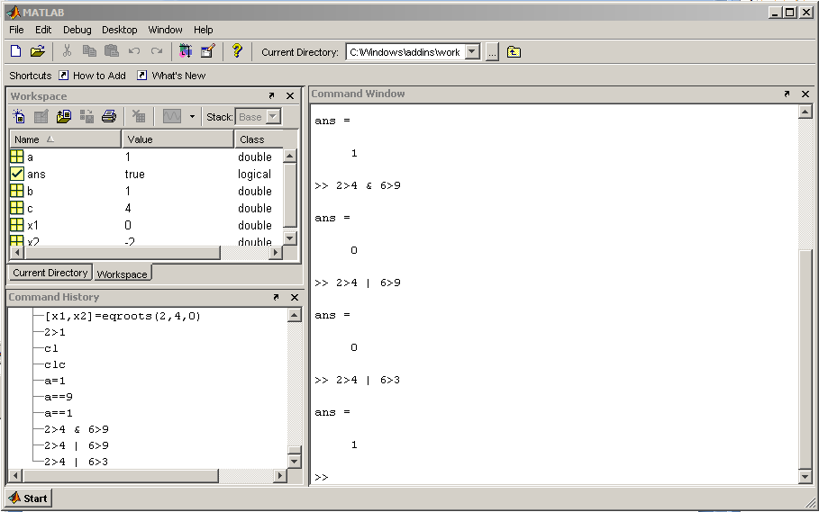
Example

Slide 17
If statements
If logical expression
statements
end

Slide 18
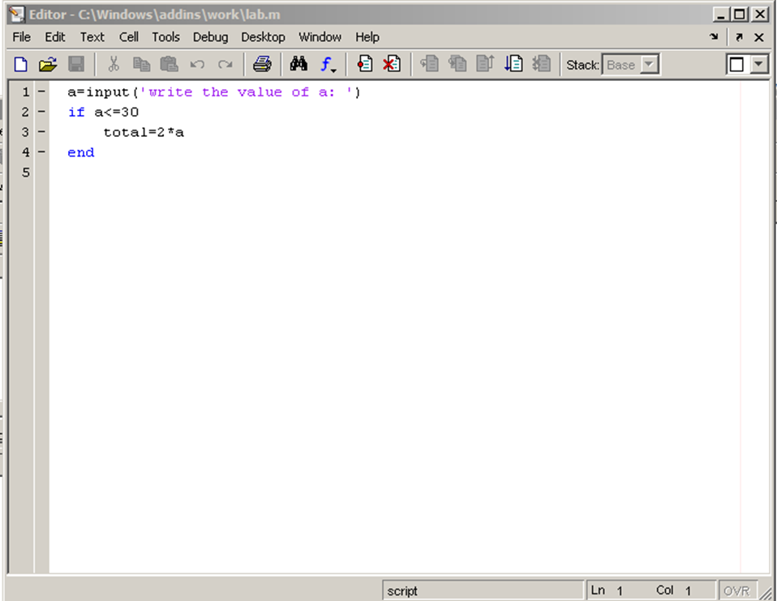
Example
If a <= 30
total = 2*a
end

Slide 19
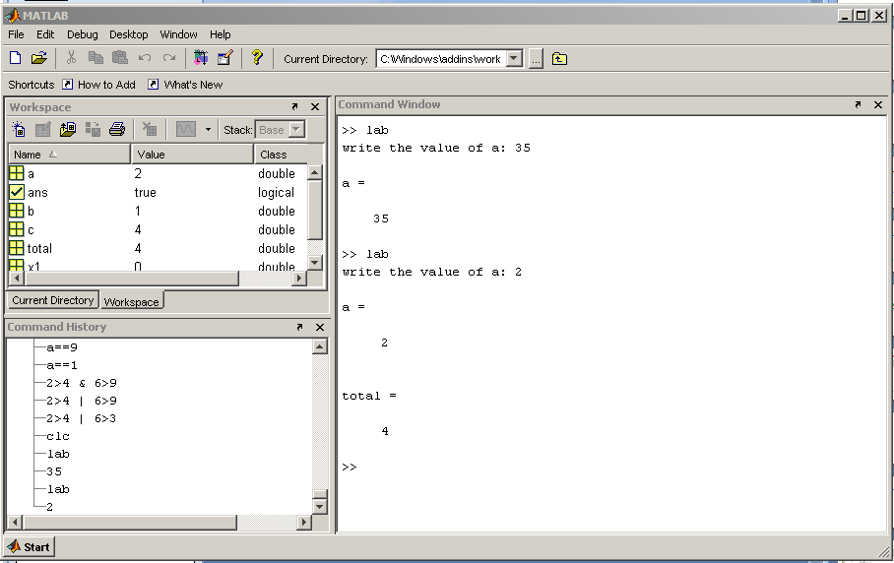

Slide 20
If-else statements
If logical expression
statement group 1
else
statement group 2
end

Slide 21
Example
If a <= 30
total = 2*a
else
total = a + 10
end

Slide 22
If-elseif-else
If logical expression 1
statement group 1
elseif logical expression 2
statement group 2
else
statement group 3
end

Slide 23
Example
If a <= 30
c = a * 2
elseif c >= 20
d = c
else
d = 0
end

Slide 24
For loops
for loop variable = m:s:n
statements
end

Slide 25
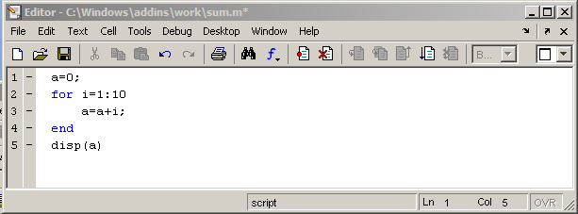
Example

Slide 26
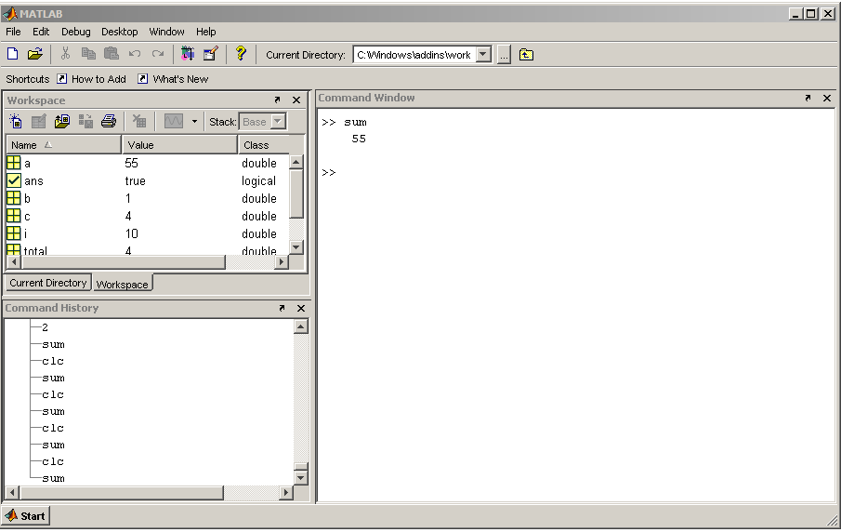

Slide 27
Assighnment
Create an M-file Function that uses if and while statements.

