Slide 1


MATH 2140
Numerical Methods
Faculty of Engineering
Mechanical Engineering Department
Instructor:
Dr. Mohamed El-Shazly
Associate Prof. of Mechanical Design and Tribology
melshazly@ksu.edu.sa
Office: F072

Slide 2
Newton-Raphson Method

Slide 3
Step 1
Evaluate
symbolically.
3
http://numericalmethods.eng.usf.edu

Slide 4
Step 2
Use an initial guess of the root, , to estimate the new value of the root, , as
4
http://numericalmethods.eng.usf.edu

Slide 5
Step 3
Find the absolute relative approximate error as
5
http://numericalmethods.eng.usf.edu

Slide 6
Step 4
Compare the absolute relative approximate error with the pre-specified relative error tolerance .
Also, check if the number of iterations has exceeded the maximum number of iterations allowed. If so, one needs to terminate the algorithm and notify the user.
Yes
Go to Step 2 using new estimate of the root.
Is ?
No
Stop the algorithm
6
http://numericalmethods.eng.usf.edu

Slide 7

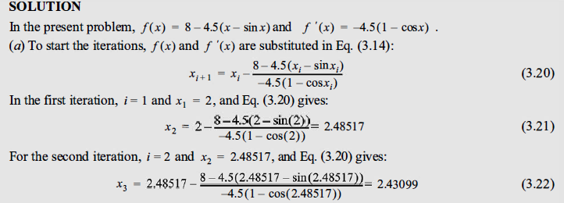

Slide 8
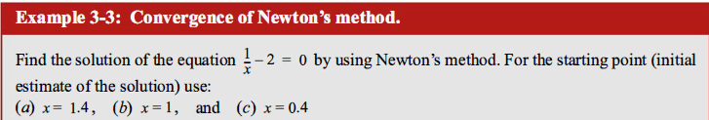
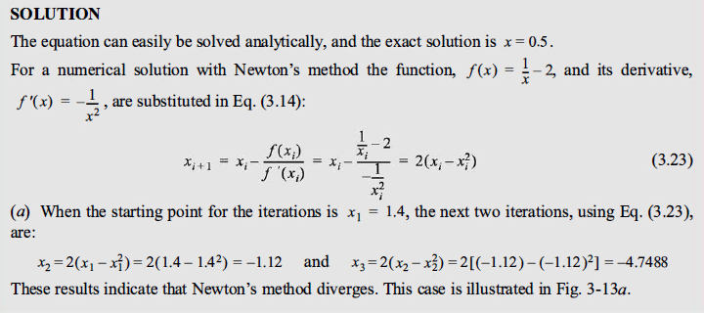

Slide 9
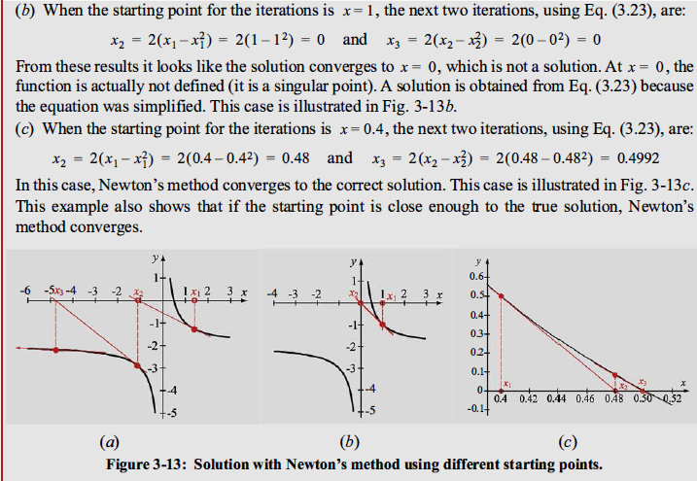

Slide 11
Newton’s Method
Derivation Example Convergence Final Remarks
Example 2: Fixed-Point Iteration & Newton’s Method
Consider the function
f (x ) = cos x − x = 0
Approximate a root of f using (a) a fixed-point method, and (b) Newton’s Method
R L Burden & J D Faires

Slide 12
Newton’s Method & Fixed-Point Iteration
Derivation Example Convergence Final Remarks
(a) Fixed-Point Iteration for f (x ) = cos x − x
R L Burden & J D Faires
15 / 33

Slide 13
Newton’s Method & Fixed-Point Iteration
Derivation Example Convergence Final Remarks
(a) Fixed-Point Iteration for f (x ) = cos x − x
A solution to this root-finding problem is also a solution to the fixed-point problem
x = cos x
and the graph implies that a single fixed-point p lies in [0, π/2].
R L Burden & J D Faires
15 / 33

Slide 14
Newton’s Method & Fixed-Point Iteration
Derivation Example Convergence Final Remarks
(a) Fixed-Point Iteration for f (x ) = cos x − x
A solution to this root-finding problem is also a solution to the fixed-point problem
x = cos x
and the graph implies that a single fixed-point p lies in [0, π/2]. The following table shows the results of fixed-point iteration with
p₀ = π/4.
R L Burden & J D Faires
15 / 33

Slide 15
Newton’s Method & Fixed-Point Iteration
Derivation Example Convergence Final Remarks
(a) Fixed-Point Iteration for f (x ) = cos x − x
A solution to this root-finding problem is also a solution to the fixed-point problem
x = cos x
and the graph implies that a single fixed-point p lies in [0, π/2]. The following table shows the results of fixed-point iteration with
p₀ = π/4.
The best conclusion from these results is that p ≈ 0.74.
R L Burden & J D Faires
15 / 33

Slide 16
Newton’s Method & Fixed-Point Iteration
Derivation Example Convergence Final Remarks
Fixed-Point Iteration: x = cos(x ), x₀ = ^{π}
4
n | ^{p}n−1 | p_{n} | |p_{n} − p_{n−1}| | ^{e}n^{/e}n−1
1 | 0.7853982 | 0.7071068 | 0.0782914 | —
2 | 0.707107 | 0.760245 | 0.053138 | 0.678719
3 | 0.760245 | 0.724667 | 0.035577 | 0.669525
4 | 0.724667 | 0.748720 | 0.024052 | 0.676064
5 | 0.748720 | 0.732561 | 0.016159 | 0.671826
6 | 0.732561 | 0.743464 | 0.010903 | 0.674753
7 | 0.743464 | 0.736128 | 0.007336 | 0.672816
R L Burden & J D Faires

Slide 17
Newton’s Method
Derivation Example Convergence Final Remarks
(b) Newton’s Method for f (x ) = cos x − x
R L Burden & J D Faires
17 / 33

Slide 18
Newton’s Method
Derivation Example Convergence Final Remarks
(b) Newton’s Method for f (x ) = cos x − x
To apply Newton’s method to this problem we need
f ^{t}(x ) = − sin x − 1
R L Burden & J D Faires
17 / 33

Slide 19
Newton’s Method
Derivation Example Convergence Final Remarks
(b) Newton’s Method for f (x ) = cos x − x
To apply Newton’s method to this problem we need
f ^{t}(x ) = − sin x − 1
Starting again with p₀ = π/4, we generate the sequence defined, for n ≥ 1, by
f (p_{n− 1} )
^{cos p}n− 1 ^{− p}n− 1
− sin p_{n−1} − 1
p_{n} = p_{n−1} − _{f (pt} = p_{n−1} −
.
n−1⁾
R L Burden & J D Faires
17 / 33

Slide 20
Newton’s Method
Derivation Example Convergence Final Remarks
(b) Newton’s Method for f (x ) = cos x − x
To apply Newton’s method to this problem we need
f ^{t}(x ) = − sin x − 1
Starting again with p₀ = π/4, we generate the sequence defined, for n ≥ 1, by
f (p_{n− 1} )
^{cos p}n− 1 ^{− p}n− 1
− sin p_{n−1} − 1
p_{n} = p_{n−1} − _{f (pt} = p_{n−1} −
.
n−1⁾
This gives the approximations shown in the following table.
R L Burden & J D Faires
17 / 33

Slide 21
Newton’s Method
Derivation Example Convergence Final Remarks
Newton’s Method for f (x ) = cos(x ) − x , x =
π
0
4
n | pn−1 | f (p_{n−1}) | f ¹ (p_{n−1}) | p_{n} | |p_{n} − p_{n−1}|
1 | 0.78539816 | -0.078291 | -1.707107 | 0.73953613 | 0.04586203
2 | 0.73953613 | -0.000755 | -1.673945 | 0.73908518 | 0.00045096
3 | 0.73908518 | -0.000000 | -1.673612 | 0.73908513 | 0.00000004
4 | 0.73908513 | -0.000000 | -1.673612 | 0.73908513 | 0.00000000
R L Burden & J D Faires
18 / 33

Slide 22
Newton’s Method
Derivation Example Convergence Final Remarks
Newton’s Method for f (x ) = cos(x ) − x , x =
π
0
4
n | pn−1 | f (p_{n−1}) | f ¹ (p_{n−1}) | p_{n} | |p_{n} − p_{n−1}|
1 | 0.78539816 | -0.078291 | -1.707107 | 0.73953613 | 0.04586203
2 | 0.73953613 | -0.000755 | -1.673945 | 0.73908518 | 0.00045096
3 | 0.73908518 | -0.000000 | -1.673612 | 0.73908513 | 0.00000004
4 | 0.73908513 | -0.000000 | -1.673612 | 0.73908513 | 0.00000000
An excellent approximation is obtained with n = 3.
R L Burden & J D Faires
18 / 33

Slide 23
Newton’s Method
Derivation Example Convergence Final Remarks
Newton’s Method for f (x ) = cos(x ) − x , x =
π
0
4
n | pn−1 | f (p_{n−1}) | f ¹ (p_{n−1}) | p_{n} | |p_{n} − p_{n−1}|
1 | 0.78539816 | -0.078291 | -1.707107 | 0.73953613 | 0.04586203
2 | 0.73953613 | -0.000755 | -1.673945 | 0.73908518 | 0.00045096
3 | 0.73908518 | -0.000000 | -1.673612 | 0.73908513 | 0.00000004
4 | 0.73908513 | -0.000000 | -1.673612 | 0.73908513 | 0.00000000
An excellent approximation is obtained with n = 3.
Because of the agreement of p₃ and p₄ we could reasonably expect this result to be accurate to the places listed.
R L Burden & J D Faires
18 / 33

Slide 24
Example 3
You are working for ‘DOWN THE TOILET COMPANY’ that makes floats for ABC commodes. The floating ball has a specific gravity of 0.6 and has a radius of 5.5 cm. You are asked to find the depth to which the ball is submerged when floating in water.
Figure 3 Floating ball problem.
24

Slide 25
Example 3 Cont.
The equation that gives the depth x in meters to which the ball is submerged under water is given by
Figure 3 Floating ball problem.
Use the Newton’s method of finding roots of equations to find
the depth ‘x’ to which the ball is submerged under water. Conduct three iterations to estimate the root of the above equation.
The absolute relative approximate error at the end of each iteration, and
The number of significant digits at least correct at the end of each iteration.
25
http://numericalmethods.eng.usf.edu

Slide 26
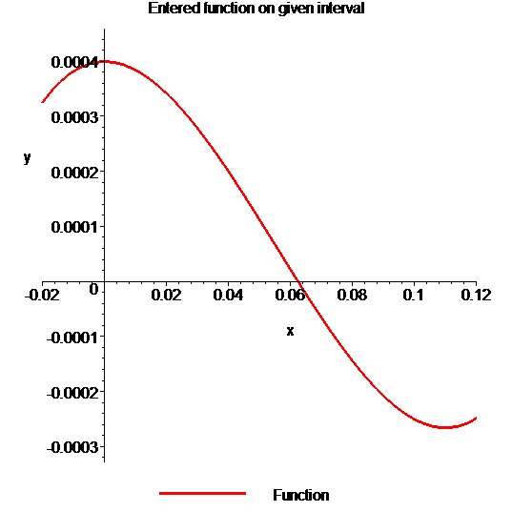
Example 1 Cont.
Solution
To aid in the understanding of how this method works to find the root of an equation, the graph of f(x) is shown to the right,
where
Figure 4 Graph of the function f(x)

Slide 27
Example 1 Cont.
Solve for
Let us assume the initial guess of the root of is . This is a reasonable guess (discuss why
and are not good choices) as the extreme values of the depth x would be 0 and the diameter (0.11 m) of the ball.

Slide 28
Example 1 Cont.
Iteration 1
The estimate of the root is

Slide 29
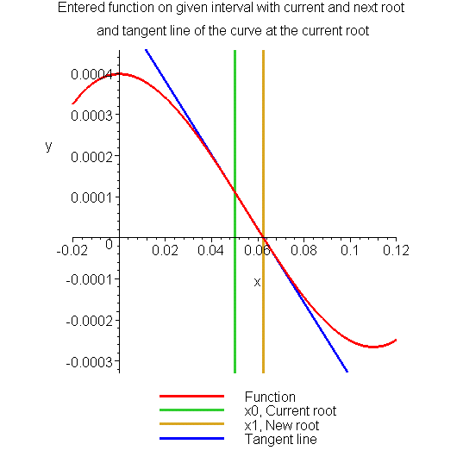
Example 1 Cont.
Figure 5 Estimate of the root for the first iteration.

Slide 30
Example 1 Cont.
The absolute relative approximate error at the end of Iteration 1 is
The number of significant digits at least correct is 0, as you need an absolute relative approximate error of 5% or less for at least one significant digits to be correct in your result.

Slide 31
Example 1 Cont.
Iteration 2
The estimate of the root is

Slide 32
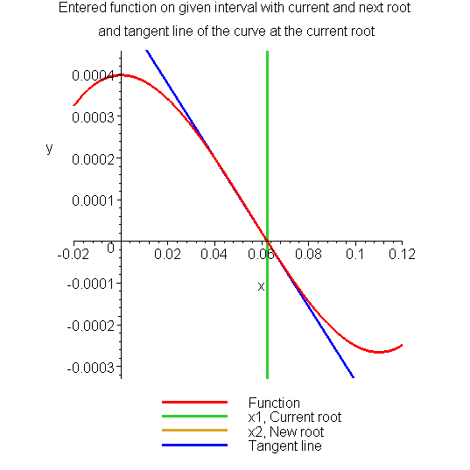
Example 1 Cont.
Figure 6 Estimate of the root for the Iteration 2.

Slide 33
Example 1 Cont.
The absolute relative approximate error at the end of Iteration 2 is
The maximum value of m for which is 2.844. Hence, the number of significant digits at least correct in the answer is 2.

Slide 34
Example 1 Cont.
Iteration 3
The estimate of the root is

Slide 35
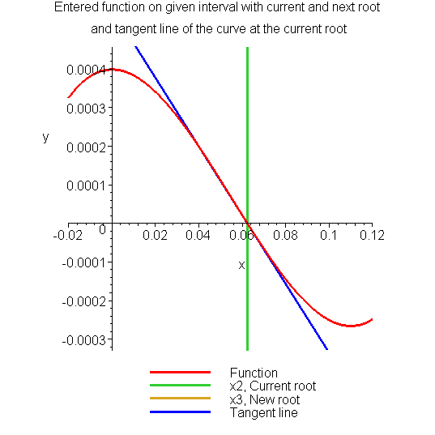
Example 1 Cont.
Figure 7 Estimate of the root for the Iteration 3.

Slide 36
Example 1 Cont.
The absolute relative approximate error at the end of Iteration 3 is
The number of significant digits at least correct is 4, as only 4 significant digits are carried through all the calculations.

