Slide 1
MATH 2140 Numerical Methods
Faculty of Engineering
Mechanical Engineering Department
Instructor:
Dr. Mohamed El-Shazly
Associate Prof. of Mechanical Design and Tribology
melshazly@ksu.edu.sa
Office: F072

Slide 2
Curve-Fitting Polynomial Interpolation

Slide 5
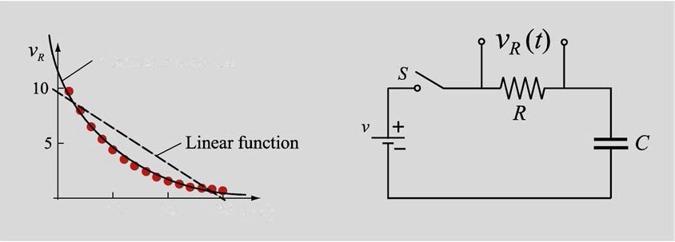
CURVE FITTING WITH NONLINEAR EQUATION BY WRITING THE EQUATION IN A LINEAR FORM
Many situations in science and engineering show that the relationship between the quantities that are being considered is not linear. For example, Fig. 6-8 shows a plot of data points that were measured in an experiment with an RC circuit. In this experiment, the voltage across the resistor is measured as a function of time, starting when the switch is closed.

Slide 6
Examples of nonlinear functions used for curve fitting in the present section are:

Slide 7
Writing a nonlinear equation in linear form
In order to be able to use linear regression, the form of a nonlinear equation of two variables is changed such that the new form is linear with terms that contain the original variables.
For example, the power function
can be put into linear form by taking the natural logarithm (ln) of both sides:

Slide 9
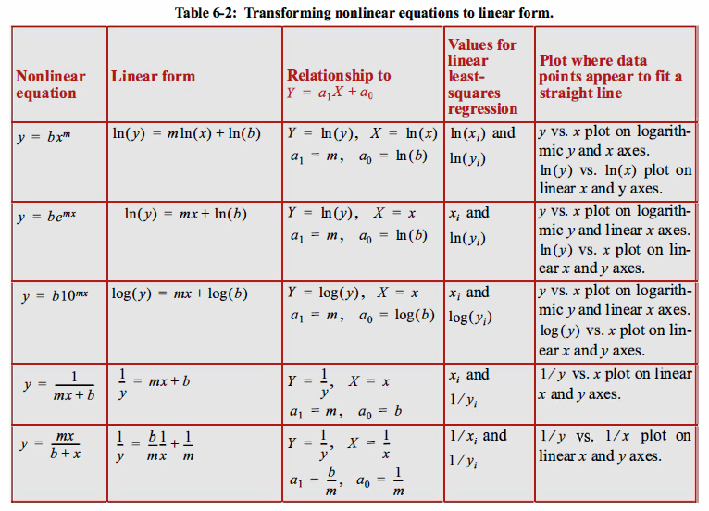

Slide 10
EXAMPLE 1
Find the curve of best fit of the type :
to the following data by the method of least squares:

Slide 11
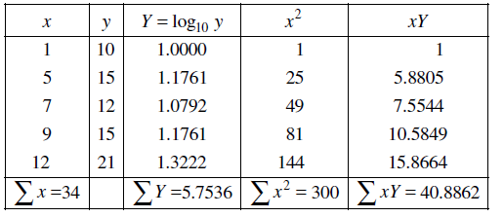

Slide 12
EXAMPLE 2
For the data given below, find the equation to the best fitting exponential curve of the form:
And if you need to convert between them: log10(x) = ln(x) / ln(10) ln(x) = log10(x) / log10(e)

Slide 13
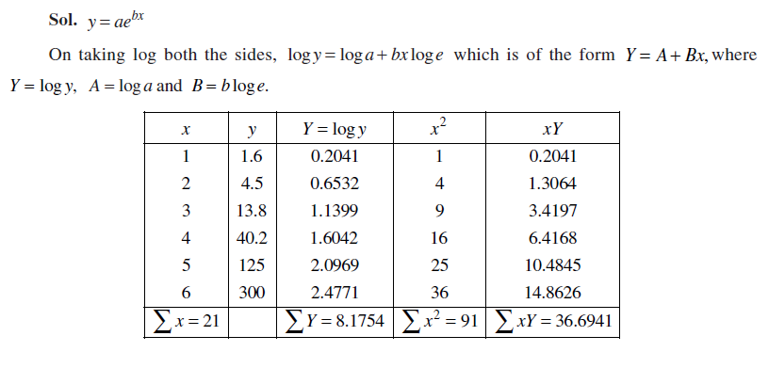

Slide 14
EXAMPLE 3
Given:
x_{i} | 1 | 2 | 3
y_{i} | 2.4 | 5 | 9

Slide 15
Linearization Method

Slide 16
Evaluating Sums and Solving
x_{i} | 1 | 2 | 3 | ∑=6
y_{i} | 2.4 | 5 | 9
z_{i}=ln(y_{i}) | 0.875469 | 1.609438 | 2.197225 | ∑=4.68213
x_{i}² | 1 | 4 | 9 | ∑=14
x_{i} z_{i} | 0.875469 | 3.218876 | 6.591674 | ∑=10.6860

Slide 17
Given the data:
x | 0 | 1 | 2 | 3 | 4
y | 1.5 | 2.5 | 3.5 | 5 | 7.5
Find the exponential function fit
to this data.

Slide 18
