Slide 1
MATH 2140 Numerical Methods
Faculty of Engineering
Mechanical Engineering Department
Instructor:
Dr. Mohamed El-Shazly
Associate Prof. of Mechanical Design and Tribology
melshazly@ksu.edu.sa
Office: F072

Slide 2
Curve-Fitting Polynomial Interpolation

Slide 5
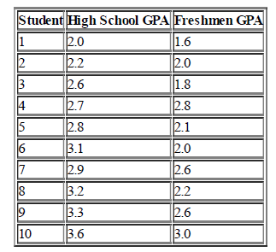
Example 2
A group of 11 students was selected at random and asked for their high school GPA and their freshmen GPA in college the subsequent year. The results were:

Slide 6
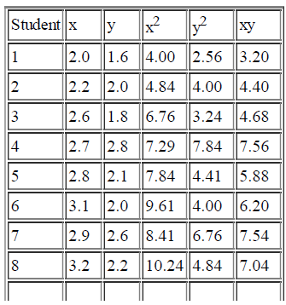
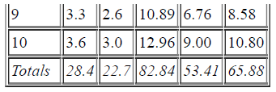
Solution

Slide 7
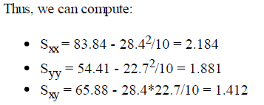

Slide 8
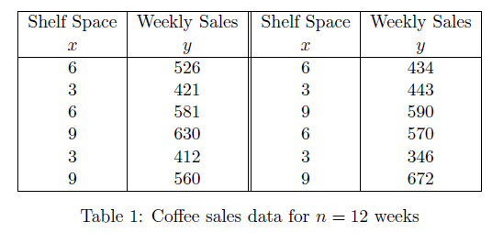
Example 3

Slide 9
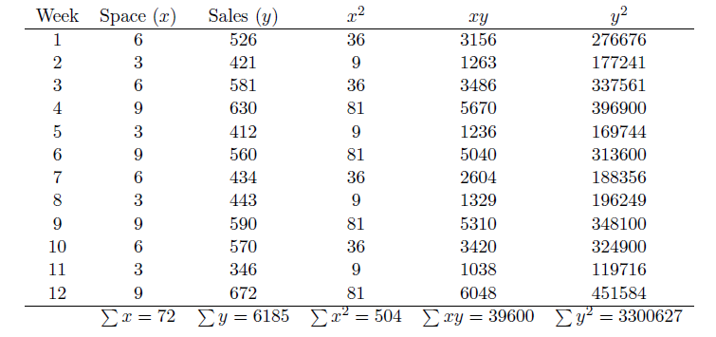

Slide 10
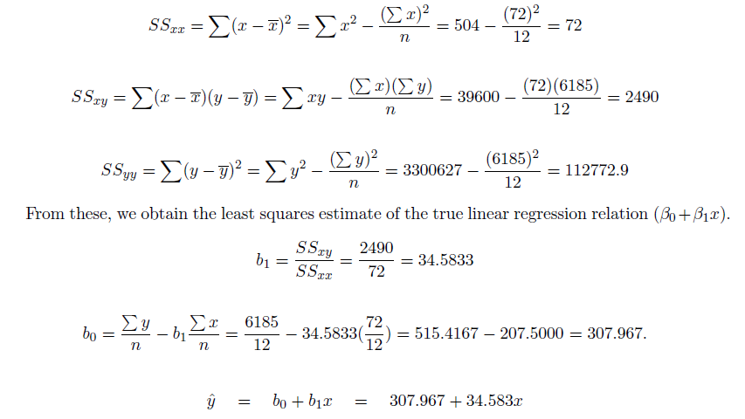

Slide 11
Example 4
Find the best-fit values of a and b so that y = a + bx fits the data given in the table.

Slide 12
