Slide 1


MATH 2140
Numerical Methods
Faculty of Engineering
Mechanical Engineering Department
Instructor:
Dr. Mohamed El-Shazly
Associate Prof. of Mechanical Design and Tribology
melshazly@ksu.edu.sa
Office: F072

Slide 2
Curve-Fitting
Polynomial Interpolation

Slide 3
Outline
Introduction
  Curve Fitting?
  Interpolation?

Slide 4
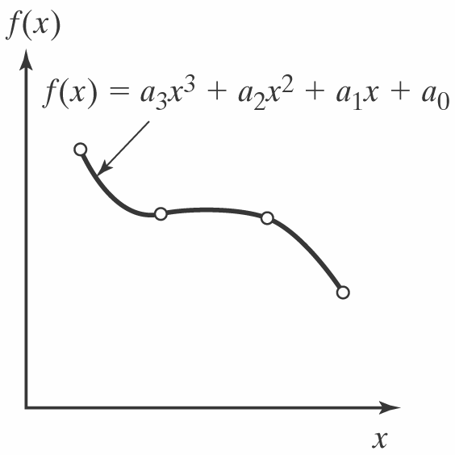
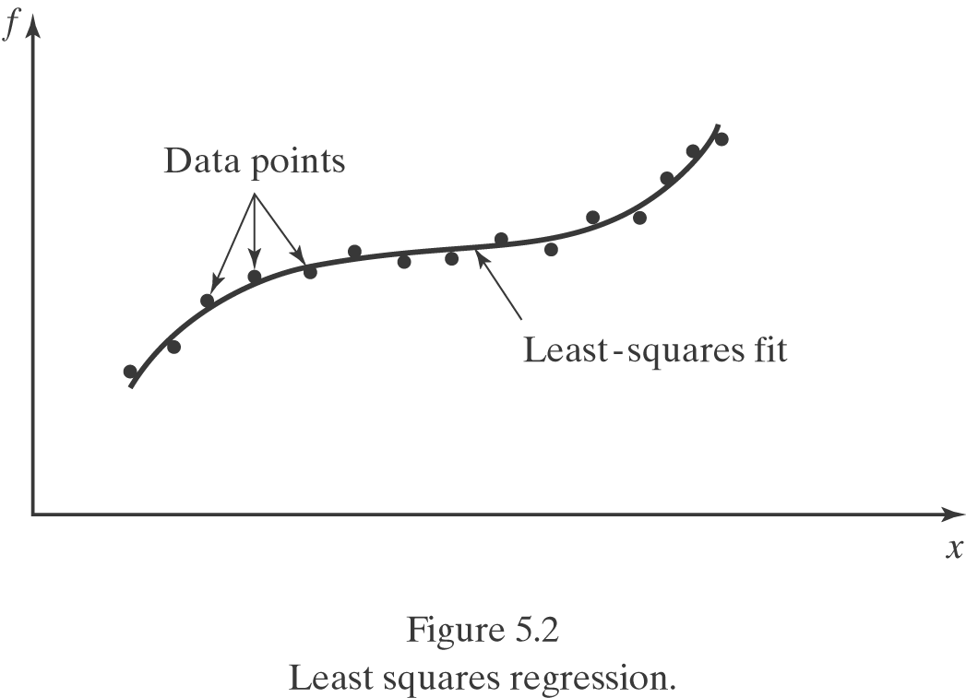
Introduction
Curve fitting? – To fit a smooth and continuous function (curve) to the available discrete data.
  A familiar example: In the Free-fall lab in General Physics I, you are asked to fit a function (quadratic) to the data of position v.s. time.
  Two approaches:
    Collocation: The approximating function passes through all the data points. Usually used when the data are known to be accurate.
    Least-square regression: The approximating curve represents the general trend of the data. Usually used when the data appear to have significant error.
Figure 5.1 Collocation-Fitting polynomials

Slide 5
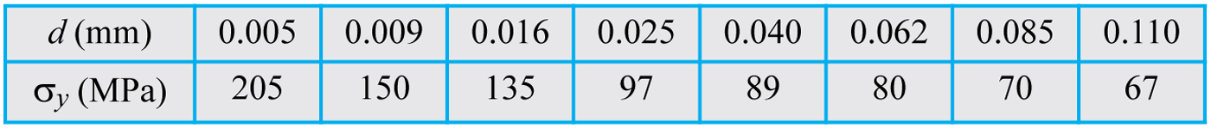
Table_6-1

Slide 6
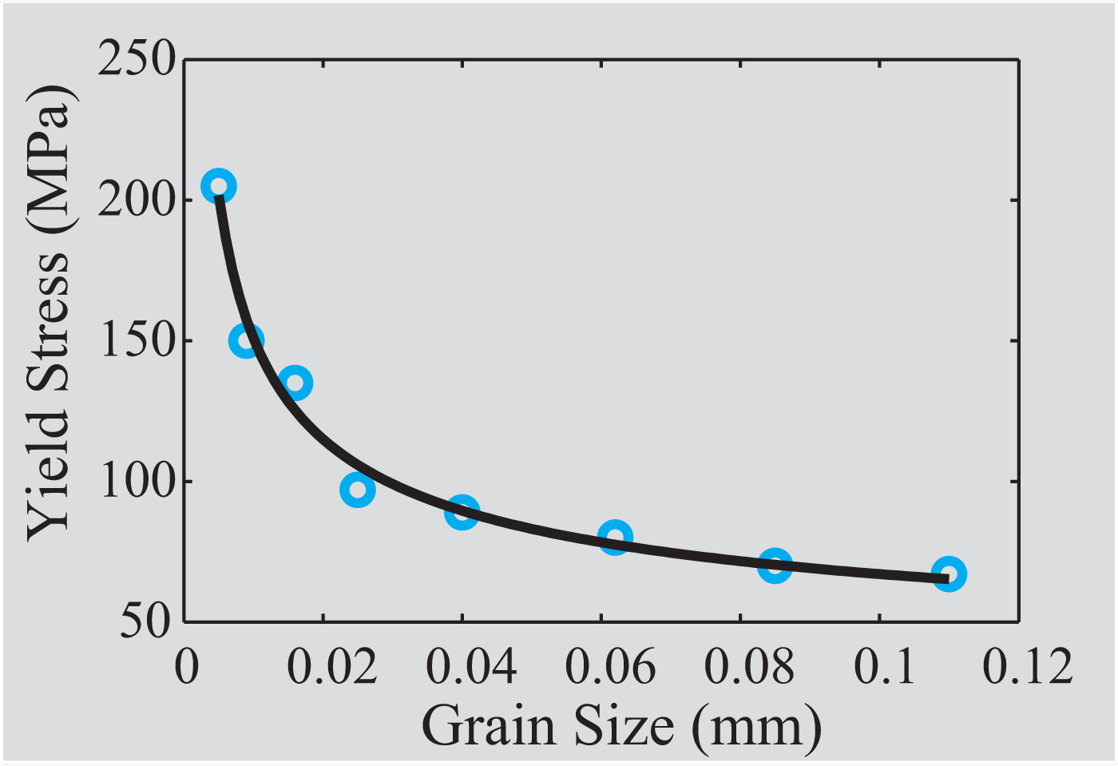
Fig_6-1

Slide 7
Interpolation?
Interpolation is a procedure for estimating a value between known values of data points. It is done by first determining a polynomial that gives the exact value at the data points, and then using the polynomial for calculating values between the points.

Slide 8
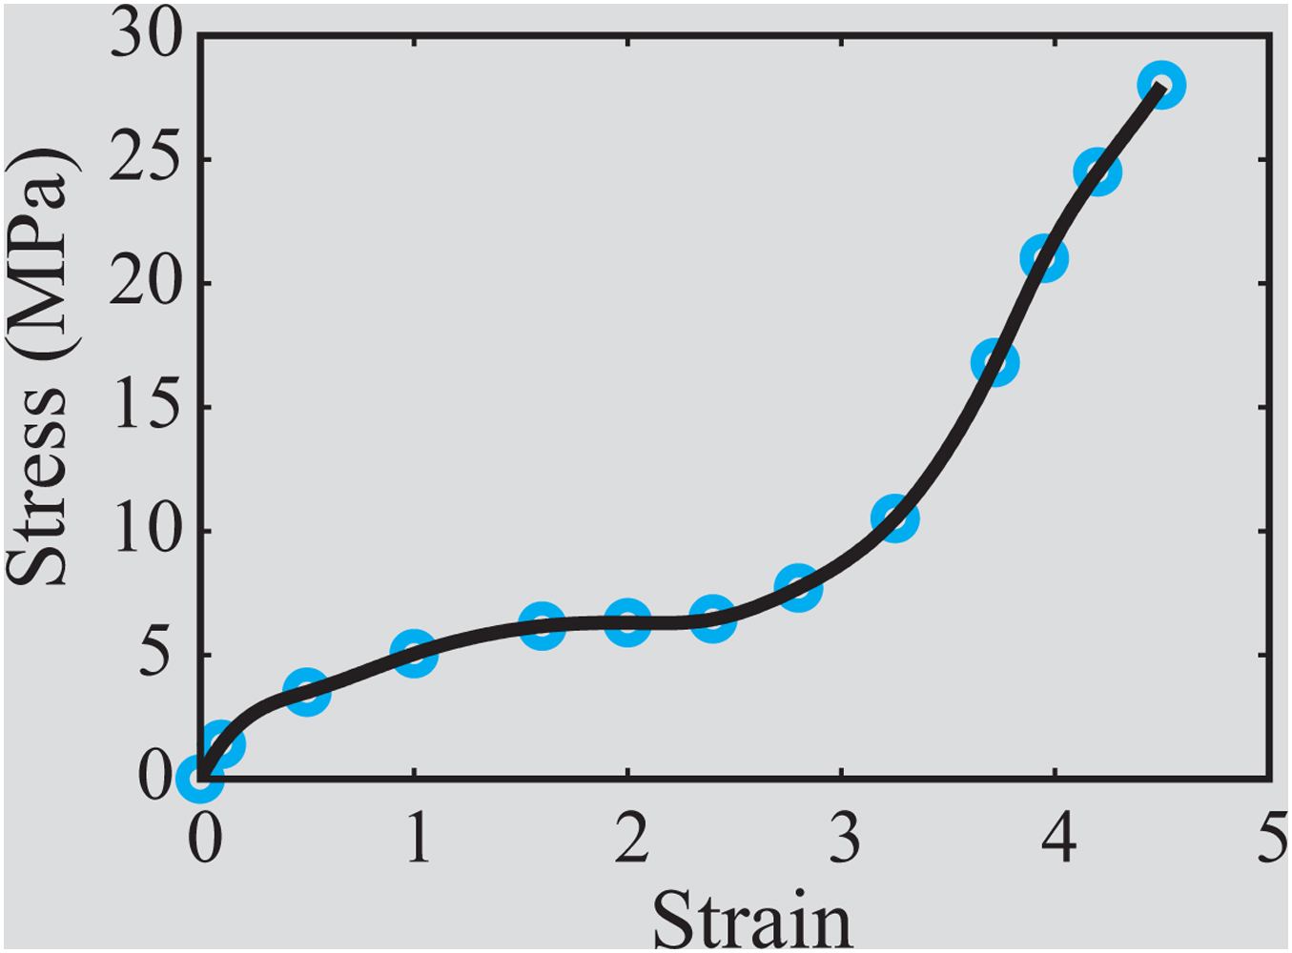
Fig_6-2
Figure 6-2: Interpolation

Slide 9
6.2 CURVE FITTING WITH A LINEAR EQUATION
Curve fitting using a linear equation (first degree polynomial) is the process by which an equation of the form:

Slide 11
Linear Least-Squares Regression
Linear least-squares regression is a procedure in which the coefficients a₁ and a₀ of a linear function y = a₁x + a₀ are determined such that the function has the best fit to a given set of data points.
The best fit is defined as the smallest possible total error that is calculated by adding the squares of the residuals according to Eq. (6.5).

Slide 12
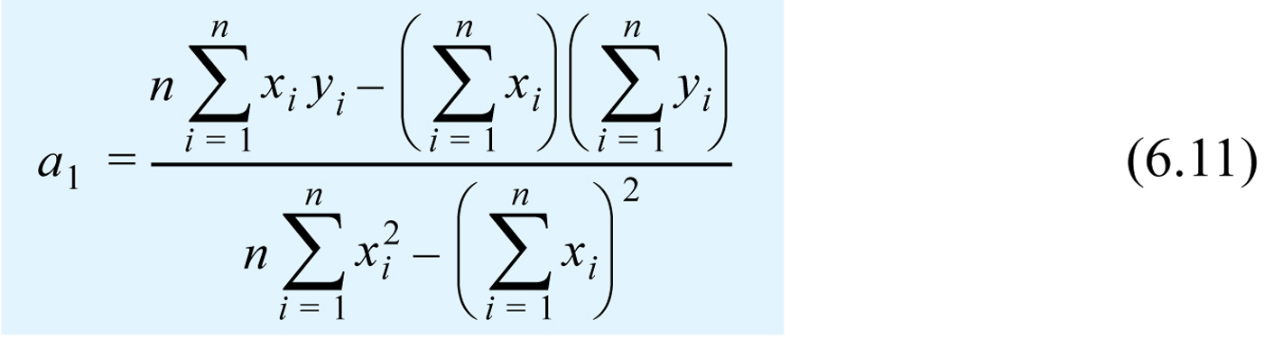
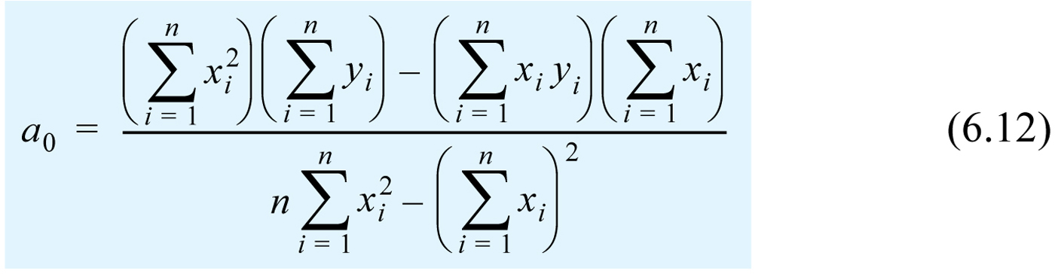

Slide 13
