Slide 1


MATH 2140
Numerical Methods
Faculty of Engineering
Mechanical Engineering Department
Instructor:
Dr. Mohamed El-Shazly
Associate Prof. of Mechanical Design and Tribology
melshazly@ksu.edu.sa
Office: F072

Slide 2
Curve-Fitting
Polynomial Interpolation

Slide 3
Outline
Introduction
  Curve Fitting?
  Interpolation?

Slide 4
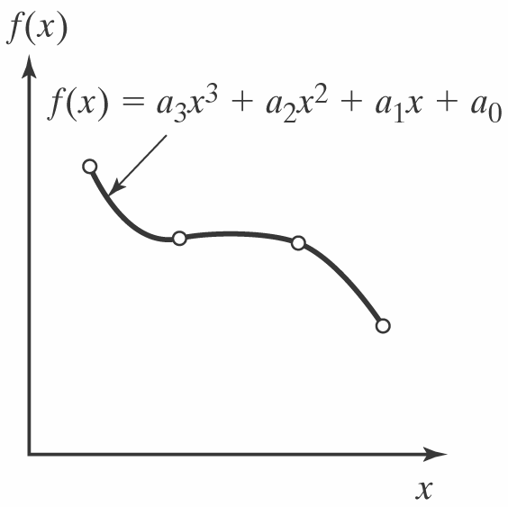
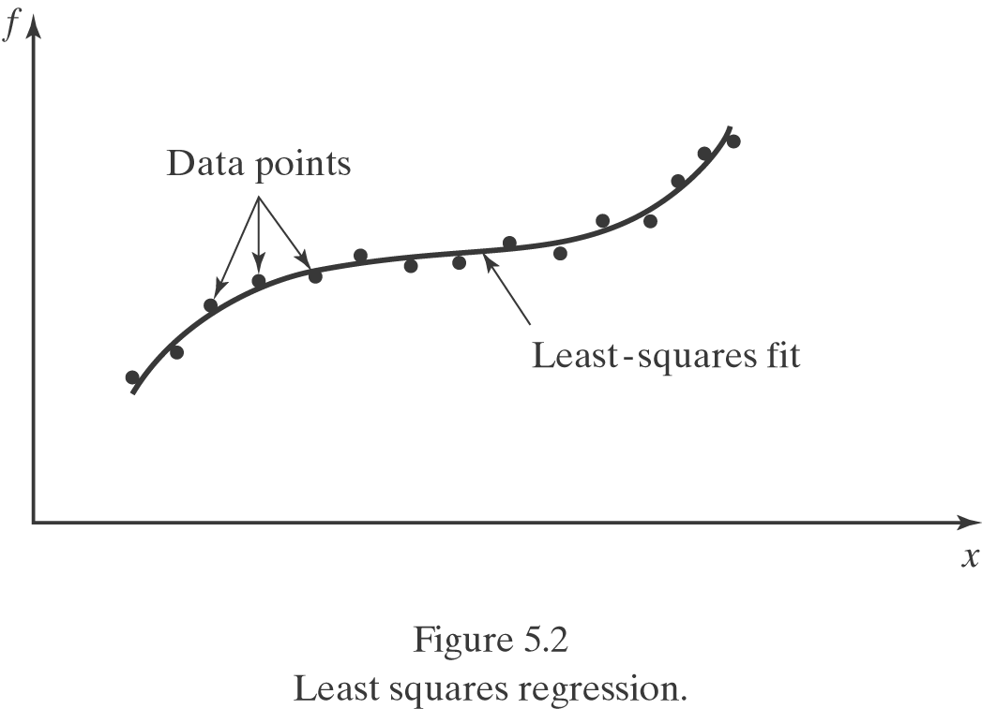
Introduction
Curve fitting? – To fit a smooth and continuous function (curve) to the available discrete data.
  A familiar example: In the Free-fall lab in General Physics I, you are asked to fit a function (quadratic) to the data of position v.s. time.
  Two approaches:
    Collocation: The approximating function passes through all the data points. Usually used when the data are known to be accurate.
    Least-square regression: The approximating curve represents the general trend of the data. Usually used when the data appear to have significant error.
Figure 5.1 Collocation-Fitting polynomials

Slide 5
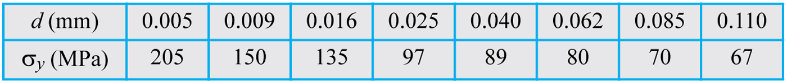
Table_6-1

Slide 6
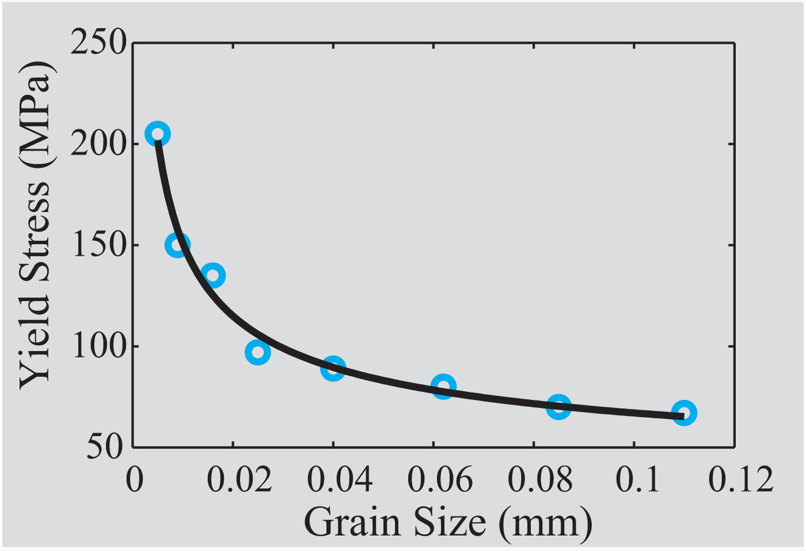
Fig_6-1

Slide 7
Interpolation?
Interpolation is a procedure for estimating a value between known values of data points. It is done by first determining a polynomial that gives the exact value at the data points, and then using the polynomial for calculating values between the points.

Slide 8
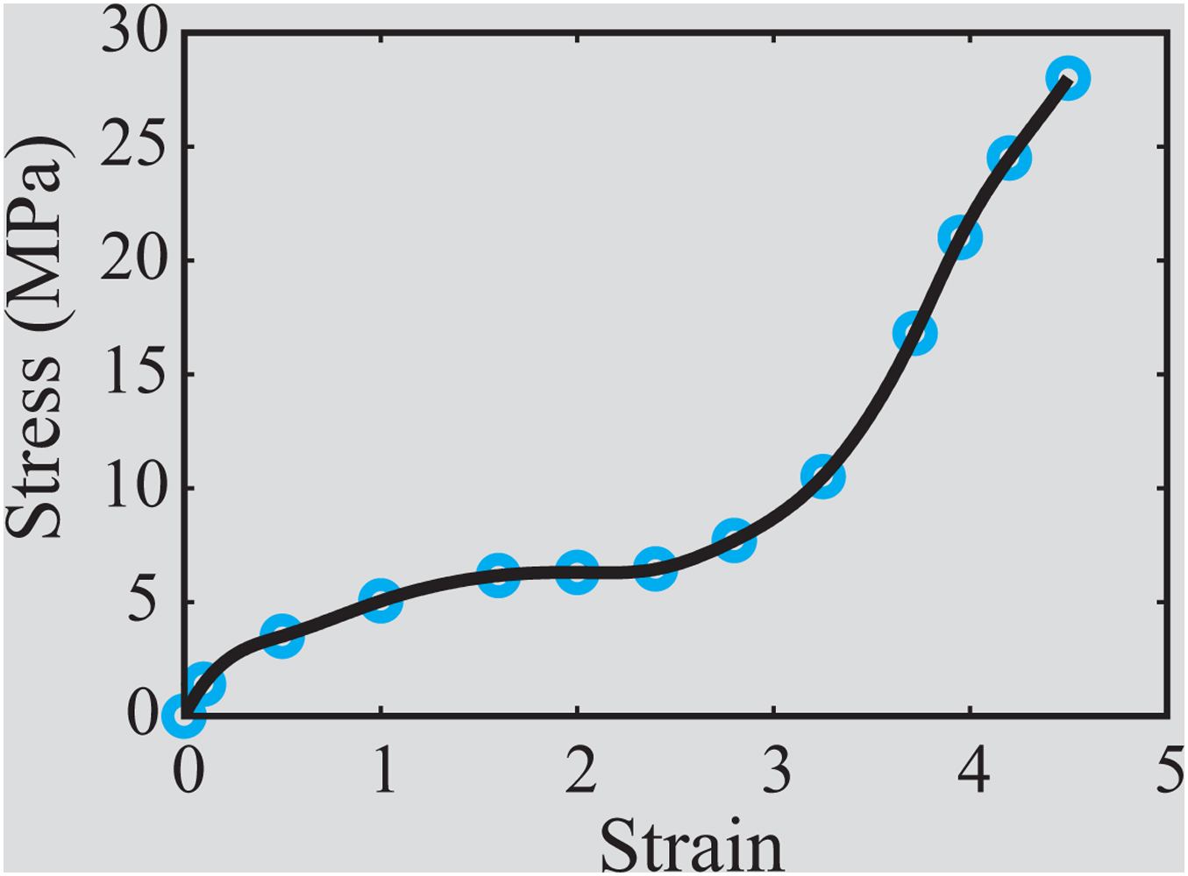
Fig_6-2
Figure 6-2: Interpolation

Slide 9
6.2 CURVE FITTING WITH A LINEAR EQUATION
Curve fitting using a linear equation (first degree polynomial) is the process by which an equation of the form:

Slide 11
Linear Least-Squares Regression
Linear least-squares regression is a procedure in which the coefficients a₁ and a₀ of a linear function y = a₁x + a₀ are determined such that the function has the best fit to a given set of data points.
The best fit is defined as the smallest possible total error that is calculated by adding the squares of the residuals according to Eq. (6.5).

Slide 12
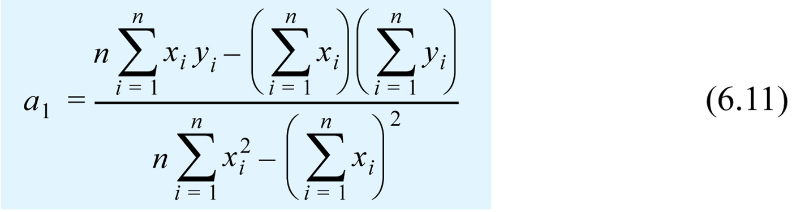
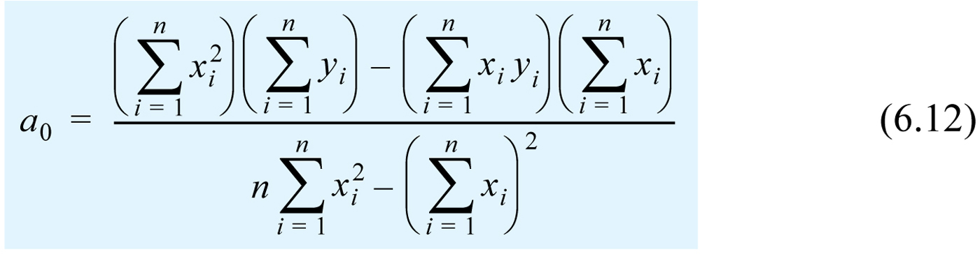

Slide 13
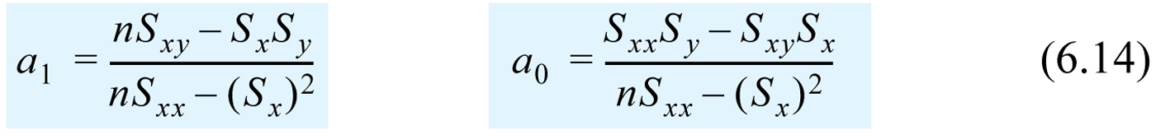

Slide 16
Curve Fitting
Regression
Linear Regression
Polynomial Regression
Multiple Linear Regression
Non-linear Regression
Interpolation
Newton's Divided-Difference Interpolation
Lagrange Interpolating Polynomials
Spline Interpolation

Slide 17
Interpolation
Given a sequence of n unique points, (x_{i}, y_{i})
Want to construct a function f(x) that passes through all the given points
so that …
We can use f(x) to estimate the value of y for any x inside the range of the known base points

Slide 18
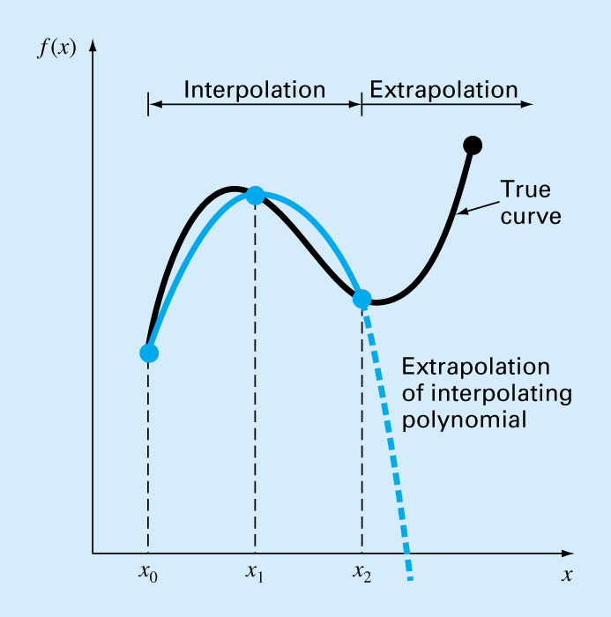
Extrapolation
Extrapolation is the process of estimating a value of f(x) that lies outside the range of the known base points.
Extreme care should be exercised where one must extrapolate.

Slide 19
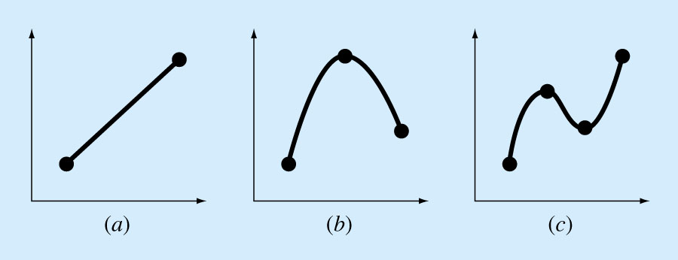
Polynomial Interpolation
Objective:
Given n+1 points, we want to find the polynomial of order n
that passes through all the points.

Slide 20
Polynomial Interpolation
The n^{th}-order polynomial that passes through n+1 points is unique, but it can be written in different mathematical formats:
  The conventional form
  The Newton Form
  The Lagrange Form
Useful characteristics of polynomials
  Infinitely differentiable
  Can be easily integrated
  Easy to evaluate

Slide 21
Characteristics of Polynomials
Polynomials of order n
  Has at most n-1 turning points (local optima)
  Hast at most n real roots
    At most n different x's that makes p_{n}(x) = 0
    p_{n}(x) passes through x-axis at most n times.
Linear combination of polynomials of order ≤ n results in a polynomial of order ≤ n.
  We can express a polynomial as sum of polynomials.

Slide 22
Conventional Form Polynomial
To calculate a₀, a₁, …, a_{n}
Need n+1 points, (x₀, f(x₀)), (x₁, f(x₁)), …, (x_{n}, f(x_{n}))
Create n+1 equations which can be solved for the n+1 unknowns as:

Slide 23
Conventional Form Polynomial
What is the shortcoming of finding the polynomial using this method?
This system is typically ill-conditioned.
  The resulting coefficients can be highly inaccurate when n is large.

Slide 24
Alternative Approaches
If our objective is to determine the intermediate values between points, we can construct and represent the polynomials in different forms.
Newton Form
Lagrange Form

Slide 25
Constructing Polynomial
Let p_{n}(x) be an n^{th}-order polynomial that passes through the first n+1 points.
Given 3 points
i | 0 | 1 | 2
x_{i} | 1 | 2 | 3
f(x_{i}) | 4 | 2 | 5
We can construct p₀(x) as
p₀(x) = f(x₀) = 4
i.e., the 0th-order polynomial that passes through the 1st point.

Slide 26
Constructing Polynomial – p₁(x)
i | 0 | 1 | 2
x_{i} | 1 | 2 | 3
f(x_{i}) | 4 | 2 | 5
We can construct p₁(x) as
p₁(x) = p₀(x) + b₁(x – 1)
for some constant b₁
At x = x₀ = 1, b₁(x – 1) is 0. Thus p₁(1) = p₀(1).
  This shows that p₁(x) also passes through the 1st point.
We only need to find b₁ such that p₁(x₁) = f(x₁) = 2.
At x = x₁ = 2,
  p₁(2) = p₀(2) + b₁(2 – 1) => b₁ = (2 – 4) / (2 – 1) = -2
Thus p₁(x) = 4 + (-2)(x – 1)

Slide 27
Constructing Polynomial – p₂(x)
i | 0 | 1 | 2
x_{i} | 1 | 2 | 3
f(x_{i}) | 4 | 2 | 5
We can construct p₂(x) as
p₂(x) = p₁(x) + b₂(x – 1)(x – 2)
for some constant b₂
At x = x₀ = 1 and x = x₁ = 2, p₂(x) = p₁(x).
  So p₂(x) also passes through the first two points.
We only need to find b₂ such that p₂(x₂) = f(x₂) = 5.
At x = x₂ = 3,
  p₁(3) = 4 + (-2)(3 – 1) = 0
  p₂(3) = p₁(3) + b₂(3 – 1)(3 – 2) => b₂ = (5 – 0) / 2 = 2.5
Thus p₂(x) = 4 + (-2)(x – 1) + 2.5(x – 1)(x – 2)

Slide 28
Constructing Polynomial – p_{n}(x)
In general, given n+1 points
(x₀, f(x₀)), (x₁, f(x₁)), …, (x_{n}, f(x_{n}))
If we know p_{n-1}(x) that interpolates the first n points, we can construct p_{n}(x) as
p_{n}(x) = p_{n-1}(x) + b_{n}(x – x₀)(x – x₁)…(x – x_{n-1})
where b_{n} can be calculated as

Slide 29
Constructing Polynomial – p_{n}(x)
We can also expand
p_{n}(x) = p_{n-1}(x) + b_{n}(x – x₀)(x – x₁)…(x – x_{n-1})
recursively and rewrite p_{n}(x) as
p_{n}(x) = b₀ + b₁(x – x₀) + b₂(x – x₀)(x – x₁) + … +
b_{n}(x – x₀)(x – x₁)…(x – x_{n-1})
where b_{i} can be calculated incrementally as

Slide 30
Calculating the Coefficients b₀, b₁, b₂, …, b_{n}
A more efficient way to calculate b₀, b₁, b₂, …, b_{n} is by calculating them as finite divided difference
b₁: Finite divided difference for f of order 1 [≈ f'(x) ]
b₂: Finite divided difference for f of order 2 [≈ f"(x)]

Slide 31
Finite Divided Differences
Recursive Property of Divided Differences
The divided difference obey the formula
Invariance Theorem
The divided difference f[x_{k}, …, x₁, x₀] is invariant under all permutations of the arguments x₀, x₁, …, x_{k}.

Slide 32
Interpolating Polynomials in Newton Form

Slide 33
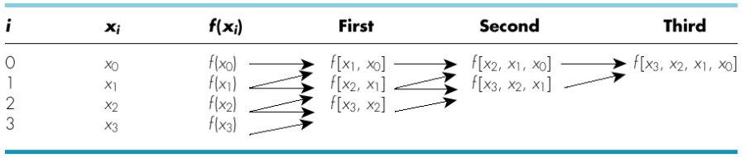
Graphical depiction of the recursive nature of finite divided differences.

Slide 34
Example
Construct a 4th order polynomial in Newton form that passes through the following points:
i | 0 | 1 | 2 | 3 | 4
x_{i} | 0 | 1 | -1 | 2 | -2
f(x_{i}) | -5 | -3 | -15 | 39 | -9
We can construct the polynomial as

Slide 35
Example
To calculate b₀, b₁, b₂, b₃, we can construct a divided difference table as
i | x_{i} | f[ ] | f[ , ] | f[ , , ] | f[ , , , ] | f[ , , , , ]
0 | 0 | -5
1 | 1 | -3
2 | -1 | -15
3 | 2 | 39
4 | -2 | -9
i | 0 | 1 | 2 | 3 | 4
x_{i} | 0 | 1 | -1 | 2 | -2
f(x_{i}) | -5 | -3 | -15 | 39 | -9

Slide 36
Example (Exercise)
Calculate f[x₁, x₀] and f[x₄, x₃].
i | x_{i} | f[ ] | f[ , ] | f[ , , ] | f[ , , , ] | f[ , , , , ]
0 | 0 | -5 | f[x₁, x₀] | f[x₂, x₁, x₀] | f[x₃, x₂, x₁, x₀] | f[x₄, x₃, x₂, x₁, x₀]
1 | 1 | -3 | f[x₂, x₁] | f[x₃, x₂, x₁] | f[x₄, x₃, x₂, x₁]
2 | -1 | -15 | f[x₃, x₂] | f[x₄, x₃, x₂]
3 | 2 | 39 | f[x₄, x₃]
4 | -2 | -9

Slide 37
Example
To calculate b₀, b₁, b₂, b₃, we can construct a divided difference table as
i | x_{i} | f[ ] | f[ , ] | f[ , , ] | f[ , , , ] | f[ , , , , ]
0 | 0 | -5 | 2
1 | 1 | -3 | 6
2 | -1 | -15 | 18
3 | 2 | 39 | 12
4 | -2 | -9

Slide 38
Example
To calculate b₀, b₁, b₂, b₃, we can construct a divided difference table as
i | x_{i} | f[ ] | f[ , ] | f[ , , ] | f[ , , , ] | f[ , , , , ]
0 | 0 | -5 | 2 | -4
1 | 1 | -3 | 6 | 12
2 | -1 | -15 | 18 | 6
3 | 2 | 39 | 12
4 | -2 | -9

Slide 39
Example
To calculate b₀, b₁, b₂, b₃, we can construct a divided difference table as
i | x_{i} | f[ ] | f[ , ] | f[ , , ] | f[ , , , ] | f[ , , , , ]
0 | 0 | -5 | 2 | -4 | 8
1 | 1 | -3 | 6 | 12 | 2
2 | -1 | -15 | 18 | 6
3 | 2 | 39 | 12
4 | -2 | -9

Slide 40
Example
To calculate b₀, b₁, b₂, b₃, we can construct a divided difference table as
i | x_{i} | f[ ] | f[ , ] | f[ , , ] | f[ , , , ] | f[ , , , , ]
0 | 0 | -5 | 2 | -4 | 8 | 3
1 | 1 | -3 | 6 | 12 | 2
2 | -1 | -15 | 18 | 6
3 | 2 | 39 | 12
4 | -2 | -9

Slide 41
Example
To calculate b₀, b₁, b₂, b₃, we can construct a divided difference table as
i | x_{i} | f[ ] | f[ , ] | f[ , , ] | f[ , , , ] | f[ , , , , ]
0 | 0 | -5 | 2 | -4 | 8 | 3
1 | 1 | -3 | 6 | 12 | 2
2 | -1 | -15 | 18 | 6
3 | 2 | 39 | 12
4 | -2 | -9
b₀
b₁
b₂
b₃
b₄
Thus we can write the polynomial as

Slide 42
Polynomial in Nested Newton Form
Polynomials in Newton form can be reformulated in nested form for efficient evaluation.
For example,
can be reformulated in nested form as

Slide 43
Lagrange Interpolating Polynomials
Construct a polynomial in the form

Slide 44
Lagrange Interpolating Polynomials
For example,

Slide 45
Example
Construct a 4th order polynomial in Lagrange form that passes through the following points:
i | 0 | 1 | 2 | 3 | 4
x_{i} | 0 | 1 | -1 | 2 | -2
f(x_{i}) | -5 | -3 | -15 | 39 | -9
We can construct the polynomial as
where L_{i}(x) can be constructed separately as …
(see next page)

Slide 46
Example
i | 0 | 1 | 2 | 3 | 4
x_{i} | 0 | 1 | -1 | 2 | -2
f(x_{i}) | -5 | -3 | -15 | 39 | -9

Slide 47
Lagrange Form vs. Newton Form
Lagrange
  Use to derive the Newton-Cotes formulas for use in numerical integration
Newton
  Allows construction of higher order polynomial incrementally
  Polynomial in nested Newton form is more efficient to evaluate
  Allow error estimation when the polynomial is used to approximate a function

Slide 48
Summary
Polynomial interpolation for approximate complicated functions. (Data are exact)
How to construct Newton and Lagrange Polynomial.
  How to calculate divided difference of order n when given n+1 data points.

Slide 49
Interpolation Error **
If p_{n}(x) interpolates f(x) at x₀, …, x_{n}, then the interpolation is
When using p_{n}(x) to approximate f(x) in an interval, one should select n+1 Chebyshev nodes/points (as oppose to equally spaced points) from the interval in order to minimize the interpolation error.

