Slide 1
MATH 2140 Numerical Methods
Faculty of Engineering
Mechanical Engineering Department
Instructor:
Dr. Mohamed El-Shazly
Associate Prof. of Mechanical Design and Tribology
melshazly@ksu.edu.sa
Office: F072

Slide 2
Numerical Integration

Slide 3
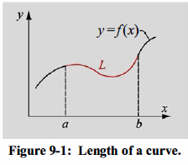
BACKGROUND
Integration is frequently encountered when solving problems and calculating quantities in engineering and science.
Integration and integrals are also used when solving differential equations.
One of the simplest examples for the application of integration is the calculation of the length of a curve (Fig. 9-1 ).

Slide 4
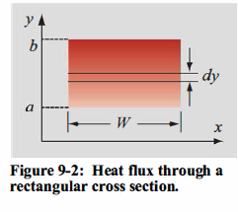
For example, the total rate of heat flow through a cross section of width W and height ( b - a) is related to the local heat flux via an integral (see Fig. 9-2):
where q" is the heat flux and Q is the heat flow rate.
Experimental measurements may yield discrete values for the heat flux along the surface as a function of y, but the quantity to be determined may be the total heat flow rate. In this instance, the integrand may be specified as a known set of values for each value of y.

Slide 5
The need for numerical integration
The integrand can be an analytical function or a set of discrete points (tabulated data).
When the integrand is a mathematical expression for which the antiderivative can be found easily, the value of the definite integral can be determined analytically.
Numerical integration is needed when analytical integration is difficult or not possible, and when the integrand is given as a set of discrete points.

Slide 6
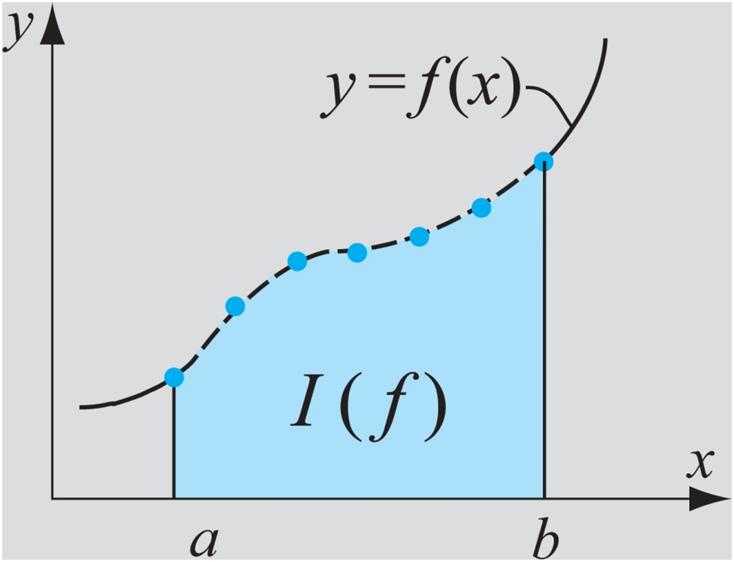
Overview of Approaches in Numerical Integration
In all cases the numerical integration is carried out by using a set of discrete points for the integrand.
When the integrand is an analytical function, the location of the points within the interval [a, b] can be defined by the user or is defined by the integration method.
When the integrand is a given set of tabulated points (like data measured in an experiment), the location of the points is fixed and cannot be changed.

Slide 7
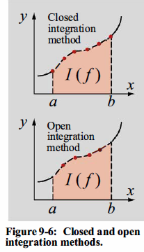
Closed and open methods
In closed integration methods, the endpoints of the interval (and the integrand) are used in the formula that estimates the value of the integral.
In open integration methods, the interval of integration extends beyond the range of the endpoints that are actually used for calculating the value of the integral (Fig. 9-6).
The trapezoidal (Section 9.3) and Simpson's (Section 9.4) methods are closed methods, whereas the midpoint method (Section 9.2) and Gauss quadrature (Section 9.5) are open methods.
There are various methods for calculating the value of an integral from the set of discrete points of the integrand. Most commonly, it is one by using Newton-Cotes integration formulas.

Slide 8
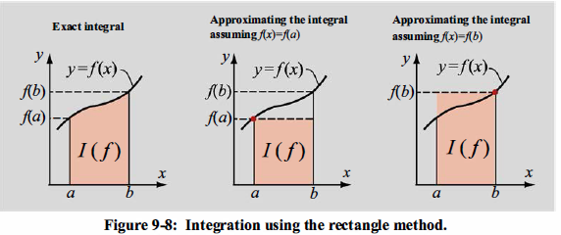
RECTANGLE AND MIDPOINT METHODS
Rectangle method

Slide 9
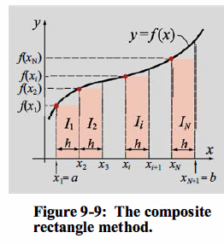
Composite rectangle method

Slide 10
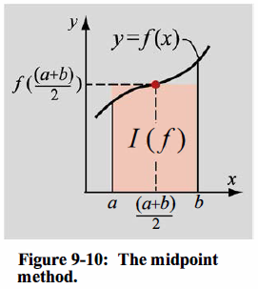
Midpoint method

Slide 11
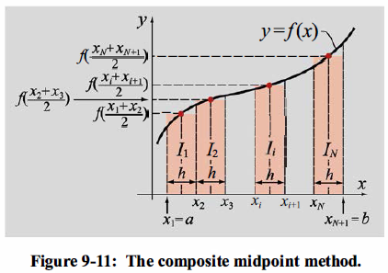
Composite midpoint method

Slide 12
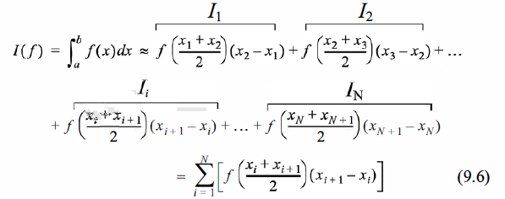

Slide 13
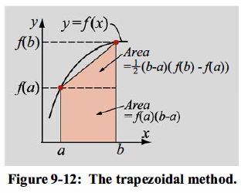
TRAPEZOIDAL METHOD

Slide 14
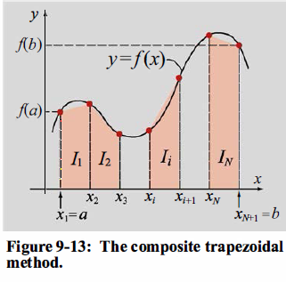
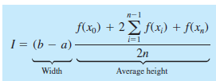
Composite Trapezoidal Method

Slide 15
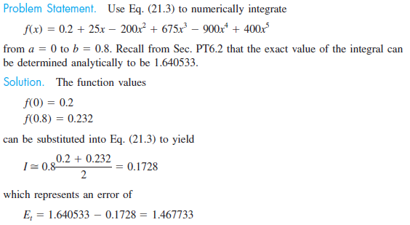
Example 1: Single Application of the Trapezoidal Rule

Slide 16
Example 2: Multiple-Application Trapezoidal Rule

Slide 17
Example: 3

Slide 18
