Slide 1
Marianne Moore
The Mind is an Enchanting Thing

Slide 2
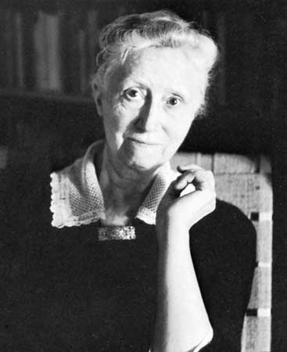
Biography
Born near St. Louis, Missouri, on November 15, 1887, Marianne Moore was raised in the home of her grandfather, a Presbyterian pastor. After her grandfather’s death, in 1894, Moore and her family stayed with other relatives, and in 1896 they moved to Carlisle, Pennsylvania. She attended Bryn Mawr College and received her BA in 1909. Following graduation, Moore studied typing at Carlisle Commercial College, and from 1911 to 1915 she was employed as a school teacher at the Carlisle Indian School. In 1918, Moore and her mother moved to New York City, and in 1921, she became an assistant at the New York Public Library. She began to meet other poets, such as William Carlos Williams and Wallace Stevens, and to contribute to the Dial, a prestigious literary magazine. She served as acting editor of the Dial from 1925 to 1929. Along with the work of such other members of the Imagist movement as Ezra Pound, Williams, and H. D., Moore’s poems were published in the Egoist, an English magazine, beginning in 1915. In 1921, H. D. published Moore’s first book, Poems (The Egoist Press, 1921), without her knowledge.
Moore was widely recognized for her work; among her many honors were the Bollingen prize, the National Book Award, and the Pulitzer Prize. She wrote with the freedom characteristic of the other modernist poets, often incorporating quotes from other sources into the text, yet her use of language was always extraordinarily condensed and precise, capable of suggesting a variety of ideas and associations within a single, compact image. In his 1925 essay “Marianne Moore," William Carlos Williams wrote about Moore’s signature mode, the vastness of the particular: “So that in looking at some apparently small object, one feels the swirl of great events.” She was particularly fond of animals, and much of her imagery is drawn from the natural world. She was also a great fan of professional baseball and an admirer of Muhammed Ali, for whom she wrote the liner notes to his record, I Am the Greatest! Deeply attached to her mother, she lived with her until Mrs. Moore’s death in 1947. Marianne Moore died in New York City on February 5, 1972.

Slide 3
“The Mind Is an Enchanting Thing” appeared in the 1944 publication of Nevertheless. Both technically and thematically it is a central poem in Moore’s work. In it, she uses intricate syllabic verse and stanzaic arrangements. Through a series of similes and metaphors, she alternates between details and generalities, integrating the two in the last line. The poems deals with a complex paradox: The mind is both subject and object, both enchanter and enchanted. It has the power to dissolve unities into multiplicities and also to synthesize those different facets into new unities. It has the power to transform dejection into joy, death into life. Moore is celebrating the miracle of the poetic process.

Slide 4
She introduces the paradox at the poem’s beginning by changing a single syllable; the “enchanting” of the title becomes “enchanted” in the first line. A series of similes follows, each focusing on the contradiction inherent in being both subject and object. Having established the paradox, Moore uses an animal, the kiwi, to lead to the central part of the poem, the concept of the mind that “walks along with its eyes on the ground.” Kiwi is the name New Zealand natives give to the apteryx, a flightless bird with a long beak that walks looking downward. It, too, is a paradox. It is a bird, but it does not fly. The mind is like the kiwi—it focuses intently, but it also “has memory’s ear.” It is in touch with the history it has stored, and in that sense, it can fly anywhere.

Slide 5
The sequence of similes that follows describes strange phenomena that bring this contradiction to life: “Like the gyroscope’s fall,” and “like the dove-/ neck animated by/ sun.” Forces of the universe move the gyroscope. Like the mind, it possesses those memories. The last line of the fourth stanza sums up these images: “It’s conscientious inconsistency.” Things are fixed and not fixed at the same time, just like the mind.

Slide 6
The concluding lines deal with the outcome of being a “conscientious inconsistency.” The mind “tears off the veil” that the heart wears. Like the veil that separated the holy from the truly elect in the temple at Jerusalem, the veil the heart wears gets in the way of understanding. The veil represents certainty and, for Moore, the opposite of insight, so this process of liberating the heart to pursue truth is as important as the truth itself. The mind is also flexible. It resembles “unconfusion [that] submits/ its confusion to proof.” Unlike King Herod, who refused to change his oath, the mind has nothing to do with death. Instead, the mind sustains life by its power to change sensation into understanding, to abstract from multiple detail by listening to inward as well as outward surroundings. The mind possesses all these powers and can delight itself even in a dull world; it perceives the unusual amid the ordinary. As long as it has these qualities, poetry is possible.

Slide 7
Moore enhances this theme by giving the poem a songlike quality. Changing “enchanting” to “enchanted” sets a rhythm. Throughout the poem, the hard consonants and rhyme scheme suggest a musical composition. Her reference to composer Domenico Scarlatti in the opening stanza reinforces this. Music liberates the spirit, but it is a controlled technical medium. Her prose technique, regular syllables per line and a precise stanzaic pattern, is also tightly controlled, yet Moore employs it to express a liberating idea.

Slide 8
Moore valued simplicity, and she attacked complex issues. The mind is worthy of celebration if it has faculties beyond simply perceiving stored memories. It can perceive hidden truths; it is not a weak, unchanging faculty but grows as life unfolds. It accepts the inevitable confusion of experience. Its connection with the spirit enables it to create poetry.

