Slide 1
Malaria: Plasmodium sp.
Phylum: Apicomplexa

Slide 2
Genus: Plasmodium
Species:
Falciparum,
Vivax,
Ovale,
Malariae,
5th species: Plasmodium knowlesi: a species that infects primates – has led to human malaria, but the exact mode of transmission remains unclear.

Slide 3
Epidemiology:

Slide 4
Spread:
Anopheles female bite
blood transfusion
vertical - transmission mother/child (congenital)

Slide 5
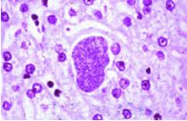
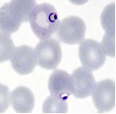
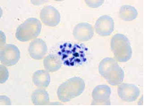
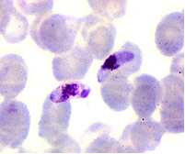
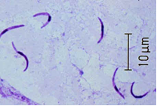
Definitions:
Hepatic schizont :
Trophozoite:
Erythrocytic schizont:
Merozoite:
Gametocyte:
Sporozoite:

Slide 6
Life Cycle

Slide 7
Clinical picture of Malaria:
fever,
chills,
anaemia,
headache,
splenomegaly,
Jaundice
Travel history
Fever pattern (paroxysm): cold stage, hot stage, sweating stage.

Slide 8
Diagnosis of malaria:
1-Peripheral blood examination.
2-Bone marrow biopsy.
3-Quantitative buffy coat technique (QBC), detects the DNA of the parasite and give fluorescence.
4-Serology: IHAT, IFAT and ELISA for detection of Abs.
5-immunodiagnostic strip test (dip stick test), ELISA for detection of Ags in the peripheral blood.
6-PCR

Slide 9
DIAGNOSIS OF SPECIES:
clinical picture
examination of thin smear

Slide 10
COMPLICATIONS:
1- Black water fever also called pernicious syndrome caused by: P.falciparum.
2- Nephrotic syndrome caused by: P. malariae.
3- Malarial relapse caused by: P. vivax, P. ovale.
4- Malarial recrudescence caused by: P. malariae mainly.
5- Severe haemolytic anaemia caused bt: P. falciparum.

Slide 11
Treatment:
Chemoprophylaxis
Treatment:
different drugs required for different stages of life cycle
(eg. primaquine and Malarone for hepatic schizonts and gametocytes).
(mefloquine, quinine and chloroquine for RBC schizonts and trophozoites).

