Slide 1
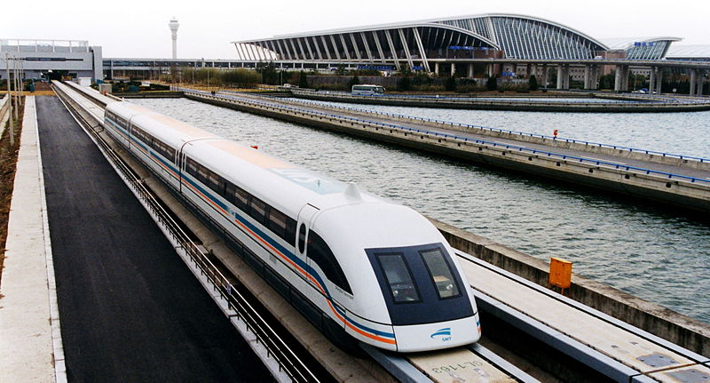
A SEMINAR ON MAGLEV

Slide 2
WHAT IS MEANT BY MAGLEV?
Maglev=Magnetic + Levitation.
Any thing which may levitate(raise or float) by means of a magnetic power is simply called as magnetic levitation.
The term ‘MAGLEV’ can be briefly explained by using an example of ‘MAGLEV TRAINS’.

Slide 3
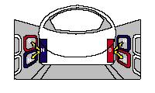
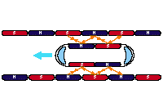
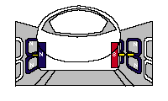
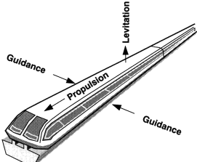
Basic Principle of Maglev Trains
Maglev trains have to perform the following functions to operate in high speeds
1.Levitation 2.Propulsion 3.Lateral Guidance

Slide 4
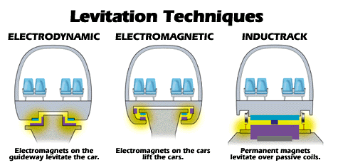
Types of Maglev Trains
Based on the techniques used for Levitation there are two types of Maglev trains
Electro magnetic Suspension -Attractive
Electro dynamic Suspension -repulsive

Slide 5
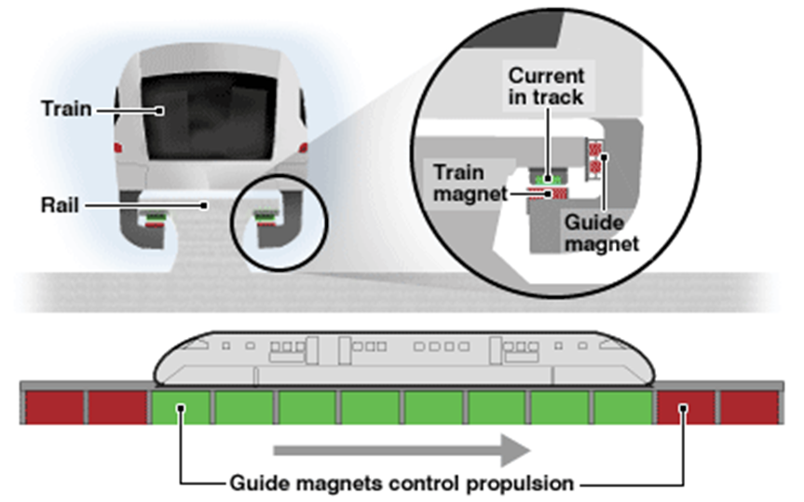
EMS (Electromagnetic Suspension)
ELECTROMAGNETIC SUSPENSION USES ELECTROMAGNETS TO LEVITATE THE TRAIN.

Slide 6
1.LEVITATION PRINCIPLE IN EMS SYSTEM:
IN EMS SYSTEM “LEVITATION BY ATTRACTION “ may takes place.
Attraction is caused by having the currents within each of the circuits traveling in the same direction. It is important to note that with attractive forces created between the train and the track.
2.PRINCIPLE OF PROPULSION IN EMS SYSTEM:
The propulsion of the train is mainly based on two types of motors:
Linear Electric Motor (LEM) and,
Linear Induction Motor (LIM)
3.PRINCIPLE OF LATERAL GUIDENCE IN EMS SYSTEM:
The levitation magnets and rail are both
U shaped(with rail being an inverted U).
The mouths of U face one another.

Slide 7
Pros and Cons of EMS
Technology | Pros | Cons
EMS (Electromagnetic suspension) | Low magnetic fields inside and outside the vehicle Commercially available No secondary propulsion system needed | The system needs to be monitored by outside system to maintain the distance between the Track and the train Vibraitions may occur due to instability and outside monitoring.

Slide 8
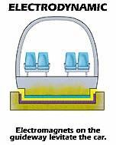
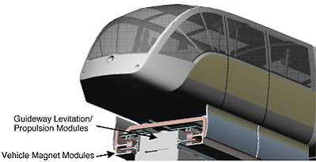
EDS (ELECTRODYNAMIC SUSPENSION):
Electrodynamic Suspension uses Superconductors for levitation,propulsion and lateral guidance

Slide 9
1.LEVITATON PRINCIPLE IN EDS SYSTEM:
IN EDS SYSTEM “LEVITATION BY REPULSION” may takes place.
The current in the top circuit travels in the opposite direction of the current in the bottom; resulting in an repulsion between the two coils
2.PRINCIPLE OF PROPULSION IN EDS SYSTEM:
The propulsion coils located on the sidewalls on both sides of the guideway are energized by a three-phase alternating current from a substation, creating a shifting magnetic field on the guideway
3.PRINCIPLE OF LATERAL GUIDENCE IN EDS SYSTEM:
When one side of the train nears the side of the guideway, the super conducting magnet on the train induces a repulsive force from the levitation coils on the side closer to the train and an attractive force from the coils on the farther side.
This keeps the train in the center.

Slide 10
PROS AND CONS OF EDS:
Technology | Pros | Cons
EDS (Electrodynamic suspension) | highest speed (581 km/h) Heavy load capacity | Necessary use of magneting shielding due to the strong magnetic fields. The vehicle must be wheeled to travel at low speed. the cryogenic system uses to cool the coils can be expensive.

Slide 11
INDUCTRACK:
The Inductrack is a newer type of EDS that uses permanent room-temperature magnets .
There are two Inductrack designs:
Inductrack I and
Inductrack II.
Inductrack I is designed for high speeds, while Inductrack II is suited for slow speeds.
If the power fails, the train can slow down gradually and stop on its auxillary wheels.

Slide 12
Other Applications
NASA plans to use magnetic levitation for launching of space vehicles into low earth orbit.
Boeing is pursuing research in MagLev to provide a Hypersonic Ground Test Facility for the Air Force.
The mining industry will also benefit from MagLev.
There are probably many more undiscovered applications!

Slide 13
CONCLUSION
Maglev trains use magnets to levitate and propel the trains forward.
Since there is no friction these trains can reach high speeds.
It is a safe and efficient way to travel.

Slide 14
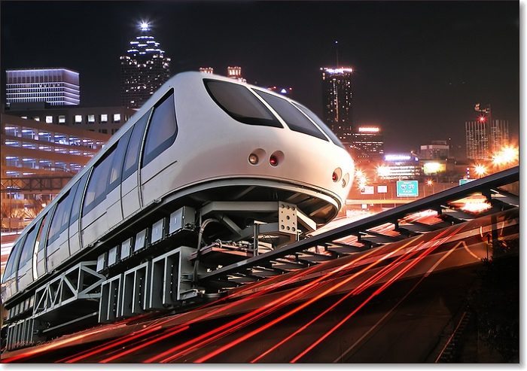
Thank you

