Slide 1
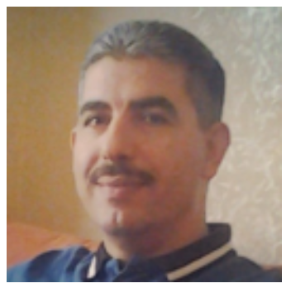
Education
1993 Master degree from Mathematics department
College of science at the University of Jordan
1990 Bachelor's degree from Mathematics department
College of science at University of Yarmouk
Experience
1998 – 2021 Lecturer, Department of mathematics,
science collage, King Saud University,
Saudi Arabia
Courses taught
111 Math (Integral Calculus)
131 Math (Foundations of Mathematics)
201 Math (Differential and Integral Calculus)
202 Math (Vector Calculus)
346 Math (Rings and Fields)
246 Math (Linear Algebra)
231 Math (Probability and statistic 1)
121 Math (Euclidean Geometry)
382 Math ( Non- Euclidean Geometry)
(Pre –Calculus)
107 Math (Vectors and Matrices)
104Math (General Mathematics)
106 Math (Integral Calculus)
200 Math (Differential and Integral Calculus)
203Math (Differential and Integral Calculus)
Wael Mustafa
Lecturer , Department of mathematics
Date Of Birth: 17th April 1968
Location: Saudi Arabia – Riyadh
Mobile: +966598243687
Email: wahmad1@ksu.edu.sa
wrsrwael@hotmail.com
Address
P.O. Box 2455, Riyadh 11451, Department of Mathematics, College of Sciences, King Saud University, Kingdom of Saudi Arabia.
Skills
Personal skills
Problem solving
Self-Confidence and Self motivated
Fast learner, Teamwork with high
spiritual
Hard-working under pressure and highly
organized
Computer Skills
MS Office (Word, PowerPoint, Excel)
Communication Skills
good skills In English language
Notes:
MOATH AL-MALLAD
Industrial Engineer
Date Of Birth: 13th March 1994
Location: Amman - Jordan
Mobile: +962786341400
Email: eng.muathmallad@gmail.com
Profile
I am an industrial engineer (Fresh Graduate). I am Self-motivated person with high ambitions. My main objective is to be part of something big, great and exciting. apply the knowledge gained through my study, and to fulfill duties and tasks required by the job. Motivation, inspiration and creativity in addition to hard work and dedication are my main key drivers.
Skills
Personal skills
Problem solving
Self-Confidence and Self motivated
Fast learner, Teamwork with high
spiritual
Hard-working under pressure and highly
organized
Computer Skills
MS Office (Word, PowerPoint, Excel)
Minitab Software
Communication Skills
good skills In English language
Education
2014 – 2018 Bachelor's degree in industrial Engineering
The Hashemite University
2012 – 2014 Diploma degree in Industrial Automation /
mechatronics Engineering
Al-Balqa Applied University-Faculty
Engineering Technology
2010 – 2012 General Secondary Certificate Exam
Taha Hussain Secondary School
Experience
Aug 2017 – Head cashier
Oct 2017 Sameh Mall
Under graduate experience in accounting and focused on
customer service
Jul 2017 – Intern - University training
Sep 2017 Jordan Shareef Plastic Factory
I had a training experience in maintenance and production
departments and focused on Quality control, product line,
problems solve
Jul 2014 – Sales Employee
Dec 2014 Al - Sha'b for Nuts and sweets
Under graduate experience in Sales and focused on
customer service, and Marketing
Feb 2014 – Intern - College training
Apr 2014 Al - Wefaq Control Systems Company
I had a training experience in identifying electrical panels
and their main components and focused on Check
electrical panels, and Assembly of electrical panels
My Graduation Project: Risk Management Process and its
analysis in Jordan Manufacturing and Services Solutions
(JMSS) Company using the International Organization for
Standardization (ISO 9001:2015)
My Graduation Project: design Simple car for remote
sensing, using the Arduino panel and Contains sensors and
input... ect, and programming it by computer

