Slide 1
Single-Row Functions
Lecture 9

Slide 2
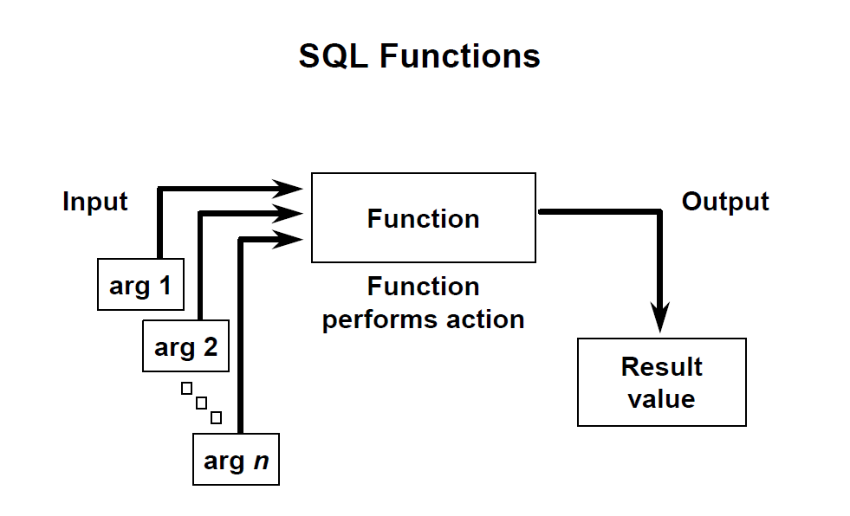

Slide 3
SQL Functions
Functions are very powerful feature of SQL and can be used to do the following:
Perform a calculation on data
Modify individual data items
Manipulate output of groups of rows
Format dates and numbers for display
Convert column data types

Slide 4
Two Types of SQL Functions
There are two distinct types of functions:
Single-Row Functions
These functions operate on single rows only and return one result per row. There are different types of single-row functions
Multiple-Row Functions
Functions can manipulate groups of rows to give one result per group of rows. These functions are known as group functions

Slide 5
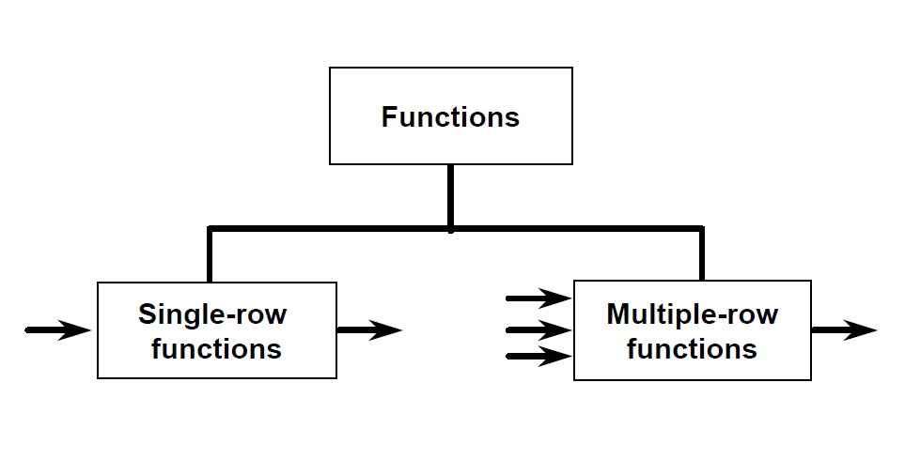

Slide 6
Single-Row Functions
Single row functions:
Manipulate data items
Accept arguments and return one value
Act on each row returned
Return one result per row
May modify the data type
Can be nested
Can be used in SELECT, WHERE, and ORDER BY clauses
Accept arguments which can be a column or an expression
Syntax:
function_name [(arg1, arg2,...)]

Slide 7
Single-Row Functions
This lesson covers the following single -row functions:
Character functions: accept character input and can return both character and number values
Number functions: Accept numeric input and return numeric values

Slide 8
Character Functions
Character Functions
Case-manipulation
Character-manipulation
LOWER
UPPER
INITCAP
SUBSTR
LENGTH

Slide 9
:Character Functions
Case Manipulation Functions
These functions convert case for character strings. See (Example 1, Example 2)
Function | result
LOWER(‘SQL Course’) | sql course
UPPER(‘SQL Course’) | SQL COURSE
INITCAP(‘SQL Course’) | Sql Course

Slide 10
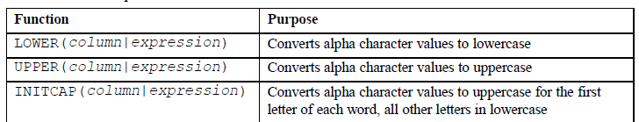
:Character Functions
Case Manipulation Functions

Slide 11
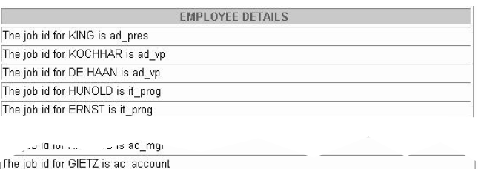
:Example1
SELECT 'The job id for '||UPPER(last_name)||' is '
||LOWER(job_id) AS "EMPLOYEE DETAILS"
FROM employees;

Slide 12
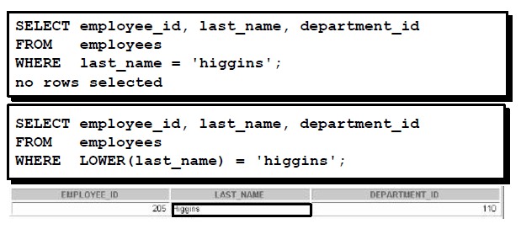
:Example2
Display the employee number, name, and department number for employee Higgins:

Slide 13
Character Functions:
Character Manipulation Functions
Function | Purpose
LENGTH(Column|expression) | Returns the number of characters in the expression
SUBSTR(column|expression,m [,n]) | Returns specified characters from character value starting at character position m,n character long (if m is negative the count starts and the end of the character value . If n is omitted all characters to the end of the string are returned

Slide 14
Character Functions:
Character Manipulation Functions
These functions manipulate character strings. For example:
Function | Result
LENGTH('HelloWorld') | 10
SUBSTR('HelloWorld',1,5) | Hello

Slide 15
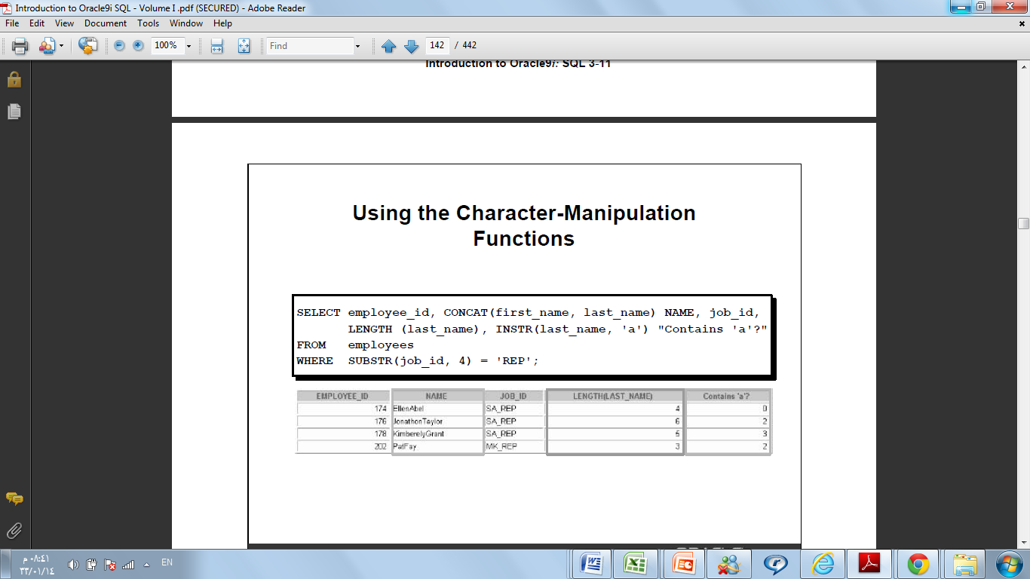
Character Functions:
Character Manipulation Functions (Cont.)
Example:
SELECT employee_id, job_id,LENGTH (last_name)
FROM employees
WHERE SUBSTR(job_id, 4) = 'REP';

Slide 16
Number Functions
ROUND: Rounds value to specified decimal (Example 3)
Syntax:
ROUND(column|expression, n) :Rounds the column, expression, or value to n decimal places, or, if n is omitted, no decimal places.
Example:
ROUND(45.926, 2) 45.93

Slide 17
Number Functions
TRUNC: Truncates value to specified decimal (Example 4)
Syntax:
TRUNC(column|expression,n) Truncates the column, expression, or value to n decimal places, or, if n is omitted, then n defaults to zero
Example:
TRUNC(45.926, 2) 45.92

Slide 18
Number Functions
MOD: Returns remainder of division (Example 5)
Syntax:
MOD(m,n) Returns the remainder of m divided by n
Example:
MOD(1600, 300) 100

Slide 19
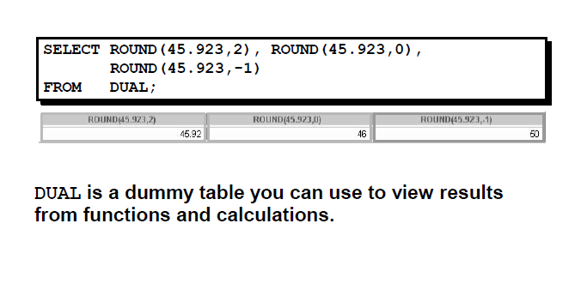
Example 3

Slide 20
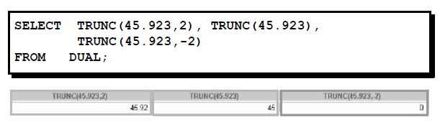
Example 4

Slide 21
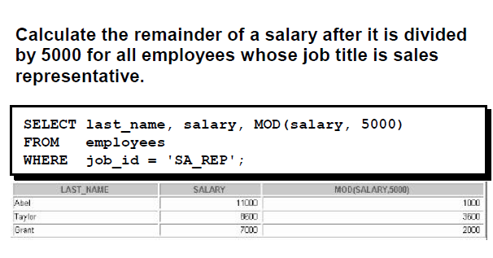
Example 5

