Slide 1
Restricting and Sorting Data
LECTURE 8

Slide 2
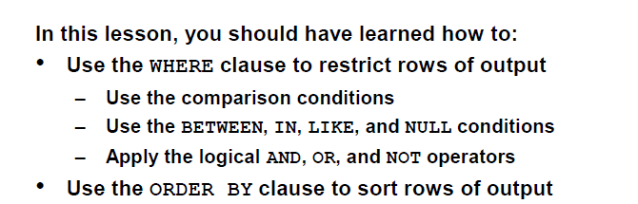
Outlines

Slide 3
Limiting the Rows Selected
Consider the table
employee(employee_id,last_name,job_id, department_id )
assume that you want to display all the employees in department 90. →The rows with a value of 90 in the DEPARTMENT_ID column are the only ones returned.
This method of restriction is the basis of the WHERE clause in SQL.

Slide 4
Limiting the Rows Selected (cont.)
Syntax
SELECT [*, DISTINCT] columns names
FROM table
[WHERE condition(s)];
You can restrict the rows returned from the query by using the WHERE clause.
A WHERE clause:
  contains a condition that must be met
  It directly follows the FROM clause.
  If the condition is true, the row meeting the condition is returned.

Slide 5
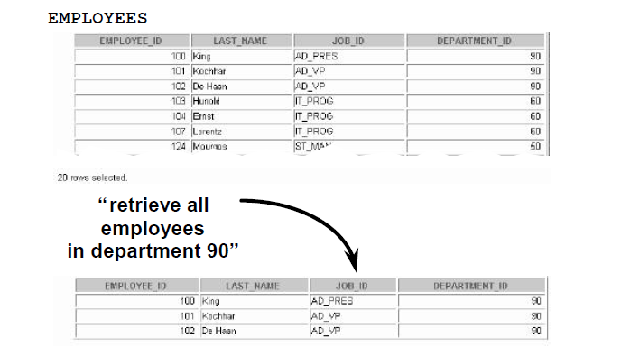
Limiting the Rows Selected (Example 1)
SELECT employee_id, last_name, job_id, department_id
FROM employees
WHERE department_id = 90;

Slide 6
Where Caluse
Before starting
  Character String and dates
  Aliases
Conditions
  Comparison Conditions
  Logical Conditions
  Rules of Precedence

Slide 7
Character Strings and Dates
Character strings and date values are enclosed in single quotation marks.
Character values are case sensitive (see Example 2), and date
values are format sensitive.
The default date format is DD-MON-YY.

Slide 8
Character Strings and Dates (Example 2)
Q: Return the last name, job id, and the department number for the employee whose last name is Goyal
SELECT last_name, job_id, department_id
FROM employees
WHERE last_name = 'Goyal';
SELECT last_name, job_id, department_id
FROM employees
WHERE last_name = ‘goyal';
Some Answers
X
SELECT last_name, job_id, department_id
FROM employees
WHERE last_name = ‘GOYAL';
X

Slide 9
Aliases
Note that: An alias cannot be used in the WHERE clause. (see Example 3)

Slide 10
Aliases (Example 3)
Q: Return the last name, job id, and the department number for the employee whose last name is Goyal
SELECT last_name AS “LN”, job_id, department_id
FROM employees
WHERE last_name = 'Goyal';
SELECT last_name AS “LN”, job_id, department_id
FROM employees
WHERE LN = ‘Goyal';
X

Slide 11
Comparison Conditions
Comparison conditions are used in conditions that compare one expression to a value or another expression (see Example 4)
They are used in the WHERE clause
Example
... WHERE hire_date='01-JAN-95'
... WHERE salary>=6000
... WHERE last_name='Smith‘

Slide 12
Comparison Conditions: (Comparison operators)
Operator | Meaning
= | Equal to
> | Greater than
< | Less than
>= | Greater or equal to
<= | Less or equal to
<> | Not equal to

Slide 13
Comparison Conditions: (Example 4)
Q: Return the last_name and salary for all employees whose salaries are not grater than 3000
SELECT last_name, salary
FROM employees
WHERE salary <= 3000;

Slide 14
Comparison Conditions: (Other Comparison operators)
Operator | Meaning
1) BETWEEN …… AND ……. | Between two values (inclusive)
2) IN(set) | Match any of a list of values
3)LIKE | Match a character pattern
4)IS NULL | Is a null value

Slide 15
Comparison Conditions :(Using the (BETWEEN Condition
Use the BETWEEN condition to display rows based on a range of values.
  Values specified with the BETWEEN condition are inclusive (i.e. lower limit and higher limit are included too)
  You must specify the lower limit first .(see Example 5)

Slide 16
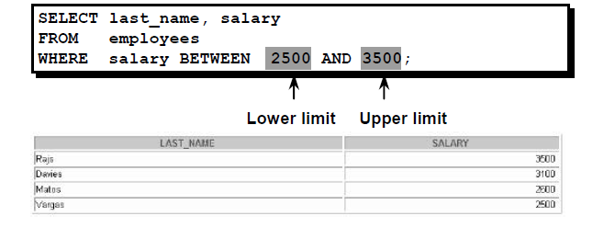
Example 5
Q: Return the last_name and salary for all employees whose salaries are in the range 2500 and 3500

Slide 17
Comparison Conditions :( Using the IN Condition)
Use the IN condition to display rows based on a specific of values. (See Example 6)

Slide 18
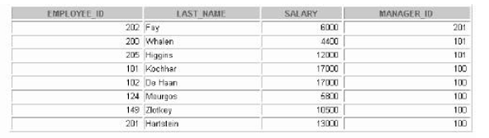
Example 6
Q: Return the employee_id, last_name, salary, and manager_d for all employees whose manager_id’s is either 100,101,or 201
SELECT employee_id, last_name, salary, manager_id
FROM employees
WHERE manager_id IN (100, 101, 201);

Slide 19
Comparison Conditions :( Using the IN Condition)(Cont.)
The IN condition can be used with any data type. The following example returns a row from the EMPLOYEES table for any employee whose last name is included in the list of names in the WHERE clause:
SELECT employee_id, manager_id, department_id
FROM employees
WHERE last_name IN ('Hartstein', 'Vargas');

Slide 20
Comparison Conditions :( Using the LIKE Condition)
With the Where clause, you may not always know the exact value to search for→
You can select rows that match a character pattern by using LIKE condition.
Search conditions can contain either literal characters or numbers (see Example7 & 8):
  % represents any zero or many characters.
  _ represent any single character.

Slide 21
Example 7
Q:Return the first name from the EMPLOYEES table for any employee whose first name begins with an S.
SELECT first_name
FROM employees
WHERE first_name LIKE 'S%';
Note that: Names beginning with an s (Lower case) are not returned.

Slide 22
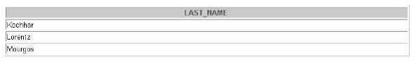
Example 8
You can combine pattern-matching characters.
SELECT last_name
FROM employees
WHERE last_name LIKE '_o%‘ ;
The previews example displays the names of all employees whose last name has an o as the second character

Slide 23
Comparison Conditions :( Using the NULL Conditions)
In the where clause we can test for NULL using the IS NULL operator (see Example 9)

Slide 24
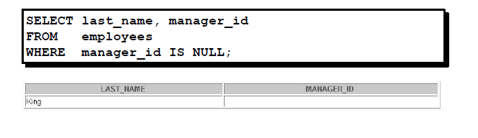
Example 9
Q:Return the last name and manager_id from the EMPLOYEES table for any employee who have NO manager

Slide 25
Logical Conditions: (Logical operators)
operator | Meaning
And | Returns TRUE if both component are true
Or | Returns TRUE if either component are true
Not | Returns TRUE if the following condition is false

Slide 26
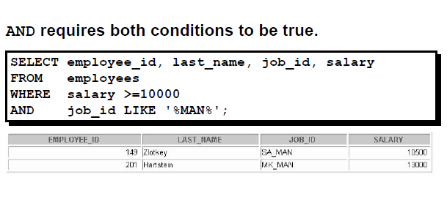
Logical Conditions :(Using the AND Operator)

Slide 27
Logical Conditions :(Using the AND Operator)
The following table shows the results of combining two expressions with AND:
And | true | false | Null
True | True | False | Null
False | False | False | False
null | null | false | null

Slide 28

Logical Conditions :(Using the OR Operator)

Slide 29
Logical Conditions :(Using the OR Operator)
The following table shows the results of combining two expressions with OR:
Or | true | false | Null
True | True | true | True
False | true | False | null
null | true | null | null

Slide 30
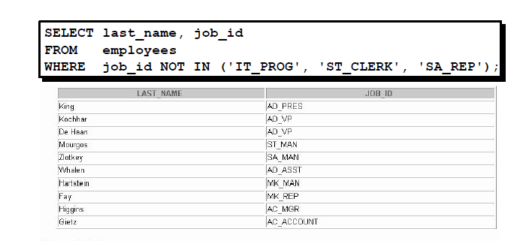
Logical Conditions :(Using the NOT Operator)

Slide 31
Logical Conditions :(Using the NOT Operator)
The following table show the result of applying the not operator on a condition:
not | true | false | null
 | false | true | null

Slide 32
Logical Conditions :(Using the NOT Operator)
Note that: The NOT operator can also be used with other SQL operators, such as BETWEEN, LIKE, and NULL. For Example
  ... WHERE job_id NOT IN ('AC_ACCOUNT', 'AD_VP')
  ... WHERE salary NOT BETWEEN 10000 AND 15000
  ... WHERE last_name NOT LIKE '%A%'
  ... WHERE commission_pct IS NOT NULL

