Slide 1
SQL .. An overview
lecture3

Slide 2
Overview of SQL
Query: allow questions to be asked of the data and display only the information required. It can include info from more the one table
Why Query language?
A Database Management system enable users to access and manipulate data using queries.
Structured Query Language (SQL): is the language used by most relational database systems.

Slide 3
Features of SQL
What is SQL?
SQL stands for Structured Query Language
SQL lets you access and manipulate databases
SQL is an ANSI (American National Standards Institute) standard

Slide 4
Features of SQL
What Can SQL do?
SQL can execute queries against a database
SQL can retrieve data from a database
SQL can insert records in a database
SQL can update records in a database
SQL can delete records from a database
SQL can create new databases
SQL can create new tables in a database
SQL can create stored procedures in a database
SQL can create views in a database
SQL can set permissions on tables, procedures, and views

Slide 5
Features of SQL
What Makes SQL Special?
SQL is an English-like language. It uses words such as select, insert, delete as part of its command set
SQL is a non-procedural language: you specify What information you require, not how to get it . This feature makes it easier for you to concentrate on obtaining the desired result.
SQL Processes sets of records rather than a single record at a time.
SQL can be used by a range of users including DBA’s, programmers, Management Personnel, and many other types of end users

Slide 6
Types of SQL Statements
Data Definition Language (DDL):
Commands that define a database.
E.g. CREATE, ALTER, DROP, ...etc.
Data manipulation language (DML):
Commands that maintain and query a database.
E.g. SELECT, INSERT, UPDATE, DELETE.
Data Control Language (DCL):
Commands that control a database, including administering
privileges and committing data.
E.g. CONNECT, GRANT, REVOKE, ...etc.

Slide 7
Writing SQL Commands
SQL commands maybe one or more lines
Command words cannot be split across lines
SQL Commands are not case sensitive
Place a semi –colon(;) at the end of last clause.

Slide 8
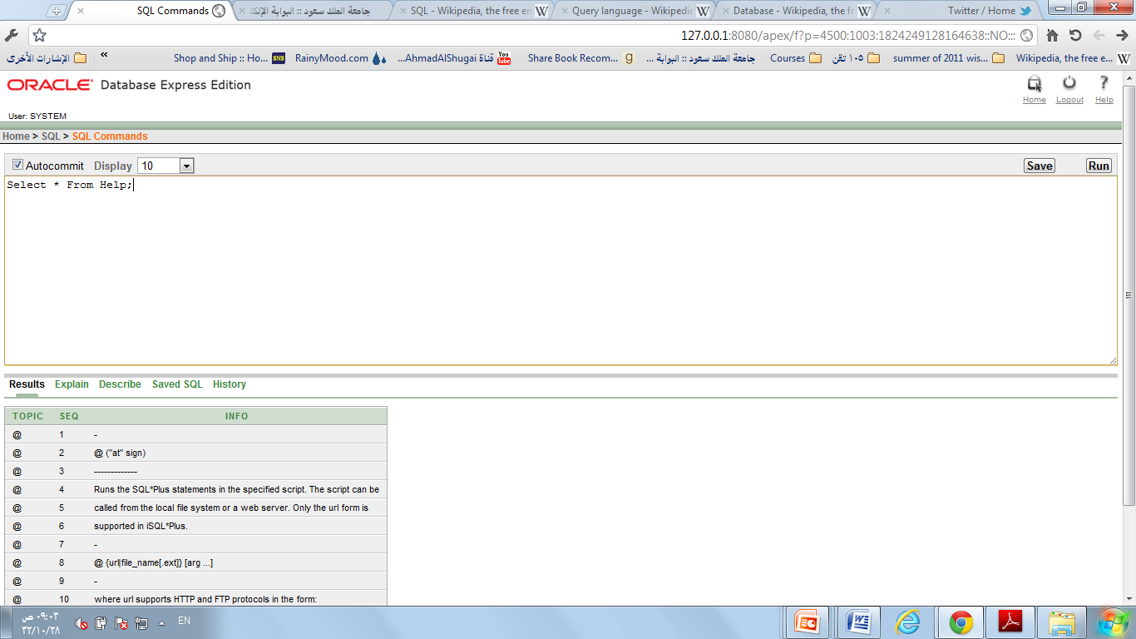
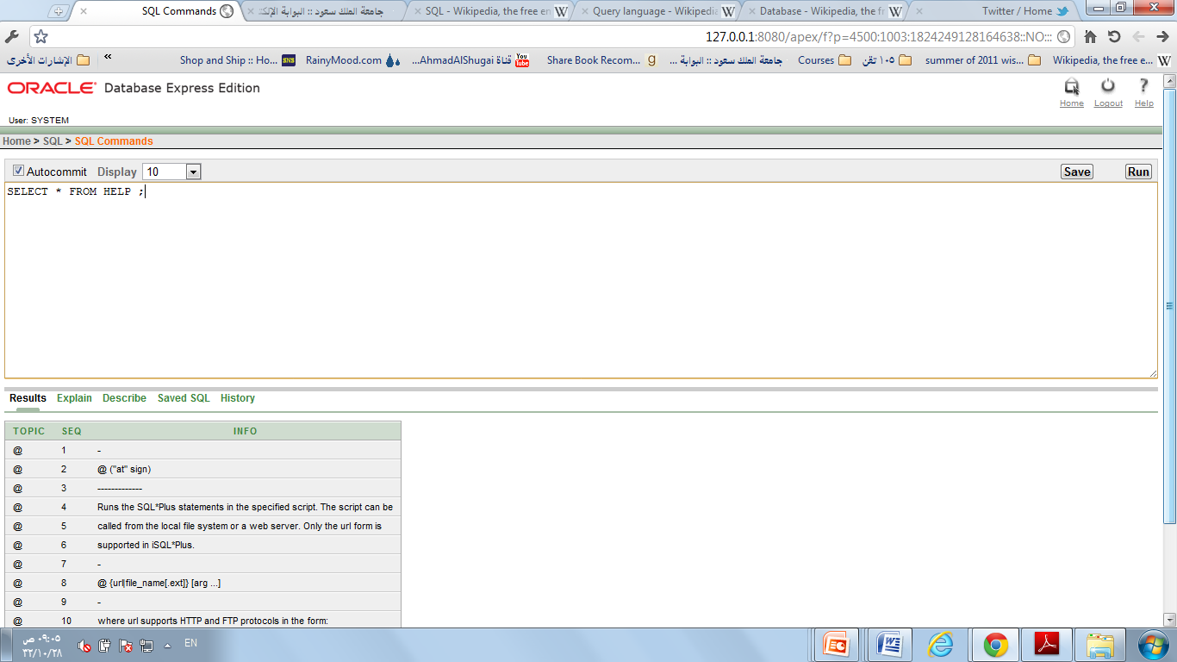
Both give the same result
not case sensitive)

