Slide 1
Aggregating Data Using Group Functions
LECTURE 10

Slide 2
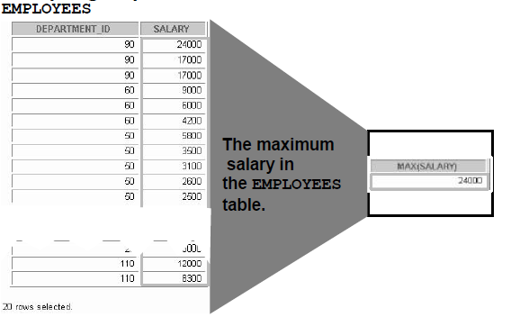
What Are Group Functions?
Group functions operate on sets of rows to give one result per group.

Slide 3
Types of Group Functions
Description | Group Function
Average value of n, ignoring null values | AVG ([DISTINCT|ALL] n)
Number of rows (count all selected rows using *, including duplicates and rows with nulls) | COUNT ({*| [DISTINCT| ALL] expr})
Maximum value of expr, ignoring null values | MAX([DISTINCT|ALL] expr)
Minimum value of expr, ignoring null values | MIN([DISTINCT|ALL] expr)
Sum values of n, ignoring null values | SUM( [DISTINCT|ALL] n)

Slide 4
Group Functions Syntax
SELECT [column,] group_function(column), ...
FROM table
[WHERE condition]
[GROUP BY column]
[ORDER BY column];

Slide 5
Guidelines for Using Group Functions
DISTINCT makes the function consider only non-duplicate values; ALL makes it consider every value including duplicates. “The default is ALL and therefore does not need to be specified.”
The data types for the functions
with an expr argument may be CHAR, VARCHAR2, NUMBER, or DATE.
With n argument can be only NUMBER.
All group functions ignore null values..

Slide 6
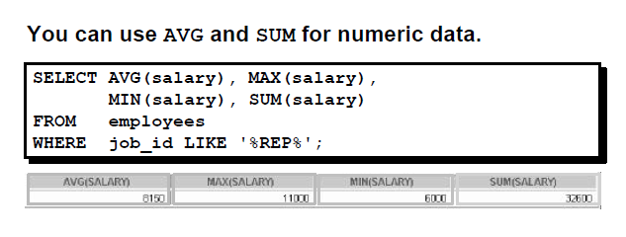
Using the AVG and SUM Functions

Slide 7
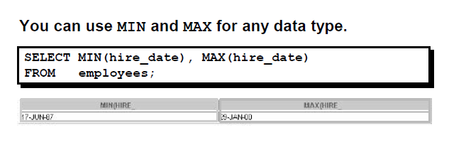
Using the MIN and MAX Functions

Slide 8
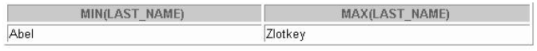
Using the MIN and MAX Functions
You can use the MIN and MAX functions for any data type.
The previews slide example displays the most junior and most senior employee.
The following example displays the employee last name that is first and the employee last name that is the last in an alphabetized list of all employees.
SELECT MIN(last_name), MAX(last_name)
FROM employees;

Slide 9
Using the MIN and MAX Functions
Note: AVG, SUM functions can be used only with numeric data types.

Slide 10
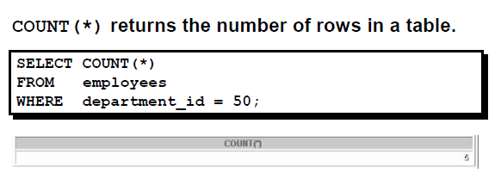
Using the COUNT Function

Slide 11
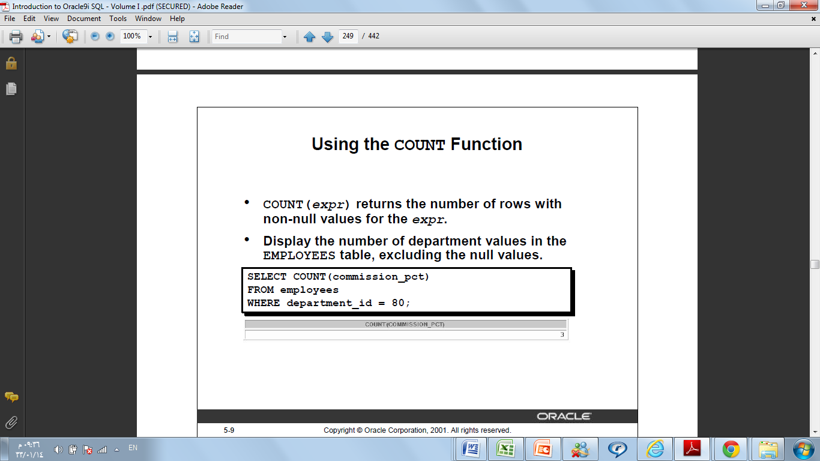
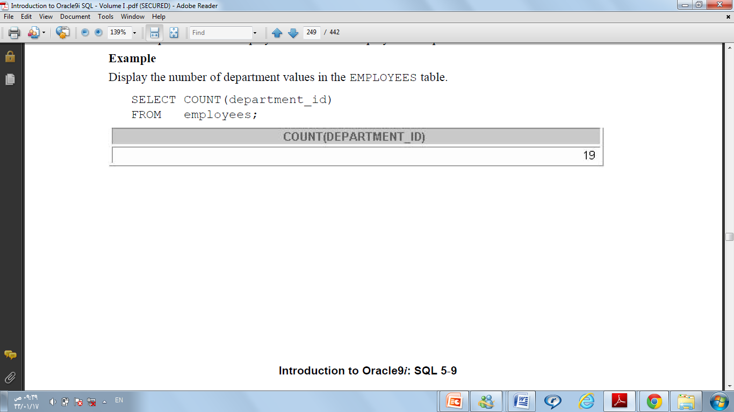
Using the COUNT Function

Slide 12
Using the COUNT Function( Example)

Slide 13
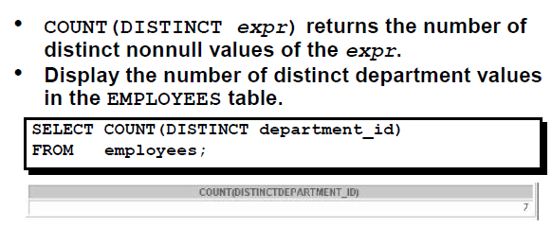
Using the DISTINCT Keyword

Slide 14
Group Functions and Null Values
Group functions ignore null values in the column. For example:
SELECT AVG(commission_pct)
FROM employees;
The average is calculated as the total commission paid to all employees divided by the number of employees receiving a commission.

Slide 15
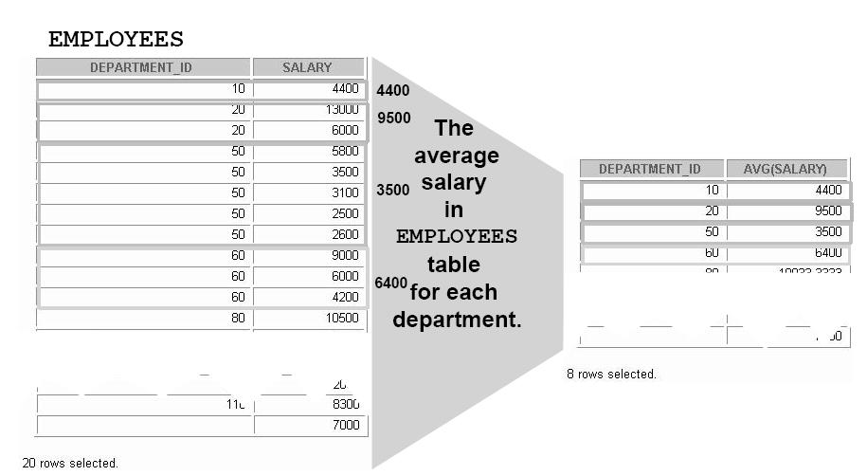
Creating Groups of Data
Until now, all group functions have treated the table as one large group of information. At times, you need to divide the table of information into smaller groups. This can be done by using the GROUP BY clause .

Slide 16
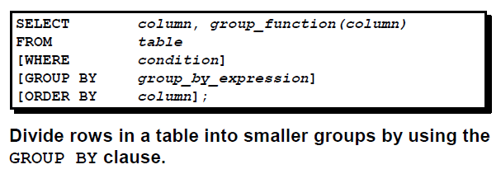
Creating Groups of Data: GROUP BY Clause Syntax

Slide 17
Guidelines
If you include a group function in a SELECT clause, you cannot select individual results as well, unless the individual column appears in the GROUP BY clause→You’ll receive an error message if you fail to include the column list in the GROUP BY clause.
Using a WHERE clause, you can exclude rows before dividing them into groups → executed first (before group by)
You cannot use a column alias in the GROUP BY clause
.
By default, rows are sorted by ascending order of the columns included in the GROUP BY list. You can override this by using the ORDER BY clause.

Slide 18
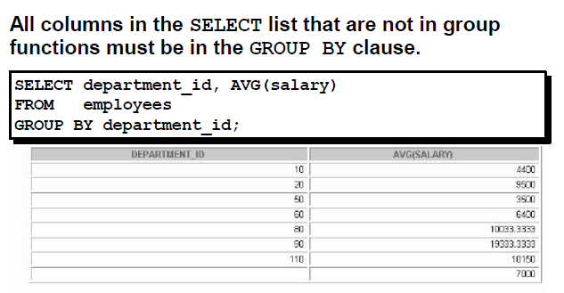
Using the GROUP BY Clause

Slide 19

Using the GROUP BY Clause

Slide 20
Grouping by More Than One Column
Sometimes you need to see results for groups within groups.
Example 1 shows a report that displays the total salary being paid to each job title, within each department.

Slide 21
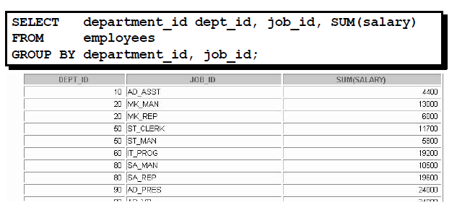
Example 1

Slide 22
Example 1
The EMPLOYEES table is grouped first by department number and then, within that grouping, by job title.
For example, the four stock clerks in department 50 are grouped together and a single result (total salary) is produced for all stock clerks within the group.

Slide 23
Using the Group By Clause on Multiple Columns
You can return summary results for groups and subgroups by listing more than one GROUP BY column. You can determine the default sort order of the results by the order of the columns in the GROUP BY clause. Here is how the SELECT statement on the slide, containing a GROUP BY clause, is evaluated:
The SELECT clause specifies the column to be retrieved:
– Department number in the EMPLOYEES table
– Job ID in the EMPLOYEES table
– The sum of all the salaries in the group that you specified in the GROUP BY clause
The FROM clause specifies the tables that the database must access: the EMPLOYEES table
The GROUP BY clause specifies how you must group the rows:
– First, the rows are grouped by department number
– Second, within the department number groups, the rows are grouped by job ID
So the SUM function is being applied to the salary column for all job IDs within each department number group.

Slide 24
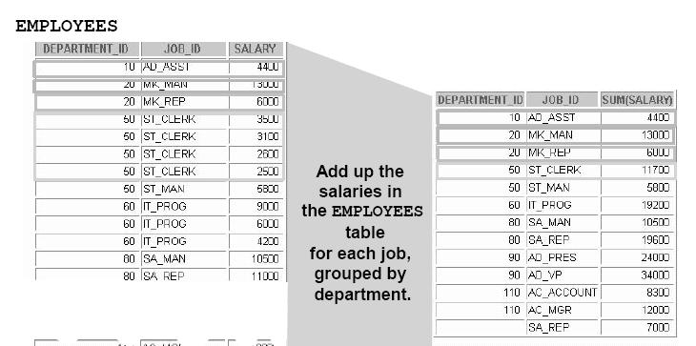

Slide 25
Illegal Queries Using Group Functions
Any column or expression in the SELECT list that is
not an aggregate function must be in the GROUP BY clause.
SELECT department_id, COUNT(last_name)
FROM employees;
Column missing in the GROUP BY clause
SELECT department_id, COUNT(last_name)
*
ERROR at line 1:
ORA-00937: not a single-group group function

Slide 26
Illegal Queries Using Group Functions
You cannot use the WHERE clause to restrict groups.
You use the HAVING clause to restrict groups.
You cannot use group functions in the WHERE clause.
SELECT department_id, AVG(salary)
FROM employees
WHERE AVG(salary) > 8000
GROUP BY department_id;
Error *
You can correct the error by using the HAVING clause to restrict groups.
SELECT department_id, AVG(salary)
FROM employees
HAVING AVG(salary) > 8000
GROUP BY department_id;

Slide 27
Excluding Group Results: The HAVING Clause
Use the HAVING clause to restrict groups:
1. Rows are grouped.
2. The group function is applied.
3. Groups matching the HAVING clause are displayed.
SELECT column, group_function
FROM table
[WHERE condition]
[GROUP BY group_by_expression]
[HAVING group_condition]
[ORDER BY column];

Slide 28
Using the HAVING Clause
SELECT job_id, SUM(salary) PAYROLL
FROM employees
WHERE job_id NOT LIKE '%REP%'
GROUP BY job_id
HAVING SUM(salary) > 13000
ORDER BY SUM(salary);

