Slide 1
“Manipulating Data”
Lecture 6

Slide 2
Data Manipulation Language
A DML statement is executed when you:
  Add new rows to a table
  Modify existing rows in a table
  Remove existing rows from a table

Slide 3
Data Manipulation Language
A DML statement is executed when you:
  Add new rows to a table
  Modify existing rows in a table
  Remove existing rows from a table

Slide 4
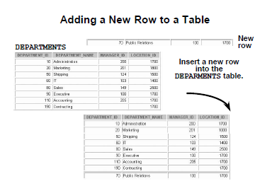

Slide 5
The INSERT Statement Syntax
INSERT statement is used to ADD new rows to a table .
Syntax
INSERT INTO table [(column1 [, column2...])]
VALUES (value1 [, value2...]);
Only one row is inserted at a time with this syntax.

Slide 6
Inserting New Rows
Insert a new row containing values for each column.
  List values in the default order of the columns in the table.
  Optionally, list the columns in the INSERT clause.
INSERT INTO departments(department_id, department_name, manager_id, location_id)
VALUES (70, 'Public Relations', 100, 1700);
Enclose character and date values within single
quotation marks.

Slide 7
”Inserting Rows with “Null Values
Implicit method: Omit the column from the column list.
INSERT INTO departments (department_id,
department_name )
VALUES (30, 'Purchasing');
Explicit method: Specify the NULL keyword in the VALUES clause.
INSERT INTO departments
VALUES (100, 'Finance', NULL, NULL);
Listing column names is mandatory
column names are not listed because it’s optional here

Slide 8
Note : listing the column names in the INSERT clause became mandatory in two cases:
1- Insert a row containing values for some columns
2- Insert a row containing values for all columns but don’t know the defult order of the columns

Slide 9
Data Manipulation Language
A DML statement is executed when you:
  Add new rows to a table
  Modify existing rows in a table
  Remove existing rows from a table

Slide 10
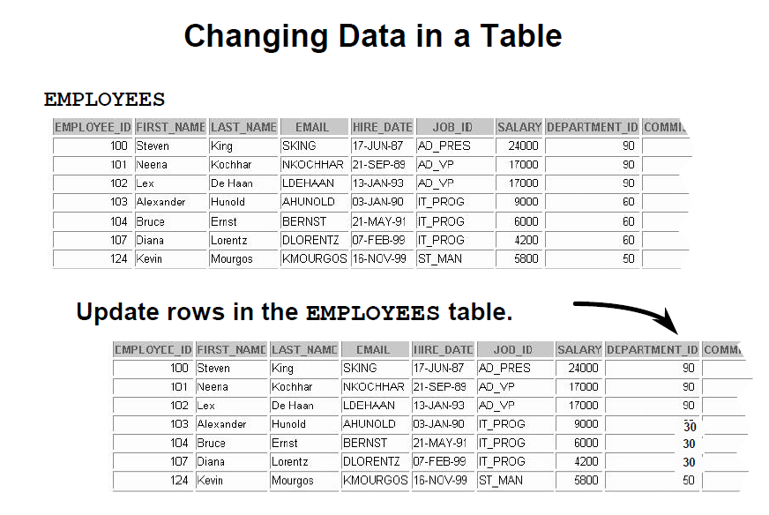

Slide 11
Updating Rows in a Table : Syntax
Update statement is used to change a table’s data
Syntax
UPDATE tablename
SET column1 = new_value [, column2 = new_value, ...]
[WHERE condition];
condition identifies the rows to be updated and is composed of (column names expressions, constants, subqueries, and comparison operators )
In general, use the primary key to identify a single row. Using other columns can unexpectedly cause several rows to be updated

Slide 12
Updating Rows in a Table : Example of updating all rows
Increase the salary of all employees by 100 $
Update employees
Set salary=salary+100;
Duplicate the salary of all employees
……………………………………………………………………

Slide 13
Updating Rows in a Table : Example of updating specific rows
The WHERE clause is used with the Update statement to change the data of a specific row(s)
UPDATE employees
SET department_id = 70
WHERE employee_id = 113;
1 row updated
Omitting the WHRE clause will change the data in all rows
UPDATE employees
SET department_id = 110;
22 rows updated.

Slide 14
Updating Rows in a Table (Integrity Constraint Error)
UPDATE employees
SET department_id = 55
WHERE department_id = 110;
UPDATE employees
*
Department number 55 does not exist
ERROR at line 1:
ORA-02291: integrity constraint (HR.EMP_DEPT_FK)
violated - parent key not found

Slide 15
Updating Rows in a Table (Integrity Constraint Error(Cont.))
If you attempt to update a record with a value that is tied to an integrity constraint, an error is returned.
In the example on the slide, department number 55 does not exist in the parent table, DEPARTMENTS, and so you receive the parent key violation ORA-02291.

Slide 16
Data Manipulation Language
A DML statement is executed when you:
  Add new rows to a table
  Modify existing rows in a table
  Remove existing rows from a table

Slide 17
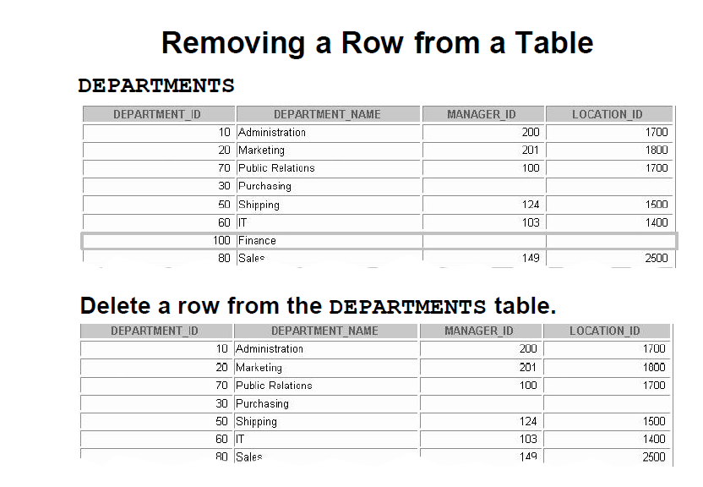

Slide 18
Removing a Row from a Table
You can remove existing rows from a table by using the DELETE statement.
DELETE [FROM] tablename
[WHERE condition];
condition identifies the rows to be deleted and is composed of (column names expressions, constants, subqueries, and comparison operators )
If no rows are deleted, a message “0 rows deleted.” is returned

Slide 19
Removing a Row from a Table
Example:
DELETE FROM departments
WHERE department_id IN (30, 40);
2 rows deleted

Slide 20
Removing a Row from a Table
Specific rows will be deleted if you specify the WHERE clause.
DELETE FROM departments
WHERE department_name = 'Finance';
1 row deleted.
All rows in the table will be deleted if you omit the WHERE clause.
DELETE FROM copy_emp;
22 rows deleted.

Slide 21
Removing a Row from a Table (
(Integrity Constraint Error
DELETE FROM departments
WHERE department_id = 60;
You cannot delete a row
DELETE FROM departments
that contains a primary key
*
that is used as a foreign key in another table.
ERROR at line 1:ORA-02292: integrity constraint (HR.EMP_DEPT_FK) violated - child record found

Slide 22
Removing a Row from a Table (
(Integrity Constraint Error
If you attempt to delete a record with a value that is tied to an integrity constraint , an error is returned.
The example in the slide tries to delete department number 60 from the DEPARTMENTS table, but it results in an error because department number is used as a foreign key in the EMPLOYEES table. If the parent record that you attempt to delete has child records, then you receive the child record found violation ORA-02292.

Slide 23
Removing a Row from a Table (
(Integrity Constraint Error
The following statement works because there are no employees in department 70:
DELETE FROM departments
WHERE department_id = 70;

Slide 24
Using Explicit Default Values
with the explicit default feature you can use the DEFAULT keyword as column value when the column default is desired)
This allows the user to control where and when the default value should be applied to data
Explicit default can be used in the INSERT and UPDATE statement

Slide 25
Using Explicit Default Values
DEFAULT with INSERT:
INSERT INTO departments
(department_id, department_name, manager_id)
VALUES (300, 'Engineering', DEFAULT);
DEFAULT with UPDATE:
UPDATE departments
SET manager_id = DEFAULT
WHERE department_id = 10;

