Slide 1
Writing Basic
SQL SELECT Statements
Lecture 7 -1

Slide 2
Outlines
SQL SELECT statement
Capabilities of SELECT statements
Basic SELECT statement
  Selecting all columns
  Selecting specific columns
  Arithmetic Expressions
    Using Arithmetic operators
    Arithmetic operators precedence
    NULL values in arithmetic expression
  Using column aliases
  Concatenation operator
  Literal Character String

Slide 3
Capabilities of SQL SELECT Statements
A SELECT statement retrieves information from the database.
Using a SELECT statement, you can do the following:
  Projection: You can use the projection capability in SQL to choose the columns in a table that you want returned by your query. You can choose as few or as many columns of the table as you require.
  Selection: You can use the selection capability in SQL to choose the rows in a table that you want returned by a query. You can use various criteria to restrict the rows that you see.
  Joining: You can use the join capability in SQL to bring together data that is stored in different tables by creating a link between them.

Slide 4
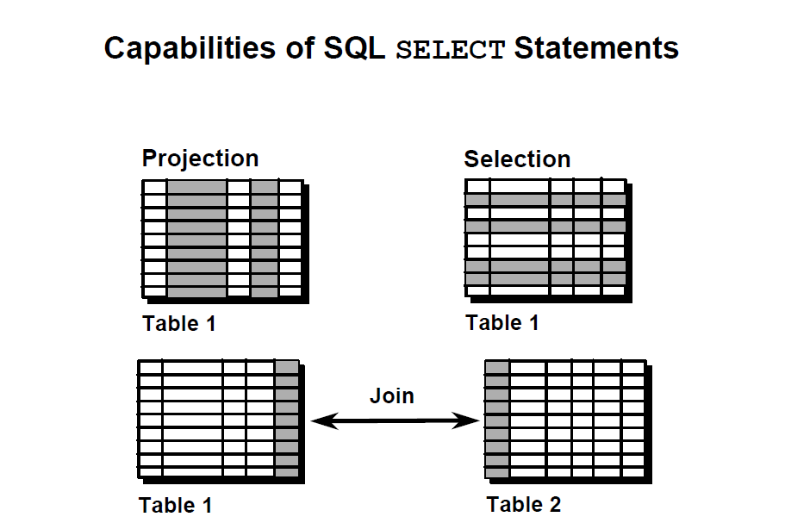
Capabilities of SQL SELECT Statements (Cont.)

Slide 5
Basic SELECT Statement
Select Statement Syntax:
SELECT [DISTINCT,*]columns names| expression [alias]
FROM table;
Note that:
SELECT clause identifies what columns to retrieve.
FROM clause specifies the table containing the columns listed in the SELECT clause.

Slide 6
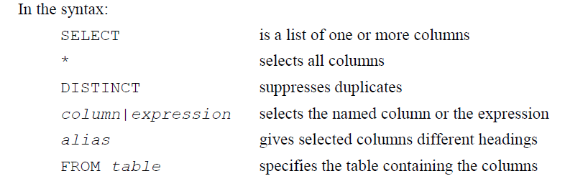
Basic SELECT Statement

Slide 7
Selecting All Columns
Syntax:
SELECT *
FROM table;
Means all columns

Slide 8
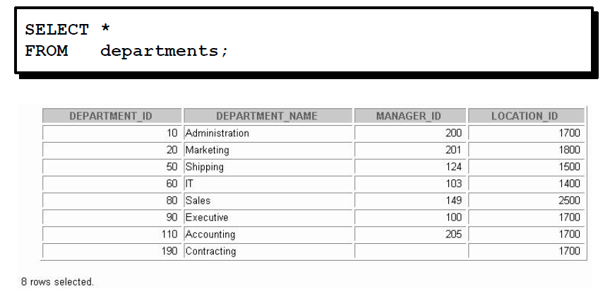
Selecting All Columns (Example)

Slide 9
Selecting All Columns (Example)
In the example on the slide, the department table contains four columns: DEPARTMENT_ID, DEPARTMENT_NAME, MANAGER_ID, and LOCATION_ID.
The table contains eight rows, one for each department.
Note That : You can also display all columns in the table by listing all the columns after the SELECT
E.g.
SELECT department_id, department_name, manager_id, location_ id
FROM departments;
The previews SQL statement, like the example on the slide, will display all columns and all rows of the DEPARTMENTS table:

Slide 10
Selecting Specific Columns
You can use the SELECT statement to display specific columns of the table by specifying the column names, separated by commas.(see Example -1-)
In the SELECT clause, specify the columns that you want to display in the order in which you want them to appear in the output. (see Example -2-)

Slide 11
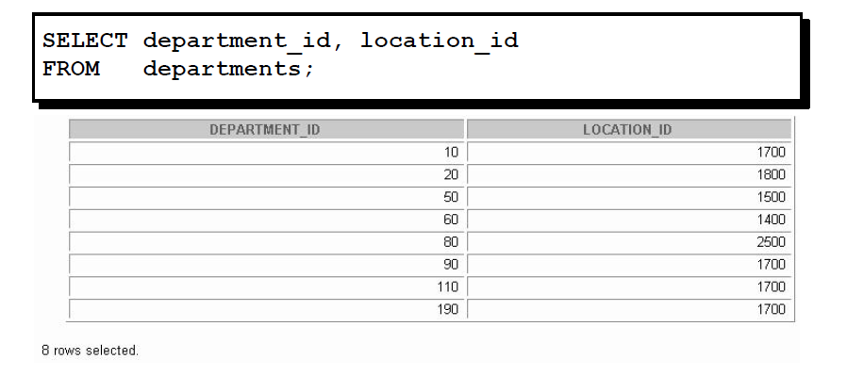
Example-1-

Slide 12
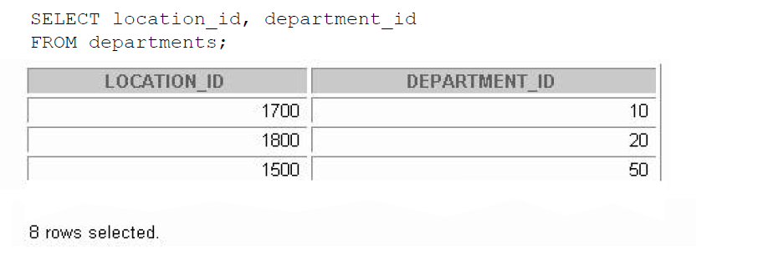
Example-2-
.
.

Slide 13
Arithmetic Expressions
Create expressions with number and date data, i.e. column names that contains only numeric or date data, by using arithmetic operators
operator | Description
+ | Add
- | Subtract
* | Multiply
/ | Divide

Slide 14
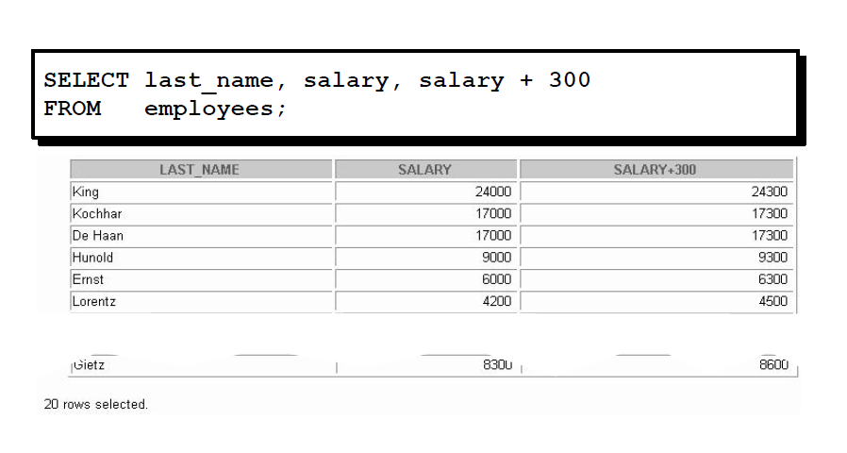
Using Arithmetic Operators

Slide 15
Using Arithmetic Operators (Cont.)
The previews example uses the addition operator to calculate a salary increase of $300 for all employees and displays a new SALARY+300 column in the output.
Note that the resultant calculated column SALARY+300 is not a new column in the EMPLOYEES table; it is for display only. Where by default, the name of a new column comes from the calculation that generated it—in this case, (salary+300).

Slide 16
Operator Precedence
* / + _
Multiplication and division take priority over addition and subtraction.
Operators of the same priority are evaluated from left to right.
Parentheses are used to force prioritized evaluation and to clarify statements.

Slide 17
Operator Precedence
SELECT last_name, salary, 12*salary+100
FROM employees;
SELECT last_name, salary, 12*(salary+100)
FROM employees;
1
2
2
1
Why?

Slide 18
Null Values in Arithmetic Expressions
Arithmetic expressions containing a null value evaluate to null.
If any column value in an arithmetic expression is null, the result is null.
For example, if you attempt to perform division with zero, you get an error. However, if you divide a number by null, the result is a null or unknown.

Slide 19
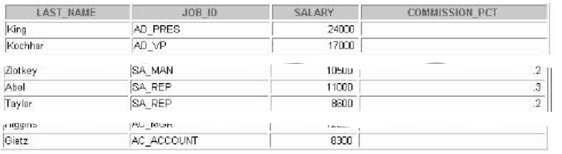
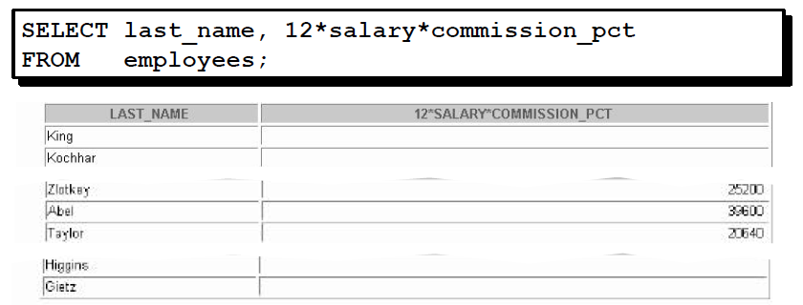
Null Values in Arithmetic Expressions

Slide 20
Using Column Aliases
Rename a column heading
Is useful with calculations
Immediately follows the column name, and there also can be the optional AS keyword between the column and the alias
Requires double quotation marks (“ “)if the alias:
  Contains space
  Contains a special characters (such as # or $)
  Is a case sensitive

Slide 21
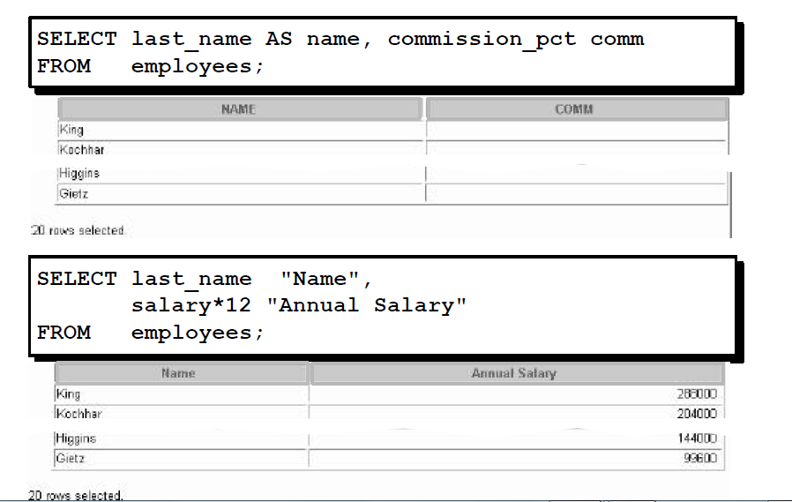
Using Column Aliases (Examples)

Slide 22
Writing Basic
SQL SELECT Statements
Lecture 7 -2

Slide 23
Concatenation Operator
A concatenation operator:
  Concatenates columns or character strings to other columns
  Is represented by two vertical bars (||)
  Creates a resultant column that is a character
Expression
  Columns on either side of the operator are combined to make a single output column

Slide 24
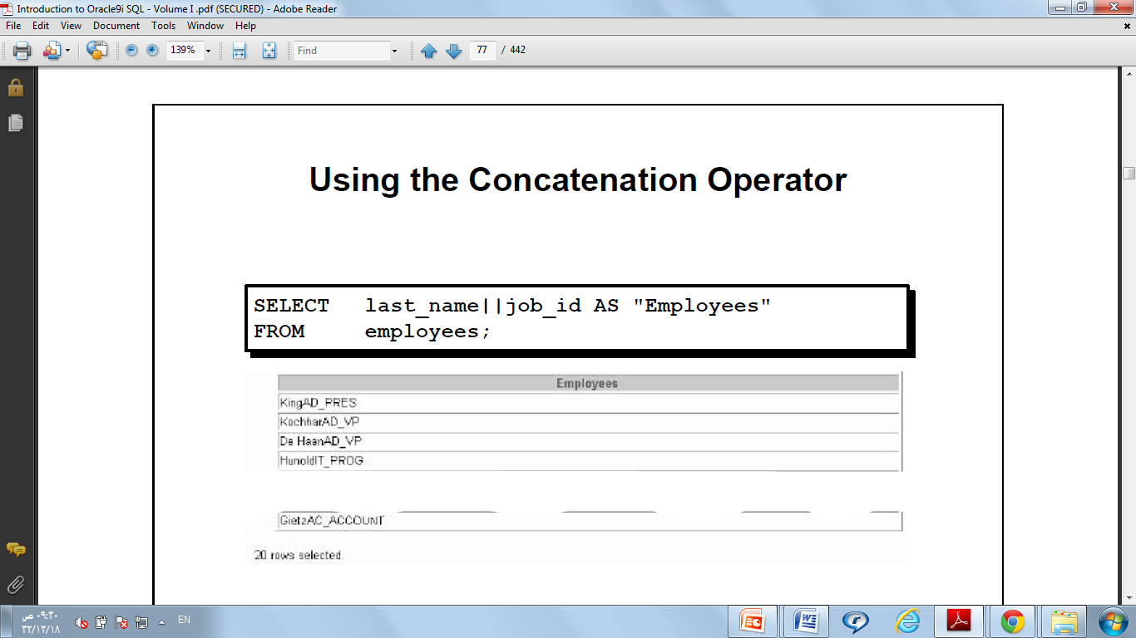
Using the Concatenation Operator ( Example )

Slide 25
Literal Character Strings
A literal value is a character, a number, or a date included in the SELECT list.
Date and character literal values must be enclosed within single quotation marks (‘ ‘).
Each character string is output once for each row returned

Slide 26
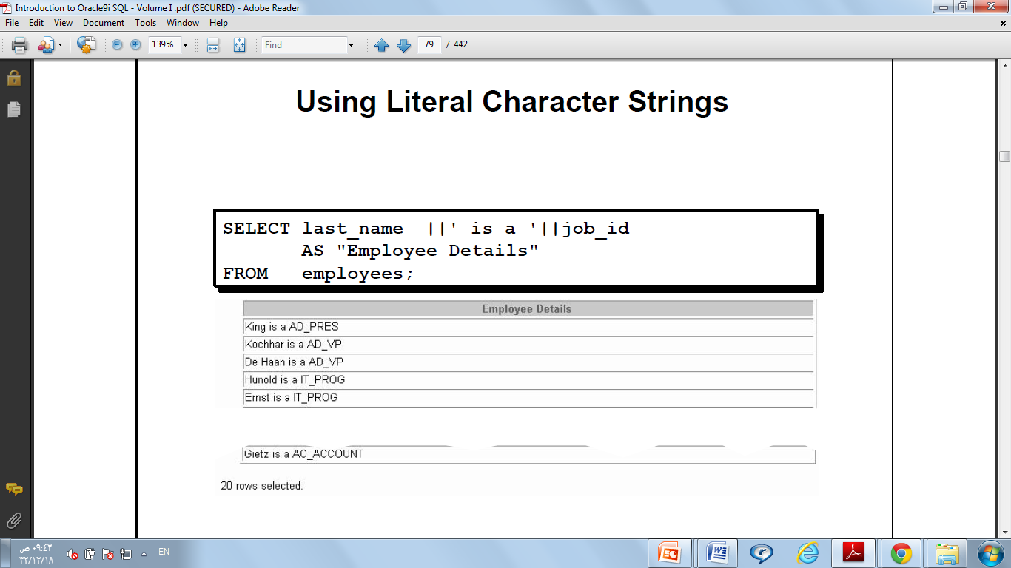
Literal Character Strings (Example)

Slide 27
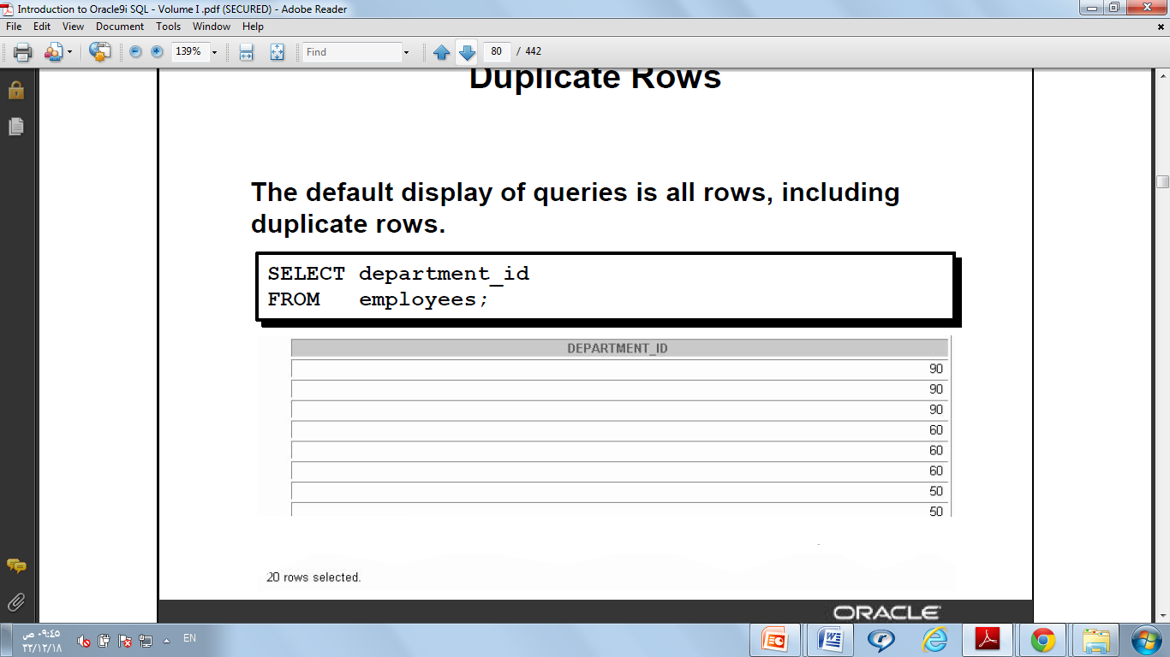
Duplicate Rows
The default display of queries is all rows, including duplicate rows. For example:

Slide 28
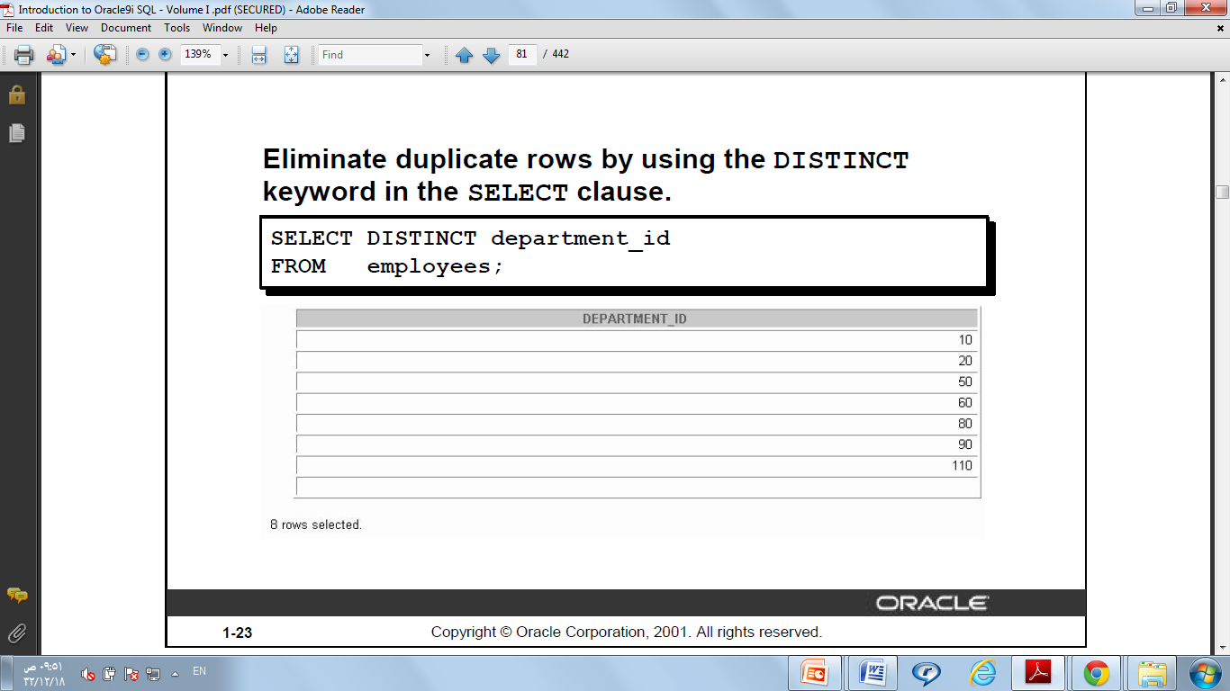
Eliminating Duplicate Rows
Eliminate duplicate rows by using the DISTINCT keyword in the SELECT clause. For example:

Slide 29
Eliminating Duplicate Rows (Cont.)
Note That: you can specify multiple columns after the DISTINCT qualifier. In such case, the DISTINCT will affect all the selected columns and the result is every distinct combination of the columns (see Example -3-)

Slide 30
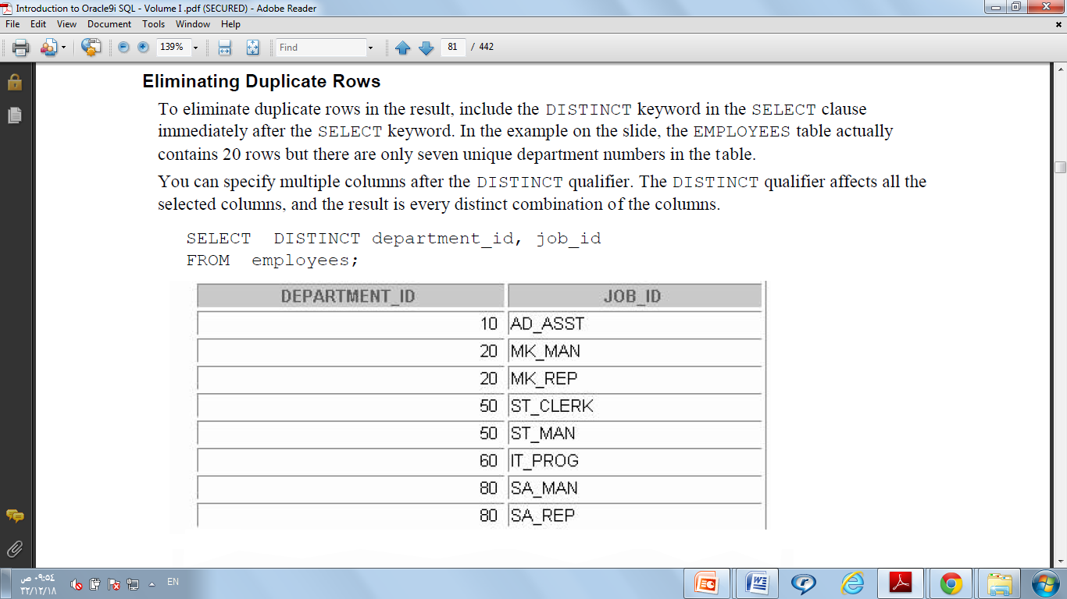
Example-3-

